Slide 1

Powerball Analytics
Smarter picks, powered by data.
Generate Smart Quick Picks
Investor / Partner Demo
Notes:
[Sources]
- https://unsplash.com/photos/a-computer-screen-with-a-bunch-of-code-on-it-TfzeRFtlkFA (background image)
[/Sources]

Slide 2

Problem
Lottery players want an edge — but most tools are hype.
Random picks and superstition dominate the experience
Existing apps are cluttered, unclear, or non-transparent
Players can't easily track what they played vs what happened
No simple path from “insight” to “action”
What users actually want
A clean, honest, data-driven workflow:
Analyze → Understand → Generate
No predictions. No guarantees. Just clarity.
Powerball Analytics — Investor Demo
Notes:
[Sources]
- https://unsplash.com/photos/a-bunch-of-different-colored-balls-in-a-cage-OccrugoA1HI (background image)
[/Sources]

Slide 3
Solution
Powerball Analytics turns historical data into a modern, usable workflow.
Built around four pillars:
Official Data Sync
Organize & Filter
Live winning numbers, jackpot,
& cash value from official sources.
Filter/sort historical & future sets
by date and by ball position.
Deep Analysis
Smart Quick Picks
Decompose correlations + positional
frequency tables (P1–P6).
Generate weighted Quick Picks
based on selected analyses.
Powerball Analytics — Investor Demo

Slide 4
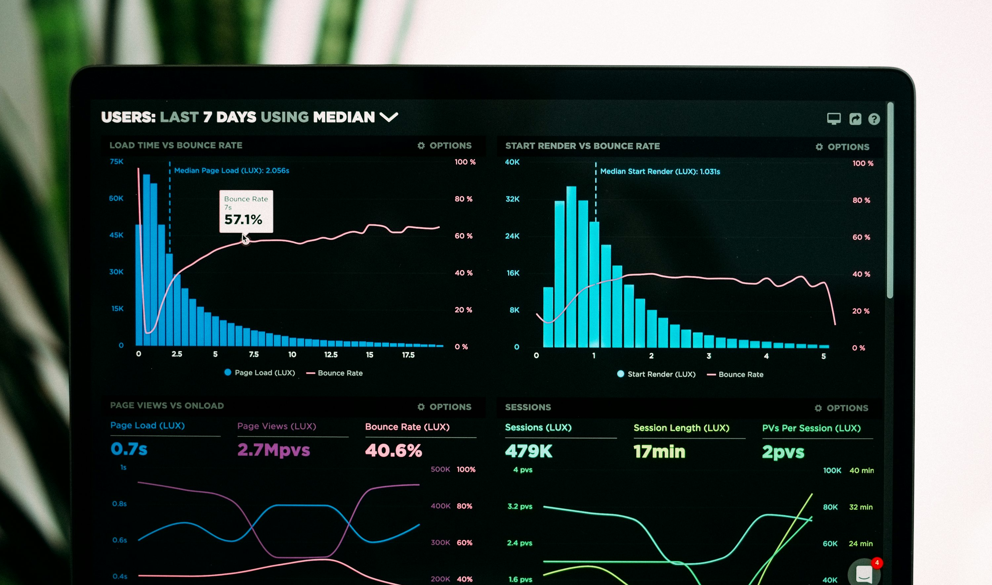
Product
A product that “sells itself” when you open it.
Desktop = deep analysis • Mobile = fast action
Highlights
Ready to Play → Quick Pick
& Pick Your Own
Official results feed
(last 10 draws)
Import: Excel / Manual
/ Ticket photo (OCR)
One-click: Generate
Smart Quick Picks
Dashboard preview (concept)
Try the Generator
Powerball Analytics — Investor Demo
Notes:
[Sources]
- https://unsplash.com/photos/graphs-of-performance-analytics-on-a-laptop-screen-JKUTrJ4vK00 (dashboard image)
[/Sources]

Slide 5
Scope
Contracted modules (v1.0)
Analysis on the left • Generation on the right
Analysis (Read-only)
Action (Generator)
Powerball Overview (jackpot, results, prize tiers)
File Import/Export (with audit trail)
Organize (Table 1 filtering/sorting)
Decompose correlations (Tables 3–7)
Positional Frequency Analysis (P1–P6)
Insights: Next Draw + Date-based
Future Combination Projection
→ feeds into Quick Picks
Generate
Smart Quick Picks
Weighted by selected analysis
(no predictions / no guarantees)
Powerball Analytics — Investor Demo

Slide 6
Data & Trust
Trust is a feature.
We use official data, enforce immutability, and keep messaging honest.
Official Sources
Immutable History
Legal-safe UX
Winning numbers feed
Jackpot + cash value
Draw schedule (Mon/Wed/Sat)
Historical dataset is read-only
Edits allowed only for user imports
Audit trail on file actions
“Analysis-based” wording
No prediction language
Disclaimers in Generator + Dashboard
Official reference: Powerball tickets are $2; drawings Mon/Wed/Sat 10:59pm ET; jackpot odds 1 in 292.2M.
Powerball Analytics — Investor Demo
Notes:
[Sources]
- https://www.powerball.com/ (ticket price, drawing schedule)
- https://www.powerball.com/media-center (odds of winning)
[/Sources]

Slide 7
Business Model
Freemium that upgrades naturally.
Start free. Pay to go deeper, faster, and more personalized.
Free
Pro
Advanced
$0
$9.99/mo
$19.99/mo
Dashboard basics
Simple Quick Picks
Limited insights
Full analysis modules
Smart Quick Picks
Saved picks + exports
Custom weighting
Deeper filters
API/export extensions
Most popular
Powerball Analytics — Investor Demo

Slide 8
Go-to-Market
Launch plan designed for fast learning + clean conversion.
PWA-first → App stores after retention signals.
Phase 1 — Private Beta
Phase 2 — Public Launch
Phase 3 — Retention
Landing page + waitlist
Invite-only access
Early adopter pricing
Product Hunt
Short demo videos
Reddit communities (data/lottery)
Saved picks + reminders
Push notifications
Feature-driven upgrades
Powerball Analytics — Investor Demo

Slide 9
Roadmap
10-week MVP plan (execution-ready)
Start: 2025-12-29 • Target launch: 2026-03-08
Weeks
1
2
3
4
5
6
7
8
9
10
Foundations (tokens, layout)
File + imports
Organize + Decompose
Positional analysis
Insights
Smart Quick Picks
Polish + QA + release
Note: timeline assumes stable requirements and 1 dedicated dev squad.
Powerball Analytics — Investor Demo

Slide 10
Next Steps
What we’re doing next
Build → ship → iterate with real user feedback.
Execution checklist
Partner / Investor fit
Sprint 1 foundations (tokens + layout + UI primitives)
Wire data sync to official sources
Implement analysis engine + generator
PWA launch + waitlist onboarding
We’re looking for distribution and/or capital to accelerate:
• Launch & growth
• Data automation
• Multi-lottery expansion
Disclaimer: Powerball Analytics provides informational insights only. No guarantees or predictions.
Powerball Analytics — Investor Demo

