Slide 1
Hidden Markov Tree priors in multiscale models for genomic data
Brendan Law
Supervisor: Dr Heejung Shim
25th October, 2019

Slide 2
Motivation
Genotypes, phenotypes, sequencing

Slide 3
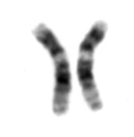
Why molecular-level phenotypes?
Possible genotypes (genetic variants)
Organismal-level phenotypes (traits)
Chromosomes
ATTCTG
ATTCTG
2
ATTCTG
ATTGTG
Traits: Height, eye colour
Disease susceptibility
1
Molecular-level phenotypes
Gene expression
Transcription factor binding
Chromatin accessibility
ATTGTG
ATTGTG
Measured by high-throughput sequencing (HTS) data
0
Notes:
Chromosomes, and strands of DNA along them
Most of our DNAs are similar, there are some points on the genome where there are commonly-found differences between the DNA of humans. (red square)
At these locations, we can code these variants (‘genetic variants’) by a number; 0, 1, or 2, based on the combination of acids at that base.
Associate with organismal-level phenotypes

Slide 4
HTS data example: DNase-seq (Degner et al. (2012))
Molecular-level behaviour: chromatin accessibility
Likely important contributor to organismal-level phenotypic variation
Notes:
The DNA in our cells are packed in a chromatin structure, most of the DNA is not accessible
So the behaviour we are investigating is how accessible the DNA is at any location along the genome (accessible to other proteins which stimulate genetic processes)
Plays important role by regulating DNA behaviour during cell replication and protecting it from damage

Slide 5
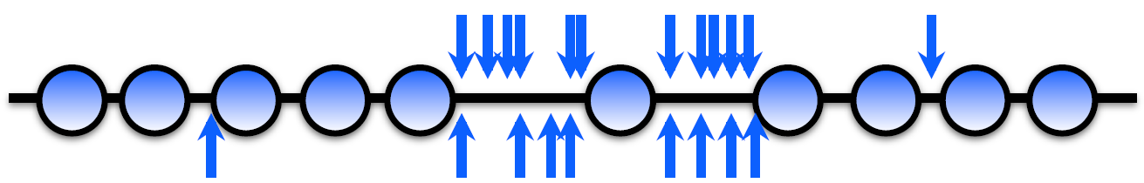
HTS data example: DNase-seq (Degner et al. (2012))
DNase cuts DNA more often at base locations where chromatin is more accessible

Slide 6
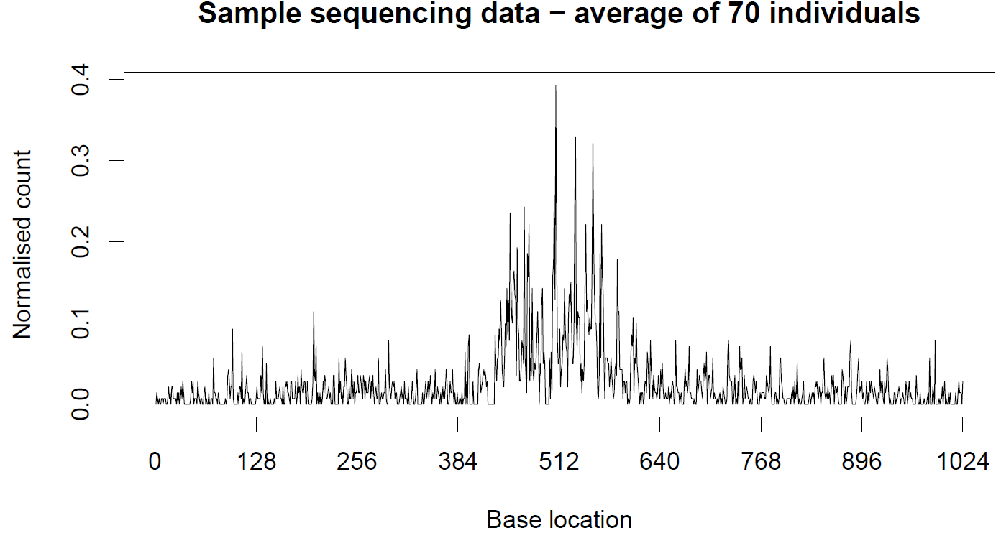
HTS data example: DNase-seq (Degner et al. (2012))
Result:
Normalised counts of cuts
Molecular phenotypes measured at a base pair level
Data is granular, but noisy
Signals are spatially structured
Notes:
Granular = high-resolution
How accessible is chromatin, at any base along the genome?

Slide 7
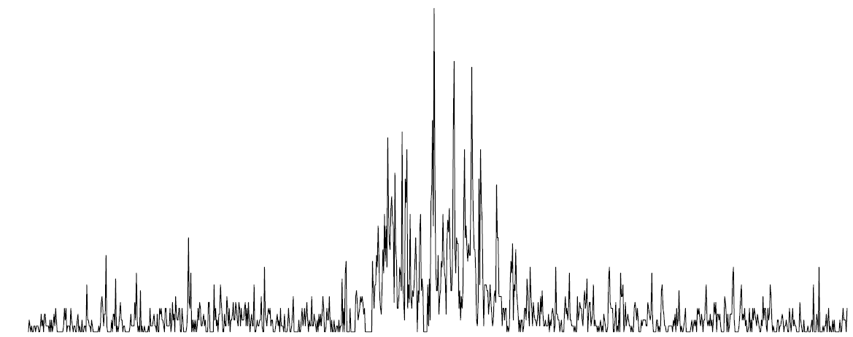
Molecular-level association analysis
Possible genotypes
Molecular-level phenotypes
ATTCTG
ATTCTG
2
ATTCTG
ATTGTG
1
ATTGTG
ATTGTG
0
Notes:
Identifying genetic variants which are associated with the molecular-level phenotype (sequence of counts)
How would a 0, 1 or 2 significantly effect the sequence of counts (shape of this function) we observe in a particular individual?

Slide 8
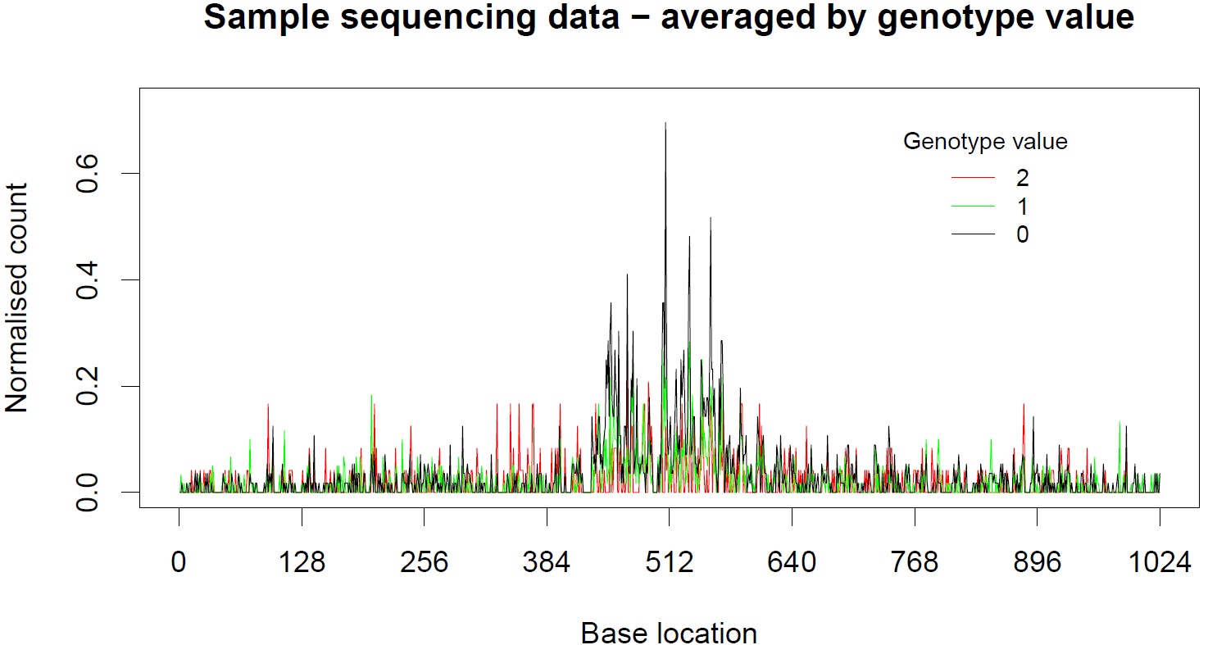
Molecular-level association analysis
Notes:
Can see differences; e.g. 0 results in a lot more accessibility in the middle than 2

Slide 9
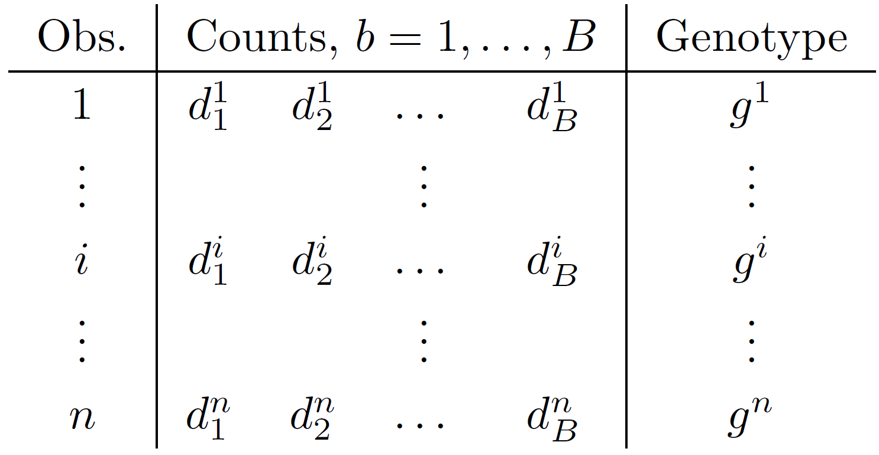
Molecular-level association analysis

Slide 10
Two statistical problems we want to solve:
Is there any association between the genotype and the molecular-level phenotype (i.e. chromatin accessibility)
How much does genotype impact the phenotype at any base pair?
Notes:
1 is any association, anywhere along the region, at all? G = 0,1,2 change the nature of the accessibility anywhere?
2 really answers the question of, if so, where? We do this by measuring the association strength at each base

Slide 11
Current analyses of HTS
Window-based methods
Aggregation to a fixed window length
Issues:
Normalised counts
Effect of genotype
g=1
g=0
Base location
Notes:
Windows: aggregation (e.g. total number of reads in a window) to a window of fixed length
Hypothetical, imagine we know the effect size at a base-pair level
Yellow region is a fixed window length – it’s hard to know what window length to pick for any analysis?
1) window is relatively small, doesn’t use all info available; potential to not be significant enough for any window throughout the effect
2) window relatively large, has the potential to pick up effects in ‘opposite’ directions which may ‘cancel’ out

Slide 12
Current analyses of HTS
Window-based methods
Aggregation to a fixed window length
Issues:
Multiscale methods
Utilise granularity of data
Adapt to spatial structure
Normalised counts
Effect of genotype
Base location

Slide 13
Wavelet-based multiscale models
WaveQTL – Shim and Stephens (2015)

Slide 14
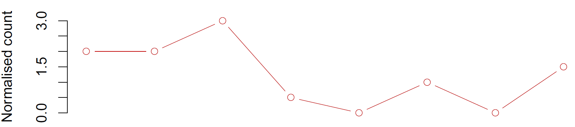


An intro to Wavelets – Haar Wavelet Transform
$$d_{3}$$
Function → Coefficients at different scales and locations
$d_{1}$ $d_{2}$
$d_{4}$ $d_{5}$ $d_{6}$ $d_{7}$ $d_{8}$
$$\left(d_{1}+d_{2}+d_{3}+d_{4}\right)+\left(d_{5}+d_{6}+d_{7}+d_{8}\right)$$

Slide 15


An intro to Wavelets – Haar Wavelet Transform
$$d_{3}$$
$d_{1}$ $d_{2}$
$d_{4}$ $d_{5}$ $d_{6}$ $d_{7}$ $d_{8}$
$$\left(d_{1}+d_{2}+d_{3}+d_{4}\right)+\left(d_{5}+d_{6}+d_{7}+d_{8}\right)$$
$$\left(d_{1}+d_{2}+d_{3}+d_{4}\right)−\left(d_{5}+d_{6}+d_{7}+d_{8}\right)$$

Slide 16

An intro to Wavelets – Haar Wavelet Transform
$$d_{3}$$
$d_{1}$ $d_{2}$
$d_{4}$ $d_{5}$ $d_{6}$ $d_{7}$ $d_{8}$
$$\left(d_{1}+d_{2}+d_{3}+d_{4}\right)+\left(d_{5}+d_{6}+d_{7}+d_{8}\right)$$
$$\left(d_{1}+d_{2}+d_{3}+d_{4}\right)−\left(d_{5}+d_{6}+d_{7}+d_{8}\right)$$
$\left(d_{1}+d_{2}\right)−\left(d_{3}+d_{4}\right)$ $\left(d_{5}+d_{6}\right)−\left(d_{7}+d_{8}\right)$

Slide 17

An intro to Wavelets – Haar Wavelet Transform
$$d_{3}$$
$d_{1}$ $d_{2}$
$d_{4}$ $d_{5}$ $d_{6}$ $d_{7}$ $d_{8}$
$$\left(d_{1}+d_{2}+d_{3}+d_{4}\right)+\left(d_{5}+d_{6}+d_{7}+d_{8}\right)$$
$$\left(d_{1}+d_{2}+d_{3}+d_{4}\right)−\left(d_{5}+d_{6}+d_{7}+d_{8}\right)$$
$\left(d_{1}+d_{2}\right)−\left(d_{3}+d_{4}\right)$ $\left(d_{5}+d_{6}\right)−\left(d_{7}+d_{8}\right)$
$d_{1}−d_{2}$ $d_{3}−d_{4}$ $d_{5}−d_{6}$ $d_{7}−d_{8}$

Slide 18
An intro to Wavelets – Haar Wavelet Transform
$$d_{3}$$
$d_{1}$ $d_{2}$
$d_{4}$ $d_{5}$ $d_{6}$ $d_{7}$ $d_{8}$
Coarser
$$\left(d_{1}+d_{2}+d_{3}+d_{4}\right)+\left(d_{5}+d_{6}+d_{7}+d_{8}\right)$$
Scale
$$\left(d_{1}+d_{2}+d_{3}+d_{4}\right)−\left(d_{5}+d_{6}+d_{7}+d_{8}\right)$$
$\left(d_{1}+d_{2}\right)−\left(d_{3}+d_{4}\right)$ $\left(d_{5}+d_{6}\right)−\left(d_{7}+d_{8}\right)$
$d_{1}−d_{2}$ $d_{3}−d_{4}$ $d_{5}−d_{6}$ $d_{7}−d_{8}$
Finer

Slide 19


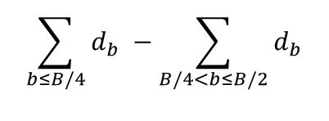

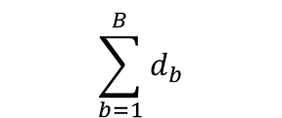





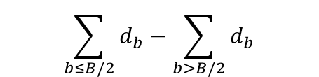





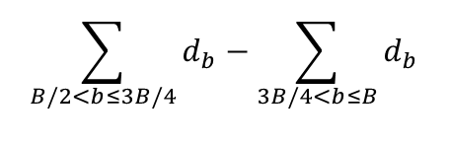



An intro to Wavelets – Haar Wavelet Transform
$$\sum_{b=1}^{B}{d_{b}}$$
$$y_{01}$$
$$y_{11}$$
$$\sum_{b≤B/2}{d_{b}}−\sum_{b>B/2}{d_{b}}$$
(Multiscale) Wavelet space
$$\sum_{b≤B/4}{d_{b}} −\sum_{B/4<b≤B/2}{d_{b}}$$
$$\sum_{B/2<b≤3B/4}{d_{b}}−\sum_{3B/4<b≤B}{d_{b}}$$
$$y_{21}$$
$$y_{22}$$
$$⋮ etc.$$
$$d_{1}−d_{2}$$
$$⋯$$
$$d_{B−1}−d_{B}$$
$$y_{J1}$$
$$⋯$$
$$y_{J,2^{J−1}}$$
Data space
$$d_{1}$$
$$d_{2}$$
$$⋯$$
$$d_{B−1}$$
$$d_{B}$$

Slide 20
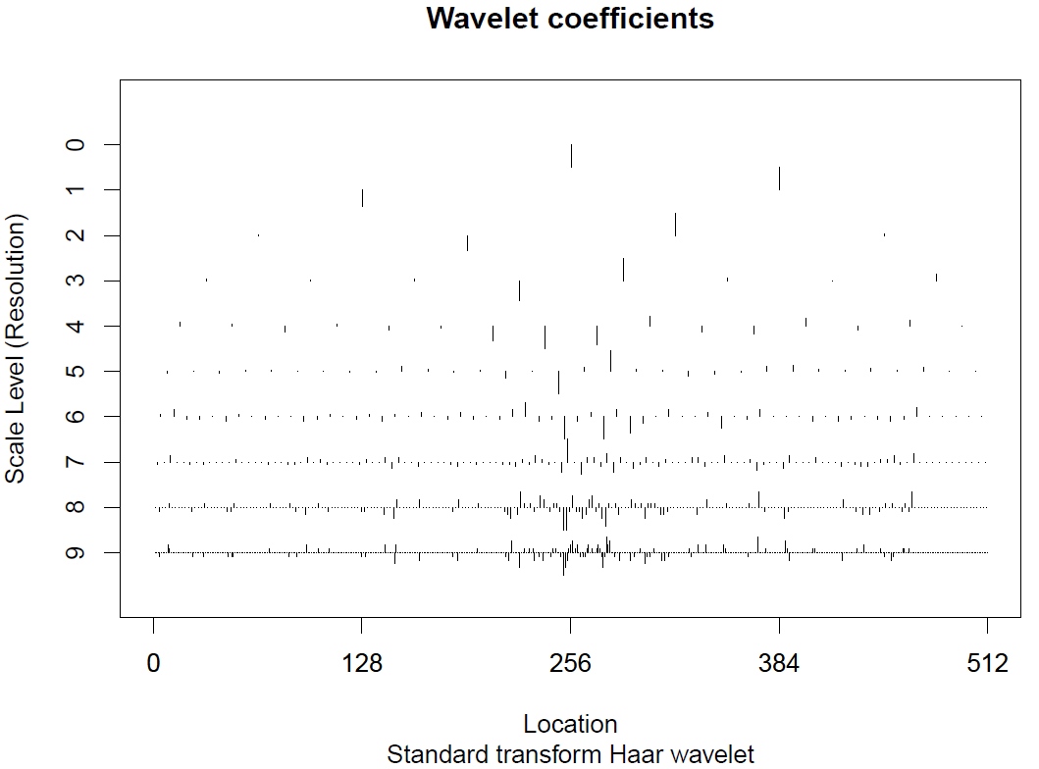
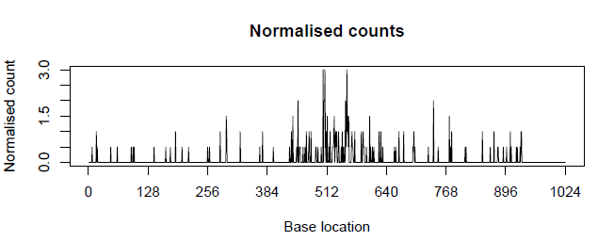
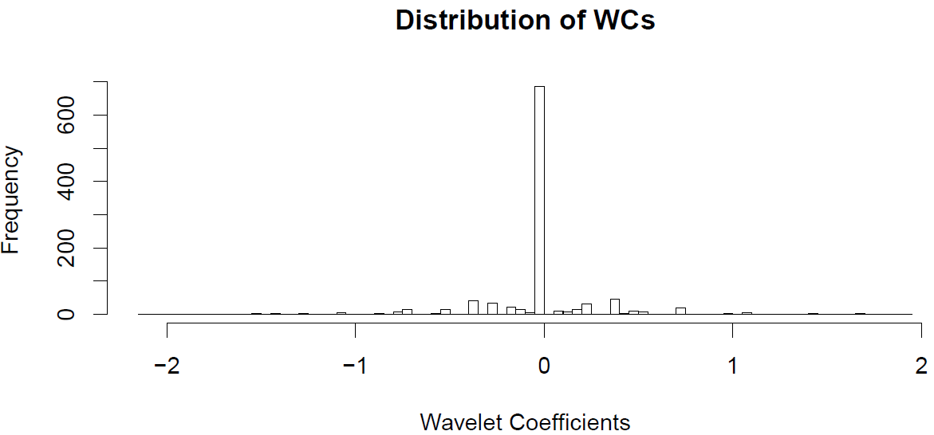
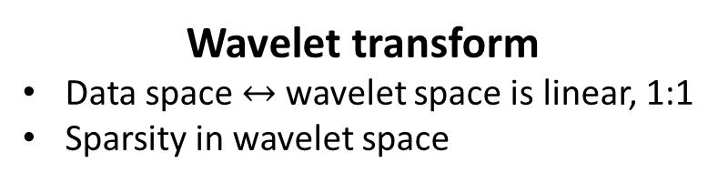
Transform data into the Wavelet space
Data space
Wavelet space
Wavelet transform
Data space $↔$ wavelet space is linear, 1:1
Sparsity in wavelet space
Notes:
1:1 movement between
But key reason is SPARSITY (otherwise why we bother to go from one representation to another?)

Slide 21
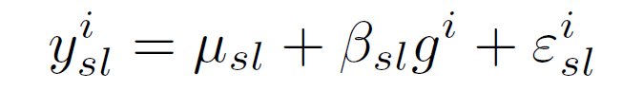
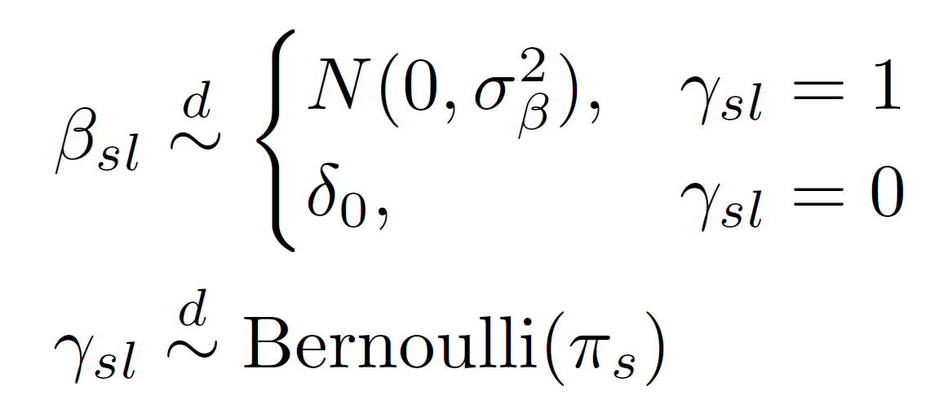












Model the WCs at each scale, location
Model at each $s,l$:
Effect size:
$π$ estimated using Empirical Bayes (EB) approach
$$y_{01}$$
$$y_{11}$$
$$y_{21}$$
$$y_{22}$$
$$⋮ etc.$$
$$d_{1}−d_{2}$$
$$⋯$$
$$d_{B−1}−d_{B}$$
$$y_{J1}$$
$$⋯$$
$$y_{J,2^{J−1}}$$
Notes:
Shrinkage, etc
Beta distributed normal wp pi
Delta0 wp 1 – pi (big brace thing)
Make link between presence of association, and association strength to linear regression terminology.
Gamma is the presence of association at any scale and location
Beta measures effect of the covariate, g, and its impact on the wavelet coefficient (a function of observed counts) at any scale and location. We will now refer to this as the “effect size”
This is the strength of association we are talking about; impact of g on the WC at a particular scale and location
Note that this effect size, beta, is in the multiscale space, we’ll address this later
EB: Pi learns sparsity from data (how much signal there is at each scale)

Slide 22
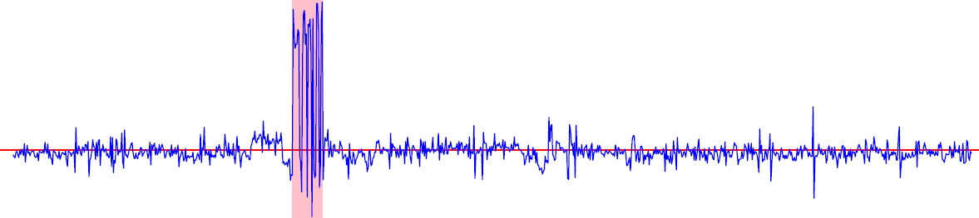
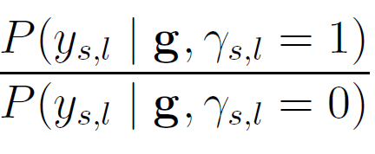
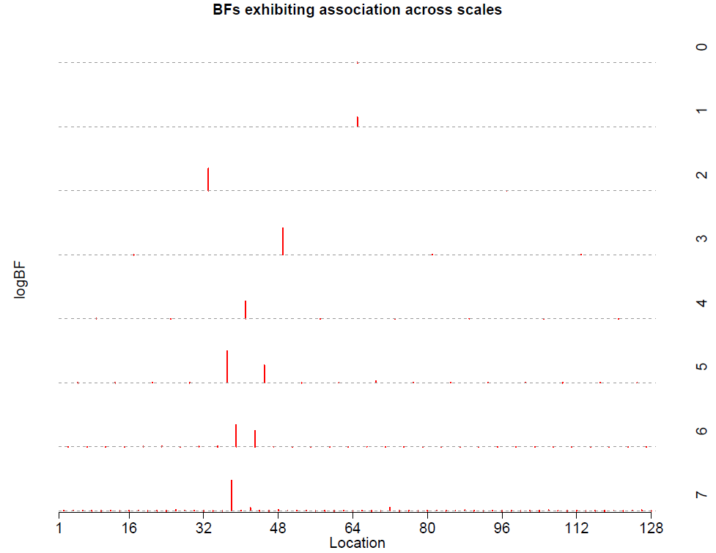
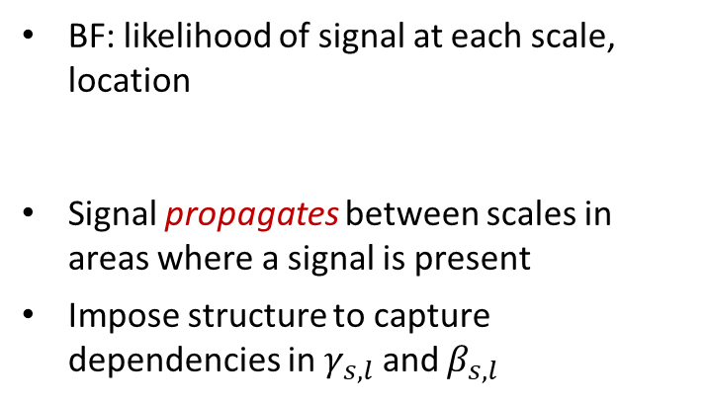
Limitations of independence
Effect size
Base
Bayes Factor (BF)
BF: likelihood of signal at each scale, location
Signal propagates between scales in areas where a signal is present
Impose structure to capture dependencies in $γ_{s,l}$ and $β_{s,l}$
Notes:
Point out the tree-shaped dependencies
Is it clear whether we need to introduce BFs at all?

Slide 23
WaveQTL with Hidden Markov Tree (HMT) priors
WaveQTL-HMT

Slide 24
Hidden Markov Trees (HMTs) (Crouse et al. (1998))
Underlying (latent) state
Observed data
Notes:
Just like a markov chain, but a tree-shape. Observed data depends on underlying latent state. Dependencies modelled on latent state – but only dependent on state of its parent (Markovian in that sense)

Slide 25
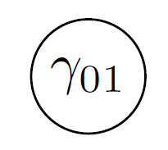
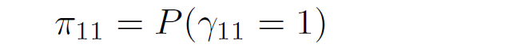
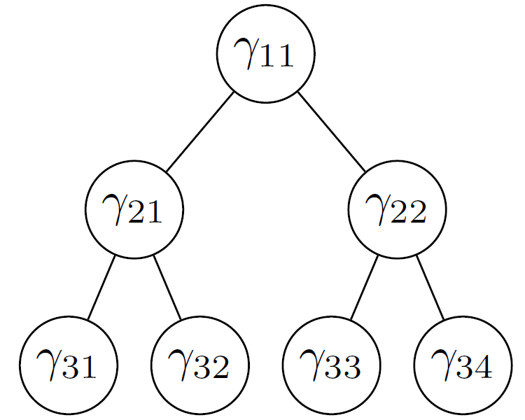
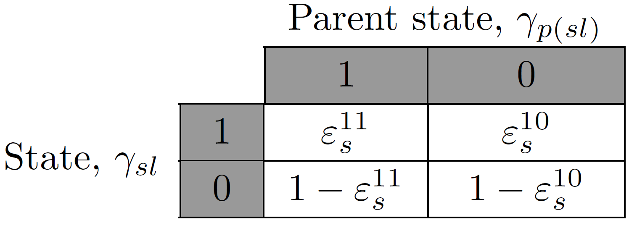
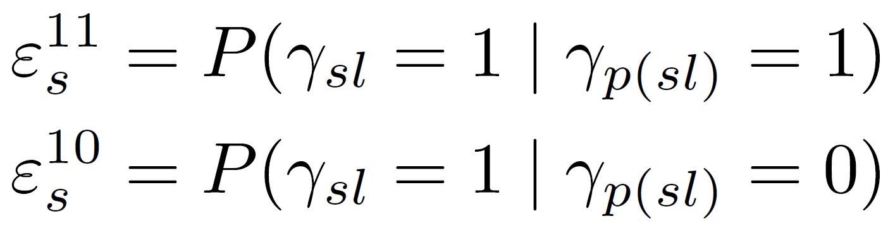
Hidden Markov Trees (HMTs) (Crouse et al. (1998))
Hyperparameters:
Notes:
Note what this means for tying
In our case, Markov Tree imposes dependencies on the states. Probability of states depends only on the probability of their parent.
Joint distribution no longer factorises into its products, but Markov structure makes it easy to evaluate.
Required hyperparameters are…tied at scale level
We will model coefficient at the 0-th scale as independent of all others (other variations to this can be found in Crouse et al)
Omit discussion of it for now – no dependencies means it’s treated the same as in WaveQTL

Slide 26










Hidden Markov Trees (HMTs) (Crouse et al. (1998))
Recall:
HMT prior on $β_{s,l}$
EM algorithm adapted for trees;
Upward-downward algorithm (Ronen et al. (1995), Crouse et al. (1998))
$$γ_{(1,1)}$$
$$β_{(1,1)}$$
$$y_{(1,1)}$$
$$γ_{(2,1)}$$
$$γ_{(2,2)}$$
$$β_{(2,1)}$$
$$β_{(2,2)}$$
$$y_{(2,1)}$$
$$y_{(2,2)}$$
Notes:
Beta depends on gamma. Model the structure using a tree-based prior. Directly model dependencies between the association signals, gamma, and indirectly model dependencies between effect sizes at different scales, beta.
The observed data are the WCs, and they will help us parameterise gamma and beta at each scale.

Slide 27

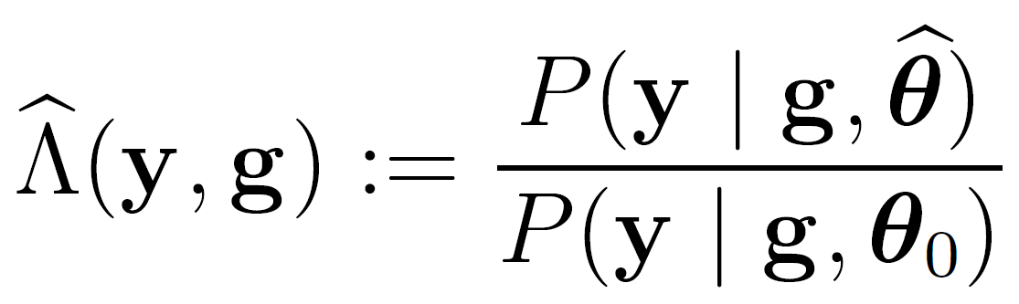

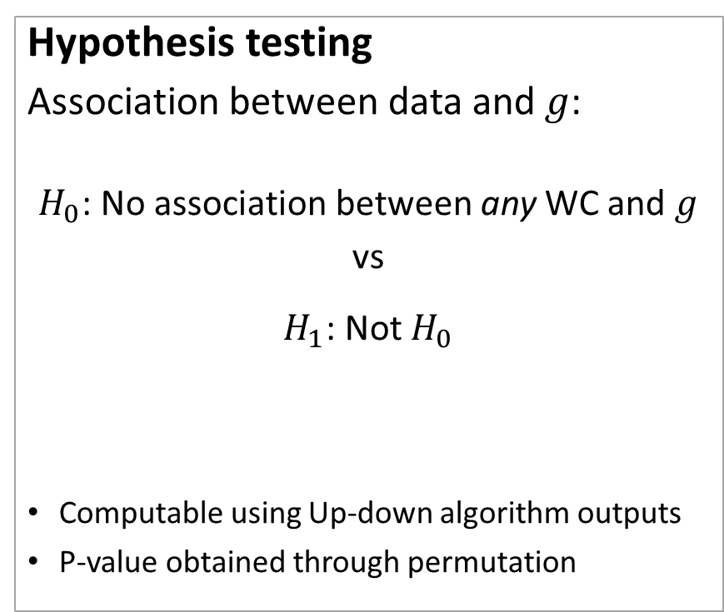

Association testing, effect size estimation
Hypothesis testing
Association between data and $g$:
$H_{0}$: No association between any WC and $g$
vs
$H_{1}$: Not $H_{0}$
Computable using Up-down algorithm outputs
P-value obtained through permutation
Estimation of effect size
Sample from posterior:
Wavelet space
Inverse W/let T/form
Data space
$$α_{b}$$
Notes:
Dependencies mean it’s more difficult to calculate, say, variance. Easier just to sample from the posterior for now.

Slide 28
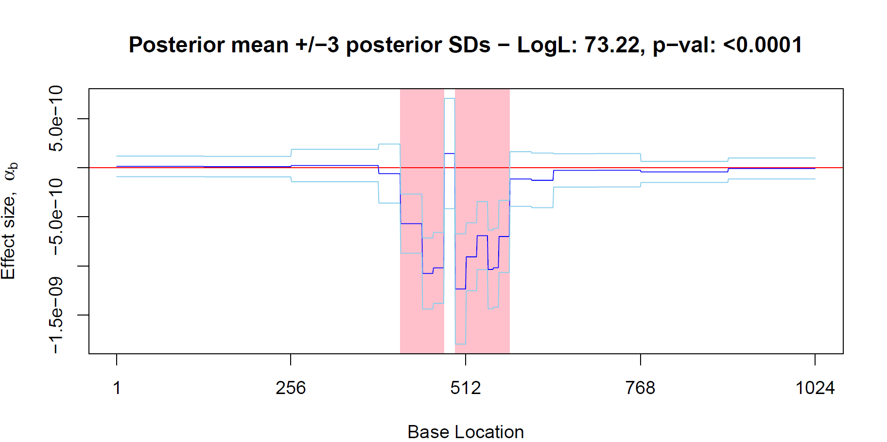
Association testing, effect size estimation
Data space
Notes:
Link the effect size and the alpha_b in the previous slide
Include a p-value on the title

Slide 29
Implementation and simulations

Slide 30
Simulating data
How does WaveQTL-HMT perform against WaveQTL?
Intuition:
WaveQTL-HMT better powered to detect effects which occur over a narrower interval
Detecting signals in different:
Effect length (8, 16, 32, 64)
Effect strength (vary % of effect strength)
Notes:
To get an idea of what length and strength means, let’s look at a typical WaveQTL and WaveQTL-HMT data space effect size output

Slide 31
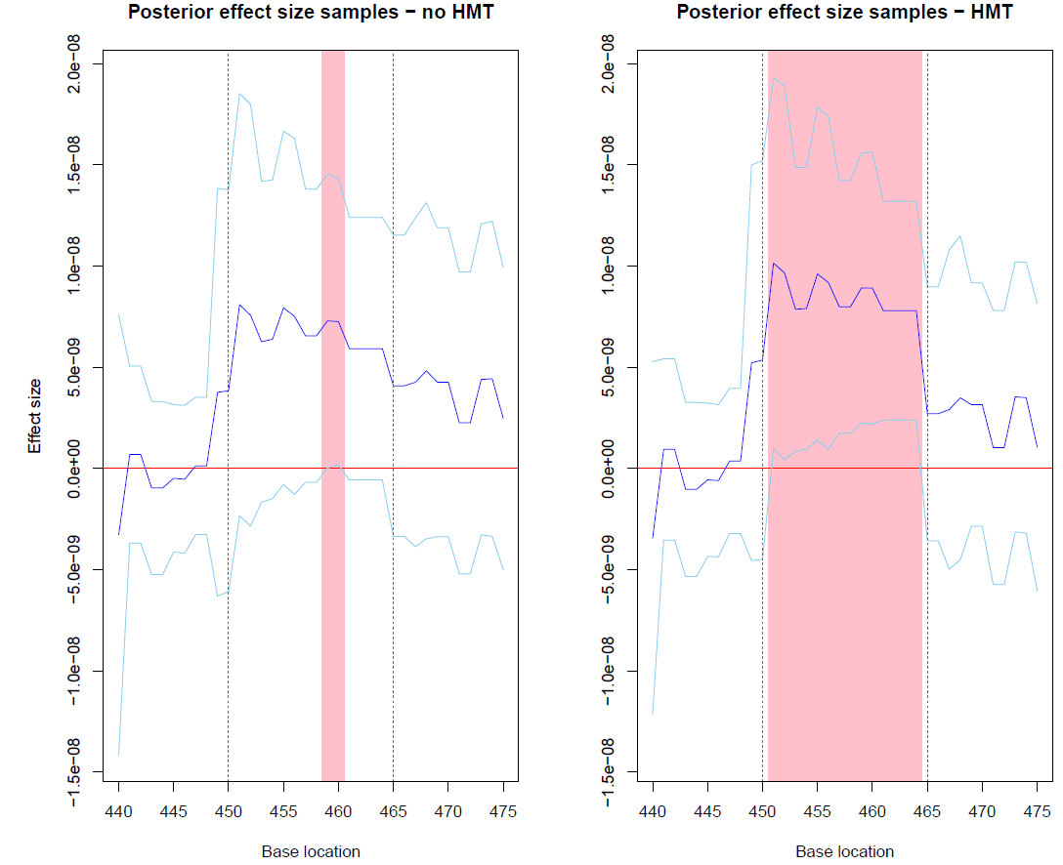
Simulating data
Notes:
Rescale this image so it’s more wide, less thin

Slide 32
Detecting signals in simulated data
Datasets:
200 datasets with effects – alt datasets
200 datasets without effects – null datasets
WaveQTL vs WaveQTL-HMT at detecting effects in the datasets
‘Detect’; apply thresholds to log-likelihood test statistic
Plot out Receiver-Operator Characteristic (ROC) curve
Notes:
Compare two models at how well they detect effects we have created (or not) in the dataset
Detection; based on thresholding the likelihood test statistic
Test at all possible threshold variations to plot out an ROC curve

Slide 33
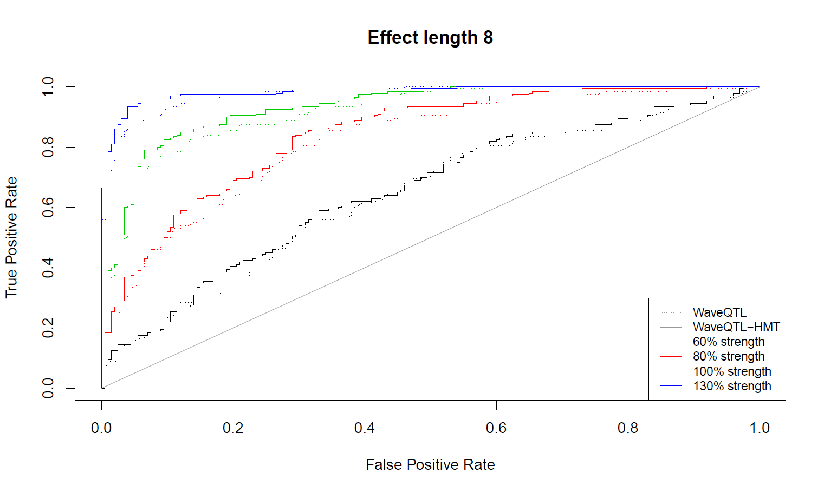
Detecting signals in simulated data

Slide 34
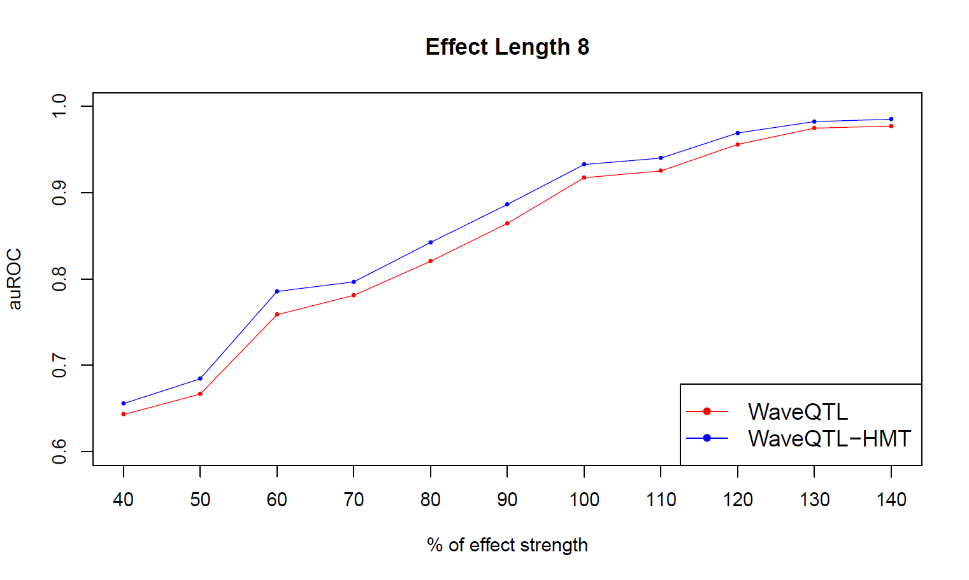
Detecting signals in simulated data

Slide 35
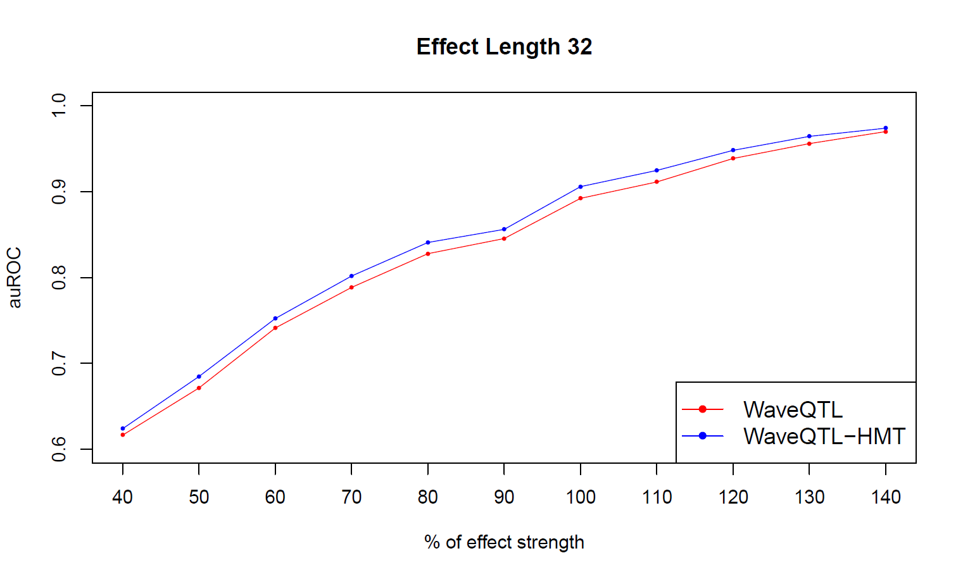
Detecting signals in simulated data

Slide 36
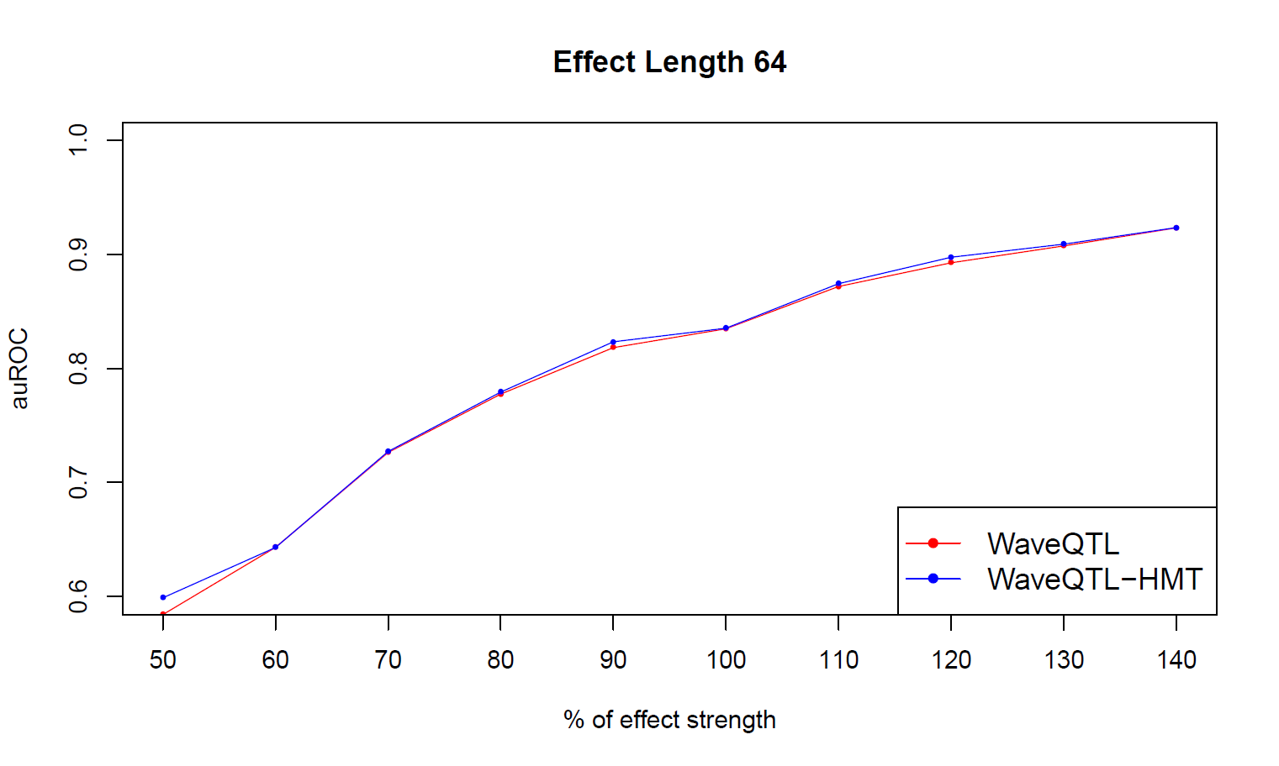
Detecting signals in simulated data

Slide 37
Concluding remarks
Notes:
Re-think the conclusion?

Slide 38
Summary
Molecular-level genotypic analyses and HTS data
WaveQTL
WaveQTL-HMT
Simulations: effects occurring over narrower intervals
Not shown today: Poisson-based multiscale models
multiseq (Shim et al (in prep), Xing (2016) and multiseq-HMT
Notes:
More a conclusion, than a summary (talk about the conclusions we found (we implemented, simulated data, found x result))

Slide 39
Future work
Real data analysis
Image data
Implement Poisson-based model (multiseq) with HMT
Performance comparison
Notes:
Real data analysis; re-analyse Degner’s dataset (was already analysed in WaveQTL) and aim to identify new genotypic variants which are associated with molecular-level phenotypes

Slide 40
Appendices
Notes:
Re-think the conclusion?

Slide 41
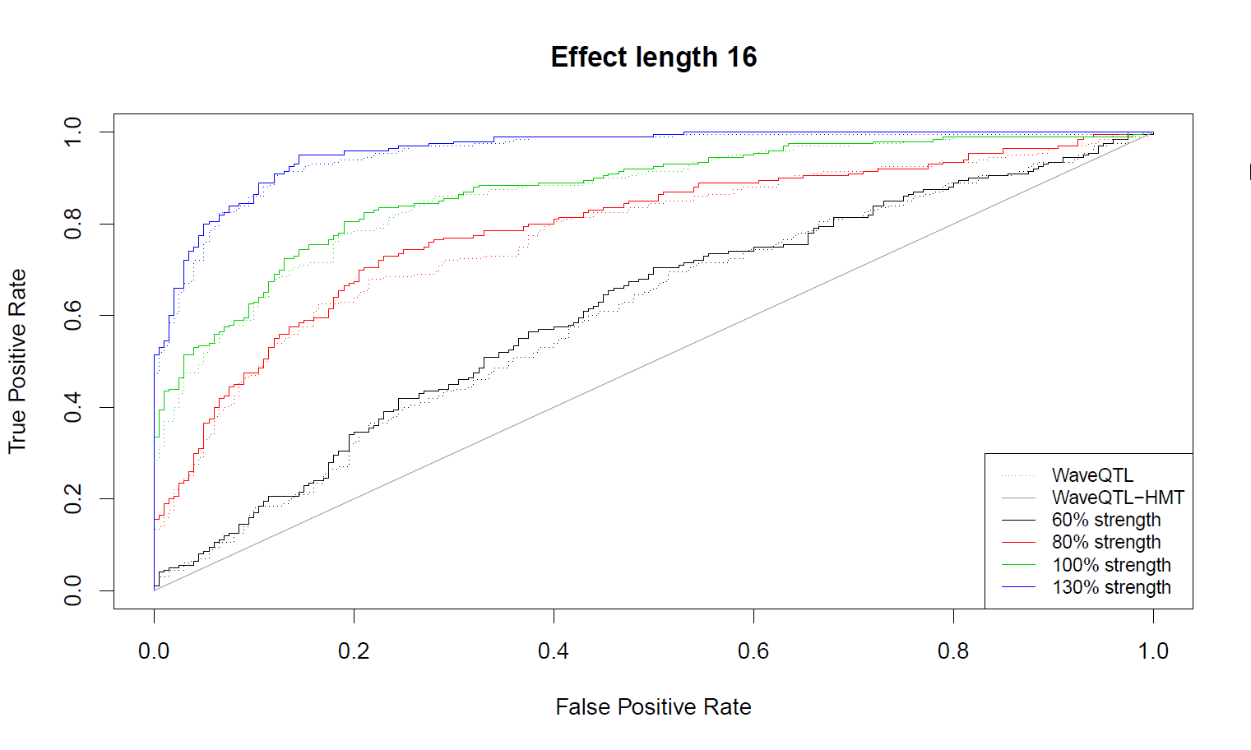
Appendix A – Effect length 16 simulations

Slide 42
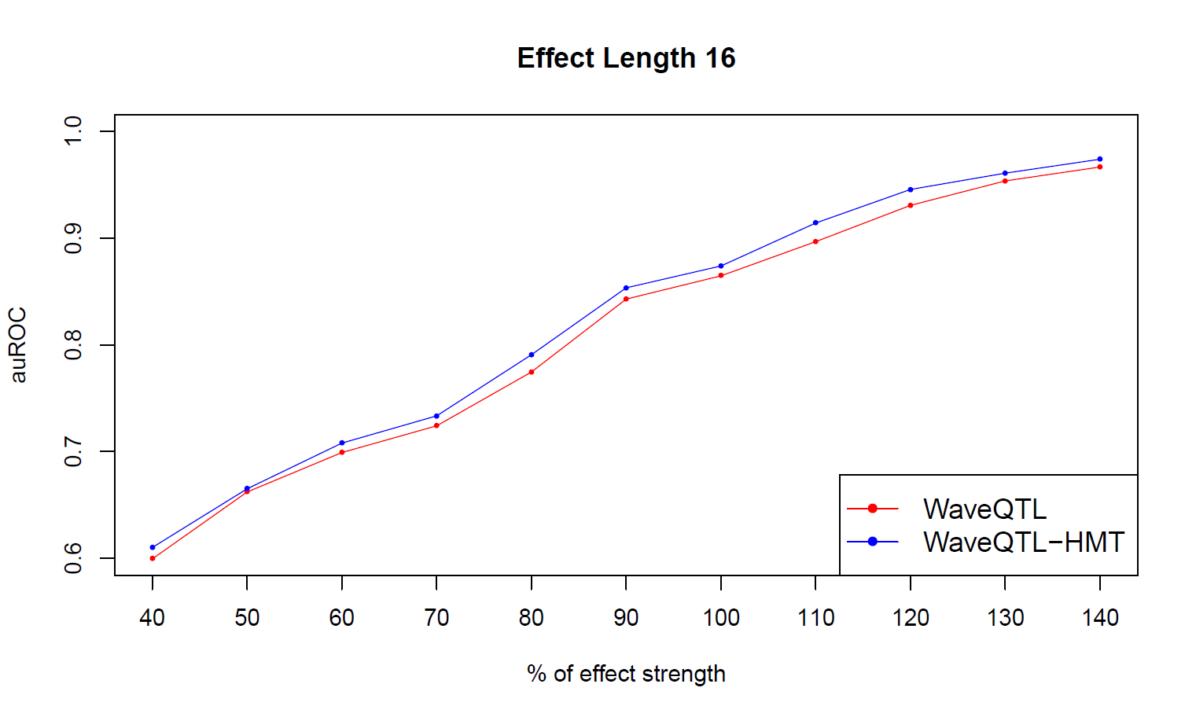
Appendix A – Effect length 16 simulations

Slide 43
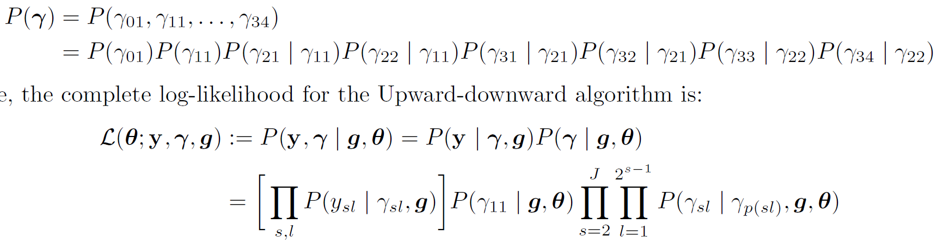

Appendix B – Upward-downward algorithm
The joint distribution for $γ$ in the example case with Markov Tree priors is:
Therefore, the complete log-likelihood for the Upward-downward algorithm is:

Slide 44
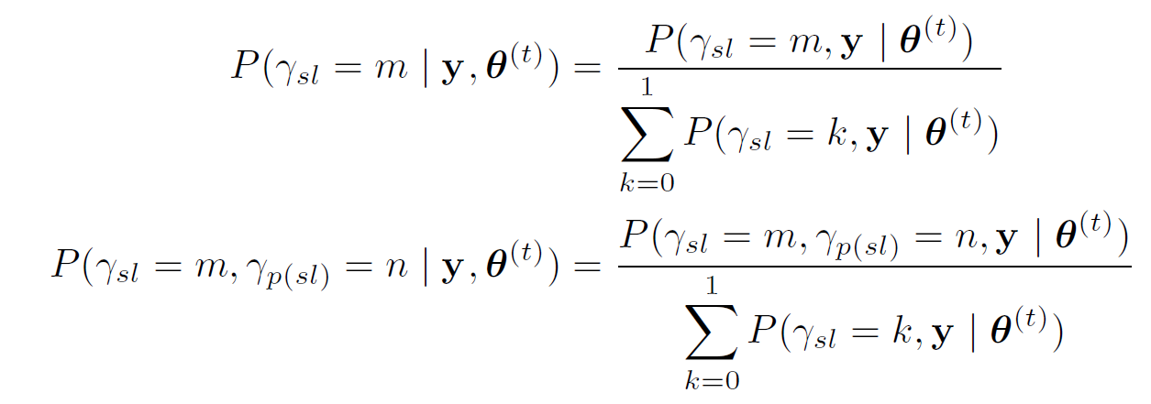
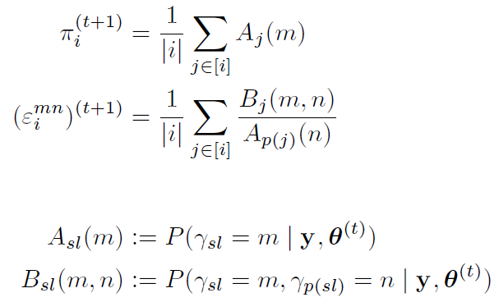

Appendix B – Upward-downward algorithm
The quantities output from the E-step are:
For the M-step, for a set of tied nodes, $[i]$, the outputs are:
Where:

Slide 45
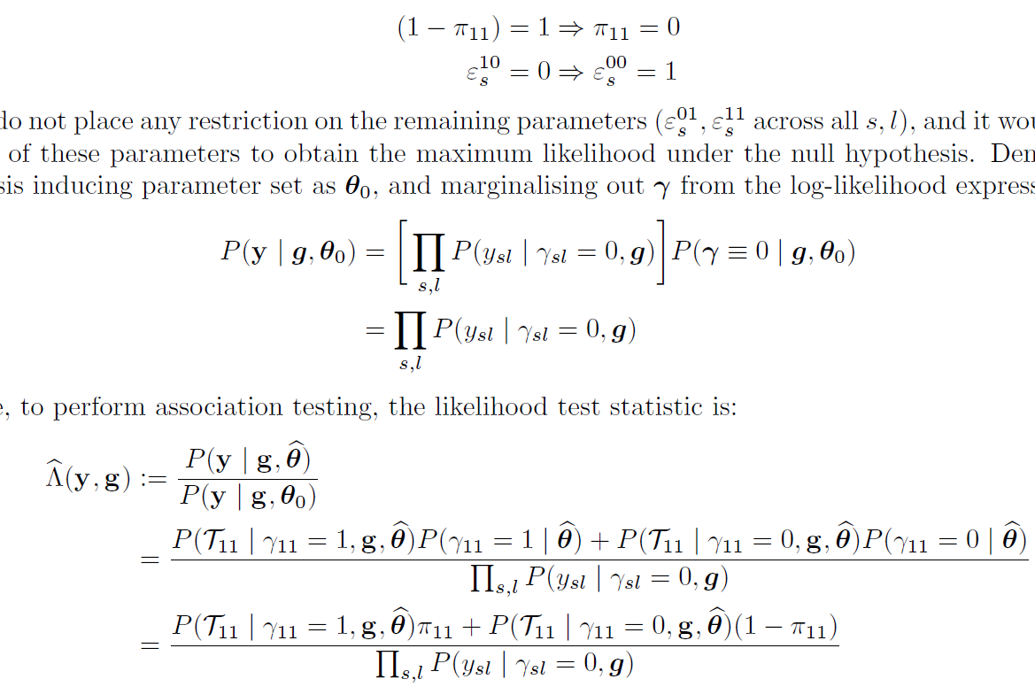
Appendix C – Likelihood ratio test statistic
A parameter set to represent the null hypothesis is one where the probability of the root state being 0 is 1, and all subsequent transitions from state 0 to 1 has probability 0:
It can be shown that:
And therefore, the likelihood ratio test statistic is:

Slide 46
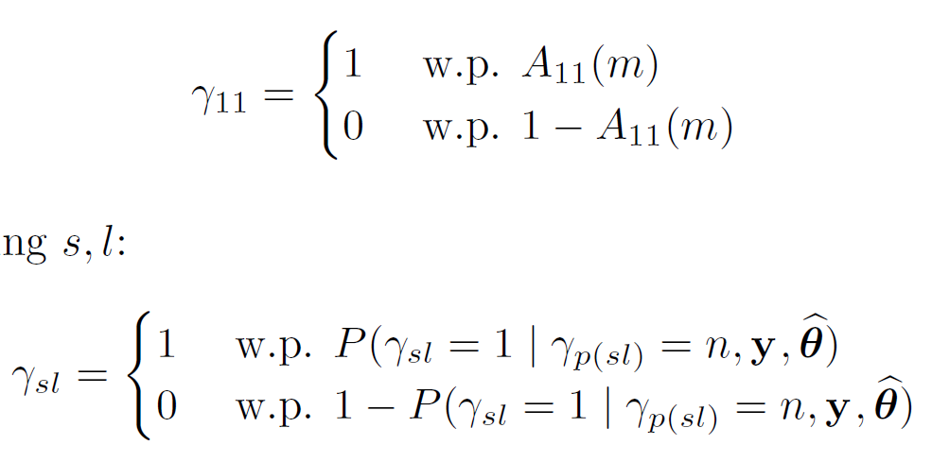
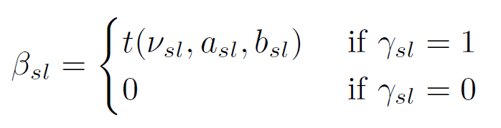
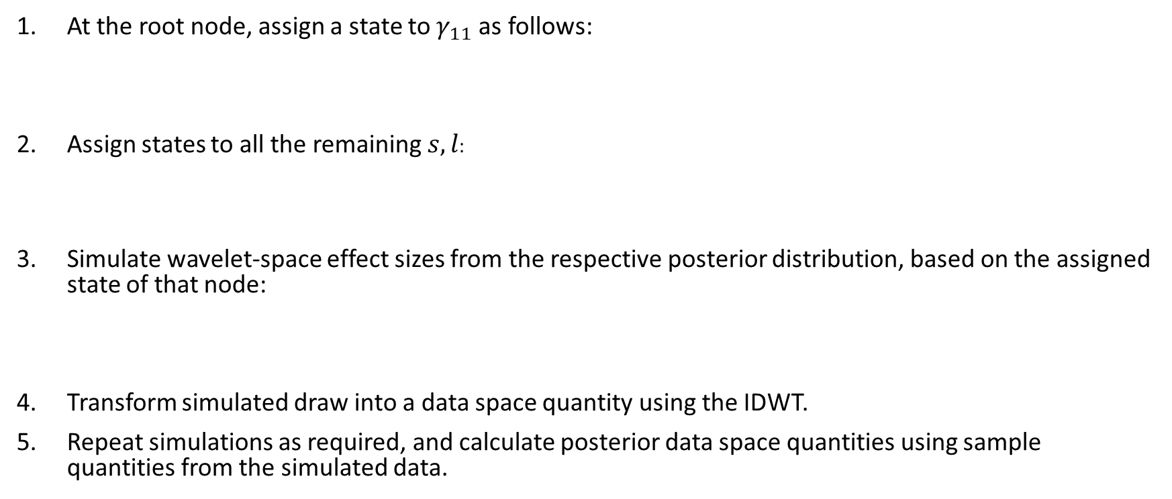
Appendix D – Simulating effect size quantities
At the root node, assign a state to $γ_{11}$ as follows:
Assign states to all the remaining $s,l$:
Simulate wavelet-space effect sizes from the respective posterior distribution, based on the assigned state of that node:
Transform simulated draw into a data space quantity using the IDWT.
Repeat simulations as required, and calculate posterior data space quantities using sample quantities from the simulated data.

Slide 47
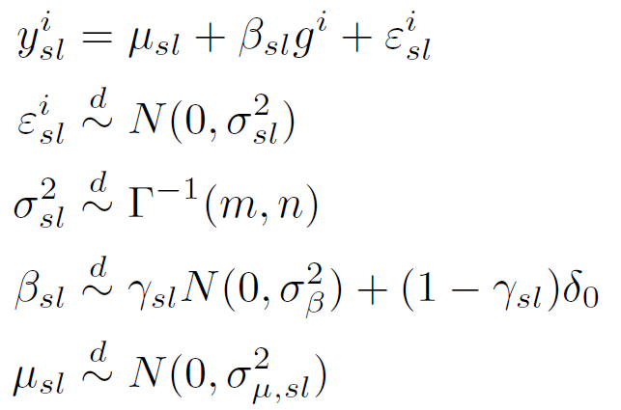

Appendix E – WaveQTL priors
For more details, see Shim and Stephens (2015)
The limiting form of the posterior, with $m,n→0$ and $σ_{μ,sl}^{2}→∞$ is used.

