Slide 1

Vue.js
The Progressive JavaScript Framework
With Special Guest: Denny Headrick

Slide 2
What does Vue.js do for us?
Magic

Slide 3
Background
First released February 2014
1.0 in October 2015
2.0 in August 2016
Authored by Evan You
Compared with Angular, Ember, React

Slide 4
On Deck
Templating
Data Binding
Components

Slide 5
Templating

Slide 6
Templating
JavaScript templating refers to the client side data binding method implemented with the JavaScript language [1]
Templating, and in particular web templating is a way to represent data in different forms [2]
This is so new… so revolutionary… so unfamiliar..
[1] https://en.wikipedia.org/wiki/JavaScript_templating
[2] https://wiki.python.org/moin/Templating

Slide 7

This is not new
I see here that you’re injecting
data into markup language
Kinda old school. Don’t you think?

Slide 8
Example
HTML
1
2
3
4
5
<ul id="list">
<li>1</li>
<li>2</li>
<li>3</li>
<li>4</li>
<li>5</li>
</ul>

Slide 9
Server-Side Templating
Classic ASP
Output
<ul id="list">
<% For i = 1 To 5 %>
<li>
<% =i %>
</li>
<% Next %>
</ul>
<ul id="list">
<li>1</li>
<li>2</li>
<li>3</li>
<li>4</li>
<li>5</li>
</ul>

Slide 10
Scripting a List
Vanilla JavaScript (JS… if you’re cool)
Output
// <ul id="list"></ul>
<ul id="list">
<li>1</li>
<li>2</li>
<li>3</li>
<li>4</li>
<li>5</li>
</ul>
let el = document.getElementById('list');
for (let i = 1; i <= 5; i++) {
let li = document.createElement('li');
li.innerText = i;
el.appendChild(li);
}

Slide 11
String Building
Vanilla JavaScript
Output
// <ul id="list"></ul>
<ul id="list">
<li>1</li>
<li>2</li>
<li>3</li>
<li>4</li>
<li>5</li>
</ul>
let innerHTML = '';
for (let i = 0; i <= 5; i++) {
innerHTML += '<li>' + i + '</li>';
}
let el = document.getElementById('list');
el.innerHTML = innerHTML;

Slide 12
Client-Side Templating
VueJS Templating
Output
<ul id="list">
<li v-for="n in 5">
{{n}}
</li>
</ul>
<ul id="list">
<li>1</li>
<li>2</li>
<li>3</li>
<li>4</li>
<li>5</li>
</ul>

Slide 13
Data Binding

Slide 14
Data Binding
Data binding is the process that establishes a connection between the application UI and business logic [1]
UI data binding binds UI elements to an application domain model [2]
[1] https://docs.microsoft.com/en-us/dotnet/framework/wpf/data/data-binding-overview
[2] https://en.wikipedia.org/wiki/UI_data_binding

Slide 15
Changes from
the UI update the model
var model = {
display: '3 + 3'
}
3 + 3
7
8
9
C
setTimeout(function () {
model.display = ''
}, 60000)
4
5
6
-
1
2
3
+
function postValueToServer() {
var xhr = new XMLHttpRequest();
xhr.open("post", restURL);
xhr.send(JSON.stringify(model);
}
.
0
=
Changes from
the model update the UI

Slide 16
Components
Software components often take the form of objects (not classes) or collections of objects (from object-oriented programming), in some binary or textual form, adhering to some interface description language (IDL) so that the component may exist autonomously from other components in a computer [1]
Web Components is a suite of different technologies allowing you to create reusable custom elements — with their functionality encapsulated away from the rest of your code — and utilize them in your web apps [2]
[1] https://en.wikipedia.org/wiki/Component-based_software_engineering
[2] https://developer.mozilla.org/en-US/docs/Web/Web_Components

Slide 17
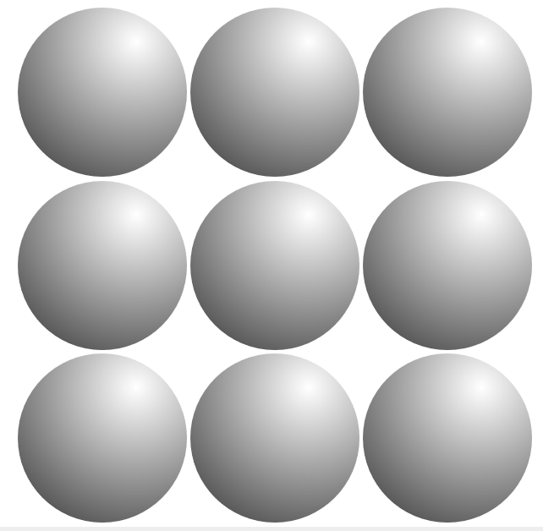
<div class="row">
<div class="circle"></div>
<div class="circle"></div>
<div class="circle"></div>
</div>
<div class="row">
<div class="circle"></div>
<div class="circle"></div>
<div class="circle"></div>
</div>
<div class="row">
<div class="circle"></div>
<div class="circle"></div>
<div class="circle"></div>
</div>
.circle{
display: inline-block;
width: 200px;
height: 200px;
background-color: #f0f0f0;
border-radius:50%;
cursor: pointer;
transition: all 0.5s;
background: radial-gradient(circle at 70% 20%, #fff, #333);
}

Slide 18
<row>
<circle />
<circle />
<circle />
</row>
<row>
<circle />
<circle />
<circle />
</row>
<row>
<circle />
<circle />
<circle />
</row>

Slide 19
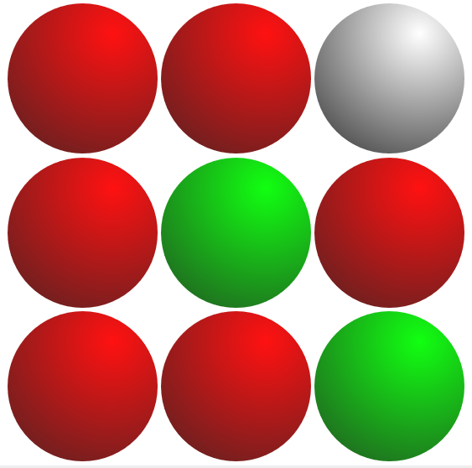
<row>
<circle color="red" />
<circle color="red" />
<circle color="grey" />
</row>
<row>
<circle color="red"/>
<circle color="green" />
<circle color="red" />
</row>
<row>
<circle color="red" />
<circle color="red" />
<circle color="green" />
</row>

Slide 20
<row circles="['red','red','grey']" />
<row circles="['red','green','red']" />
<row circles="['red','red','green']" />

Slide 21
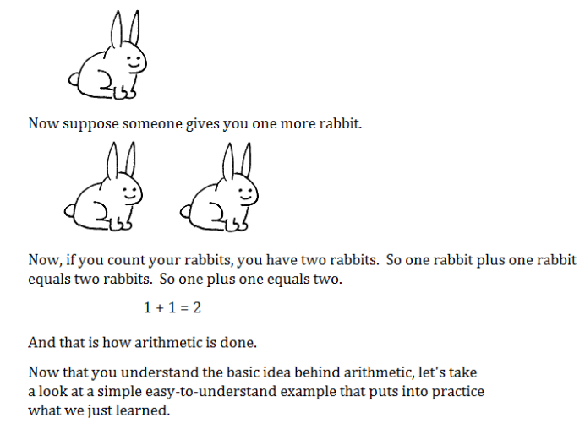
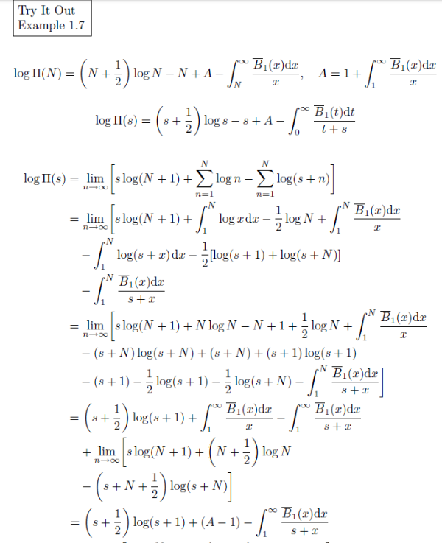
If authors of computer programming books wrote arithmetic textbooks

Slide 22
Resources
Guide - https://vuejs.org/v2/guide/
Forum - https://forum.vuejs.org/
GitHub - https://github.com/vuejs/vue
Stack Overflow - https://stackoverflow.com/questions/tagged/vue.js
Reddit – https://reddit.com/r/vuejs

