Slide 1
Notes: 1. Correct fonts won’t load until you open this in PowerPoint (e.g., if you’re previewing this in your browser it’ll look uglier than it actually is). 2. Generate QR codes here: https://www.qrcode-monkey.com/

Slide 2
NUI Galway Notes: Four official NUI Galway colours are: NUI Galway Mulberry Pantone ds 167-1: C 50, M 100, Y 0, K 40. RGB: Red 104, Green 0. Blue 92. Hex: 67005b RAL: 4008 NUI Galway Midnight Blue can be achieved by matching the following four-colour process specification. Pantone ds 202-2: C 90, M 70, Y 30, K 30. RGB: Red 44, Green 60. Blue 100. Hex: 2c3c63 RAL: 5009 NUI Galway Jade can be achieved by matching the following four-colour process specification. Pantone ds 269-6: C 45, M 0, Y 35, K 25. RGB: Red 126, Green 169. Blue 150. Hex: 7da995 RAL: 6027 NUI Dusk Blue can be achieved by matching the following four-colour process specification. Pantone ds 237-6: C 50, M 5, Y 15, K 10. RGB: Red 127, Green 186. Blue 201. Hex: 7ebac9 RAL: 6034

Slide 3


Main finding goes here, translated into plain English. Emphasize the important words.
Title: Subtitle
Leeroy Jenkins, author2, author3, author4
Title goes here; make it small if you need to free up space.
AMMO BAR
Delete this and replace it with your…
Extra Graphs
Extra Correlation tables
Extra Figures
Extra nuance that you’re worried about leaving out.
Keep it messy! This section is just for you.
Leeroy Jenkins, author2, author3, author4
INTRO
Just give context for the gap you’re filling
You’re not going to get yelled at if you don’t cite the 5 papers from 1937 that defined this construct. They’ll download your paper if they want that.
METHODS
N = ###,
Collected this
Tested with X statistical test
RESULTS
Graph or table with essential results only.
All the other correlations in the ammo bar.
DISCUSSION
“If this result actually generalized and I didn’t have to humbly disclaim the possibility of a thousand confounds and limitations, it would imply that….”
Keep font size as high above 28 as possible.
Take a picture to download the full paper

Slide 4
Main finding goes here, translated into plain English. Emphasize the important words.
Title: Subtitle
Leeroy Jenkins, author2, author3, author4
Title goes here; make it small if you need to free up space.
AMMO BAR
Delete this and replace it with your…
Extra Graphs
Extra Correlation tables
Extra Figures
Extra nuance that you’re worried about leaving out.
Keep it messy! This section is just for you.
Leeroy Jenkins, author2, author3, author4
INTRO
Just give context for the gap you’re filling
You’re not going to get yelled at if you don’t cite the 5 papers from 1937 that defined this construct. They’ll download your paper if they want that.
METHODS
N = ###,
Collected this
Tested with X statistical test
RESULTS
Graph or table with essential results only.
All the other correlations in the ammo bar.
DISCUSSION
“If this result actually generalized and I didn’t have to humbly disclaim the possibility of a thousand confounds and limitations, it would imply that….”
Keep font size as high above 28 as possible.
Take a picture to download the full paper

Slide 5
Main finding goes here, translated into plain English. Emphasize the important words.
Title: Subtitle
Leeroy Jenkins, author2, author3, author4
Title goes here; make it small if you need to free up space.
AMMO BAR
Delete this and replace it with your…
Extra Graphs
Extra Correlation tables
Extra Figures
Extra nuance that you’re worried about leaving out.
Keep it messy! This section is just for you.
Leeroy Jenkins, author2, author3, author4
INTRO
Just give context for the gap you’re filling
You’re not going to get yelled at if you don’t cite the 5 papers from 1937 that defined this construct. They’ll download your paper if they want that.
METHODS
N = ###,
Collected this
Tested with X statistical test
RESULTS
Graph or table with essential results only.
All the other correlations in the ammo bar.
DISCUSSION
“If this result actually generalized and I didn’t have to humbly disclaim the possibility of a thousand confounds and limitations, it would imply that….”
Keep font size as high above 28 as possible.
Take a picture to download the full paper

Slide 6
Main finding goes here, translated into plain English. Emphasize the important words.
Title: Subtitle
Leeroy Jenkins, author2, author3, author4
Title goes here; make it small if you need to free up space.
AMMO BAR
Delete this and replace it with your…
Extra Graphs
Extra Correlation tables
Extra Figures
Extra nuance that you’re worried about leaving out.
Keep it messy! This section is just for you.
Leeroy Jenkins, author2, author3, author4
INTRO
Just give context for the gap you’re filling
You’re not going to get yelled at if you don’t cite the 5 papers from 1937 that defined this construct. They’ll download your paper if they want that.
METHODS
N = ###,
Collected this
Tested with X statistical test
RESULTS
Graph or table with essential results only.
All the other correlations in the ammo bar.
DISCUSSION
“If this result actually generalized and I didn’t have to humbly disclaim the possibility of a thousand confounds and limitations, it would imply that….”
Keep font size as high above 28 as possible.
Take a picture to download the full paper

Slide 7
Main finding goes here, translated into plain English. Emphasize the important words.
Title: Subtitle
Leeroy Jenkins, author2, author3, author4
Title goes here; make it small if you need to free up space.
AMMO BAR
Delete this and replace it with your…
Extra Graphs
Extra Correlation tables
Extra Figures
Extra nuance that you’re worried about leaving out.
Keep it messy! This section is just for you.
Leeroy Jenkins, author2, author3, author4
INTRO
Just give context for the gap you’re filling
You’re not going to get yelled at if you don’t cite the 5 papers from 1937 that defined this construct. They’ll download your paper if they want that.
METHODS
N = ###,
Collected this
Tested with X statistical test
RESULTS
Graph or table with essential results only.
All the other correlations in the ammo bar.
DISCUSSION
“If this result actually generalized and I didn’t have to humbly disclaim the possibility of a thousand confounds and limitations, it would imply that….”
Keep font size as high above 28 as possible.
Take a picture to download the full paper

Slide 8
Main finding goes here, translated into plain English. Emphasize the important words.
Title: Subtitle
Leeroy Jenkins, author2, author3, author4
Title goes here; make it small if you need to free up space.
AMMO BAR
Delete this and replace it with your…
Extra Graphs
Extra Correlation tables
Extra Figures
Extra nuance that you’re worried about leaving out.
Keep it messy! This section is just for you.
Leeroy Jenkins, author2, author3, author4
INTRO
Just give context for the gap you’re filling
You’re not going to get yelled at if you don’t cite the 5 papers from 1937 that defined this construct. They’ll download your paper if they want that.
METHODS
N = ###,
Collected this
Tested with X statistical test
RESULTS
Graph or table with essential results only.
All the other correlations in the ammo bar.
DISCUSSION
“If this result actually generalized and I didn’t have to humbly disclaim the possibility of a thousand confounds and limitations, it would imply that….”
Keep font size as high above 28 as possible.
Take a picture to download the full paper

Slide 9
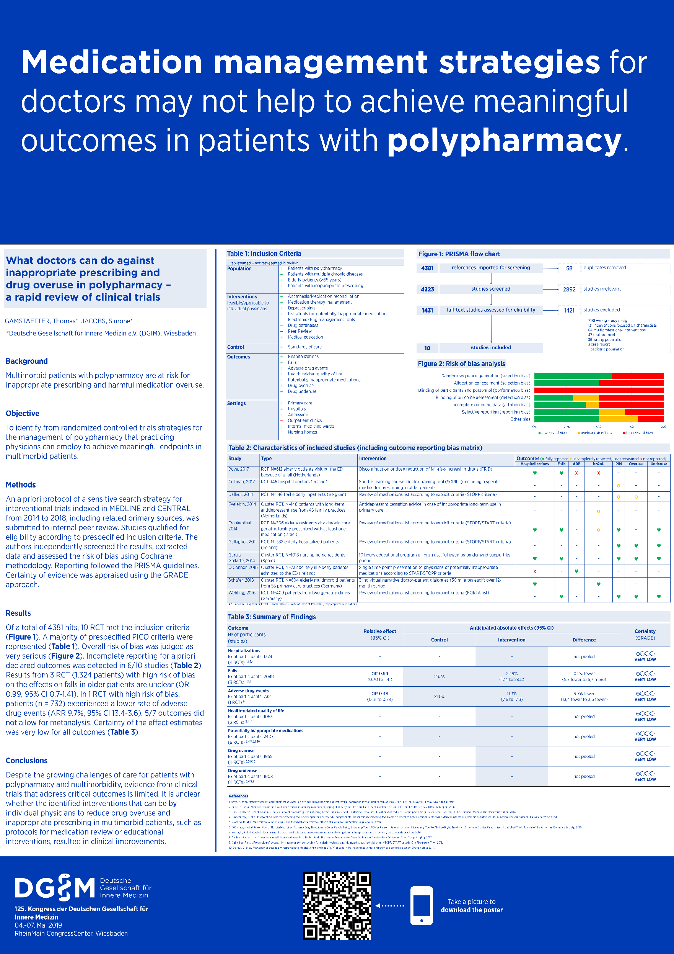
Example donated by Dr. Thomas Gamstätter

