Slide 1
Wavelet Based Image Coding

Slide 2
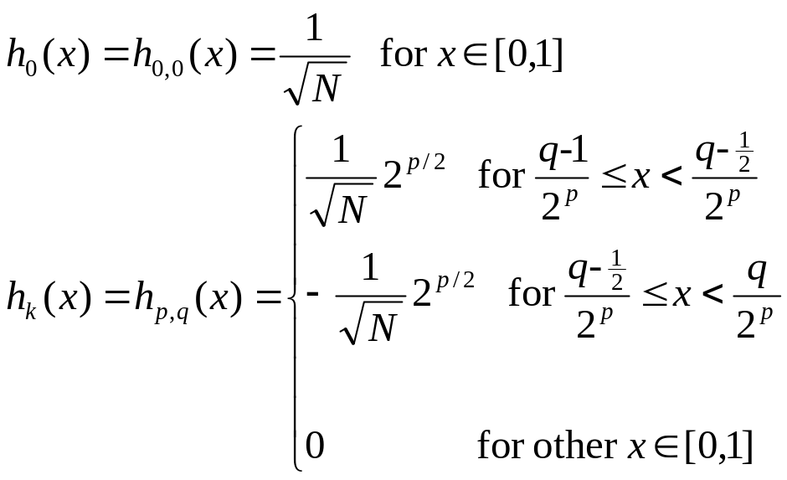
Construction of Haar functions
Unique decomposition of integer k ⬄ (p, q)
  k = 0, …, N-1 with N = 2^{n}, 0 <= p <= n-1
  q = 0, 1 (for p=0); 1 <= q <= 2^{p} (for p>0)
  e.g., k=0 k=1 k=2 k=3 k=4 …
  (0,0) (0,1) (1,1) (1,2) (2,1) …
h_{k}(x) = h _{p,q}(x) for x ∈ [0,1]
power of 2
k = 2^{p} + q – 1
“reminder”
x
1

Slide 3
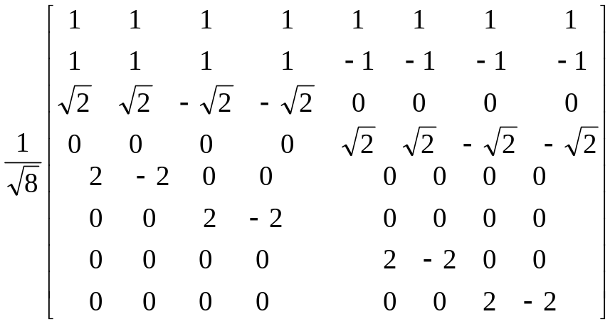
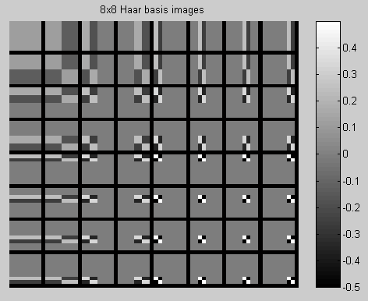
Haar Transform
Haar transform H
  Sample h_{k}(x) at {m/N}
    m = 0, …, N-1
  Real and orthogonal
  Transition at each scale p is
  localized according to q
Basis images of 2-D
(separable) Haar transform
  Outer product of two basis vectors

Slide 4
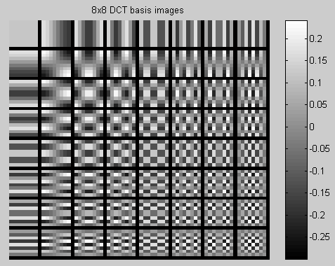
Compare Basis Images of DCT and Haar
See also: Jain’s Fig.5.2 pp136

Slide 5
Summary on Haar Transform
Two major sub-operations
  Scaling captures info. at different frequencies
  Translation captures info. at different locations
Can be represented by filtering and downsampling
Relatively poor energy compaction
x
1

Slide 6
Orthonormal Filters
Equiv. to projecting input signal to orthonormal basis
Energy preservation property
  Convenient for quantizer design
    MSE by transform domain quantizer is same as reconstruction MSE
Shortcomings: “coefficient expansion”
  Linear filtering with N-element input & M-element filter
  ➔ (N+M-1)-element output ➔ (N+M)/2 after downsample
  Length of output per stage grows ~ undesirable for compression
Solutions to coefficient expansion
  Symmetrically extended input (circular convolution) &
  Symmetric filter

Slide 7
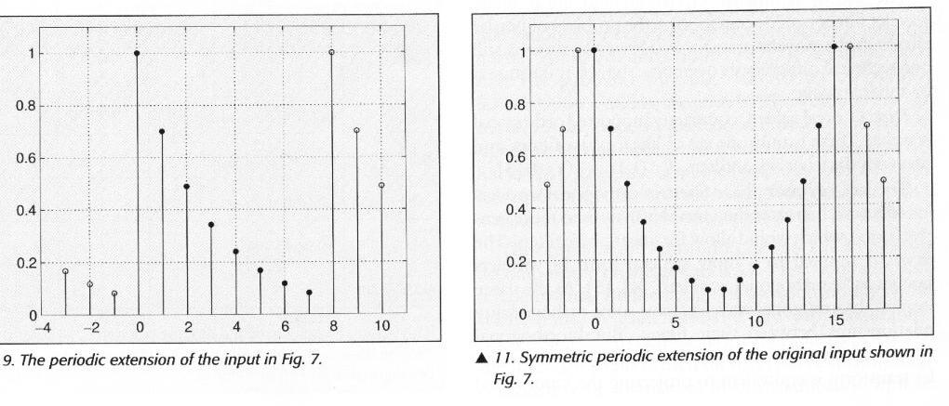
Solutions to Coefficient Expansion
Circular convolution in place of linear convolution
  Periodic extension of input signal
  Problem: artifacts by large discontinuity at borders
Symmetric extension of input
  Reduce border artifacts (note the signal length doubled with symmetry)
  Problem: output at each stage may not be symmetric
From Usevitch (IEEE Sig.Proc. Mag. 9/01)

Slide 8
Solutions to Coefficient Expansion (cont’d)
Symmetric extension + symmetric filters
  No coefficient expansion and little artifacts
  Symmetric filter (or asymmetric filter) => “linear phase filters”
  (no phase distortion except by delays)
Problem
  Only one set of linear phase filters for real FIR orthogonal wavelets
  ➔ Haar filters: (1, 1) & (1,-1)
  do not give good energy compaction

Slide 9
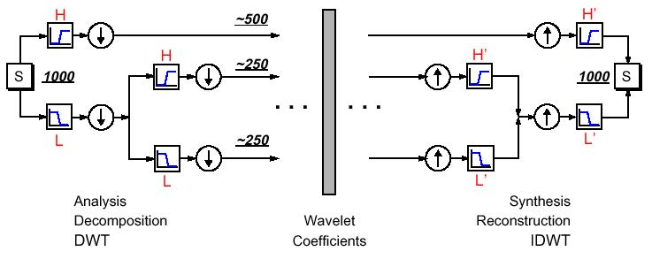
Successive Wavelet/Subband Decomposition
  Successive lowpass/highpass filtering and downsampling
    on different level: capture transitions of different frequency bands
    on the same level: capture transitions at different locations
Figure from Matlab Wavelet Toolbox Documentation

Slide 10
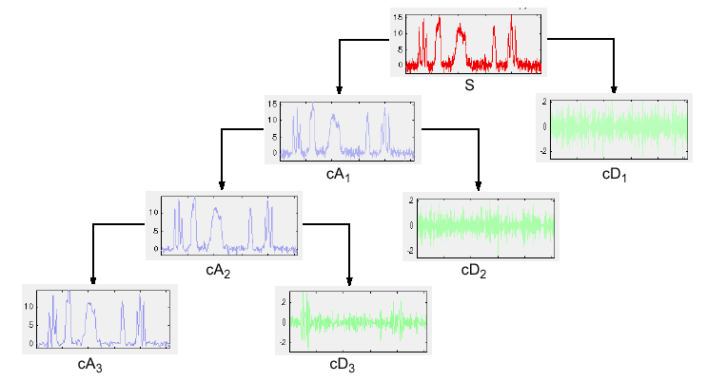
Examples of 1-D Wavelet Transform
From Matlab Wavelet Toolbox Documentation

Slide 11
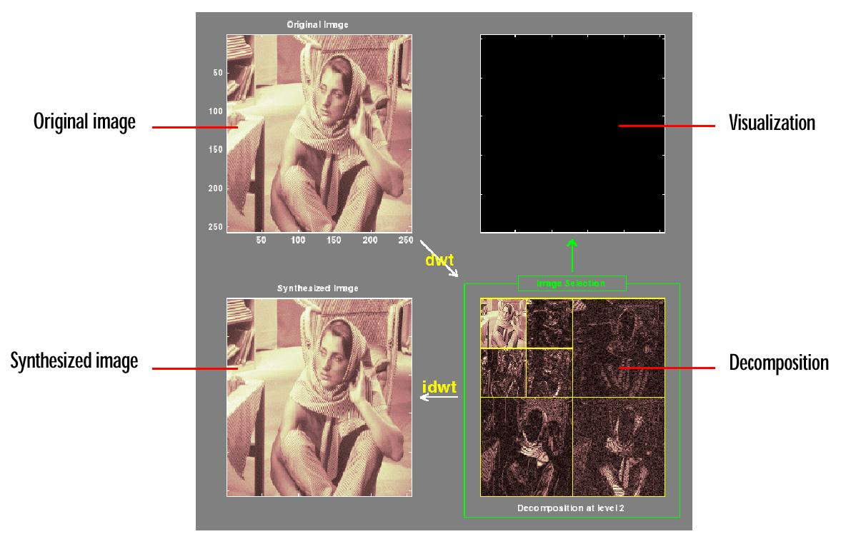
2-D Wavelet Transform via Separable Filters
From Matlab Wavelet Toolbox Documentation

Slide 12
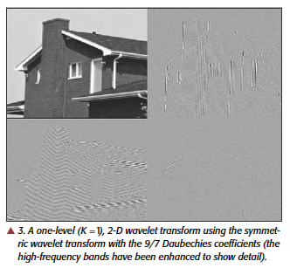
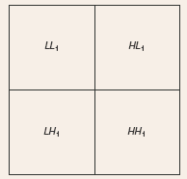
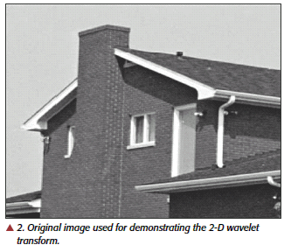
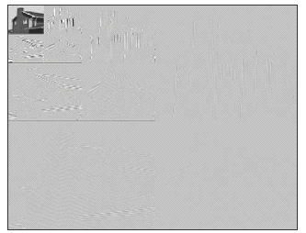
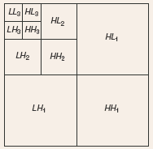
2-D Example
From Usevitch (IEEE Sig.Proc. Mag. 9/01)

Slide 13
Subband Coding Techniques
General coding approach
  Allocate different bits for coeff. in different frequency bands
  Encode different bands separately
  Example: DCT-based JPEG and early wavelet coding
Some difference between subband coding and early wavelet coding ~ Choices of filters
  Subband filters aims at (approx.) non-overlapping freq. response
  Wavelet filters has interpretations in terms of basis and typically designed for certain smoothness constraints
  (=> will discuss more )
Shortcomings of subband coding
  Difficult to determine optimal bit allocation for low bit rate applications
  Not easy to accommodate different bit rates with a single code stream
  Difficult to encode at an exact target rate

Slide 14
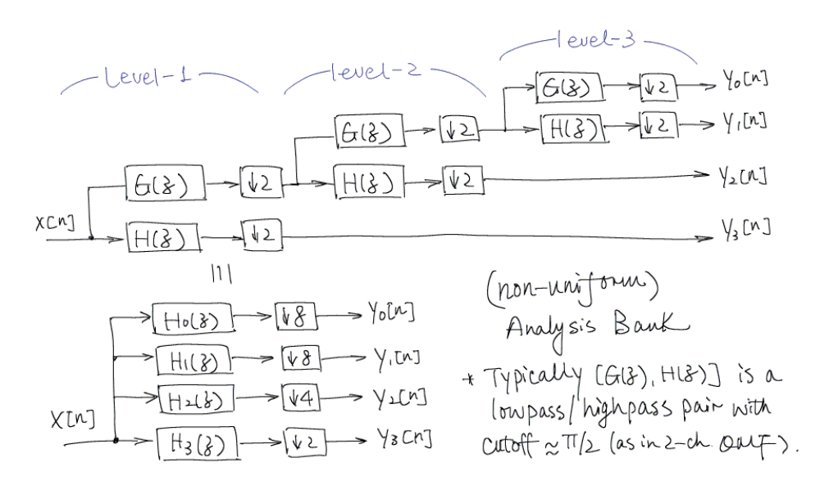
Review: Filterbank & Multiresolution Analysis

Slide 15
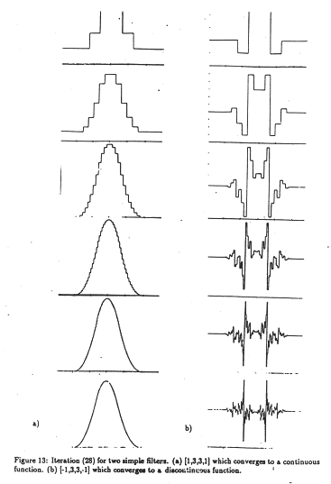
Smoothness Conditions on Wavelet Filter
  Ensure the low band coefficients obtained by recursive filtering can provide a smooth approximation of the original signal
From M. Vetterli’s wavelet/filter-bank paper

