Slide 1
Wavelets : Introduction and Examples
L. J. Wang

Slide 2
Contents
Introduction
A Short Review of Wavelet Analysis
A Simple Example :
☺ Haar Wavelets
Subband filtering scheme
Conclusions and Further Research

Slide 3
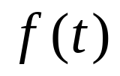
I. Introduction
The wavelet transform of a signal is the function of scale (or frequency) and time. Thus, wavelets provide a tool for time-frequency localization.
Time-frequency localization
In many applications, given a signal , one is interested in its frequency content locally in time. This similar to music notation, for example, each note specified a frequency and a position in time.

Slide 4
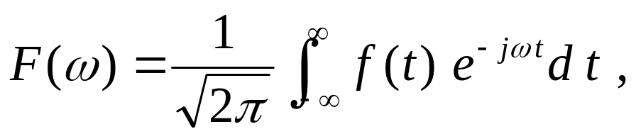

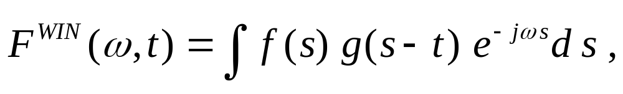

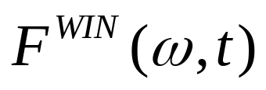

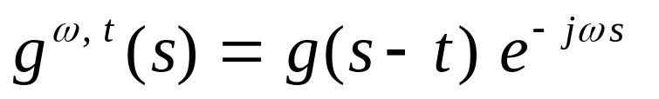
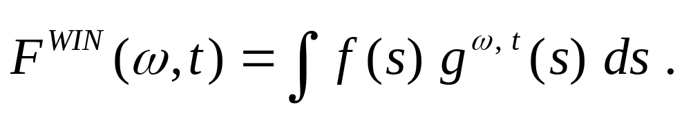
The Fourier transform of ,
is only the function of , frequency.
The windowed Fourier transform of is
where is a windowing function ,
is a function of and .
Let , then

Slide 5
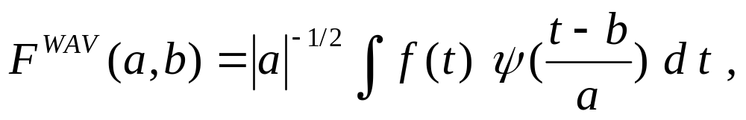
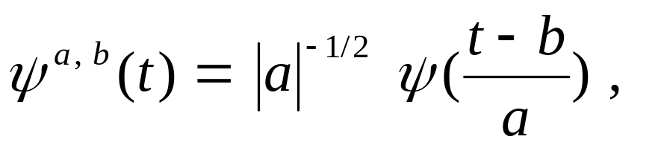
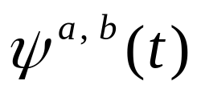

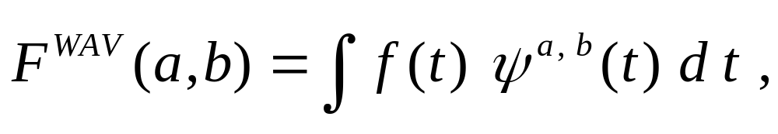
The windowed Fourier transform provides a description of in the time-frequency plane.
The wavelet transform of is defined by
Let
where are called wavelets and
is called mother wavelets.
Then,
This is similar with window Fourier transform.

Slide 6
Compression techniques are divided into two main techniques : transforms (DCT, JPEG, FFT, Wavelet) and nontransforms (PCM, DPCM).
Compression can be achieved by transforming the data, projecting it on a basis of functions, and then encoding the resulted coefficients.
The wavelet transform cuts up the image into a set of subimages with different resolutions corresponding to different frequency bands.
One encoding approach is based on quantizing the coefficients using vector quantization.

Slide 7
Because of the nature of the image signal and the mechanisms of human vision, the transform used must accept nonstationarity and be well localized in both the space and frequency domain.
To avoid redundancy, the transform must be at least biorthogonal and lastly, in order to save CPU time, the corresponding algorithm must be fast. The wavelet transform satisfies each of these conditions.

Slide 8
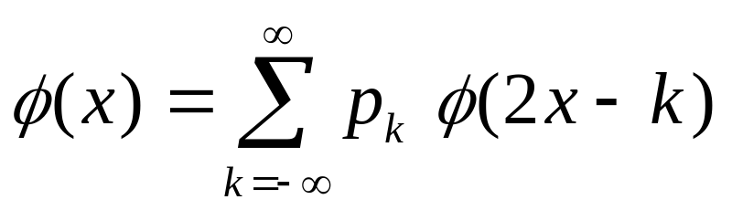
II. A Short Review of Wavelet Analysis
Scaling functions
The basic constructions of wavelets using scaling functions is as follows:
1. Define a scaling function
2. Define a subspace V of a vector space U, U is a collection of elements over the real number R, then V⊂U.

Slide 9

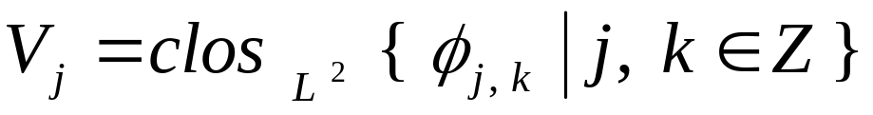
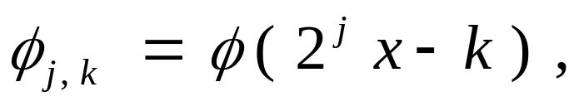
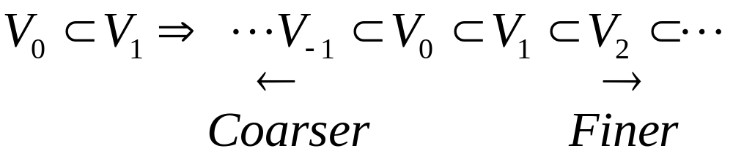
3. Given a nested sequences of subspace ,
is defined as
where
then we have
( containment property )

Slide 10
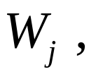
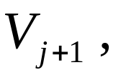
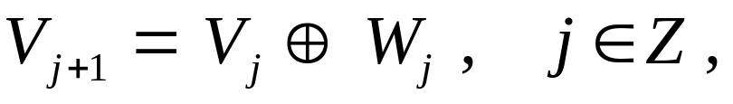
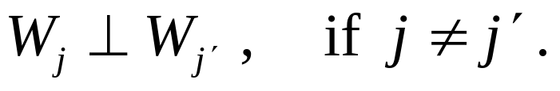
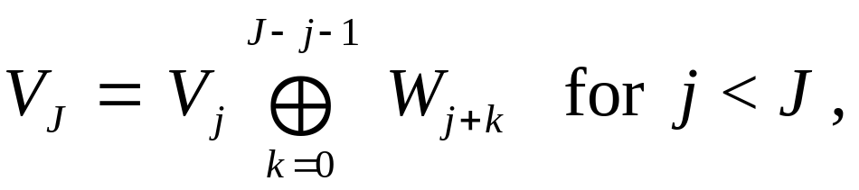
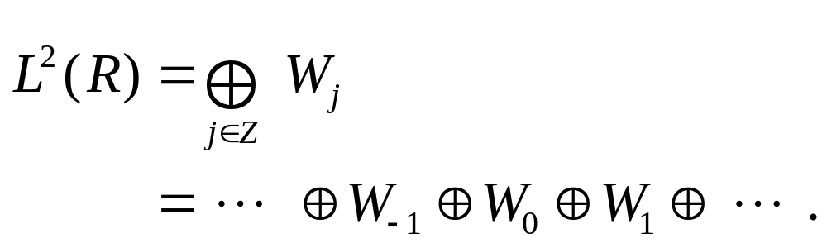
Wavelets
1. In containment property, there exists subspace
which are orthogonal complements of in
that is,
and
2. Since the subspaces are nested, it follows that

Slide 11

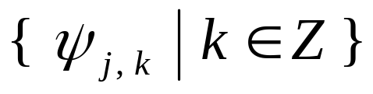

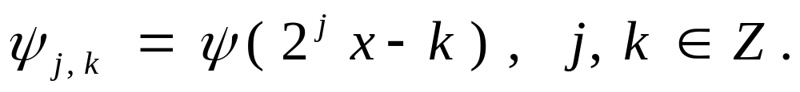
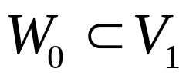
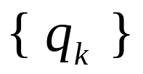
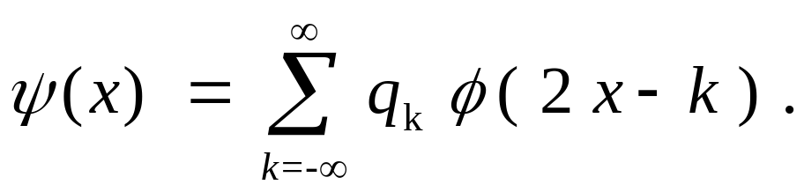
3. Given a scaling function φ in , there exists another function ψ in called the wavelet, such that generates , where
4. Since , there exists a sequence , such that

Slide 12
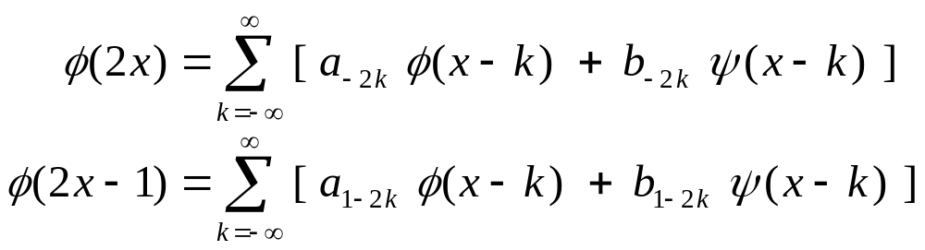
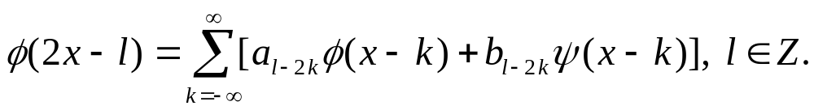
Decomposition and Reconstruction
1. Since
we have
2. The decomposition relation can be generalized as

Slide 13
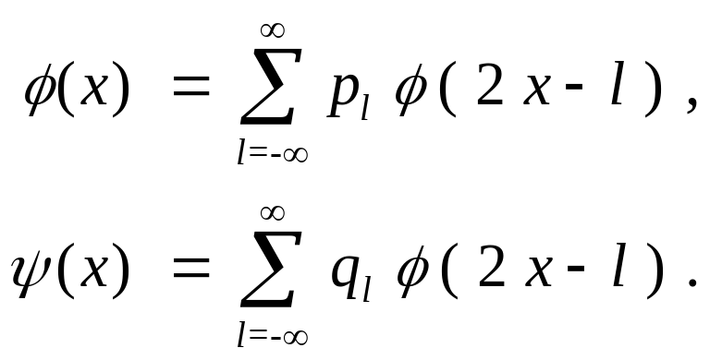

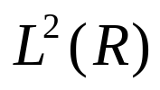


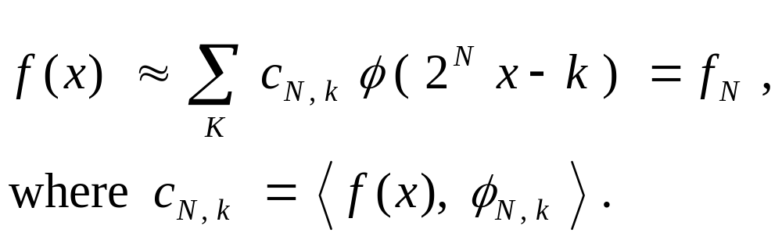
3. The reconstruction relation can be formulated as
4. Given a function in , can be approximately by an for some .

Slide 14
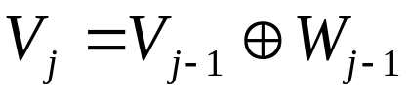

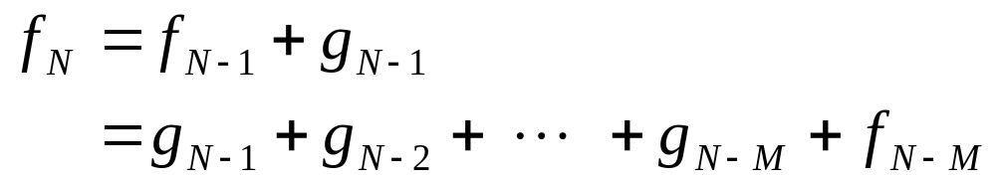
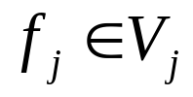
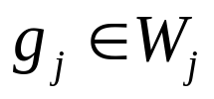





5. Since ,
has a unique wavelet decomposition :
where and for any .
is the sum of its components , ,
and , and recovering is also
from these components.

Slide 15


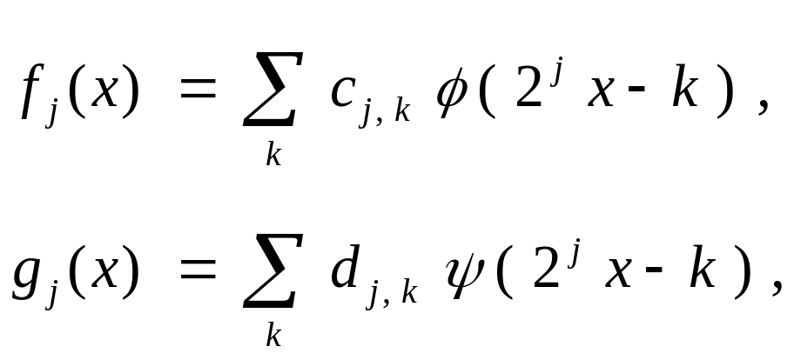
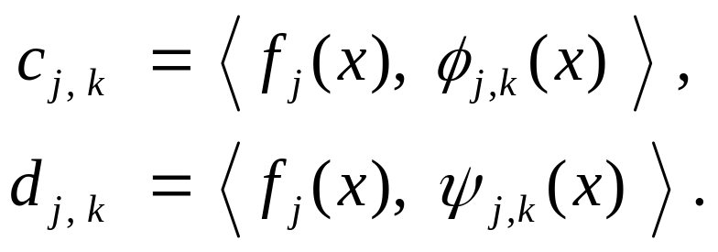
6. To describe decomposition and reconstruction algorithms, and can be represented as follows.
where

Slide 16
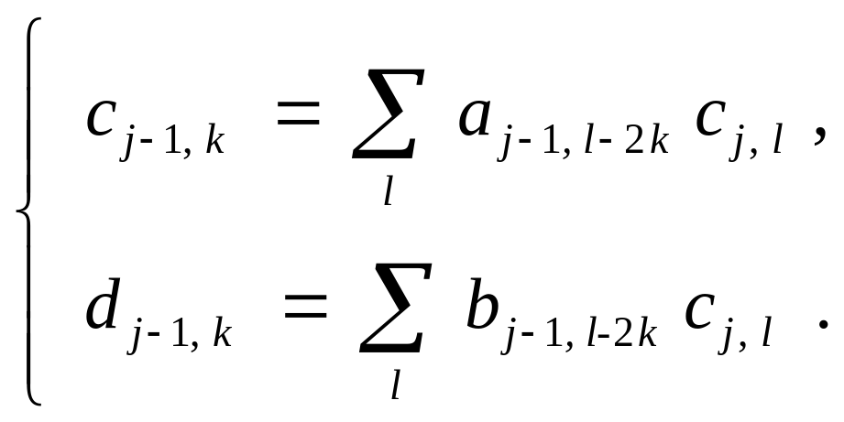
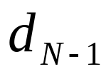
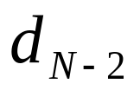
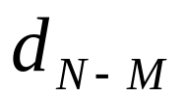

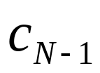
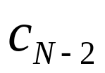
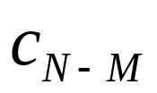
7. Wavelet decomposition algorithm :

Slide 17
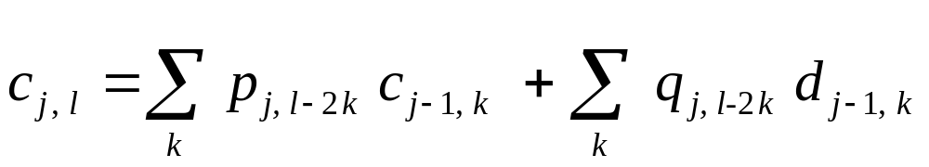
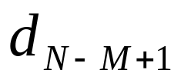
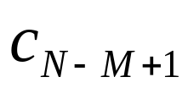
8. Wavelet reconstruction algorithm :

Slide 18
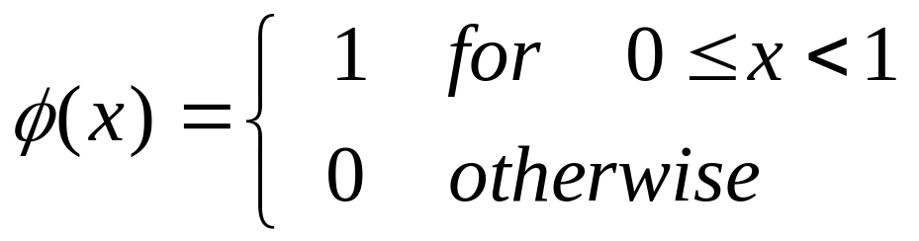
III. A Simple Example : Haar Wavelets
Scaling functions
1. Haar scaling function is defined by
and is shown in Figure 1.
Some examples of its translated and scaled versions are shown in Figures 2-4.

Slide 19
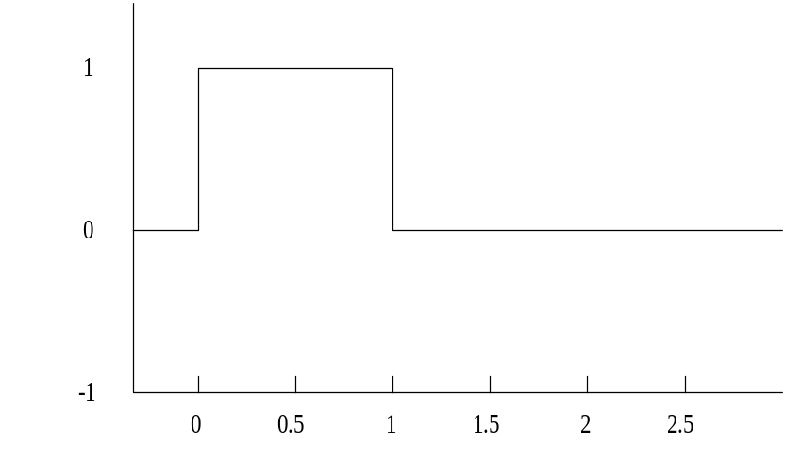
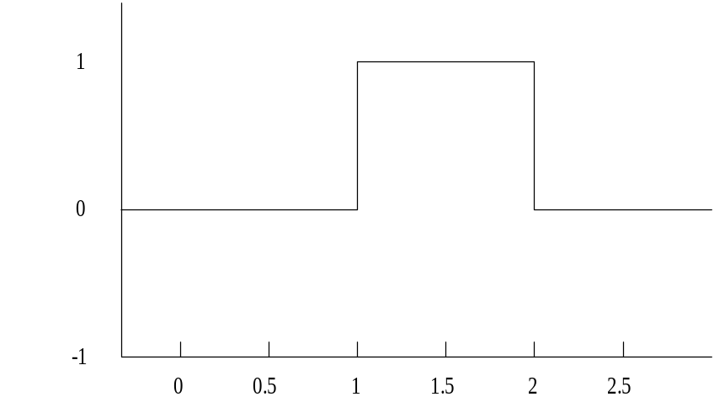
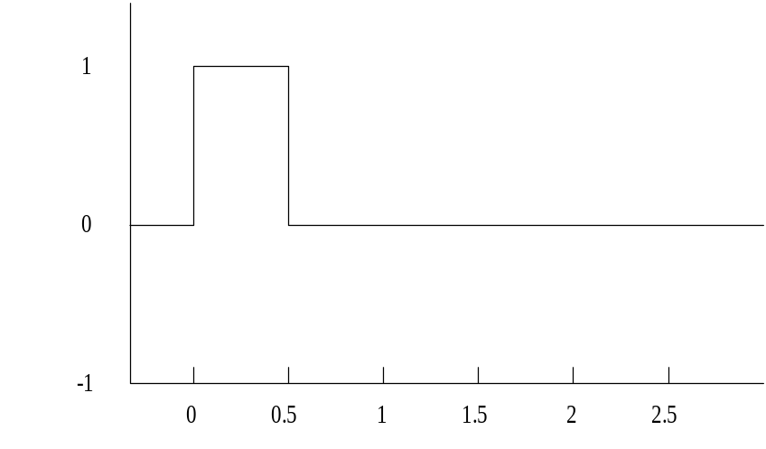

Fig.1: Haar scaling function φ(x).
Fig.2: Haar scaling function φ(x-1).
Fig.3: Haar scaling function φ(2x).
Fig.4: Haar scaling function φ(2x-1).

Slide 20




2. The two-scale relation for Haar scaling function is
Therefore, the two-scale sequence for Haar scaling function have non-zero values
and 0’s for other ’s .

Slide 21


Wavelets
1. The Haar wavelet ψ (x) is given by
and is shown in Figure 5.
2. The two-scale relation for Haar wavelet is

Slide 22

Figure 5: Haar Wavelet ψ (x) .

Slide 23


Decomposition relation
1. Both of the two-scale relation together are called the reconstruction relation.
2. The decomposition relation can be derived as follows.

Slide 24
IV. Subband filtering scheme
ROWS
COLUMNS
Image corresponding
to the low resolution
level m
h
1↓2
h
2↓1
Initial image
corresponding
to the resolution
level m-1
g
1↓2
Detail images corresponding
to the resolution
level m
h
1↓2
g
2↓1
g
1↓2
h
Convolve with low-pass filter
2↓1
Keep one column out of two
g
Convolve with high-pass filter
1↓2
Keep one row out of two
Figure 6: One stage in a multiscale image decomposition.

Slide 25

m 2
m = 2
m = 1
Resolution m=2
Horizontal
orientation
sub-image
Low resolution
sub-image
Resolution m=1
Horizontal
orientation
sub-image
Resolution m=2
Vertical
orientation
sub-image
Resolution m=2
Diagonal
orientation
sub-image
Resolution m=1
Vertical
orientation
sub-image
Resolution m=1
Diagonal
orientation
sub-image
m : resolution level
Figure 7: Image decomposition .

Slide 26


COLUMNS
ROWS
Image corresponding
to the low resolution
level m
1↑2
×2
⊕
2↑1
×2
Reconstructed image
resolution
level m-1
1↑2
×2
Detail images resolution
level m
⊕
1↑2
×2
⊕
2↑1
×2
1↑2
×2
X
Convolve with filter X
1↑2
Put one row of zero between each row
×2
Multiply by 2
2↑1
Put one column of zero between each column
Figure 8: One stage in a multiscale image reconstruction.

