Slide 1

Wavelet Transform
Yuan F. Zheng
Dept. of Electrical Engineering
The Ohio State University
DAGSI Lecture Note

Slide 2
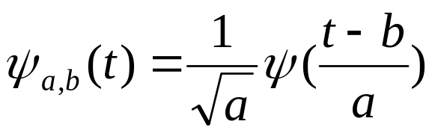
Wavelet Transform (WT)
Wavelet transform decomposes a signal into a set of basis functions.
These basis functions are called wavelets
Wavelets are obtained from a single prototype wavelet ψ(t) called mother wavelet by dilations and shifting:
    (1)
  where a is the scaling parameter and b is the shifting parameter

Slide 3
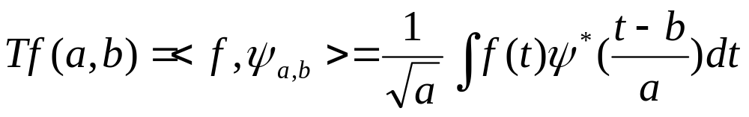
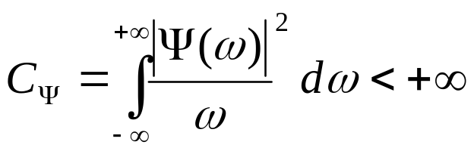
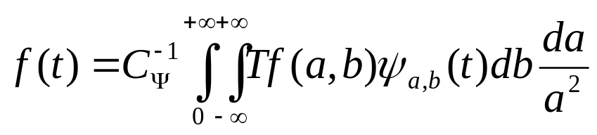
The continuous wavelet transform (CWT) of a function f is defined as
If ψ is such that
f can be reconstructed by an inverse wavelet transform:

Slide 4
Wavelet transform vs. Fourier Transform
The standard Fourier Transform (FT) decomposes the signal into individual frequency components.
The Fourier basis functions are infinite in extent.
FT can never tell when or where a frequency occurs.
Any abrupt changes in time in the input signal f(t) are spread out over the whole frequency axis in the transform output F(ω) and vice versa.
WT uses short window at high frequencies and long window at low frequencies (recall a and b in (1)). It can localize abrupt changes in both time and frequency domains.

Slide 5
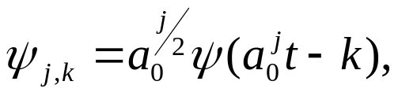



Discrete Wavelet Transform
Discrete wavelets
In reality, we often choose
In the discrete case, the wavelets can be generated from dilation equations, for example,
φ(t) = [h(0)φ(2t) + h(1)φ(2t-1) + h(2)φ(2t-2) + h(3)φ(2t-3)].(2)
Solving equation (2), one may get the so called scaling function φ(t).
Use different sets of parameters h(i)one may get different scaling functions.

Slide 6




Discrete WT Continued
The corresponding wavelet can be generated by the following equation
ψ (t)= [h(3)φ(2t) - h(2)φ(2t-1) + h(1)φ(2t-2) - h(0)φ(2t-3)]. (3)
When and
equation (3) generates the D4 (Daubechies) wavelets.

Slide 7

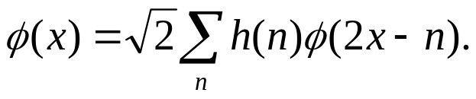
Discrete WT continued
In general, consider h(n) as a low pass filter and g(n) as a high-pass filter where
g is called the mirror filter of h. g and h are called quadrature mirror filters (QMF).
Redefine
  Scaling function

Slide 8
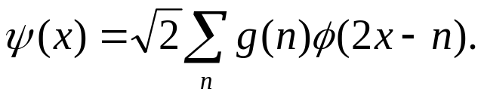
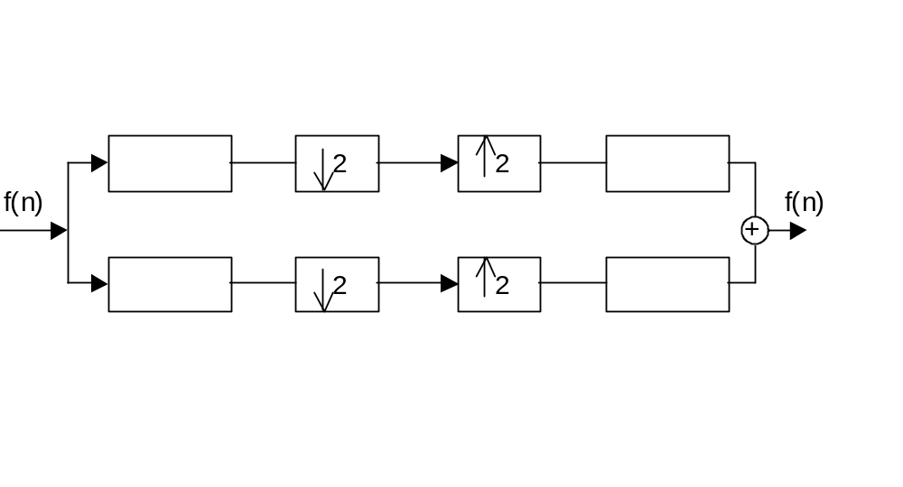






Discrete Formula
  Wavelet function
Decomposition and reconstruction of a signal by the QMF.
where and is down-sampling and is up-sampling

Slide 9








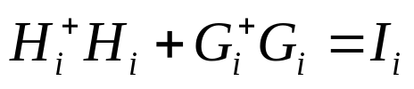






Generalized Definition
Let be matrices, where are positive integers
    is the low-pass filter and is the high-pass filter.
If there are matrices and which satisfy:
where is an identity matrix. G_{i} and H_{i} are called a discrete wavelet pair.
If and
The wavelet pair is said to be orthonormal.

Slide 10







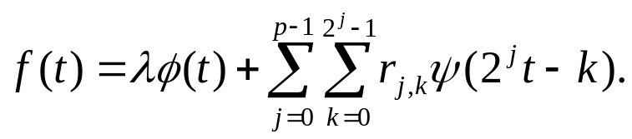
For signal let and
One may have
The above is called the generalized Discrete Wavelet Transform (DWT) up to the scale
        is called the smooth part of the DWT and
        is called the DWT at scale
In terms of equation

Slide 11
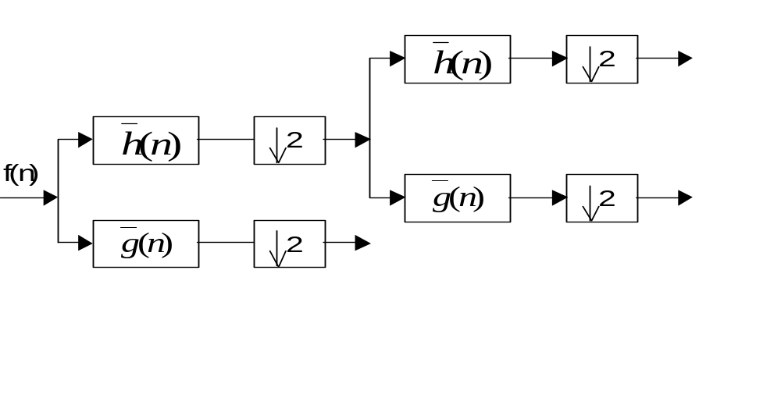

Multilevel Decomposition
A block diagram
2
2

Slide 12
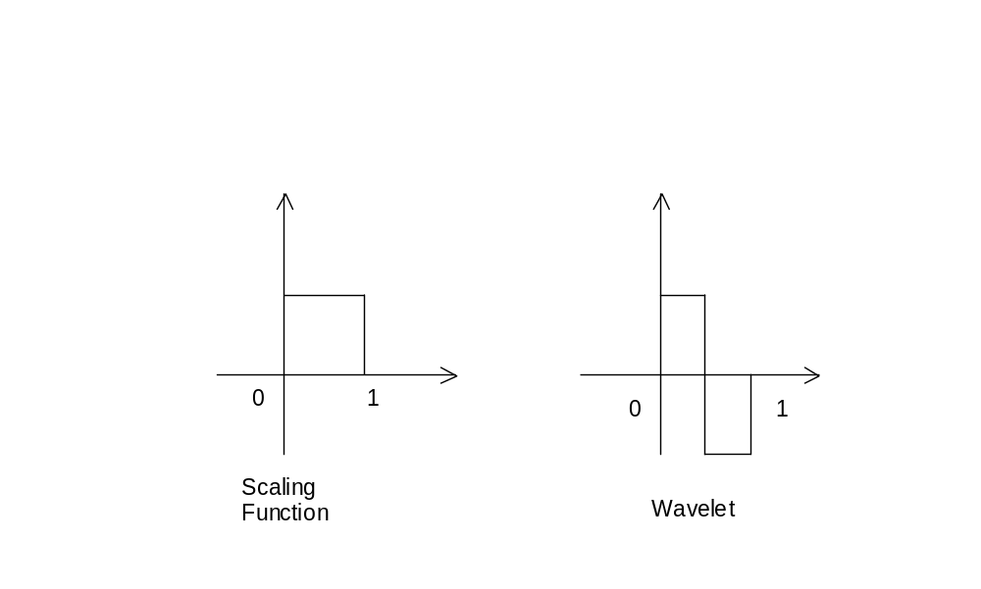
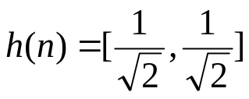
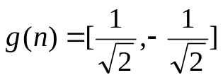
Haar Wavelets
Example: Haar Wavelet

Slide 13
2D Wavelet Transform
We perform the 2-D wavelet transform by applying 1-D wavelet transform first on rows and then on columns.
    Rows Columns
    LL
  f(m, n) LH
      HL
      HH
H
2
H
2
G
2
H
2
G
2
G
2

Slide 14
Integer-Based Wavelets
By using a so-called lifting scheme, integer-based wavelets can be created.
Using the integer-based wavelet, one can simplify the computation.
Integer-based wavelets are also easier to implement by a VLSI chip than non-integer wavelets.

Slide 15
Applications
Signal processing
  Target identification.
  Seismic and geophysical signal processing.
  Medical and biomedical signal and image processing.
Image compression (very good result for high compression ratio).
Video compression (very good result for high compression ratio).
Audio compression (a challenge for high-quality audio).
Signal de-noising.

Slide 16

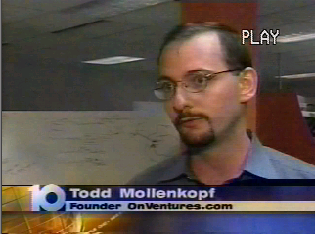


3-D Wavelet Transform for Video Compression
Original Video Sequence
Reconstructed Video Sequence

