Slide 1
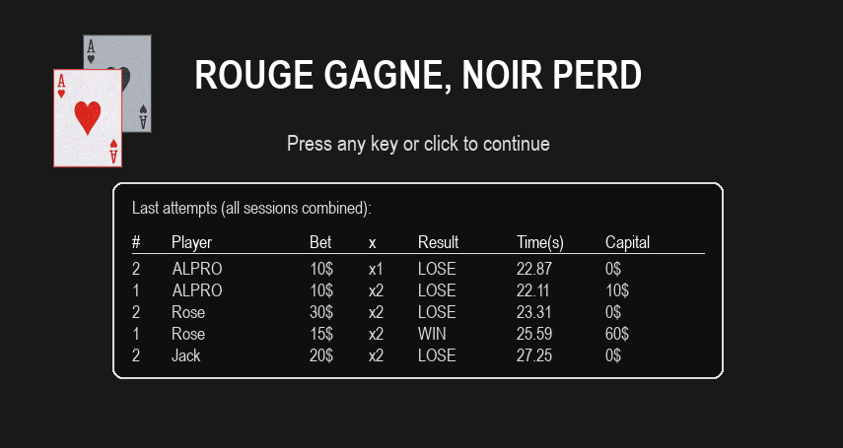


M1 CORO DASSIP
2025-2026
Dec 12, 2025
Prepared by: Sena - Denos

Slide 2
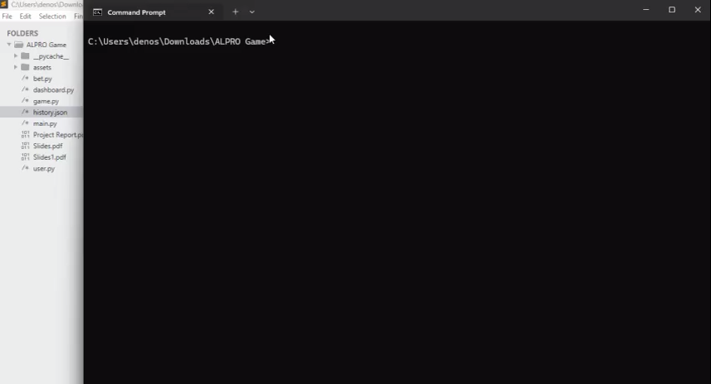

Slide 3
AGENDA
- Project Context & Architecture
- SDLC timeline & Functional Test Cases
- OOP in the project
- Key code snippets
- Sequence diagram (one round)
- Game demo
- Perspectives & Recommendations

Slide 4
PROJECT CONTEXT
What is “Rouge Gagne, Noir Perd”?
“Rouge Gagne, Noir Perd” is an interactive card game where players track a red card among three shuffled cards within a time limit
What the Game Teaches?
Goal: Player bets, chooses a card, system resolves win/loss
Features: Betting logic, state machine, dashboard, history
Tools: Python, Pygame for graphics, JSON for data storage.
Timeline: Planned and delivered between Oct–Dec 2025.
Visual attention: follow the Red card.
Memory: remember its position after fast shuffling.
Decision-making: pick the right card quickly.

Slide 5
MODULES COVERED
Advanced Topics
Object Oriented Design
Basic Python Concepts
Event-driven programming with Pygame
GUI development
Data persistence with JSON
Modular architecture design
Variables
Data types
Control flow
Functions
Libraries
Classes
Objects
Attributes
Methods
Encapsulation

Slide 6
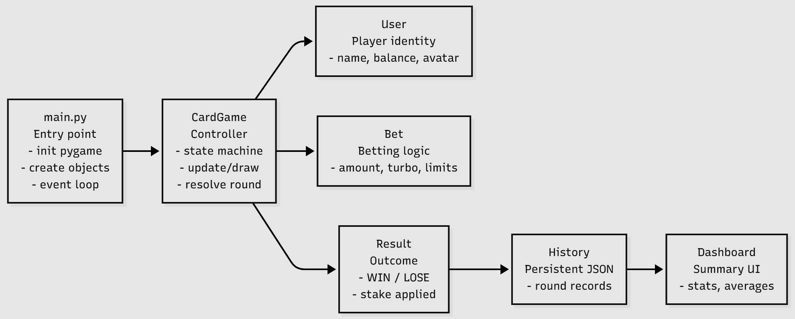
PROJECT ACHITECTURE
PROJECT ARCHITECTURE

Slide 7
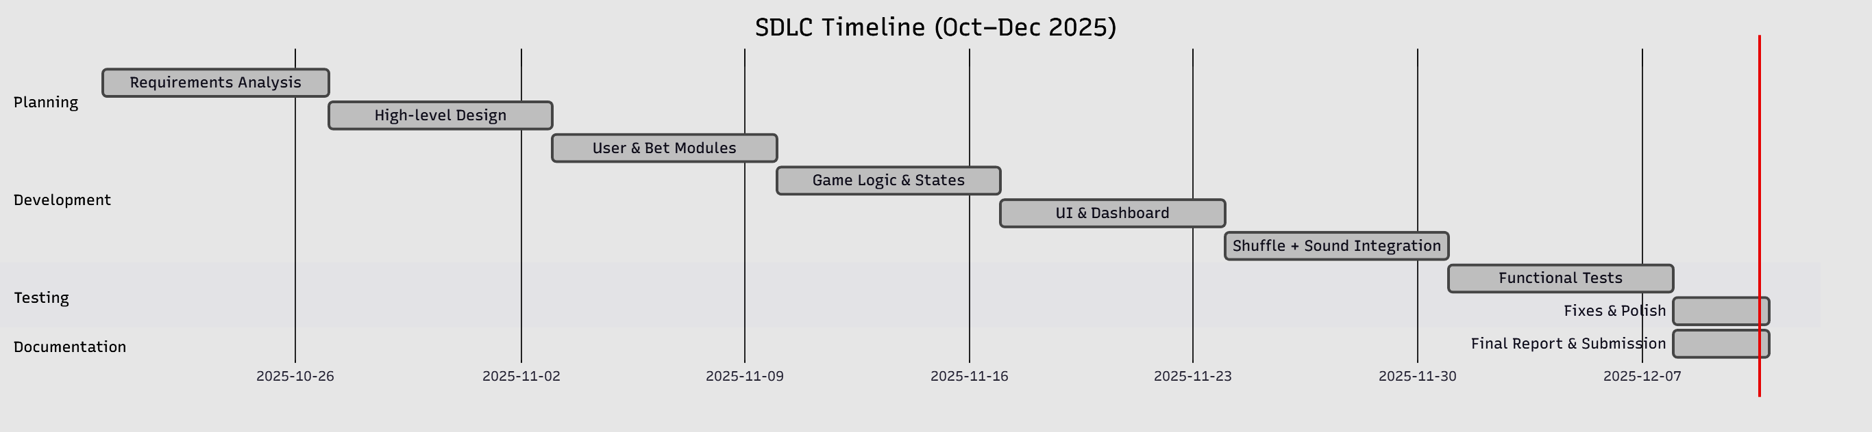

Slide 8
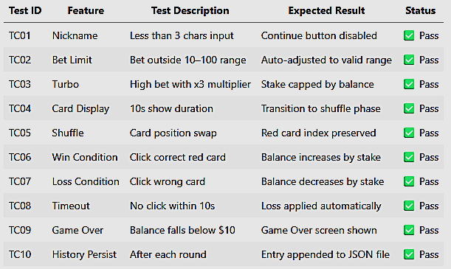
TESTING SUMMARY

Slide 9
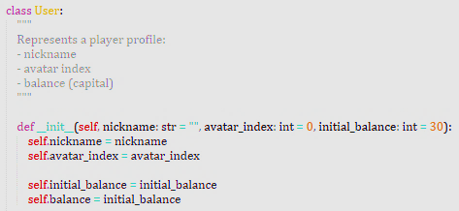
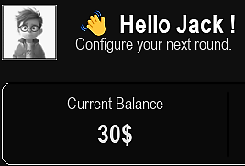
User Class Represents the player’s identity and resources.
Attributes: nickname, avatar_index, initial_balance, balance.
Encapsulation: Keeps player data organized and easy to manage.
Role: Forms the foundation for betting and game logic.
Purpose: Represents the player’s identity and resources.
Attributes: name, balance, initial_balance, avatar_index.
Encapsulation: Keeps player data organized and easy to manage.
Role: Forms the foundation for betting and game logic.

Slide 10
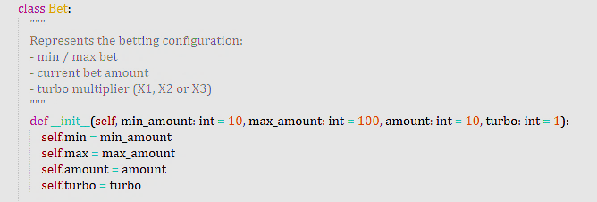
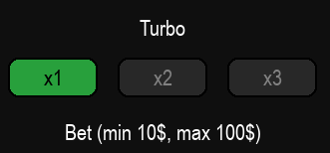
Bet Class Represents the player’s bet in each round.
Attributes: amount(base bet), turbo(X1, X2, X3), (min: 10 - max 100)
Encapsulation: Keeps betting logic separate from player identity
Role: Ensures bets are valid and consistent
Purpose: Represents the player’s bet in each round.
Attributes: amount(base bet), turbo(X1, X2, X3), (min: 10 - max 100)
Encapsulation: Keeps betting logic separate from player identity
Role: Ensures bets are valid and consistent

Slide 11
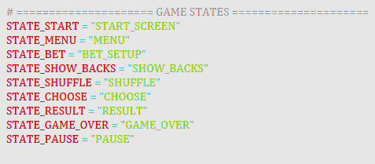
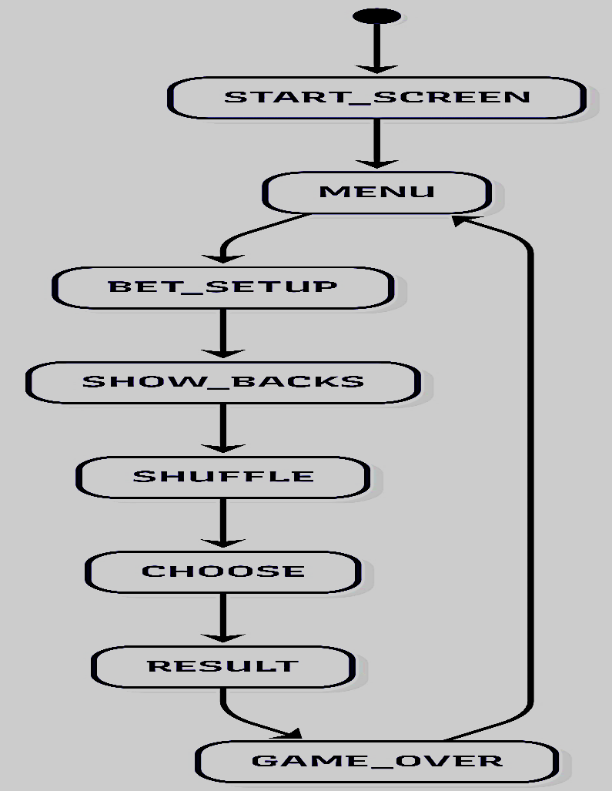

Slide 12
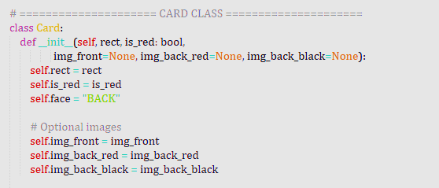
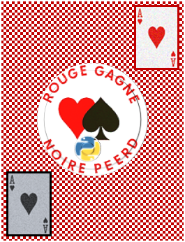


Card Class Represents a single card in the game.
Attributes: rect (position), is_red(true/false), face (“BACK” OR “FRONT”)
Keeps card visuals and logic modular.
Used by CardGame to build the round and resolve outcomes.

Slide 13
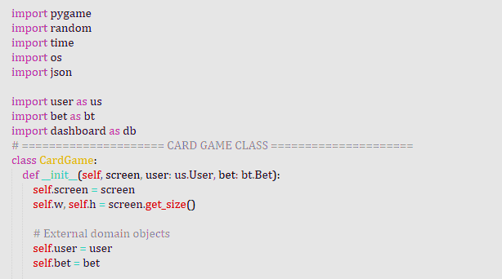
CardGame Class is the central controller that manages game logic, screen rendering,
and state transitions.
Attributes: screen, user, bet and screen dimensions w, h
Encapsulation: Keeps logic modular, extensible, and testable.
Role: Coordinates all gameplay phases and connects external modules.

Slide 14
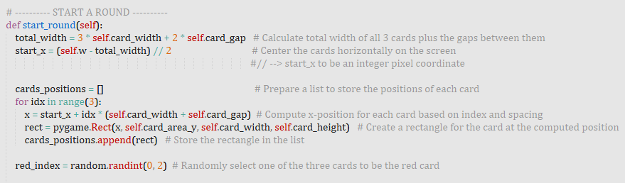
METHOD

Slide 15
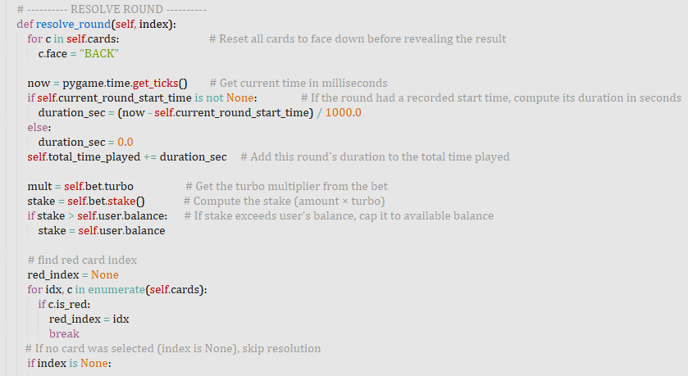
METHOD

Slide 16
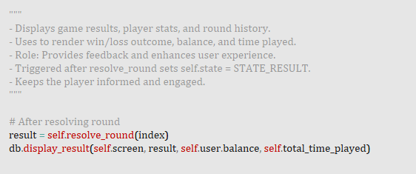
DASHBOARD INTEGRATION

Slide 17
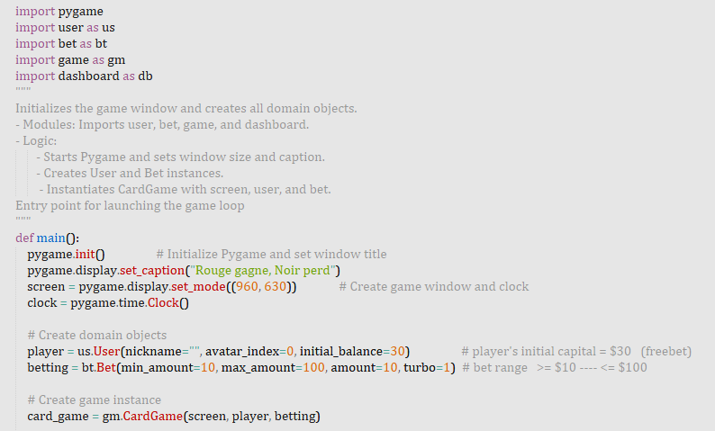
MAIN FUNCTION

Slide 18
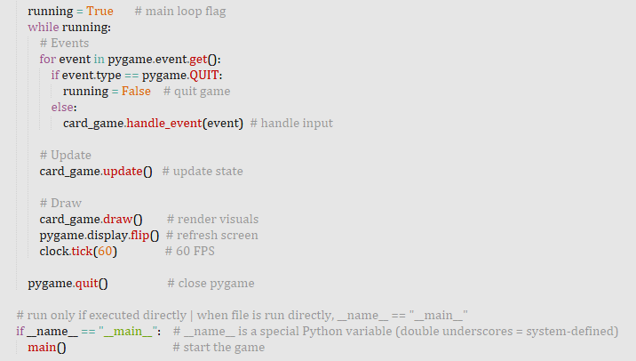
GAME LOOP

Slide 19
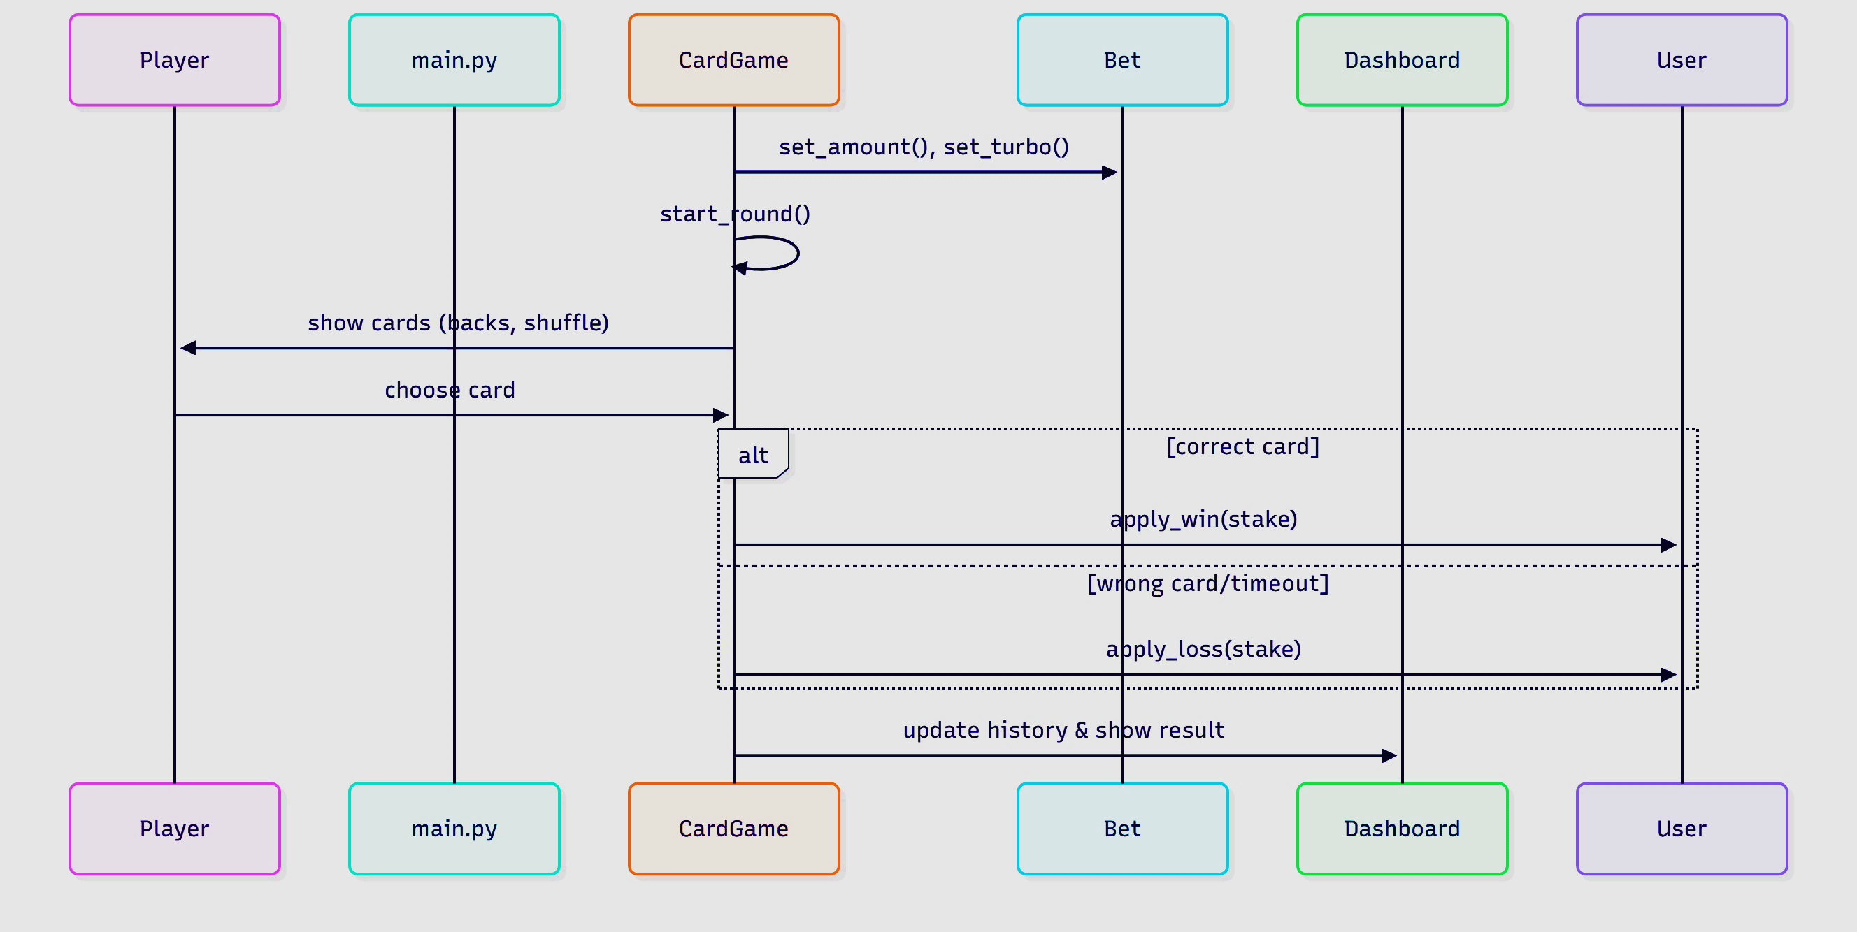
SEQUENCE DIAGRAM (ONE ROUND)

Slide 20
PERSPECTIVES & RECOMMENDATIONS
Built a modular, testable card game with clear state flow
Applied OOP and functional testing successfully
Achieved smooth gameplay and responsive user experience
Add animations for better feedback
Expand dashboard with more stats
Explore multiplayer and mobile adaptation
References
  Python Software Foundation, Python Documentation, https://docs.python.org
  Pygame Community, Pygame Documentation, https://www.pygame.org/docs
  ALPRO Course Material, 2025.

