Slide 1


Course Selection 2022
HTHS
Objectives:
Course Selection
Graduation Information
FAQ
Graduation:
Grade 9 Audience
Graduating in 2025

Slide 2
Grade 10 Requirements
HTHS
Requirements:
Basic Courses:
English 10 – Full Year
Math 10 – Geometry, measures and finance (FI GMF)
One choice of Numbers Relations and Functions (FI NRF) OR Financial Workplace Math (FI FINWPL)
Science 10 (FI Science 10)
French 10 (FI Language Arts 10)
Social Studies 10 (FI Social Studies 10)
Plus Two Specialties:
PDCP 10
Music 10

Slide 3
Graduation Requirements
HTHS
Note: In grade 9 you do not get credits. You are getting pre-requisites.
Graduation Requirements:
Until You Graduate:
Successful completion of the English Language Proficiency Assessment.
Grade 10 : Numbers, Relations and Functions or Financial Workplace Math
Grade 11:
English 11 (2 Credits)
Financial Workplace Math 120 or Foundations of Mathematics 11 (1 Credit)
Science (1 Credit)
Modern History 11 (1 Credit)
Fine Arts/Life Role Development Cluster (1 Credit)
Grade 12:
English 12 (1 Credit)
Four other courses at the grade 12 level
Attention: You must have 18 credits to graduate from a NB high school!

Slide 4
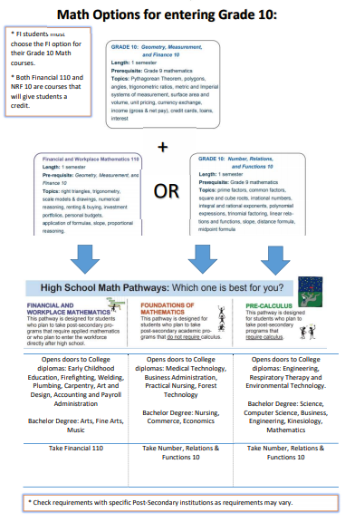
Math Pathways

Slide 5
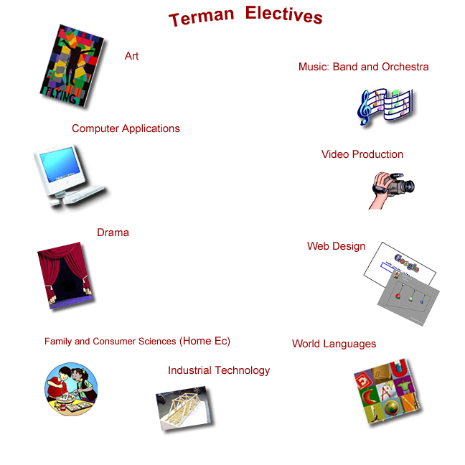
Grade 11 Electives
HTHS
Elective Information:
All grade ten students have an option to take a grade eleven elective from the prescribed list of Harrison Trimble approved course.
For options please see next slide.
Attention: You need to have passed all grade 9 classes for electives!

Slide 6
Electives
HTHS
Computer Science 110***
**Culinary Tech 110
Early Childhood Services 110
**Fashion Tech 110
Hospitality & Tourism 110
** Intro to Applied Tech 110 (Pre-req for Trades courses)
Tech Support & Cyber Security 110***
**Visual Art 110
Phys Ed through Team Sports 110
FI Biology 112 and Biology 112

Slide 7
High School Videos
HTHS Course Guide (harrisontrimble.ca)

Slide 8
Course Selection Process
HTHS
March 31st: Grade level presentations in the theatre.
April 5th: Assembly day schedule, make choices in HR
April 6th: Assembly day schedule Students log in to their own Power School to input their course selections.
April 7th: Homeroom schedule: Verification sheets given to students
Verification Sheets must be returned with a parental signature.
Make your choices wisely as these cannot be easily changed.
Notes:
Show form in Excel

