Slide 1


Course Selection 2022
Grade 10 & 11 audience
Graduation requirements
Preparation for Post secondary
My Blueprint

Slide 2

After High School?
Apprenticeship
Military
Direct to Work
Post secondary
Universities
NBCC
Private Colleges

Slide 3





Preparation for University
It is imperative to check with the universities of your choice.
A general guideline would be to have a minimum of five “university-approved” credits for Maritime universities. UNB requires six and a minimum of six for Ontario universities.
It is an excellent idea to have at least one more acceptable credit than the minimum required.

Slide 4




Preparation for college
It is important to recognize that some colleges have very early admission dates.
NBCC admissions is on a first come, first serve basis and begins in April of your grade eleven year for students. (Example: If you want to attend NBCC in September 2023, you should apply this April)

Slide 5
Graduation Requirements (2023)
Successful completion of the 9/10 Program
Successful completion of the English Language Proficiency Assessment
Compulsory Courses : You must have the following 8 compulsory credits:
Grade 11 level
English 11 (2 credits)
Financial and Workplace Mathematics 11 or Foundations of Mathematics 11 (1 credit)
Science (1 credit)
Modern History 11 (1 credit)
Fine Arts/Life Role Development cluster (1 credit)
Grade 12 level
English 12 (1 credit)
Additional credit
In Math (1 credit)
You must also have:
4 other courses at the grade ’12’ level
Plus 6 other courses at the 11 or 12 level
You must have a minimum of 18 credits to graduate

Slide 6

Graduation requirement:
English Language Arts
English 11 (2 credits)
111
112
113
English 12
121
122
123

Slide 7

Graduation requirement: Modern History
Modern History
112
113
FI Modern History 112

Slide 8

Graduation requirement:
Math
You NEED one grade eleven level math to be eligible to graduate (FWP or Foundations)
For 2023 grads and beyond, you must pass one other Math Credit (NRF10, Financial 120).
If you are a student who is inclined to do trades or wants to directly enter the workplace, you should do:
Financial and Workplace Mathematics 11
If you are a student who is inclined to go to university and does well in math:
Foundations of Mathematics 11

Slide 9

Graduation requirement: Science
If you are a student who does well in science and math:
Biology 112
FI Biology 112
Chemistry 112
Physics 112
*Very few post-secondary programs require all 3 sciences
If you are a student who finds math challenging :
Human Physiology 110
Environmental Science 120
Automotive Electrical Systems 120

Slide 10
Graduation requirement: Fine Arts/Life role development
Must have at least one of these credits
Entrepreneurship 110 (FI Entrepreneurship 110)
Graphic Art & Design 110
Individual & Family Dynamics 120 (FI Ind & Fam Dynamics 120)
Music 112/122
Outdoor Pursuits/Education 110
Phys Ed Leadership 120
Theatre/Dramatic Arts 120
Wellness through Physical Education 110
Visual Arts 110/120
Any Trades course (Residential Finishing, Electrical Wiring, Framing and Sheathing, Metals Fab, Mill and Cabinet, IC Engines, Intro to Applied Tech)
Culinary Technology 110, 120
Career Explorations 110
Growth, Goals and Grit 120
Co-op 120 (only available in grade 12 year)

Slide 11

Certificates:
French Immersion
50% of the course load in grade 9 and 10 must be FI designated (e.g. FI Science)
A minimum of 5 courses with an FI designation in grades 11 and 12 must be taken (e.g., FI Modern History 112)

Slide 12
Certificates:
Focus on Technology (FIT) Certificate
Information Technology 120
Business Organization and Management 120
One other elective course:
Entrepreneurship 110
Cybersecurity and Tech Support 110
Computer Science 110
Digital Productions 120

Slide 13
Courses that require an application
Cooperative Education 120
FI Cooperative Education 120
IDEA Center
Career Exploration 110
Human Services 110
Personal Interest Course

Slide 14

Online Courses
There are several courses offered by the New Brunswick Virtual Learning Centre that are not offered in person at HTHS.
If you are interested in an online course, please see your school counsellor in the Fall.
Some offerings include:
FSL Techniques de communication orale 120
FSL Writing 110
Introductory Mi’kmaw 110
Intermediate Mi’kmaw 110
Introductory Wolastoqey 110
Intermediate Wolastoqey 110
FSL Law 120
Creative Arts 110

Slide 15
Notes
For graduation purposes, only 2 of your credits can be local option courses.
These courses are identified on our course selection sheet by (LO)
They are:
Psychology 120
Marketing 120
Advanced Computer Science 120
Advanced Training Principles 120
Phys Ed Through Team Sports 110

Slide 16
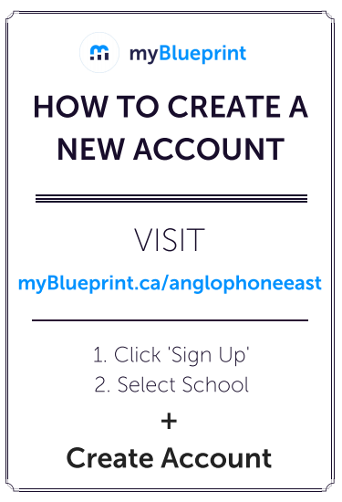
My Blueprint

Slide 17
Course Selection Process
March 31st: Grade level presentations in the theatre.
April 5th: Assembly day schedule, make choices in HR
April 6th: Assembly day schedule Students log in to their own Power School to input their course selections.
April 7th: Homeroom schedule to give out verification sheets for parental signature.
April 8th: Homeroom schedule to collect verification.
Make your choices wisely as these cannot be easily changed.

Slide 18

Course Selection Process
Although we do our best to accommodate everyone’s choices, sometimes it is not possible.
We offer courses based on interest, e.g., if only 20 students sign up for a course, we will only offer one section of that course.
Do not assume that you can change all of your courses, it may not be possible in September.

Slide 19

Thank you for your attention
Mrs. Babineau-Hall, Mrs. MacCormack, and Mrs. Ross can help with questions. Reach out to us via Teams chat or email for a quicker response.
Guidance office will be open during noon hour to help you with your choices.
All forms are due next week.

