Slide 1

Music Sharing App
Dennis Qiu
Jeremy Thomas
Jacob Hill

Slide 2
Project Description
Essentially a music storing web application.
It can be used to store and share song information with others using the app.
Users can conveniently access song information by searching through specific criteria.

Slide 3
Functionality
Flask Front-End
Allows users to create/login to an account
Initial Startup: Allows users to search for a song within a certain criteria in our database of songs.
Allows users to upload song information including the song's Name, Artist, Genre, and Description.
Each time a song is "played" the number of plays is incremented by 1.
You can also close the database connection from the UI

Slide 4
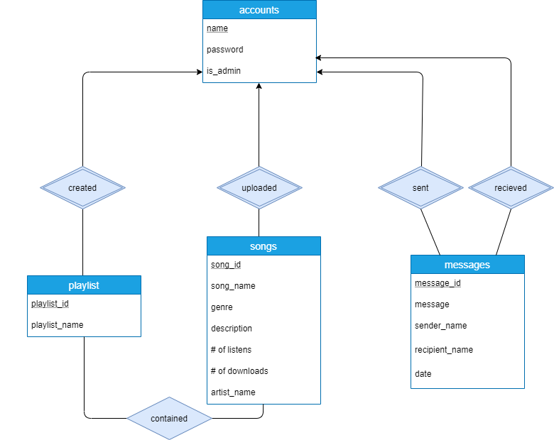
ER Diagram

Slide 5
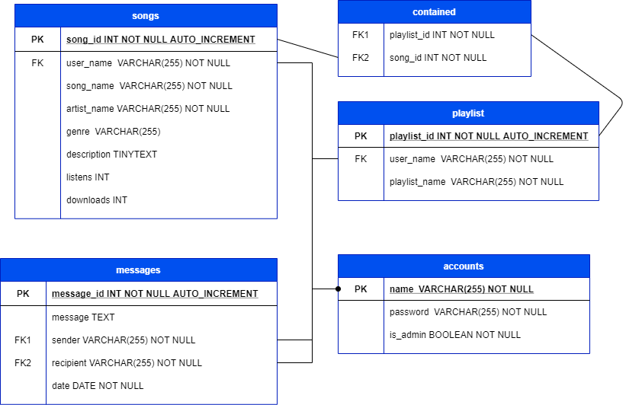
Tables

Slide 6
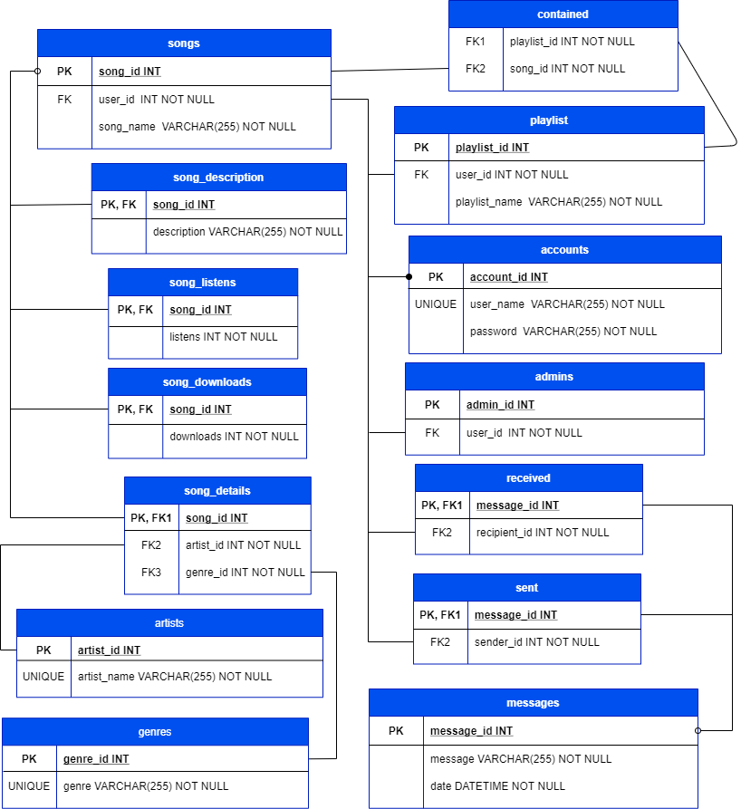
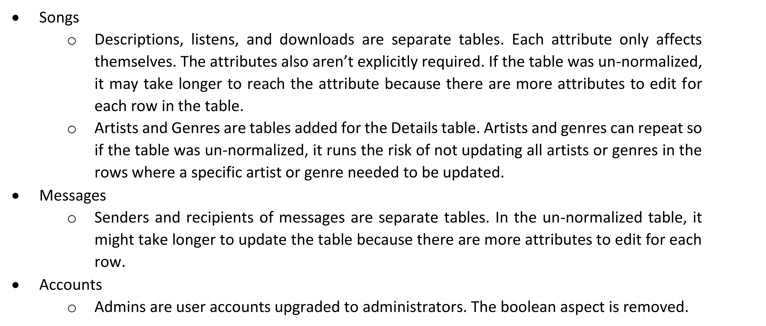
Normalized Tables
Songs
Descriptions, listens, and downloads are separate tables. Each attribute only affects themselves. The attributes also aren’t explicitly required.
Artists and Genres are tables added for the Details table. Artists and genres can repeat so if the table was un-normalized, it runs the risk of not updating all artists or genres in the rows where a specific artist or genre needed to be updated.

Slide 7
Demo

Slide 8
Lessons
Improved our understanding of "full-stack" web development (Flask + MySQL)
Greater understanding of Flask framework
Visualization of Data through the ER Model
Maximizing the efficiency of the backend before implementing a front-end

