Slide 1
CSC 231: Introduction to Data Structures
Jack Tompkins

Slide 2
Algorithm Analysis
Why?
Big O
Growth rate of functions
Analyzing the big-O of code

Slide 3
Is This Algorithm Fast?
Problem: given a problem, how fast does this code solve that problem?
"My program finds all the primes between 2 and 10,000,000 in 4 seconds on a slow computer."
How good is this solution?
Could try to measure the time it takes, but that is subject to lots of errors
multitasking operating system
speed of computer
language solution is written in

Slide 4
Analysis of Algorithms
What do we mean by an “efficient” algorithm?
We mean an algorithm that uses few resources.
By far the most important resource is time.
Thus, when we say an algorithm is efficient (assuming we do not qualify this further), we mean that it can be executed quickly.

Slide 5
Is there some way to measure efficiency that does not depend on the state of current technology?
Yes!
The Idea
Determine the number of “steps” an algorithm requires when given some input.
We need to define “step” in some reasonable way.
Write this as a formula, based on the input.

Slide 6
Generally, when we determine the efficiency of an algorithm, we are interested in:
Time Used by the Algorithm
Expressed in terms of number of steps.
People also talk about “space efficiency”, etc.
How the Size of the Input Affects Running Time
Think about giving an algorithm a list of items to operate on. The size of the problem is the length of the list.
Worst-Case Behavior
What is the slowest the algorithm ever runs for a given input size?
Occasionally we also analyze average-case behavior.

Slide 7
Relative rates of growth
Most algorithms' runtime can be expressed as a function of the input size N
Rate of growth: measure of how quickly the graph of a function rises
Goal: distinguish between fast- and slow-growing functions
We only care about very large input sizes (for small sizes, most any algorithm is fast enough)
Notes:
Motivation:
we usually care only about algorithm performance when there are large number of inputs.
We usually don’t care about small changes in run-time performance. (inaccuracy of estimates
make small changes less relevant). Consider algorithms with slow growth rate better than
those with fast growth rates.

Slide 8
Big O
Definition: T(N) = O(f(N)) if there exist positive constants c , n₀ such that: T(N) ≤ c · f(N) for all N ≥ n₀
Idea: We are concerned with how the function grows when N is large. We are not picky about constant factors: coarse distinctions among functions
Lingo: "T(N) grows no faster than f(N)."

Slide 9
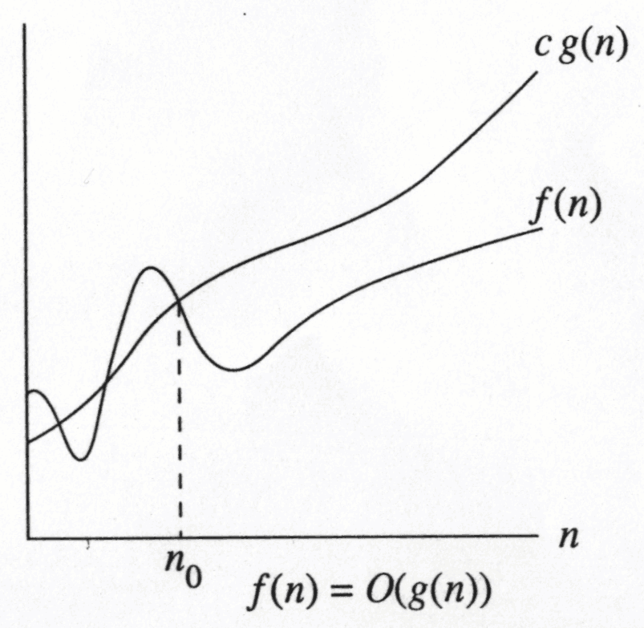
Big O
∃ c ᵋ R, n₀ > 0 such that f(N) ≤ c g(N) when N ≥ n₀
f(N) grows no faster than g(N) for “large” N

Slide 10
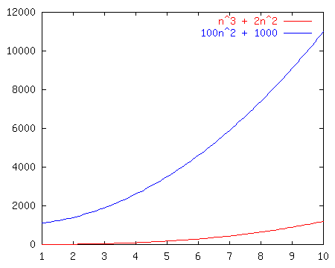
Growth rate example
Consider these graphs of functions.
Perhaps each one represents an algorithm:
n³ + 2n²
100n² + 1000
Which grows faster?

Slide 11
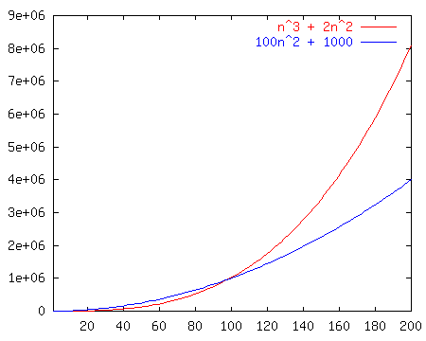
Growth rate example
How about now?

Slide 12
Preferred big-O usage
pick tightest bound. If f(N) = 5N, then:
f(N) = O(N⁵)
f(N) = O(N³)
f(N) = O(N log N)
f(N) = O(N) ← preferred
ignore constant factors and low order terms
T(N) = O(N), not T(N) = O(5N)
T(N) = O(N³), not T(N) = O(N³ + N² + N log N)

Slide 13
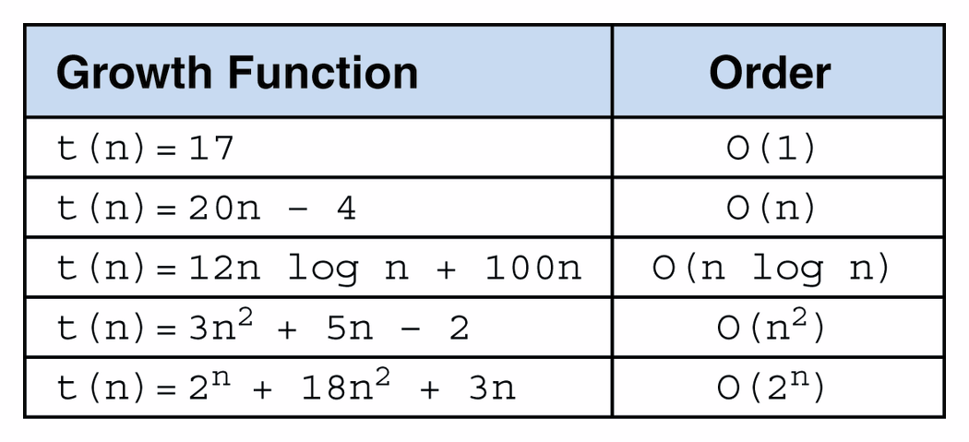
Big-O of selected functions

Slide 14
An O(1) algorithm is constant time.
The running time of such an algorithm is essentially independent of the input.
Such algorithms are rare, since they cannot even read all of their input.
An O(log_{b}n) [for some b] algorithm is logarithmic time.
We do not care what b is.
An O(n) algorithm is linear time.
Such algorithms are not rare.
This is as fast as an algorithm can be and still read all of its input.
An O(n log_{b}n) [for some b] algorithm is log-linear time.
This is about as slow as an algorithm can be and still be truly useful (scalable).
An O(n²) algorithm is quadratic time.
These are usually too slow.
An O(b^{n}) [for some b] algorithm is exponential time.
These algorithms are much too slow to be useful.

Slide 15
Facts about big-O
If T(N) is a polynomial of degree k, then: T(N) = O(N^{k})
example: 17n³ + 2n² + 4n + 1 = O(n³)

Slide 16
Hierarchy of Big-O
Functions, ranked in increasing order of growth:
1
log log n
log n
n
n log n
n²
n² log n
n³
...
2^{n}
n!
n^{n}

Slide 17
Various growth rates

Slide 18
Program loop runtimes
Suppose we have a list, myList, with n elemenst:
for x in myList: // O(n)
statement(s)
The loop runtime grows linearly when compared to its maximum value n.

Slide 19
Program loop runtimes
counter = 0
while counter < n:
statement(s)
counter += 1
What’s the big-O?

Slide 20
Program loop runtimes
counter = 0
while counter < n:
statement(s)
counter += 2
What’s the big-O?

Slide 21
Program loop runtimes
counter = 0
while counter < n*n:
statement(s)
counter += 1
What’s the big-O?

Slide 22
Program loop runtimes
Suppose we have a list, myList, with n elements:
for x in myList:
for y in myList:
statement(s)
Nesting loops multiplies their runtimes.
The outer loop is O(n). The inner loop is O(n). Multiply.
The total big-O is O(n²).

Slide 23
Program loop runtimes
counter = 0
while counter < n:
counter2 = 0
while counter2 < n:
counter3 = 0
while counter3 < n:
statements
counter3 += 1
counter2 += 1
counter += 1
What’s the big-O?

Slide 24
Python Review Exercises
Create a new Python file called Student.
Make the class definition.
Student has four instance variables, firstName, lastName, gpa (defaults to 0.0), and middleName (defaults to ‘’ making it optional).
Define the constructor.
Re-define __str__ ‘last, first middle gpa: d.dd’

Slide 25
Using the class Student
In another file, call it, Roster, create a few students and print them out.
Remember to import Student
Here is a file containing a list of students in the format
<last name><SPACE><first name><SPACE><gpa>
roster.txt
Write code to read in that file, creating each Student object, and put them in a list
Iterate through the list, printing out each student

Slide 26
Now let’s make another program
Call it TestNumbers
Set a variable, n, to be 100.
Using a loop, create a list that has n random integers in it (all between 0 and 2*n).
Write a method called find(list, x). The first argument will be a list, the second argument is an element that might be in a list.
find(list,x) should return true if x is in the list; false otherwise. Do not use the built-in list methods to see if x is in there. Just iterate to find it (or not).
Time how long it takes to find some random number (between 0 and 2*n but not in the list) in the list.
“start = time.clock()” “end = time.clock()”. The total time is end – start.
Write out (on one line), the value of n, a comma, and the total time to the file data.csv
Now the fun part:
Take all of the code (not including the method find) and put it inside a loop that varies n from 50000 to 1000000, step 50000.
“for n in range(50000, 1000000, 50000):”

Slide 27
Graphing data
We could graph within Python
But let’s make our life easy:
Use Excel
Open data.csv in Excel by double clicking the file
Select the two columns. Choose Scatter Plot.
Plot it!
Does it look linear?

