Slide 1
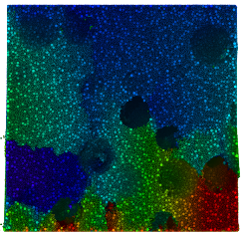
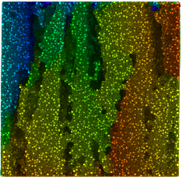
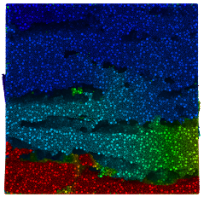
100
Isotropic Anisotropic parallel Anisotropic transverse
80
Axial Stress (MPa)
60
40
20
0
0
0.2
0.4 0.6
Axial Strain (%)
0.8
1

