Slide 1
AARAE
Audio and Acoustical Response Analysis Environment for Matlab
Notes for Internal Launch 6 Dec 2013

Slide 2
What is AARAE?
Matlab-based
GUI-driven (but also command line)
Easy extensibility
Reasonably intuitive
Teaching and research resource

Slide 3
What can AARAE be used for?
Measuring impulse responses, background noise, calibration tones
Processing audio for analysis
Visual and auditory display
Deriving parameters
Synthesizing audio for analysis
Promoting your research

Slide 4
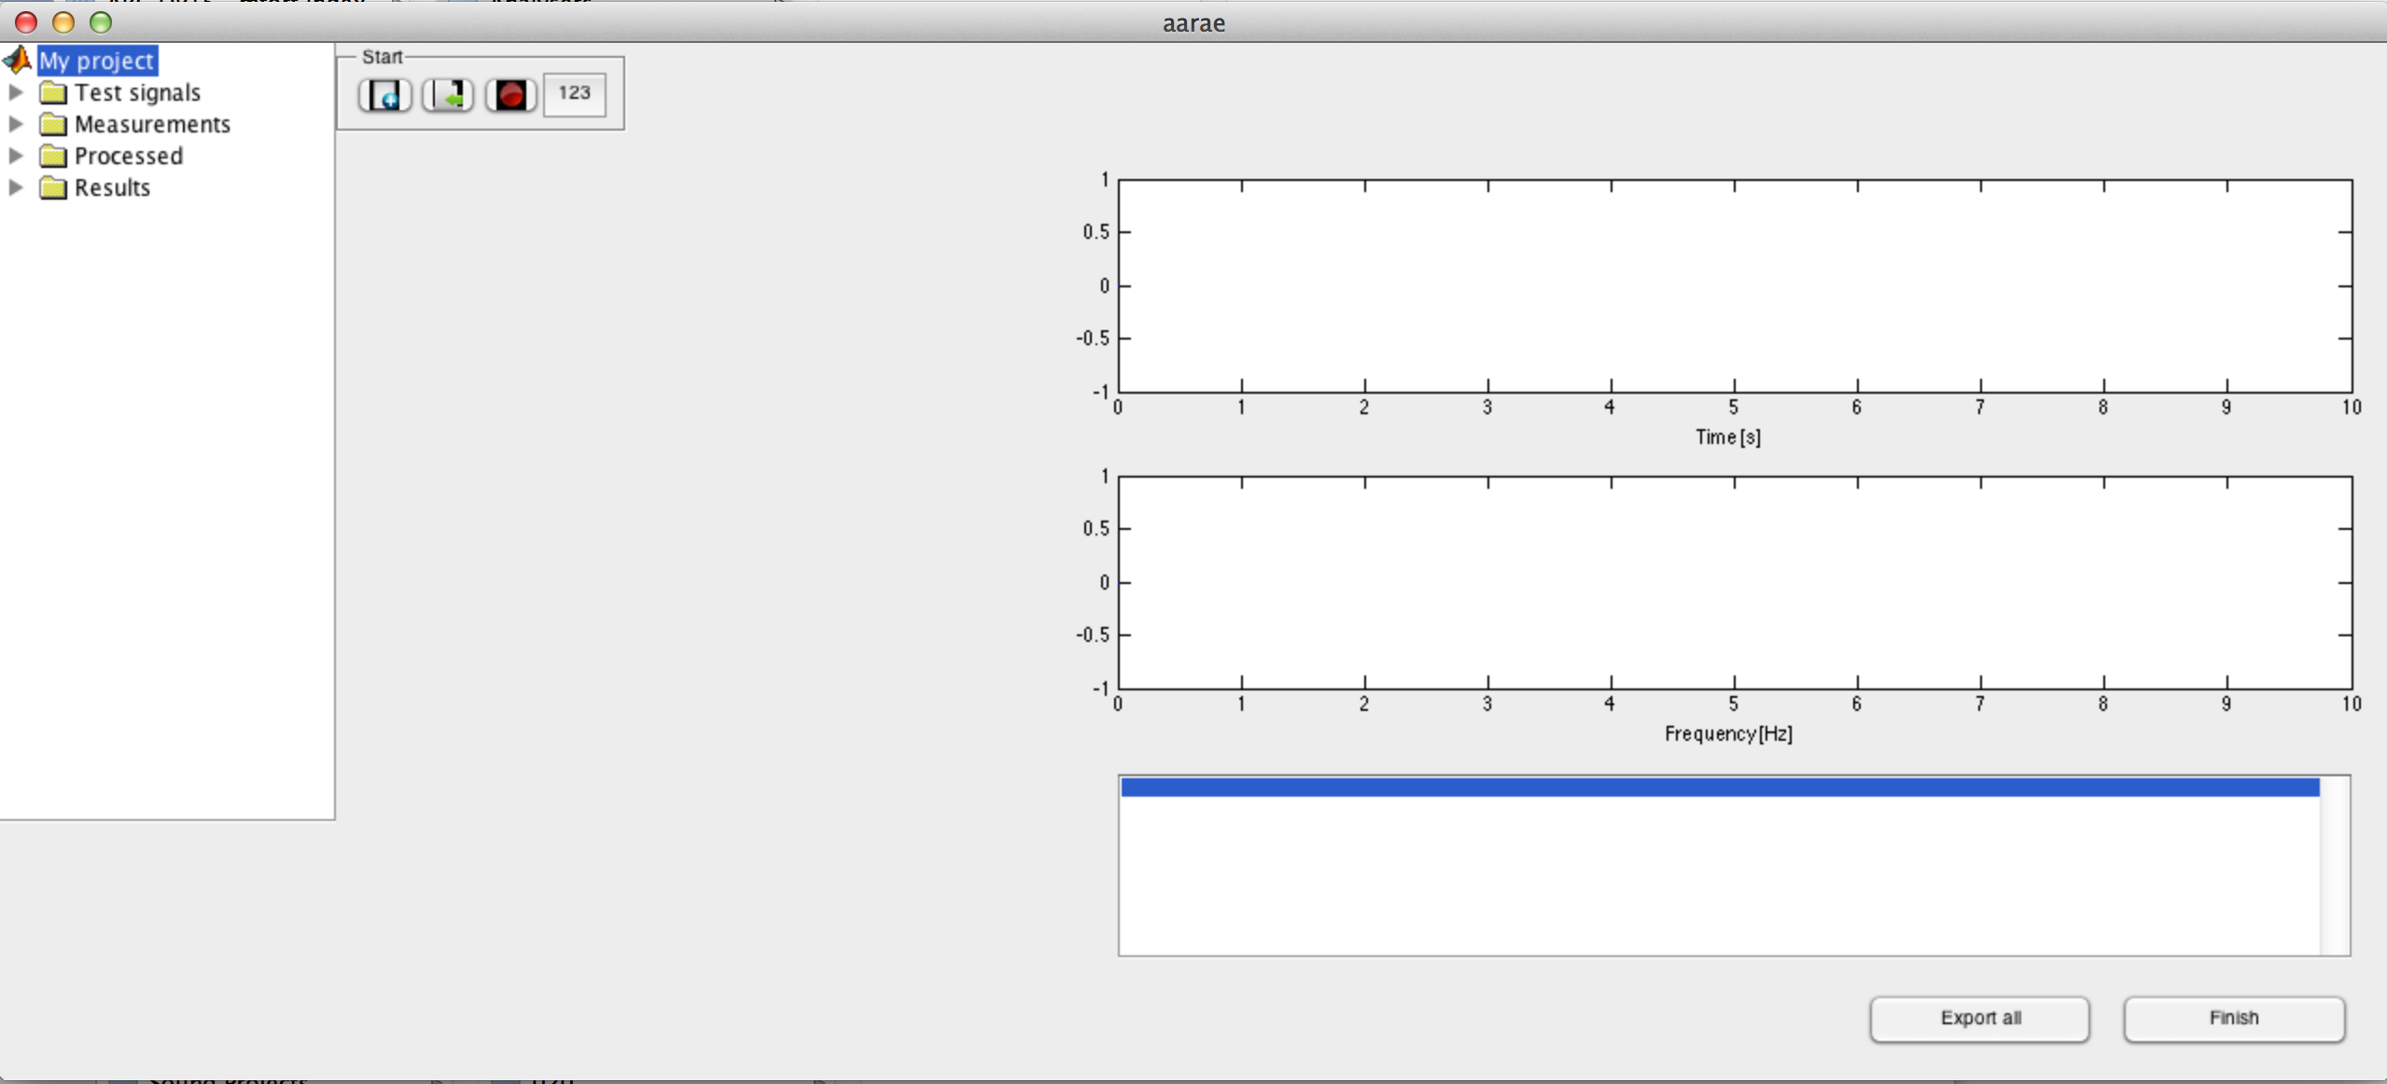
AARAE GUI – initial state
START HERE
To acquire audio data, you can:
Generate a test signal;
Import audio from wav or mat files
Record audio
Use a ‘calculator’ that generates an audio result

Slide 5
Extensible components to AARAE
Calculators: miscellaneous output
Generators: audio out
Processors: audio in; audio out
Analysers: audio in; output charts, tables & data structures (can be saved as mat)

Slide 6
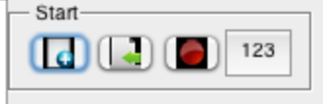
Calculators
Calculators are the miscellaneous category of extensible AARAE function.
Only a small collection of calculators exists at present: two reverberant impulse response calculators, and a dissipation calculator
All three of these generate audio, but calculators do not necessarily generate audio

Slide 7
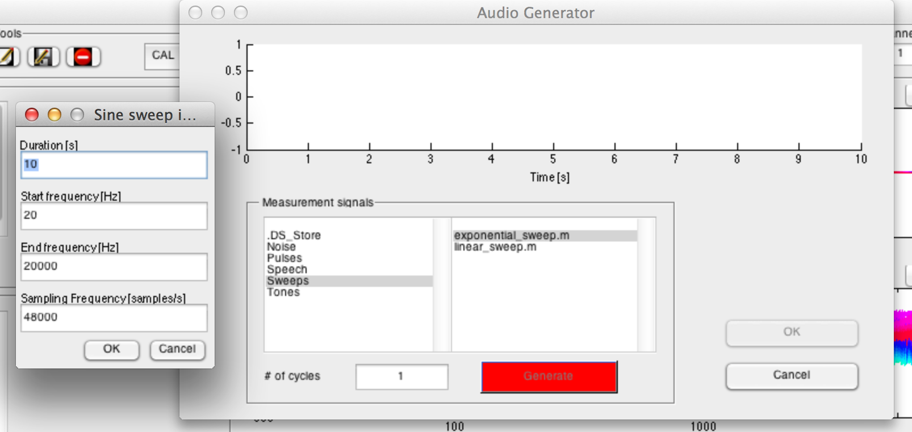
Generators
Generators are used to generate test signals
e.g., swept sinusoids, noise, etc
Generator code is in the Generators folder

Slide 8
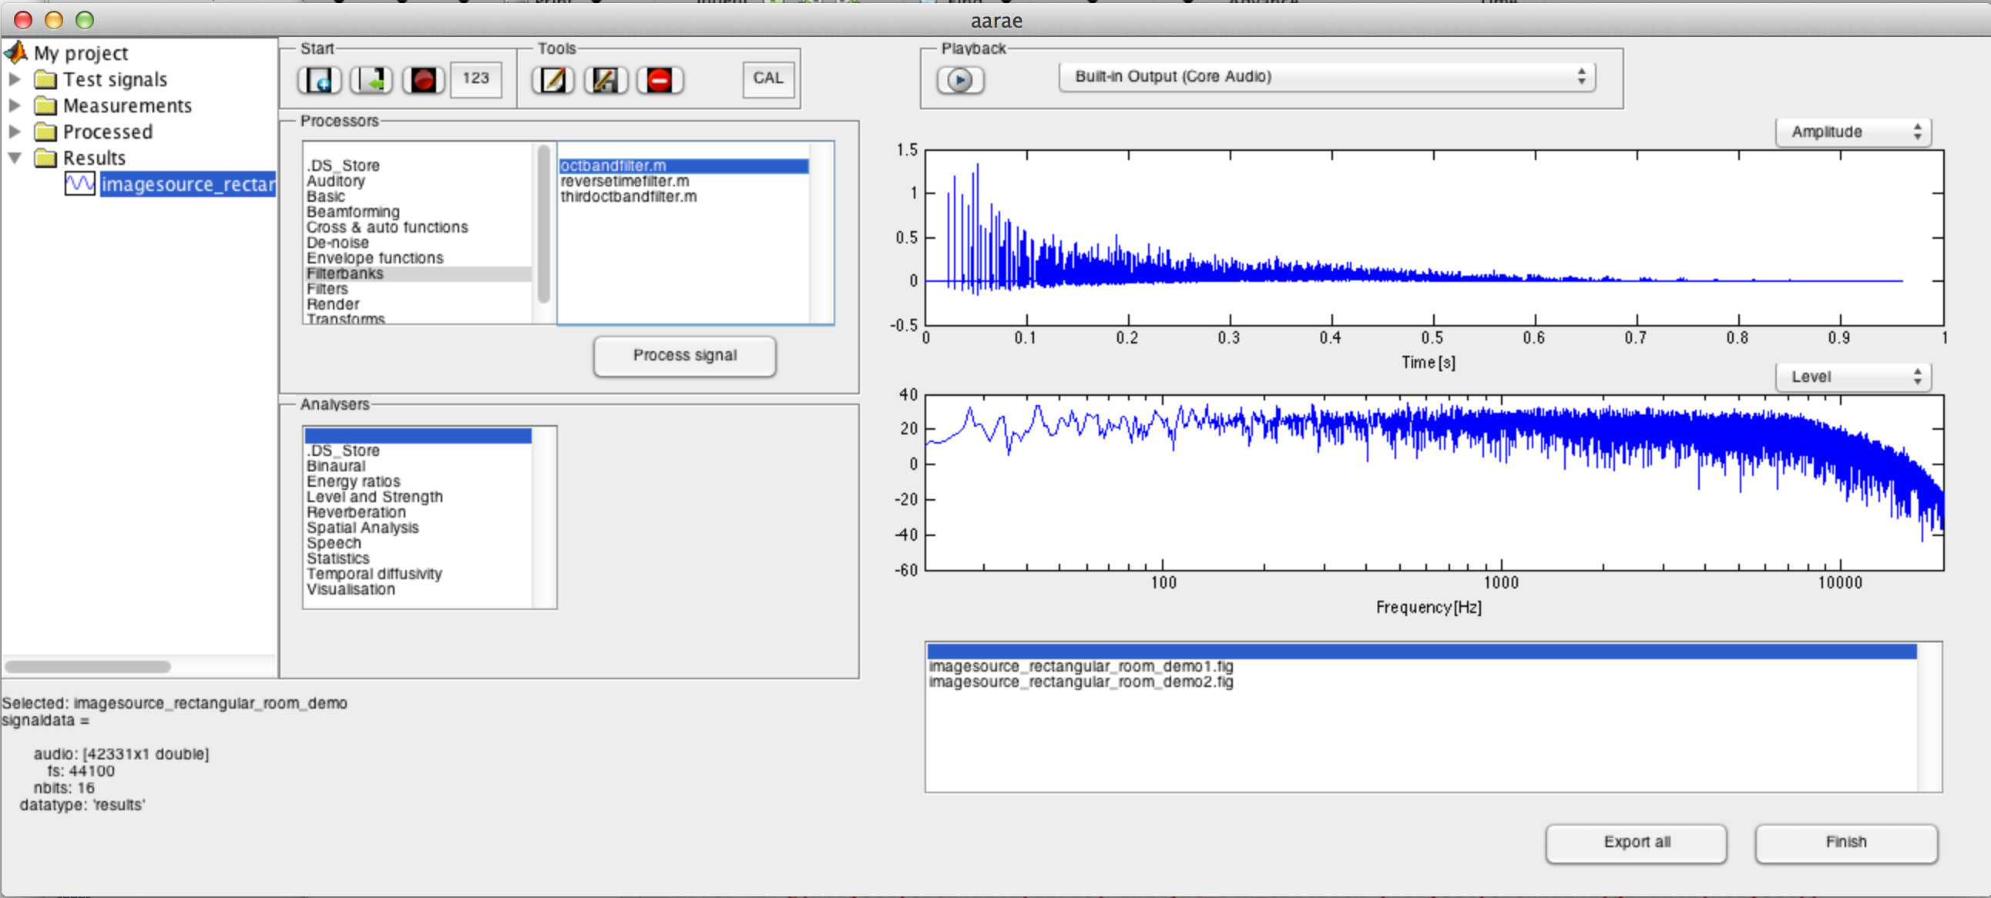
Processors
Processors have audio in and audio out.
They include filters, convolution, etc
Processors code is in the Processors folder

Slide 9
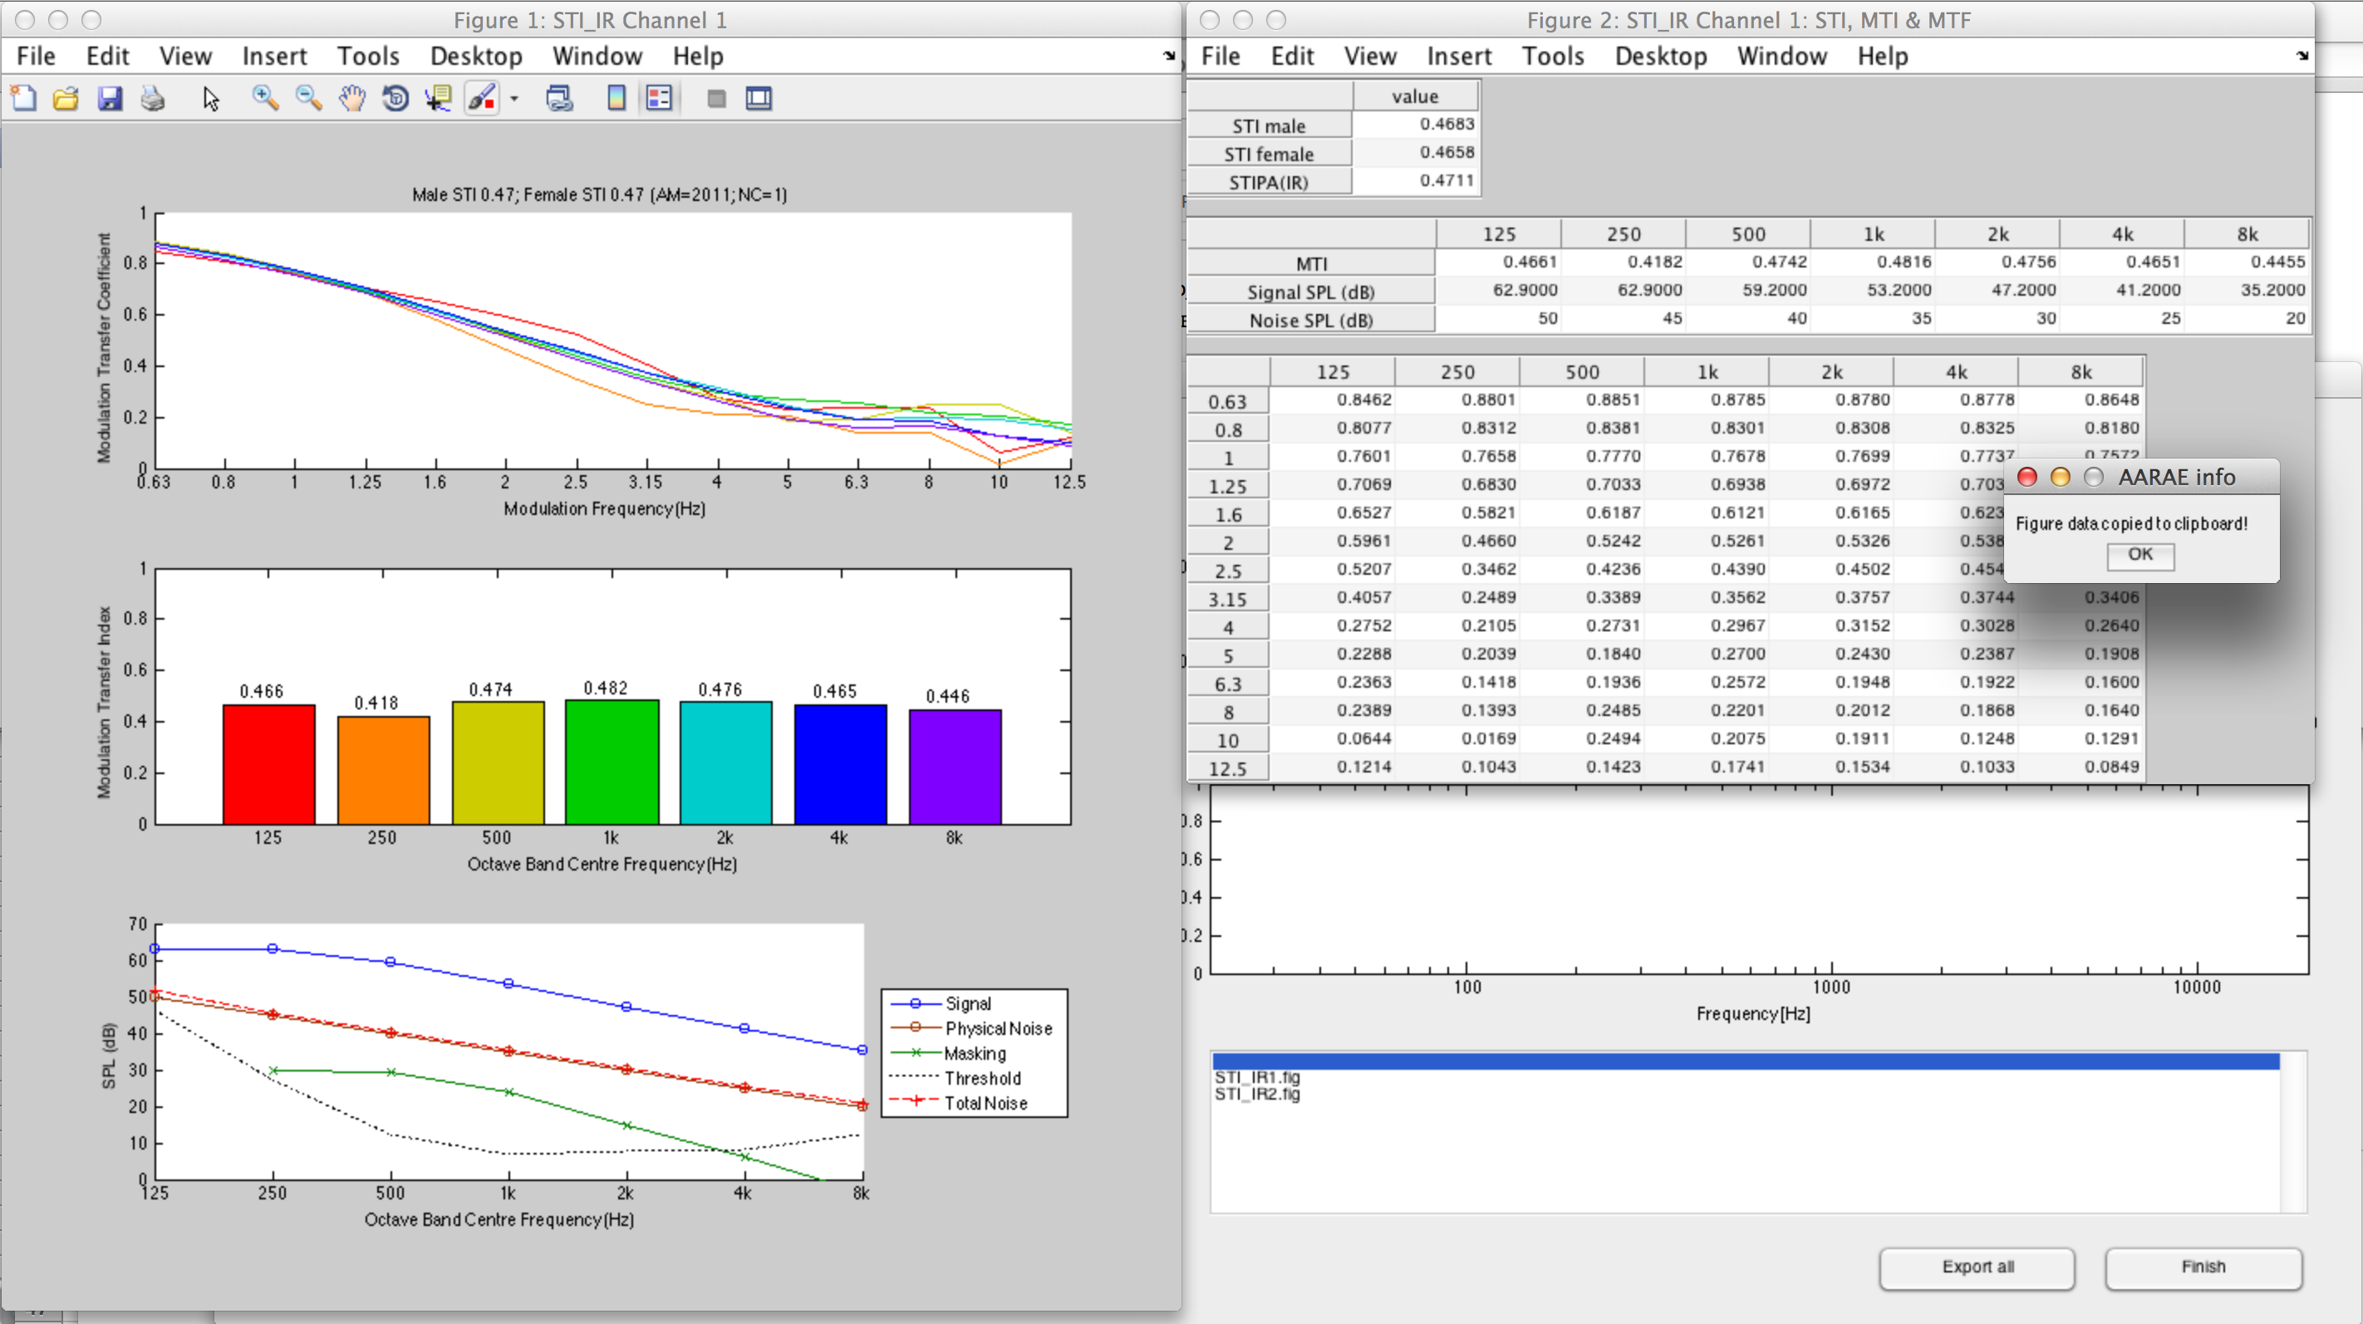
Analysers
Analysers output figures, tables, and/or potentially other result displays

Slide 10
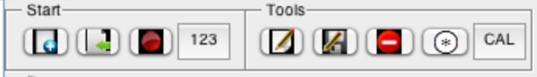
Tools
Tools allow:
Simple editing of audio
Saving (exporting) of data
Deleting audio from AARAE workspace
Convolving audio with audio2 (e.g. for deriving an impulse response)
Calibrating audio

Slide 11
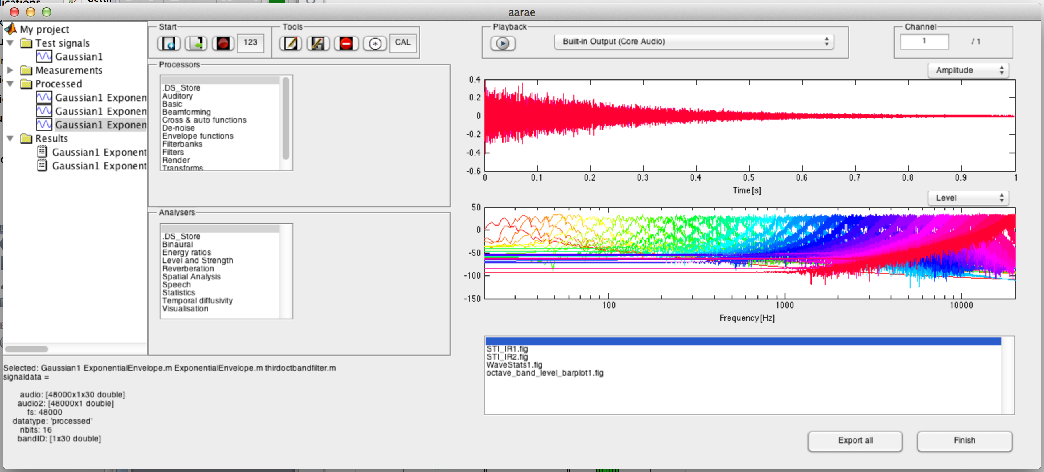
AARAE Results
AARAE results may be in charts, tables, Matlab structures, etc.
Table contents can be copied to clipboard (if the table is implemented using disptable).
All data, tables and figures can be exported via ‘Export all’ to the ‘Projects’ folder.
AARAE automatically keeps a log of activity in the ‘Log’ folder.

Slide 12
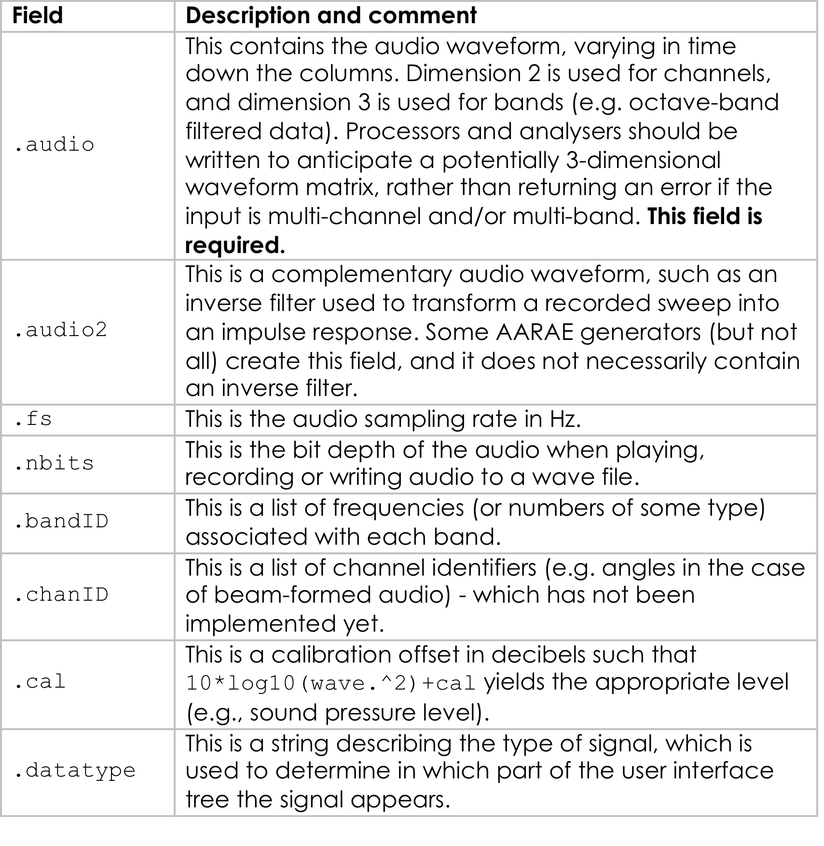
AARAE Fields

Slide 13
Helpful AARAE functions
Octave and 1/3-octave band filterbank processors
Choose_audio – for acquiring additional audio data within a calculator, generator, processor or analyser
Disptables – for automatic sizing of tables with copy-to-clipboard by clicking on the table background

Slide 14
AARAE Templates
The Templates folder contains templates to help write a calculator, generator, processor or analyser.

