Slide 1





SENTIMENT ANALYSIS AI SYSTEM
Team :J.DENSING RAJ
& densinghdensingh@gmail.com
Guide: P. Raja, (Master Trainer, Edunet Foundation)
Disclaimer: The content is curated for educational purposes only.
Notes:
Slides: Prepare a short slide deck (10-12 slides) summarizing the project objectives, methodology, and key results.

Slide 2
OUTLINE
Abstract of the Project
Problem Statement
Proposed Solution
System Architecture
Live Demo of the Project
Embedded Video of Project
Conclusion
Future Scope

Slide 3
Abstract
As part of a business strategy, effective competitive research helps businesses outperform their competitors and attract loyal consumers. To perform competitive research, sentiment analysis may be used to assess interest in certain themes, uncover market conditions, and study competitors. Artificial intelligence (AI) has improved the performance of multiple areas, particularly sentiment analysis. Using AI, sentiment analysis is the process of recognizing emotions expressed in text. AI comprehends the tone of a statement, as opposed to merely recognizing whether particular words within a group of text have a negative or positive connotation. This article reviews papers (2012–2022) that discuss how competitive market research identifies and compares major market measurements that help distinguish the services and goods of the competitors. AI-powered sentiment analysis can be used to learn what the competitors’ customers think of them across all aspects of the businesses

Slide 4
Problem Statement
In today's digital world, businesses and organizations collect massive amounts of customer feedback, reviews, and opinions across various platforms (e.g., e-commerce websites, social media, customer surveys). Understanding and interpreting the sentiment behind this feedback is critical to improving customer satisfaction, refining products or services, and making data-driven decisions.
However, manual sentiment analysis is time-consuming, inconsistent, and prone to human error. Traditional machine learning approaches to sentiment analysis can be complex to implement and may lack the nuance needed for accurately understanding customer sentiment, especially with challenges like sarcasm, context, or multi-language support.
The challenge is to build an automated, scalable, and accurate sentiment analysis system that can analyze large volumes of customer feedback data and provide actionable insights to businesses using advanced AI techniques

Slide 5
Proposed Solution
. ChatGPT's ability to process natural language and understand context, tone, and emotions makes it an ideal tool for sentiment analysis.
Key Features of the System:
Dataset: The system will use a dataset of customer reviews, which can be sourced from platforms such as Amazon or Yelp, or a custom dataset can be created for the specific business domain.
OpenAI API Integration: The OpenAI GPT-3 or GPT-4 API will be integrated into the system for sentiment classification and analysis. The model will classify the sentiment of customer reviews as positive, neutral, or negative.
Jupyter Notebook Implementation: A Jupyter notebook will be used to run the code and interact with the API, allowing for an easy and interactive environment to perform sentiment analysis.
Actionable Insights: The system will not only classify sentiment but also generate summaries, key insights, and suggestions for improvement based on the feedback.

Slide 6
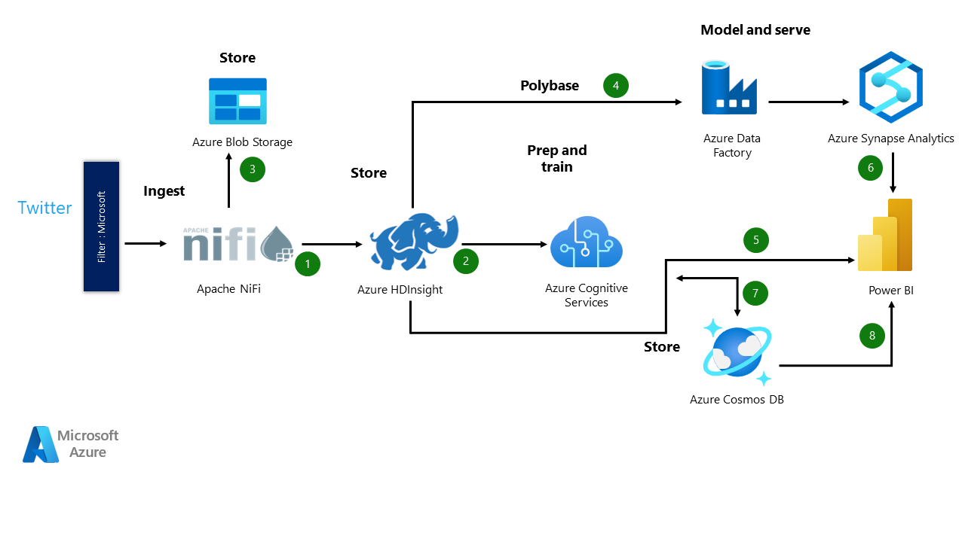
System Architecture

Slide 7
Conclusion
One of the most important elements of good strategic competitive research is understanding the perceptions, and the reasons behind these, that consumers have of the competitors. This will help ascertain the actual strengths and weaknesses of various firm’s components. This comprises conducting market research to obtain data for business uses. One of the best ways to accomplish this goal is to use text analytics to perform sentiment analysis. Sentiment analysis creates a report by comparing how consumers perceive a brand’s products or services to those of its competitors. Brands may use these insightful data to distinguish themselves positively from the competition. AI-powered sentiment analysis is beginning to be used by enterprises as a key tool. It helps in obtaining an understanding of customers’ perspectives. It is also helpful for an understanding of the thoughts and sentiments of employees. The majority of the time, it is utilized to understand customer reviews, the seriousness of a service problem, social media references, etc. It might be claimed that sentiment analysis will soon be used to probe deeper into people’s feelings. It will help computers understand the emotions expressed in messages, comments, and feedback better. Businesses will be able to better personalize their responses as a result. This study aimed to examine the literature on AI-based sentiment analysis to help new researchers stay up to date with the progress of the field, and to give suggestions for improving the quality of future research

Slide 8
Future Scope
Fine-tuning the Model: Although the pre-trained models like GPT-3 and GPT-4 are incredibly powerful, fine-tuning the model with domain-specific data could significantly improve its accuracy in specific industries (e.g., healthcare, e-commerce, or finance). By training the model on a specialized dataset of reviews or customer interactions, businesses can ensure more relevant and precise sentiment classification.
Handling Complex Sentiments: Real-world customer feedback often contains mixed emotions or nuanced sentiments (e.g., "This product is great but the shipping took forever."). Fine-tuned models can better identify such complexities and classify sentiment with higher precision.
Cross-Language Sentiment Consistency: AI models can be developed to understand sentiment in different languages while maintaining consistency in sentiment classification, even if the expressions of sentiment vary across languages or cultures.

Slide 9
Thank you!
Notes:
thank you very much for joining this PPT, keep learning.
9

