Slide 1

Intel Do-It-Yourself Challenge WiFi
Nicolas Vailliet www.Intel-Software-Academic-Program.com paul.guermonprez@intel.com Intel Software 2014-02-01

Slide 2
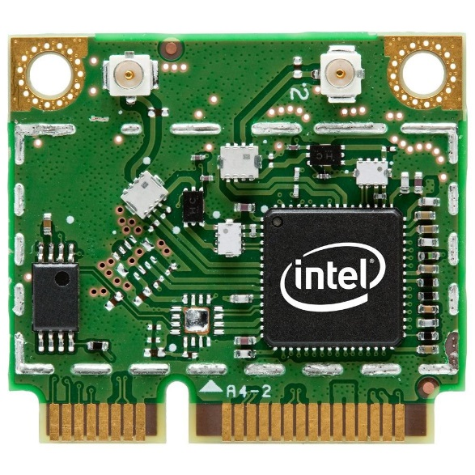
WiFi
Network
There’s an Ethernet port on the board, that’s a 29euro optional shield you won’t have to buy.
But there’s also a mini PCIe slot ! You can plug a small laptop-style WiFi card.
That’s cheap (7.5 euros for a Intel 135BN) compared to an official WiFi shield (69 euros + VAT). And a lot smaller too.
Galileo has the good sides of Arduino … and PCs !

Slide 3
We’ll use …
Hardware
Galileo board, Intel WiFi card, antenna. You can get an Intel 135BN online for 7.5e, or borrow one from a laptop (most laptops use this format).
Software
By default, the small linux image provided only contains the drivers for N-135 and N-6205. But it’s easy to add drivers for other intel supported cards.
Setup
The board is booted from a SD card, and we are connected over Ethernet with ssh.

Slide 4
Get the drivers
Do I need additionnal drivers ?
If you took the small linux image, there’s 2 drivers. If you took the large linux image, there’s a lot more. In any case, all the supported drivers are on kernel.org
Download drivers
From kernel.org : http://wireless.kernel.org/en/users/Drivers/iwlwifi
Unpack and copy to SD card
Unpack with “tar –xvzf iwlwifi-XXX.tgz”, copy files from your PC to the SD card.

Slide 5
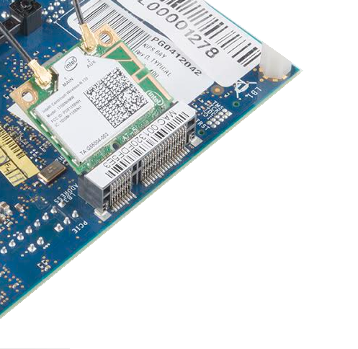
Install card and drivers
Hardware
Plug the card and connect the antenna. Boot the board and ssh.
Copy files
After you copied the files from your PC to the SD card, or downloaded the file directly on the galileo, copy them : “cp /where-I-copied-the-files/*ucode /lib/firmware”

Slide 6
WPA protection
WPA
Get you SSID and WPA password, then type (replacing the SSID with the right value) : “wpa_passphrase SSID << EOF > /etc/wpa_supplicant.conf”
press enter,
type your password,
press enter,
type “EOF”,
press enter.

Slide 7
Automatic Wireless
Edit network interfaces config file
Edit with your favorite command line editor the file “/etc/network/interfaces”. We’ll use vi : “vi /etc/network/interfaces” Press “i” to enter in edition mode. Type “auto wlan0”, press enter, press escape. Type “:wq” to save and exit vi.
Your Wireless card will be enabled by default.

Slide 8
Automatic WPA
Edit network interfaces config file
Edit with your favorite command line editor the file “/etc/network/interfaces”. The file should look like : “auto wlan0
iface wlan0 inet dhcp
wpa-conf /etc/wpa_supplicant.conf”
Edit network interfaces config file
Restart the networking service :
“/etc/init.d/networking restart”

Slide 9
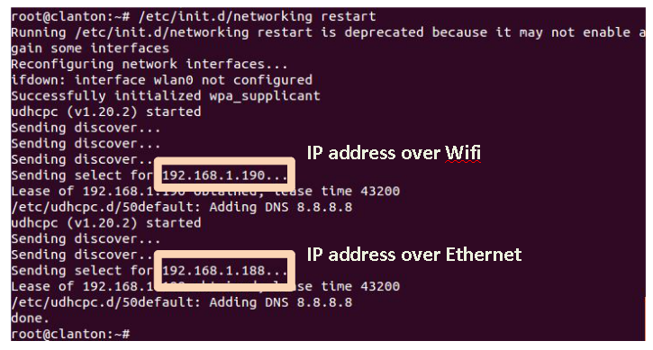

Slide 10
Preparing and booting the SD card

Slide 11


SD card
Format the micro SD Card
Connect the micro SD card to your PC, format as fat32.
Adapters
To connect the microSD to your PC, you can use :
> a SD-microSD adapter if you have a SD slot in your PC
> a USB-microSD adapter

Slide 12
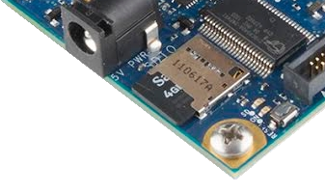
Boot
Boot loader
The Galileo board is using grub, a common tool.
How to boot
Plug the SD card in the slot of the Galileo board.
Plug the power supply, wait for the green LED, plug via USB.
What’s working ?
You can still send sketches from the Arduino IDE, but you now have a linux running with included services and libraries like SSHd, bluez, nodejs, OpenCV.

Slide 13
Enable networking

Slide 14
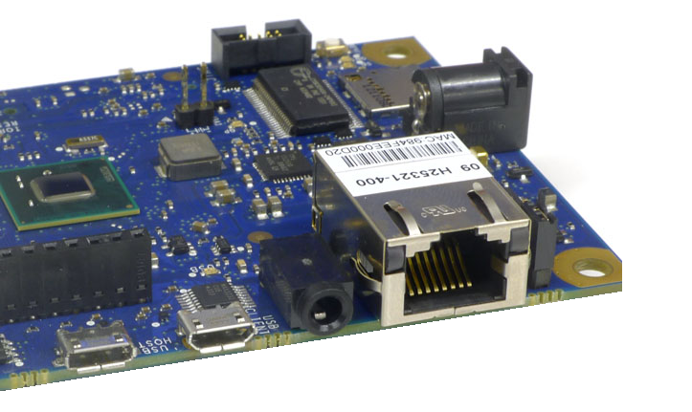
Ethernet
Procedure
We’ll need to run a sketch from the Arduino IDE to :
> use the “Ethernet” package to enable the Ethernet port > launch a ifup linux command with “system” to enable the interface.
Then your board will receive an IP address from your local DHCP server (usually your home router), or will use the fixed IP you provided if DHCP doesn’t work.
Then you’ll be able to connect with ssh and get rid of the IDE.

Slide 15
Ethernet
Procedure
> Plug the Ethernet cable
> Copy/Paste the sketch on next slide to your IDE window
> Edit the MAC (sticker on your board) and IP values
> Validate and upload.
> Determine your IP address.
> ssh to you Galileo IP as root.

Slide 16
Sketch to copy/paste
#include <SPI.h>
#include <Ethernet.h>
// MAC address for the Galileo (there’s a sticker on the Ethernet connector)
byte mac[] = { 0x??, 0x??, 0x??, 0x??, 0x??, 0x?? };
//the IP address for the Galileo: (will be used if there’s no DHCP server on your network)
byte ip[] = { ???, ???, ???, ??? };
void setup() {
delay(5000); //let the time time to open the serial monitor
Serial.println("Attempting to configure Ethernet using DHCP");
if (Ethernet.begin(mac) == 0) {
Serial.begin(9600);
Serial.println("Failed to configure Ethernet using DHCP");
Serial.println("Attempting to configure Ethernet using Static IP");
Ethernet.begin(mac, ip);
Serial.println(" Please check ifconfig");
}
system("ifup eth0"); // load Ethernet interface!
else Serial.println("Sounds good");
} }
void loop () {}

Slide 17
What’s my IP ?

Slide 18
What’s my IP address ?
Fixed IP
If you have no DHCP router and entered an IP, you have it.
Router info page
If you have a home router, you can consult the DHCP log.
Display ifconfig output
Run sketch from the following slide, it will : > run the ifconfig linux command > output the result in a file > display the file content

Slide 19
Sketch to copy/paste
char output[500];
void setup(){
Serial.begin(9600);
}
void loop(){
system(“ifconfig > log.txt”);
FILE *fp;
fp = fopen(“log.txt”,”r”);
while(fgets(output,500,fp) != NULL)
Serial.println(output);
fclose(fp);
delay(5000);
}

Slide 20
ssh

Slide 21
ssh
Serial log
After running the sketch, your board should be connected to your LAN network.
ssh
ssh root@192.168.1.100 # replace with your IP You should see : root@clanton:~#
Reboot ?
If you reboot your card, you should be able to reconnect automatically. Wait at least 45 seconds for the OS to load the network and ssh service.

Slide 22
Tips and links

Slide 23
If you have WiFi problems …
Card and antenna
If you have WiFi problems, check your card and antenna.
SSID list
Launch the command : “iwlist wlan0 scan” to list networks.
Reload the WiFi interface
Launch the command : “ifup wlan0”

Slide 24
Links
http://wireless.kernel.org/en/users/Drivers/iwlwifi
http://www.malinov.com/Home/sergey-s-blog/intelgalileo-addingwifi
http://help.ubuntu.com/community/WifiDocs/WiFiHowTo

Slide 25
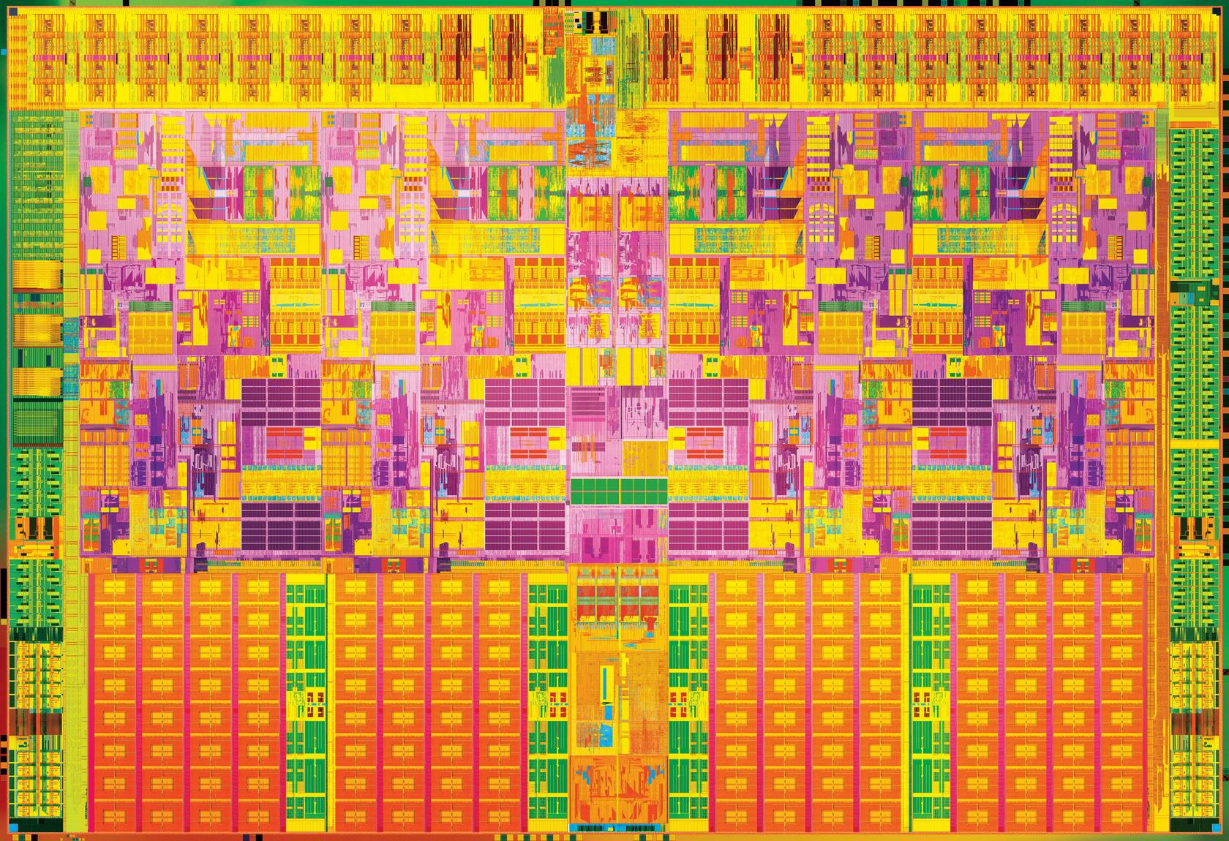

Slide 26
License Creative Commons – By 3.0
You are free:
to Share — to copy, distribute and transmit the work
to Remix — to adapt the work
to make commercial use of the work
Under the following conditions:
Attribution — You must attribute the work in the manner specified by the author or licensor (but not in any way that suggests that they endorse you or your use of the work).
With the understanding that:
Waiver — Any of the above conditions can be waived if you get permission from the copyright holder.
Public Domain — Where the work or any of its elements is in the public domain under applicable law, that status is in no way affected by the license.
Other Rights — In no way are any of the following rights affected by the license:
Your fair dealing or fair use rights, or other applicable copyright exceptions and limitations;
The author's moral rights;
Rights other persons may have either in the work itself or in how the work is used, such as publicity or privacy rights.
Notice — For any reuse or distribution, you must make clear to others the license terms of this work. The best way to do this is with a link to this web page.
http://creativecommons.org/licenses/by/3.0/

