Slide 1

Intel Do-It-Yourself Challenge Rebuild (with) Yocto
Nicolas Vailliet www.Intel-Software-Academic-Program.com paul.guermonprez@intel.com Intel Software 2014-02-01

Slide 2
Why ? Should I ?

Slide 3
Yocto ?
Is Yocto a distribution ?
“Yocto is not an embedded Linux distribution it creates a custom one for you” https://www.yoctoproject.org/about
What’s included ?
“Yocto provides templates, tools and methods to help you create custom Linux-based systems for embedded products regardless of the hardware architecture.”

Slide 4
Rebuild (with) Yocto
Prepackaged images
Yocto for Galileo comes with several prepackaged images you can download and boot from using a microSD card.
And you are free to install packages manually after booting the image on the Galileo.
Rebuild the OS
But what if you want to rebuild the full OS yourself? Perhaps you want to change what’s installed by default, or change kernel parameters (may be required for some IO operations). Even if you don’t need it, it’s always nice to know you can. That’s Linux !

Slide 5
Yocto output files
Rebuild Yocto vs build for Yocto Yocto can be used in two different ways. After a short configuration phase, you will choose between generating a Linux file system file or the cross compile development environment (or toolchain).
And then, it will take up to 8 hours to compile output files, on a notebook (depending on system configuration and network connection speed).
On a modern Xeon workstation, it will take less than 2 hours.
Source code from repositories or local projects
Yocto
Toolchain
Linux image

Slide 6
You’ll need
Board Support Package Sources for Intel Quark
An archive with all tools you need, available on Galileo drivers website.
https://communities.intel.com/docs/DOC-22226
Storage and internet bandwidth
Make sure you have 100Gb available on your hard drive. We’ll also need a good internet connectivity.
CPU
If you would like to rebuild the full Yocto OS or generate the cross compile toolchain, it will take up to 8 hours on a workstation.

Slide 7
You’ll need
Linux
We’ll use Ubuntu 12.04
Packages
“sudo apt-get install build-essential sed wget cvs subversion git-core coreutils unzip texi2html texinfo libsdl1.2-dev docbook-utils gawk python-pysqlite2 diffstat help2man make gcc g++ desktop-file-utils chrpath libgl1-mesa-dev libglu1-mesa-dev mercurial autoconf automake groff libtool xterm p7zip-full bitbake”

Slide 8
Rebuilding (with) Yocto

Slide 9
Procedure (1/5)
Uncompress
7z x Board_Support_Package_Sources*.7z
Rename your BSP folder with a shorter name
mv Board_Support_Package_*** BSP_Galileo
Unpack
tar -xvzf meta-clanton_*.tar.gz
Go to the new Yocto home folder
cd meta-clanton_...
Download, compile and set up Poky, a tool used by Yocto ./setup.sh source poky/oe-init-build-env yocto_build

Slide 10
Procedure (2/5)
Setting up Yocto receipe
By default, Yocto is ready to compile a tiny Linux image or cross compile toolchain.
But, we want to compile, debug and use libraries.
Asking for a full configuration:
Edit the conf/local.conf file.
Change “clanton-tiny” to “clanton-full”.
Set BB_NUMBER_THREADS and PARALLEL_THREADS to “number of cores your processor has multiply by 3”.
Save the file.

Slide 11
Procedure (3/5)
Disable uClibc
It will disable uClibc, and replace it by EGlibC, which have more features and is commonly used under Linux.
Edit “../meta-clanton-distro/recipes-multimedia/v4l2apps/v4l-utils_0.8.8.bbappend”
Comment these 3 lines: #FILESEXTRAPATHS_prepend := "${THISDIR}/files:“ #SRC_URI += file://uclibc-enable.patch #DEPENDS += "libiconv"

Slide 12
Procedure (4/5)
Get a default config
Copy the full image configuration from a sample: cp ../meta-clanton-distro/recipes-core/images/image-full.bb ../meta-clanton-distro/recipes-core/images/image-sdk.bb
Edit the default config
These options are set up for generating the associated Linux image later.
You can (un)comment features you do (not) want. The image size will be 3GB.
Edit ../meta-clanton-distro/recipes-core/images/image-sdk.bb :
IMAGE_INSTALL = "packagegroup-core-boot ${ROOTFS_PKGMANAGE_BOOTSTRAP} ${CORE_IMAGE_EXTRA_INSTALL} packagegroup-core-basic packagegroup-core-lsb kernel-dev“
IMAGE_FEATURES += "package-management tools-sdk dev-pkgs tools-debug eclipse-debug tools-profile tools-testapps debug-tweaks’’
IMAGE_ROOTFS_SIZE = "3072000"

Slide 13
Procedure (5/5)
Last details To have a Linux system that can support full Galileo connectivity (pins, pwm…), you have to apply the following patch: Edit ../meta-clanton-bsp/recipes-kernel/linux/files/clanton.patch +static unsigned int i2c_std_mode = 1; This is line #10722. By default, this variable is not initialized. You set it to 1.
Configure kernel features
bitbake linux-yocto-clanton -c menuconfig
Launch the incredible machine
It will compile the cross compile toolchain.
This is the step that will take a while…. bitbake image-sdk

Slide 14
How to use the Linux image

Slide 15

How to use Linux image files
Get Yocto output files
Files you generated are in: yocto_build/tmp/deploy/images.
Deploy on your microSD card
Copy the following files and folder on a SD card:
- bzImage-* (rename it to bzImage)
- core-image-minimal-initramfs-* (rename it to core-image-minimal-initramfs- clanton.cpio.gz)
- image-* (rename it to image-full-clanton.ext3)
- boot folder
Insert the SD card in Galileo board slot
Then, boot it ! Ethernet configuration is automatic.
Keep your Board Support folder if you plan to generate other output files with Yocto.

Slide 16
Tips

Slide 17
Tips & Troubleshooting
GRUB On malitov.com, Sergey’s blog explains how to add multiple image on the SD card (that could be use useful).
Graphical/CLI If you run bitbake via remote access, you will have the following error: ERROR: No valid terminal found, unable to open devshell Try to connect to your machine with ssh –X to enable X forwarding. If it doesn’t work, don’t use ‘-c menuconfig’ attribute. (you won’t be able to customize the kernel using the config menu).
NodeJS If do_compile Node JS can fail with the following error: Make[1]: Execvp: printf: Argument list too long To solve this problem, be sure ‘pwd’ command prints less than 50 characters in your shell when you are in yocto-build folder.

Slide 18
Tips & Troubleshooting
Quickly edit the image without rebuilding it
You can edit and customize the Linux file system before booting on the board. To do so, insert the SD card in your computer and run the following command: sudo mount –o loop –t ext3 /media/yoursdcard/image-full-clanton.ext3 /mnt
You can now access the card sysfs as if you were running it. It’s very useful to edit the Ethernet configuration to use a static IP or to copy a new Wifi driver…
See next slide to set up Wifi with this full image.

Slide 19
Tips & Troubleshooting
Network
The full Linux image contains the connection manager, which is tool to manage wifi, ethernet and bluetooth connection.
It allows only one established connection by default. When it’s available Wifi is default. Otherwise, Ethernet is used.
However, you can use both with the command “ifup eth0”.
We recommand to configure your router to associate a static IP address for your board (one for each technology).
Follow next slide procedure to install the previously described behaviour.

Slide 20
Tips & Troubleshooting
To set up Wifi access to a WPA-secured hotspot connmanctl enable wifi scan wifi services #(copy/paste your access point ID wifi_***_psk) exit
cat << EOF > /var/lib/connman/wifi.config
[service_wifi_***************_managed_psk] Type = wifi Security = wpa Name = ESSID Passphrase = WPA_KEY EOF
# … reboot the board

Slide 21
Tips & Troubleshooting
Other ways to do it
/etc/init.d/connman restart
OR
connmanctl
connect wifi_***************_managed_psk
ifup wlan0

Slide 22
Good to read
Xavier Hallade (Intel Paris)
http://ph0b.com/adding-dev-tools-gcc-make-to-galileo-sd-image/
Sergey Kiselev (Intel Portland)
http://www.malinov.com/Home/sergey-s-blog
Yocto Quick Start Guide
http://www.cnx-software.com/2012/02/09/yocto-project-quick-start-guide-for-ubuntu/

Slide 23
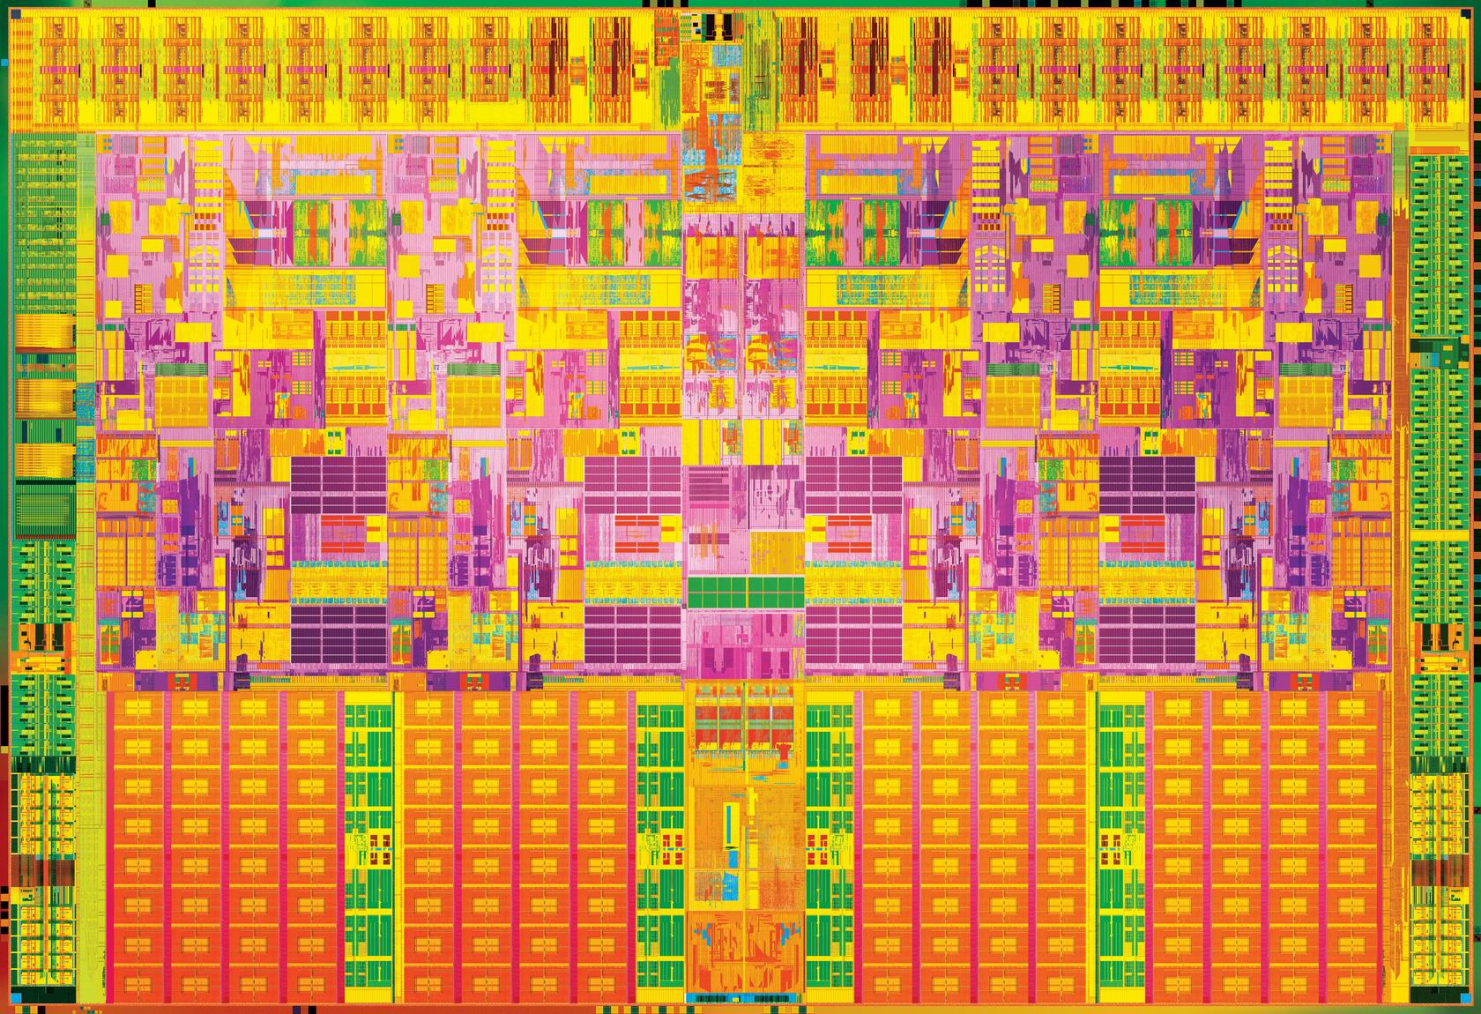

Slide 24
License Creative Commons – By 3.0
You are free:
to Share — to copy, distribute and transmit the work
to Remix — to adapt the work
to make commercial use of the work
Under the following conditions:
Attribution — You must attribute the work in the manner specified by the author or licensor (but not in any way that suggests that they endorse you or your use of the work).
With the understanding that:
Waiver — Any of the above conditions can be waived if you get permission from the copyright holder.
Public Domain — Where the work or any of its elements is in the public domain under applicable law, that status is in no way affected by the license.
Other Rights — In no way are any of the following rights affected by the license:
Your fair dealing or fair use rights, or other applicable copyright exceptions and limitations;
The author's moral rights;
Rights other persons may have either in the work itself or in how the work is used, such as publicity or privacy rights.
Notice — For any reuse or distribution, you must make clear to others the license terms of this work. The best way to do this is with a link to this web page.
http://creativecommons.org/licenses/by/3.0/

