Slide 1

Intel Do-It-Yourself Challenge node.js
Nicolas Vailliet www.Intel-Software-Academic-Program.com paul.guermonprez@intel.com Intel Software 2014-02-01

Slide 2
Why OpenCV and node.js ?
Arduino … and more
The typical way to use an Arduino board is to compile and upload sketches. But the Galileo has a powerful Quark processor with Ethernet and WiFi links.
Processor
With a fast processor, you can process images, sound, data from sensors on the board itself. Here we’ll use the computer vision library OpenCV. Originally developed by Intel, it is now Open Source.
Network
We’ll use the node.js framework to use network capabilities. Node.js is built on the Chrome JS runtime.

Slide 3
You’ll need
Ethernet and ssh
You’ll need a Galileo board with the network configured. You should be able to connect to the board with ssh. Both WiFi and Ethernet are OK. To transfer files between your PC and the board you can use the “scp” command on linux or Filezilla on Windows.
C/C++ development environment
For OpenCV you may edit, compile and execute on the Galileo itself. But it’s faster to develop on your computer and upload the binary to the Galileo for execution.

Slide 4
node.js

Slide 5
node.js Hello World
Goal
Node.js is a framework using the Chrome JavaScript runtime and used to communicate over networks.
Here we’ll create a web server listening on a port and answering “HelloWorld” in your browser.
Steps
Create a folder, copy paste the content of the next slide in a file called “hello.js”
Replace the X.X.X.X IP in the file with your board IP.

Slide 6
node.js Hello World
var http = require('http');
http.createServer(
function (req, res) {
res.writeHead(200,{'Content-Type': 'text/plain'});
res.end('Hello World\n');
}
).listen(1337, ‘X.X.X.X');
console.log(‘Server running at http://X.X.X.X:1337/');

Slide 7
node.js Hello World
Launch the server
Launch the command : “node hello.js”
See the result
From a PC on the same network, launch a browser with : http://X.X.X.X:1337
You should see “Hello World”

Slide 8
Why is node.js so good ?
What is node.js exactly ?
NodeJS is a server-side Javascript solution, written in C. It allows programmers to write JavaScript program and to execute than as a standalone application on a server.
What should I do ?
You easily develop server application, typing less than 20 lines of code ! http://nodejs.org
NodeJS is very fast : non-blocking, asynchronous architecture! It’s a way to be able to provide complex tools by using a simple and powerful high level language.

Slide 9
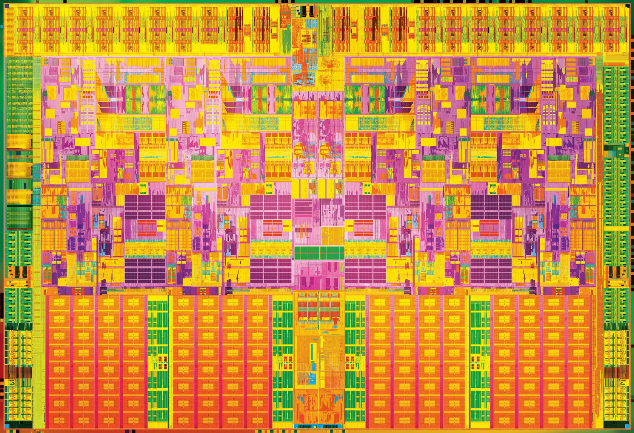

Slide 10
License Creative Commons – By 3.0
You are free:
to Share — to copy, distribute and transmit the work
to Remix — to adapt the work
to make commercial use of the work
Under the following conditions:
Attribution — You must attribute the work in the manner specified by the author or licensor (but not in any way that suggests that they endorse you or your use of the work).
With the understanding that:
Waiver — Any of the above conditions can be waived if you get permission from the copyright holder.
Public Domain — Where the work or any of its elements is in the public domain under applicable law, that status is in no way affected by the license.
Other Rights — In no way are any of the following rights affected by the license:
Your fair dealing or fair use rights, or other applicable copyright exceptions and limitations;
The author's moral rights;
Rights other persons may have either in the work itself or in how the work is used, such as publicity or privacy rights.
Notice — For any reuse or distribution, you must make clear to others the license terms of this work. The best way to do this is with a link to this web page.
http://creativecommons.org/licenses/by/3.0/

