Slide 1

Intel Do-It-Yourself Challenge Compile C/C++ for Galileo
Nicolas Vailliet www.Intel-Software-Academic-Program.com paul.guermonprez@intel.com Intel Software 2014-02-01

Slide 2
Why ?

Slide 3
C/C++ code ?
Why C/C++ code ?
Arduino sketches and node.js scripts are great, well known methods to develop smart objects. But what if you want to write C/C++ code ? Maybe you like it, or want better performance or need to use certain C/C++ libraries.
CPU intensive code on a Galileo ?
After all the Quark SoC has a lot of power to offer, processing data from sensors, sound or webcam can be done on the Galileo board itself. Why use a remote server if you can do it locally ?

Slide 4
Native code ?
Processor compatibility
The core inside the Intel Quark System on Chip is ia32. The assembly is nearly the same as a Pentium processor. It means you could easily develop, compile and even execute on any regular Linux system running on an Intel machine. It’s simple.
Libraries compatibility
Yocto has a specific set of libraries and Quark is 32bit, that’s why you need to install a build environment compatible with Yocto and Quark on your workstation.

Slide 5
Compile on the Galileo

Slide 6
Compile on the Galileo itself
Add gcc to Yocto You can add gcc and tools to the Galileo Yocto build and compile for Galileo on the Galileo itself. It works !
Performance As the Galileo is not as fast as a workstation, it’s not convenient for large projects.
Using Yocto?
Compile your code faster on your computer and then, run it on Galileo!

Slide 7
Generate the cross compile toolchain

Slide 8
Yocto output files
Rebuild Yocto vs build for Yocto Yocto can be used in two different ways. After a short configuration phase, you will choose between generating a Linux file system file or the cross compile development environment (or toolchain).
And then, it will take up to 8 hours to compile output files, on a notebook (depending on system configuration and network connection speed).
On a Sandy bridge workstation, it lasts less than 2 hours.
Source code from repositories or local projects
Yocto
Toolchain
Linux image

Slide 9


Cross compilation
Generating a cross compiler This course will cover how to generate the cross compile toolchain. But what is a cross compiler?
A cross compiler allows you to compile a code for Intel Quark SoC, on your computer, and then to move it to the Galileo board to execute it.
//C program
int main(){
Return 0;}
Cross compilation with Yocto-generated toolchain
Execution

Slide 10
You’ll need
Board Support Package Sources for Intel Quark
An archive with all tools you need, available on Galileo drivers website.
https://communities.intel.com/docs/DOC-22226
Storage and internet bandwidth
Make sure you have 100Gb available on your hard drive. We’ll also need a good internet connectivity.
CPU
If you just want to compiling a small code, no problem. You can even do that on the Galileo itself (if you have already installed the full Linux image, see our course about it).
But if you’d like to rebuild the full Yocto OS or generate the cross compile toolchain, it will take up to 8 hours on a workstation.

Slide 11
You’ll need
Linux
We’ll use Ubuntu 12.04
Packages
“sudo apt-get install build-essential sed wget cvs subversion git-core coreutils unzip texi2html texinfo libsdl1.2-dev docbook-utils gawk python-pysqlite2 diffstat help2man make gcc g++ desktop-file-utils chrpath libgl1-mesa-dev libglu1-mesa-dev mercurial autoconf automake groff libtool xterm p7zip-full bitbake”

Slide 12
Procedure (1/6)
Uncompress
7z x Board_Support_Package_Sources*.7z
Rename your BSP folder with a shorter name
mv Board_Support_Package_*** BSP_Galileo
Unpack
tar xvzf meta-clanton_*.tar.gz
Go to the new Yocto home folder
cd meta-clanton_...
Download, compile and set up Poky, a tool used by Yocto ./setup.sh source poky/oe-init-build-env yocto_build

Slide 13
Procedure (2/6)
Setting up Yocto receipe
By default, Yocto is ready to compile a tiny Linux image or cross compile toolchain. But, we want to compile, debug and use libraries.
Asking for a full configuration:
Edit the conf/local.conf file.
Change “clanton-tiny” to “clanton-full”.
Set BB_NUMBER_THREADS and PARALLEL_THREADS to “number of cores your processor has multiply by 3”.
Save the file.

Slide 14
Procedure (3/6)
Disable uClibc
It will disable uClibc, and replace it by EGlibC, which have more features and is commonly used under Linux.
Edit “../meta-clanton-distro/recipes-multimedia/v4l2apps/v4l-utils_0.8.8.bbappend”
Comment these 3 lines: #FILESEXTRAPATHS_prepend := "${THISDIR}/files:“ #SRC_URI += file://uclibc-enable.patch #DEPENDS += "libiconv"

Slide 15
Procedure (4/6)
Get a default config
copy the full image configuration from a sample: cp ../meta-clanton-distro/recipes-core/images/image-full.bb ../meta-clanton-distro/recipes-core/images/image-sdk.bb
Edit the default config
These options are set up for generating the associated Linux image later.
You can (un)comment features you do (not) want. The image size will be 3GB.
edit ../meta-clanton-distro/recipes-core/images/image-sdk.bb :
IMAGE_INSTALL = "packagegroup-core-boot ${ROOTFS_PKGMANAGE_BOOTSTRAP} ${CORE_IMAGE_EXTRA_INSTALL} packagegroup-core-basic packagegroup-core-lsb kernel-dev“
IMAGE_FEATURES += "package-management tools-sdk dev-pkgs tools-debug eclipse-debug tools-profile tools-testapps debug-tweaks’’
IMAGE_ROOTFS_SIZE = "3072000"

Slide 16
Procedure (4/6)
Get a default config
copy the full image configuration from a sample: cp ../meta-clanton-distro/recipes-core/images/image-full.bb ../meta-clanton-distro/recipes-core/images/image-sdk.bb
Edit the default config
These options are set up for generating the associated Linux image later.
You can (un)comment features you do (not) want. The image size will be 3GB.
edit ../meta-clanton-distro/recipes-core/images/image-sdk.bb :
IMAGE_INSTALL = "packagegroup-core-boot ${ROOTFS_PKGMANAGE_BOOTSTRAP} ${CORE_IMAGE_EXTRA_INSTALL} packagegroup-core-basic packagegroup-core-lsb kernel-dev“
IMAGE_FEATURES += "package-management tools-sdk dev-pkgs tools-debug eclipse-debug tools-profile tools-testapps debug-tweaks’’
IMAGE_ROOTFS_SIZE = "3072000"

Slide 17
Procedure (5/6)
Last details To have a Linux system that can support full Galileo connectivity (pins, pwm…), you have to apply the following patch: Edit ../meta-clanton-bsp/recipes-kernel/linux/files/clanton.patch +static unsigned int i2c_std_mode = 1; This is line #10722. By default, this variable is not initialized. You set it to 1.

Slide 18
Procedure (6/6)
Launch the incredible machine
It will compile the cross compile toolchain.
This is the step that will take a while….
bitbake image-sdk –c populate_sdk
Install the environment
To use the new environment, execute the script:
./tmp/deploy/sdk/clanton-tiny-***-1.4.2.sh
Link your new headers and libs
source /opt/clanton-full/1.4.2/environment-******-linux
You’re now ready to compile a program.

Slide 19
Linking and compiling
${CC} and ${CXX} variables To compile a C program, use CC, a environment variable referring to gcc for Intel Quark architecture (C compiler).
${CC} myfile.c –o myfile
And use ${CXX} instead of ${CC} to use g++ for Intel Quark architecture (C++ compiler).
Need a library?
If you want to use a library, just add : `pkg-config LIBNAME --libs`
at the end of the C++ compile command.
Try it with opencv or libusb-1.0 (cf. other courses).

Slide 20
Run your program
SSH and SCP
You are compiling on your workstation, but you need to execute on the Galileo board. Remember to send the binary over the network, scp is very convenient and secure (it uses SSH). scp mybinary root@192.168.1.XXX:~
Execute You can now connect over SSH and execute your binary. ssh root@192.168.1.XXX ./mybinary

Slide 21
Tips
Reuse the cross compile toolchain
Once you have generated the cross compile toolchain, you will only need to execute this command:
>source /opt/clanton-full/1.4.2/environment-******-linux
You have to run this command every time you open a new terminal/shell.
Using gcc and g++ to compile a program for your computer is not recommended (it should not link the program properly).
Keep your Board Support folder if you plan to generate other output files with Yocto.

Slide 22
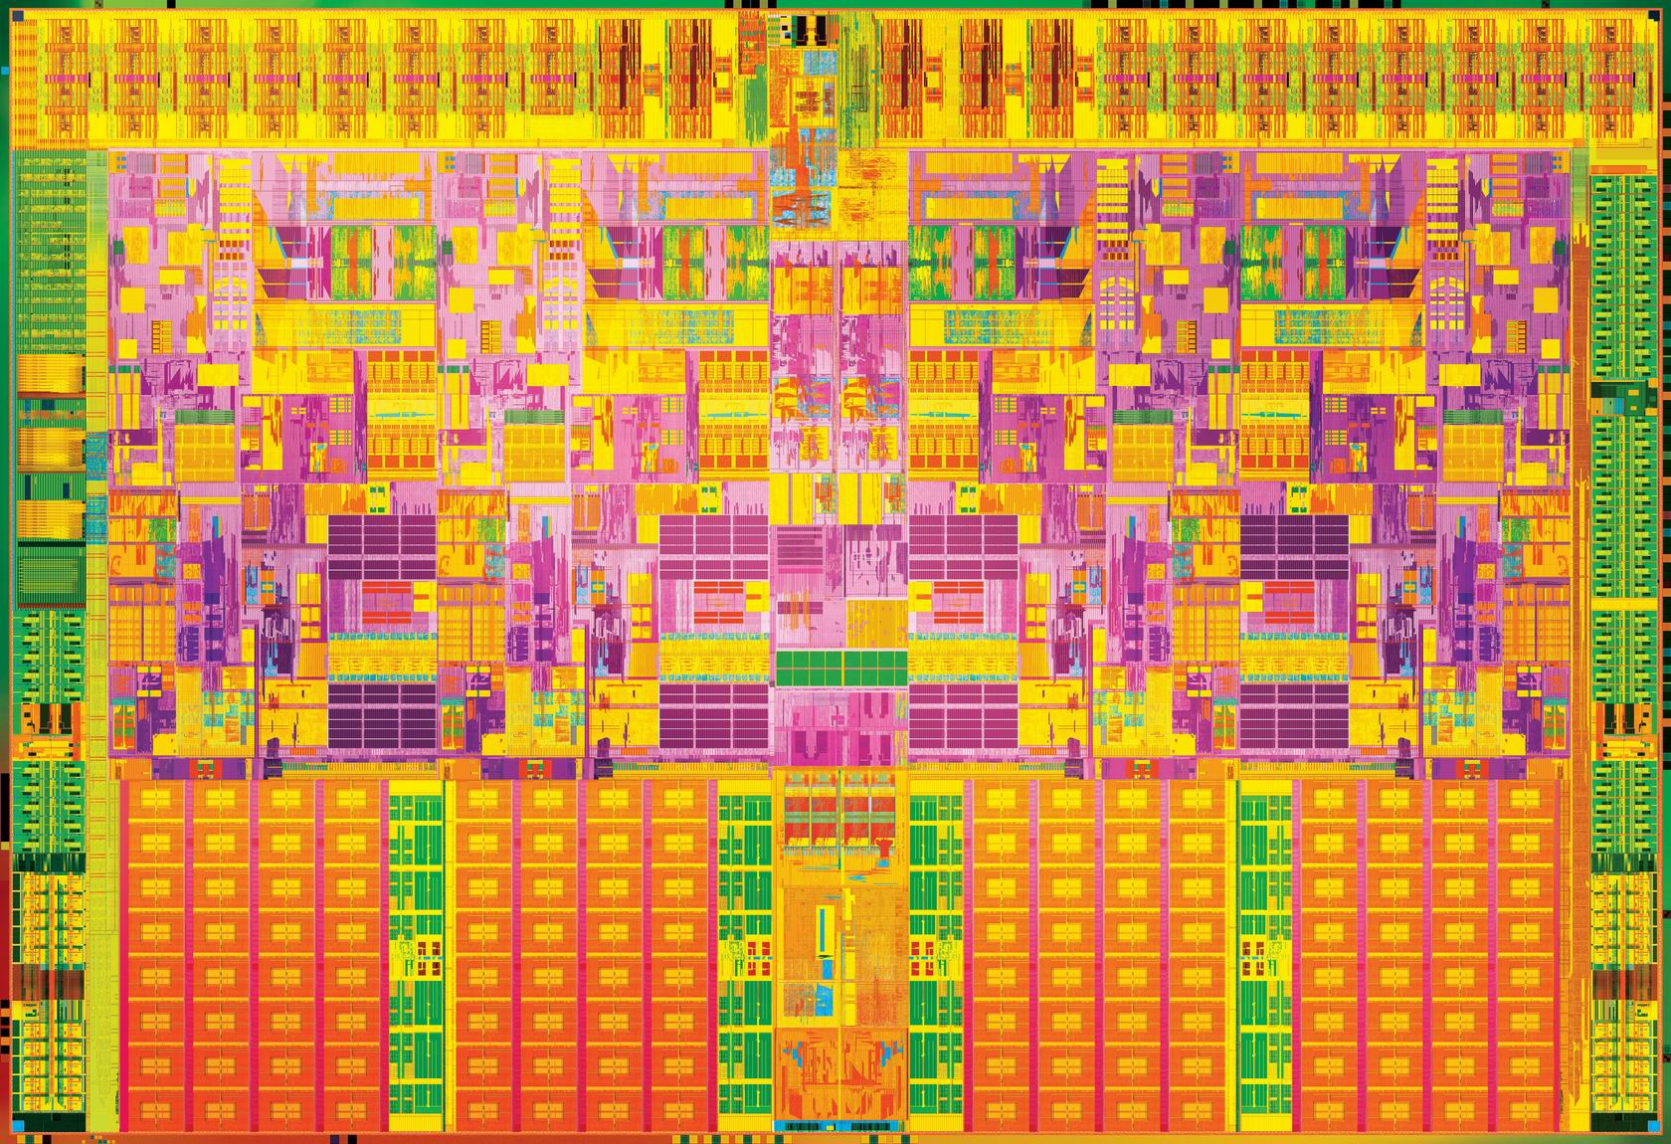

Slide 23
License Creative Commons – By 3.0
You are free:
to Share — to copy, distribute and transmit the work
to Remix — to adapt the work
to make commercial use of the work
Under the following conditions:
Attribution — You must attribute the work in the manner specified by the author or licensor (but not in any way that suggests that they endorse you or your use of the work).
With the understanding that:
Waiver — Any of the above conditions can be waived if you get permission from the copyright holder.
Public Domain — Where the work or any of its elements is in the public domain under applicable law, that status is in no way affected by the license.
Other Rights — In no way are any of the following rights affected by the license:
Your fair dealing or fair use rights, or other applicable copyright exceptions and limitations;
The author's moral rights;
Rights other persons may have either in the work itself or in how the work is used, such as publicity or privacy rights.
Notice — For any reuse or distribution, you must make clear to others the license terms of this work. The best way to do this is with a link to this web page.
http://creativecommons.org/licenses/by/3.0/

