Slide 1
Agentforce Data‑Aware Agent — Solution Architecture
Diagrams Pack — one image per slide

Slide 2
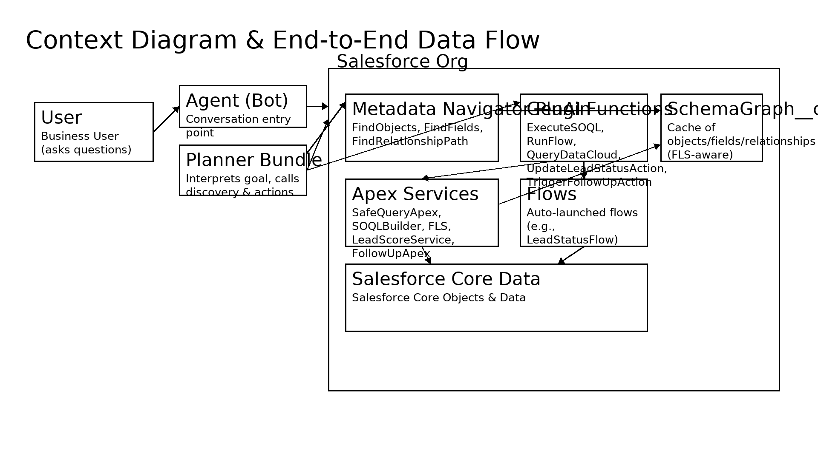
Context diagram & data flow

Slide 3
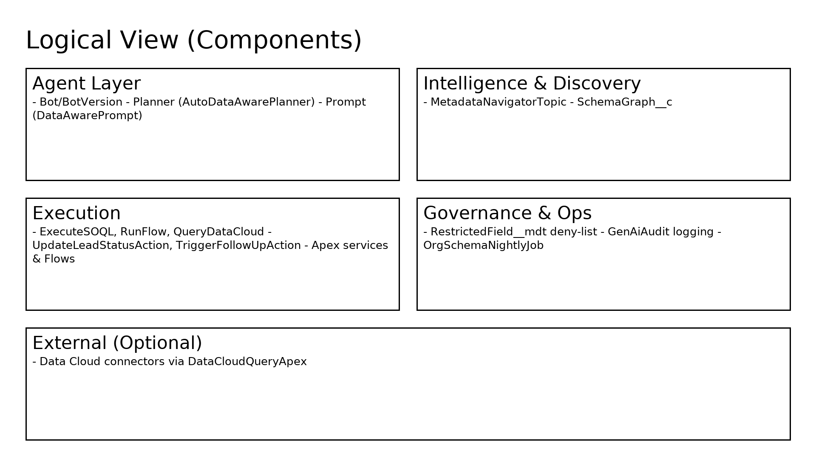
Logical view (components)

Slide 4
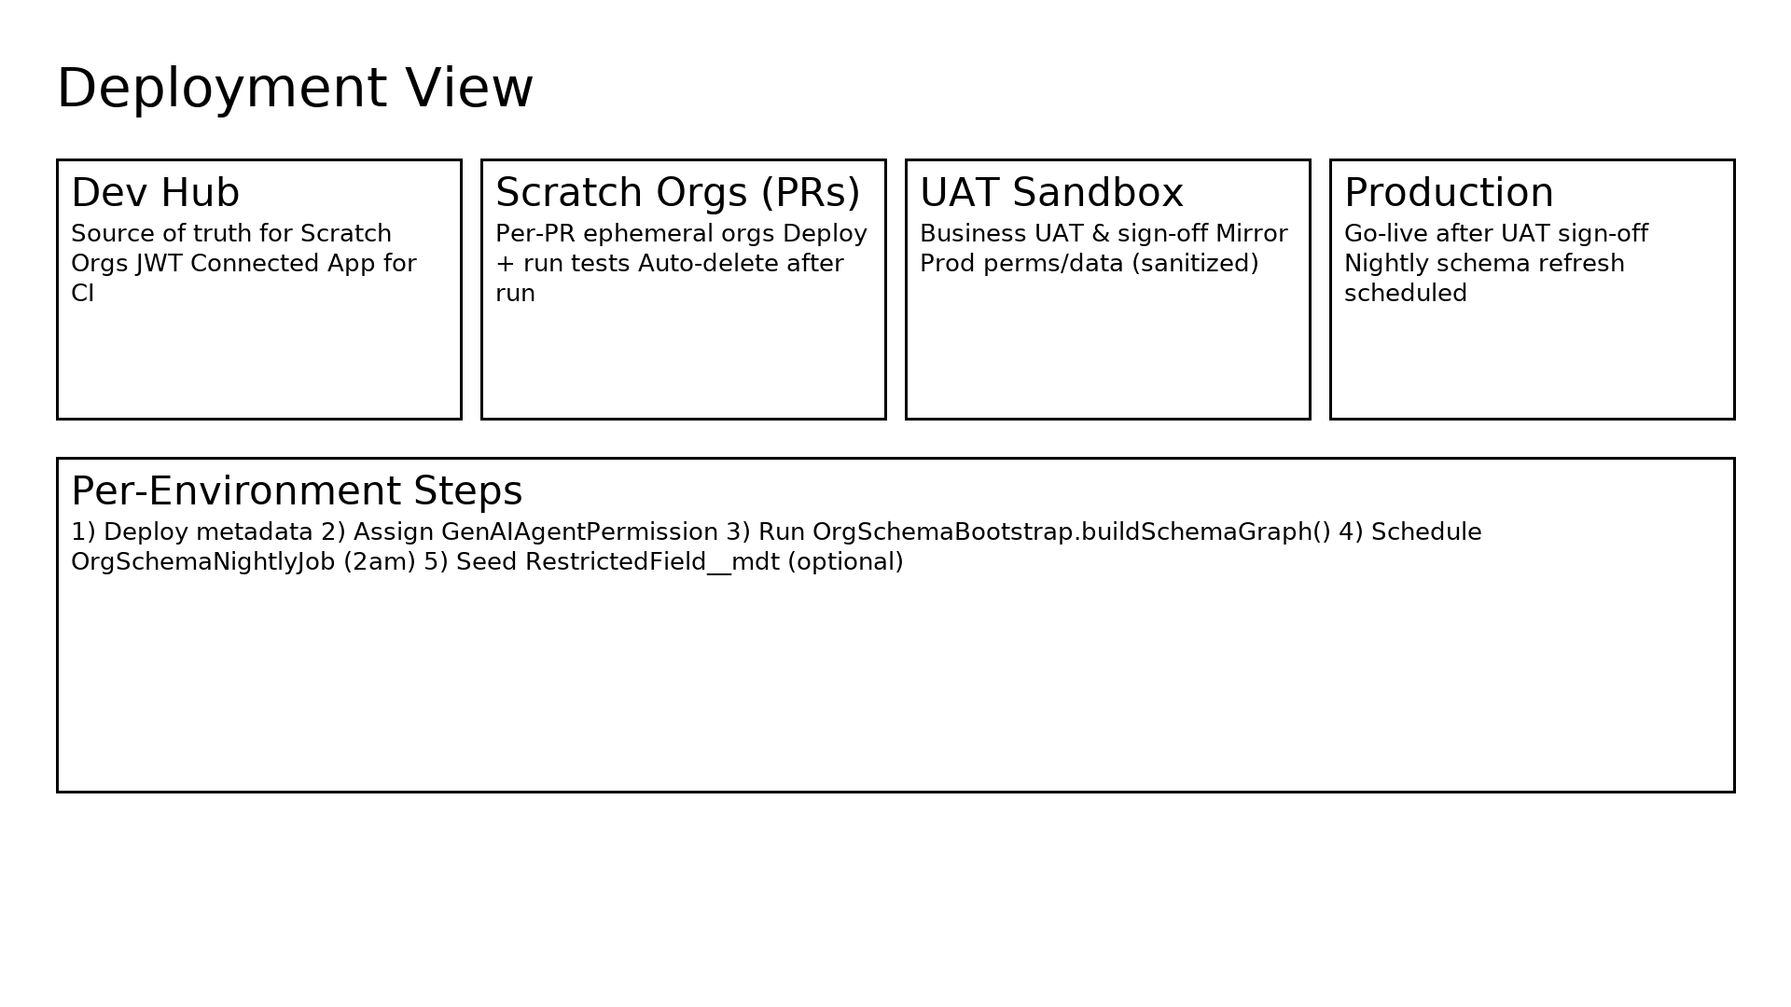
Deployment view

Slide 5
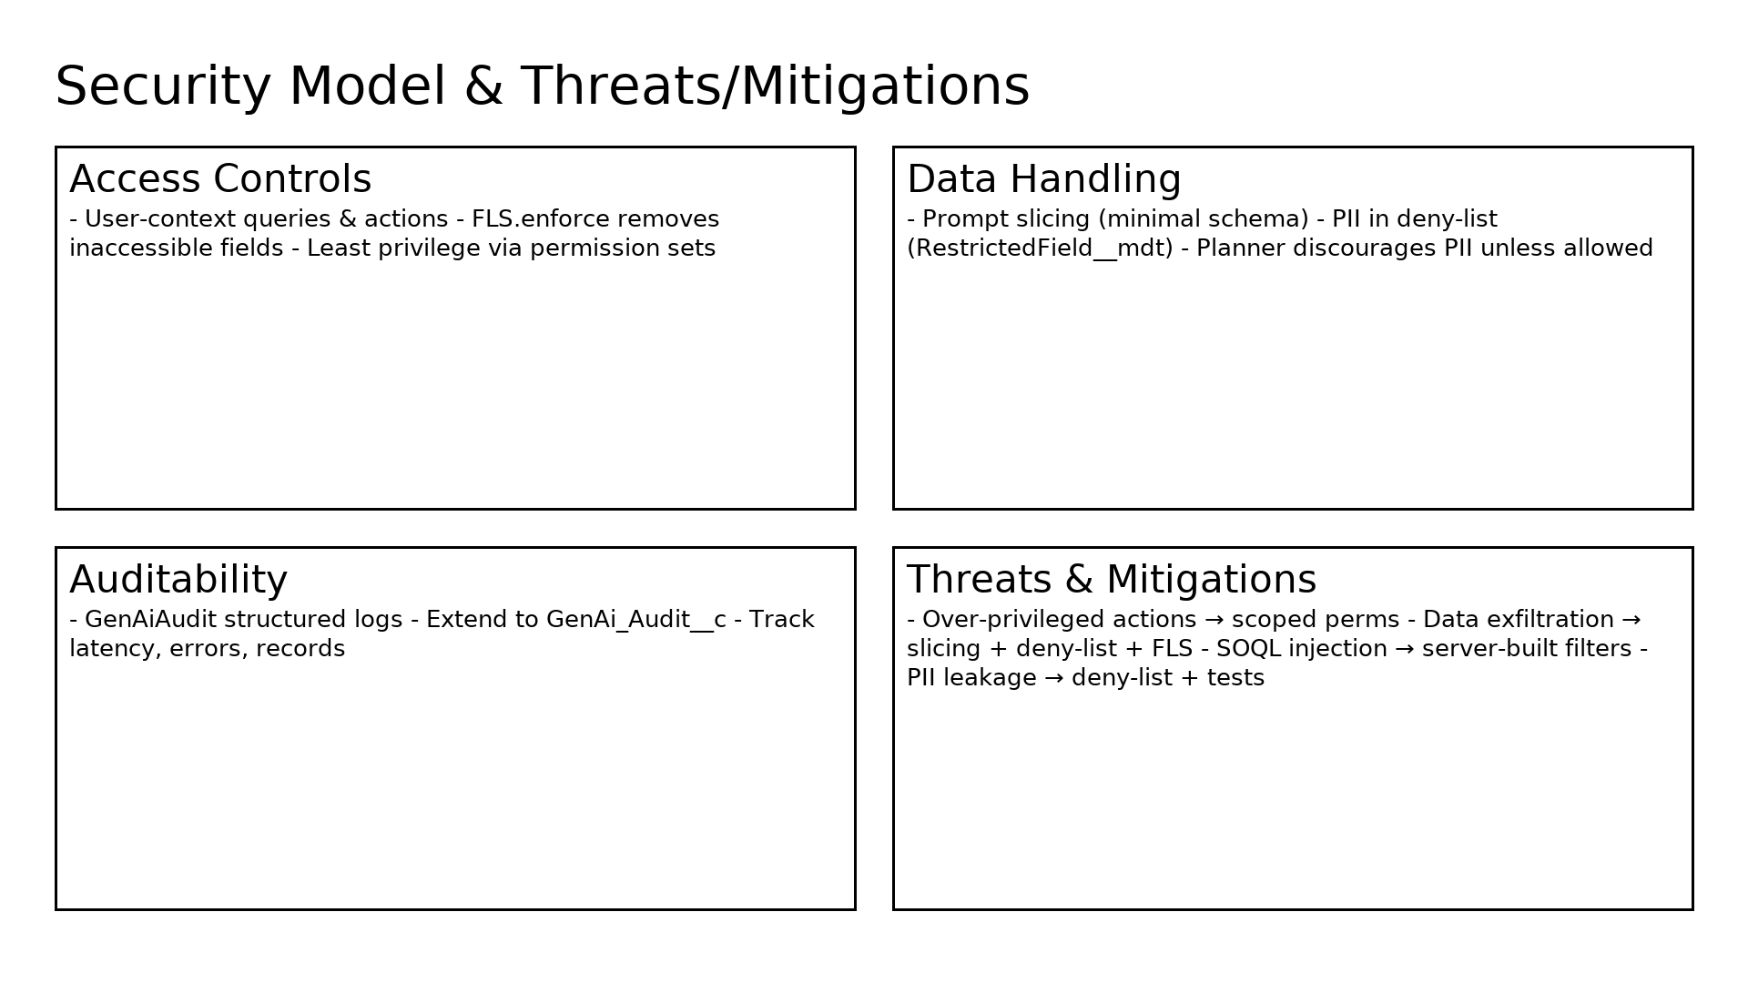
Security model (incl. threats & mitigations)

Slide 6
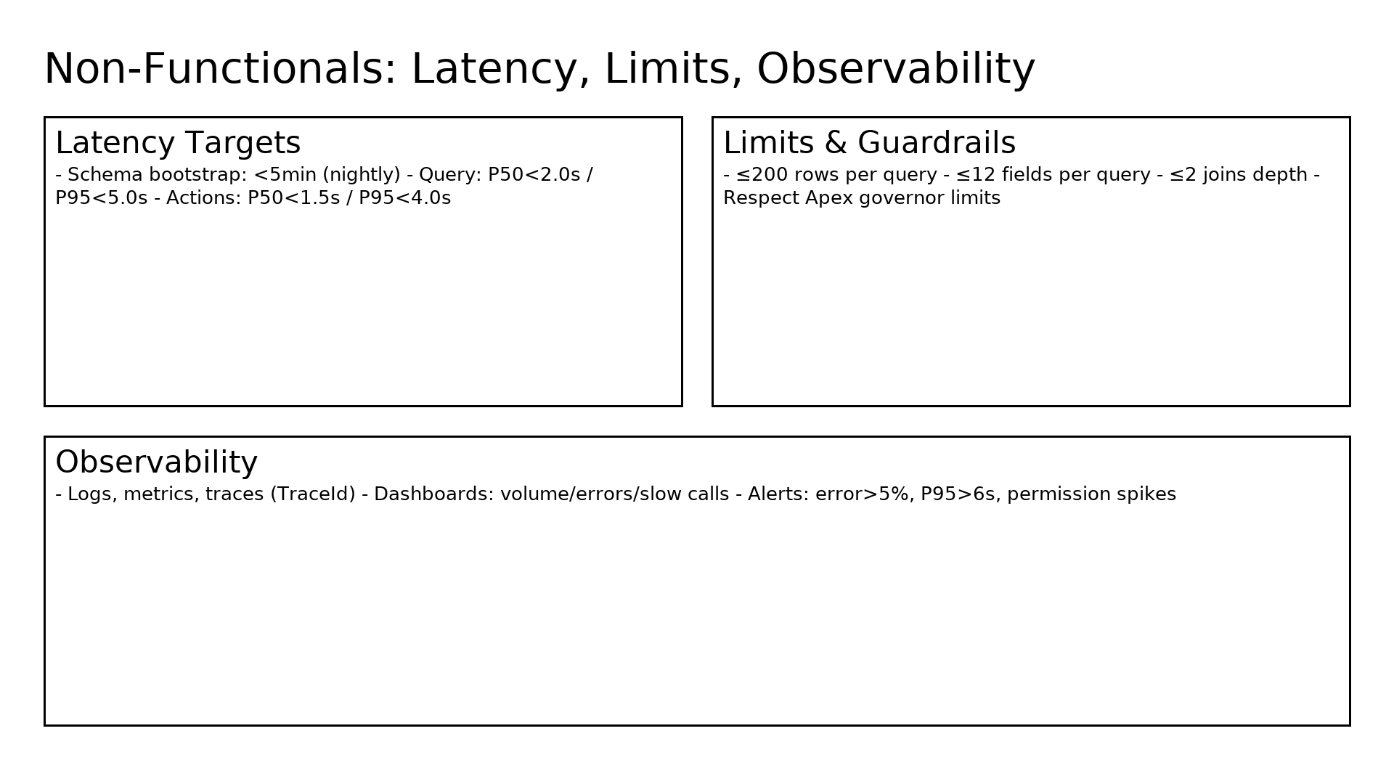
Non-functionals (latency, limits, observability)

Slide 7
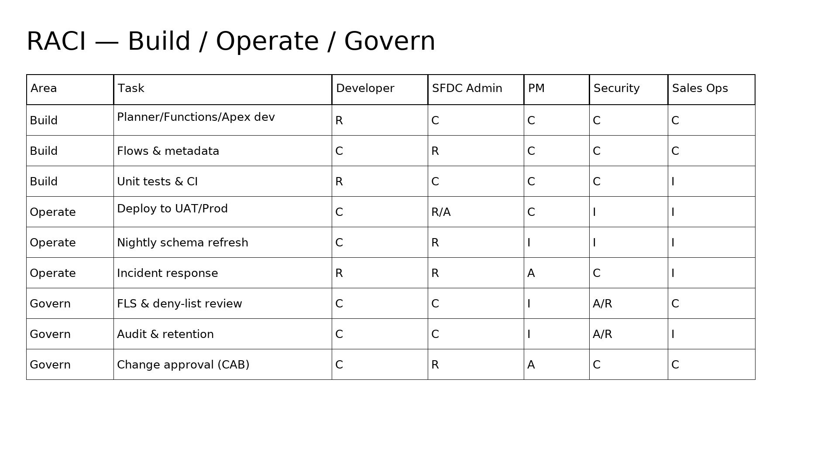
RACI — build/operate/govern

Slide 8
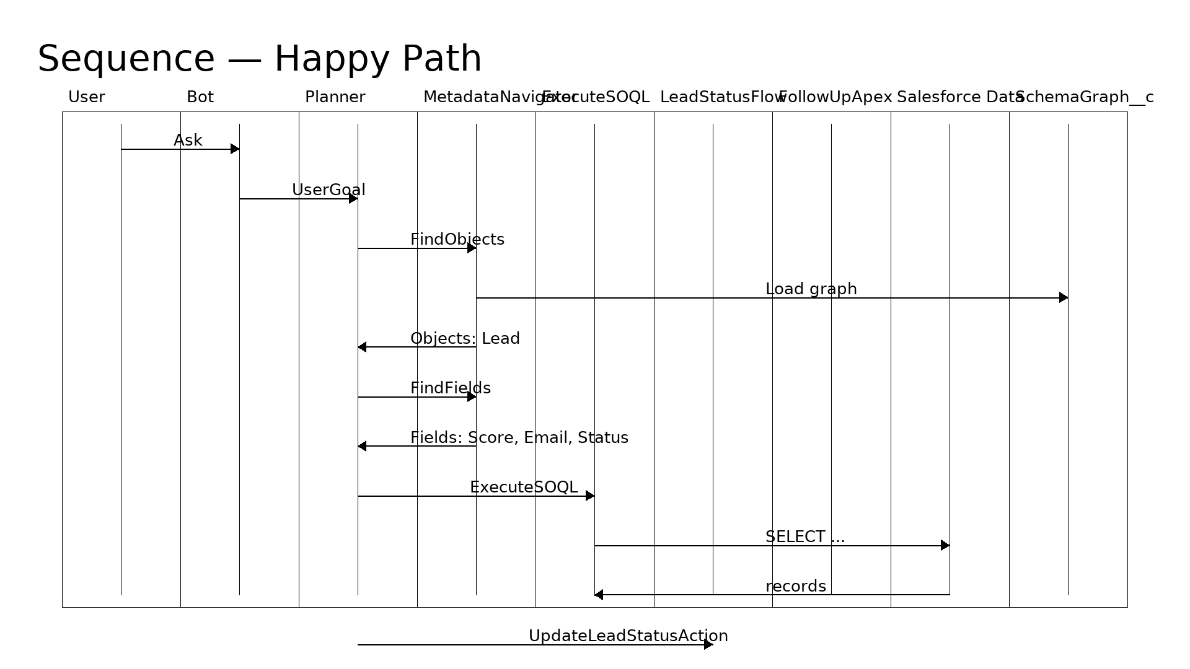
Sequence diagram — happy path

Slide 9
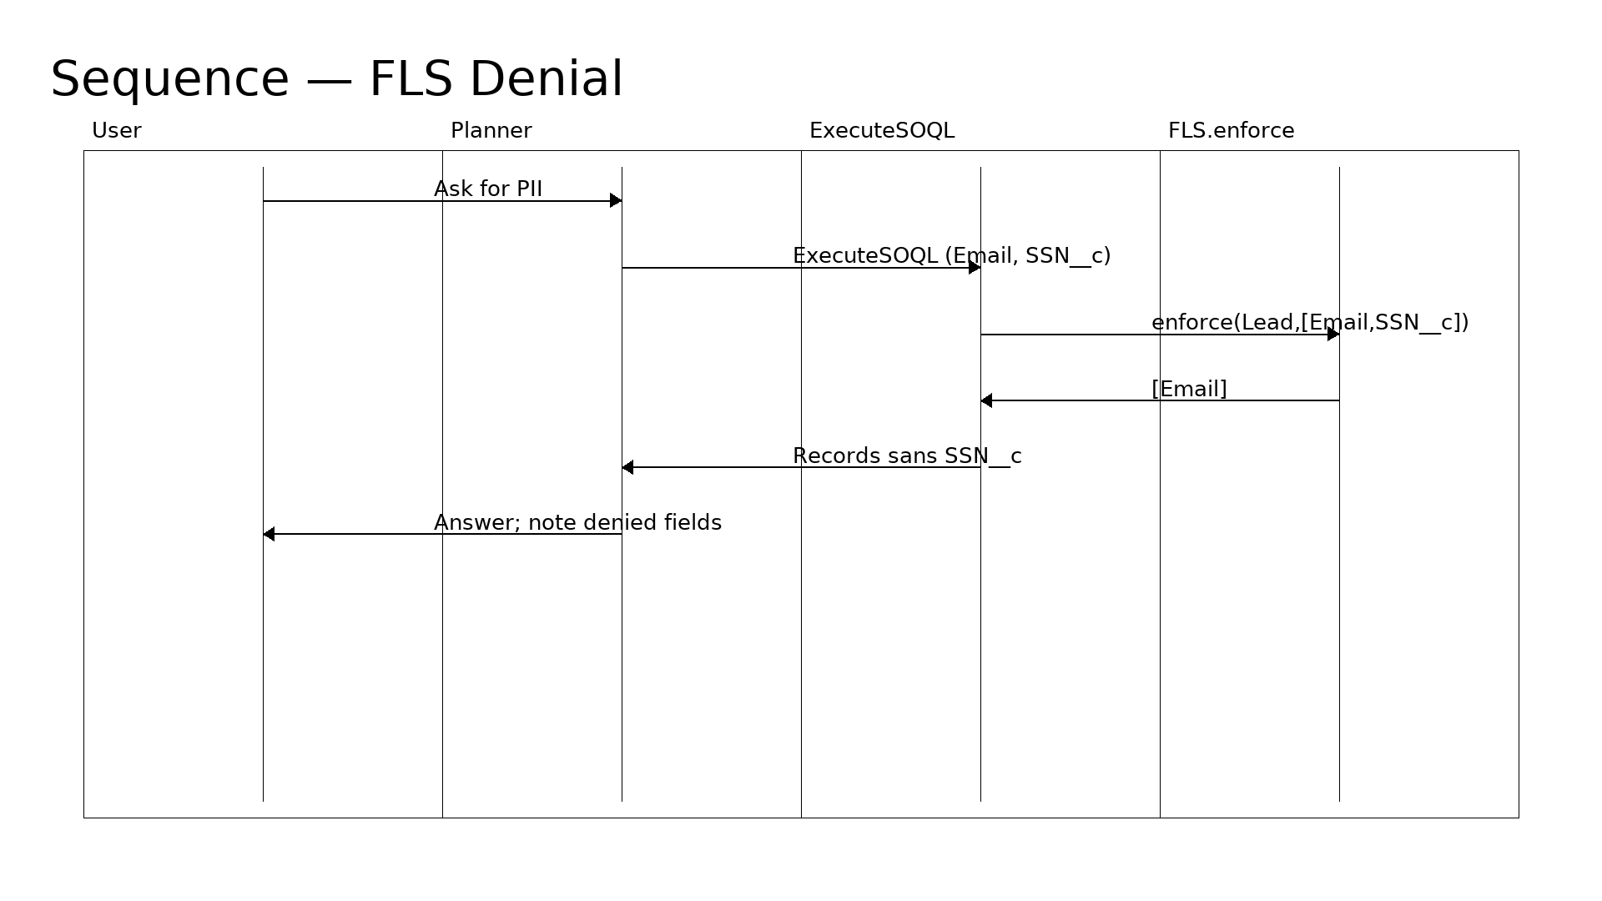
Sequence diagram — FLS denial path

Slide 10
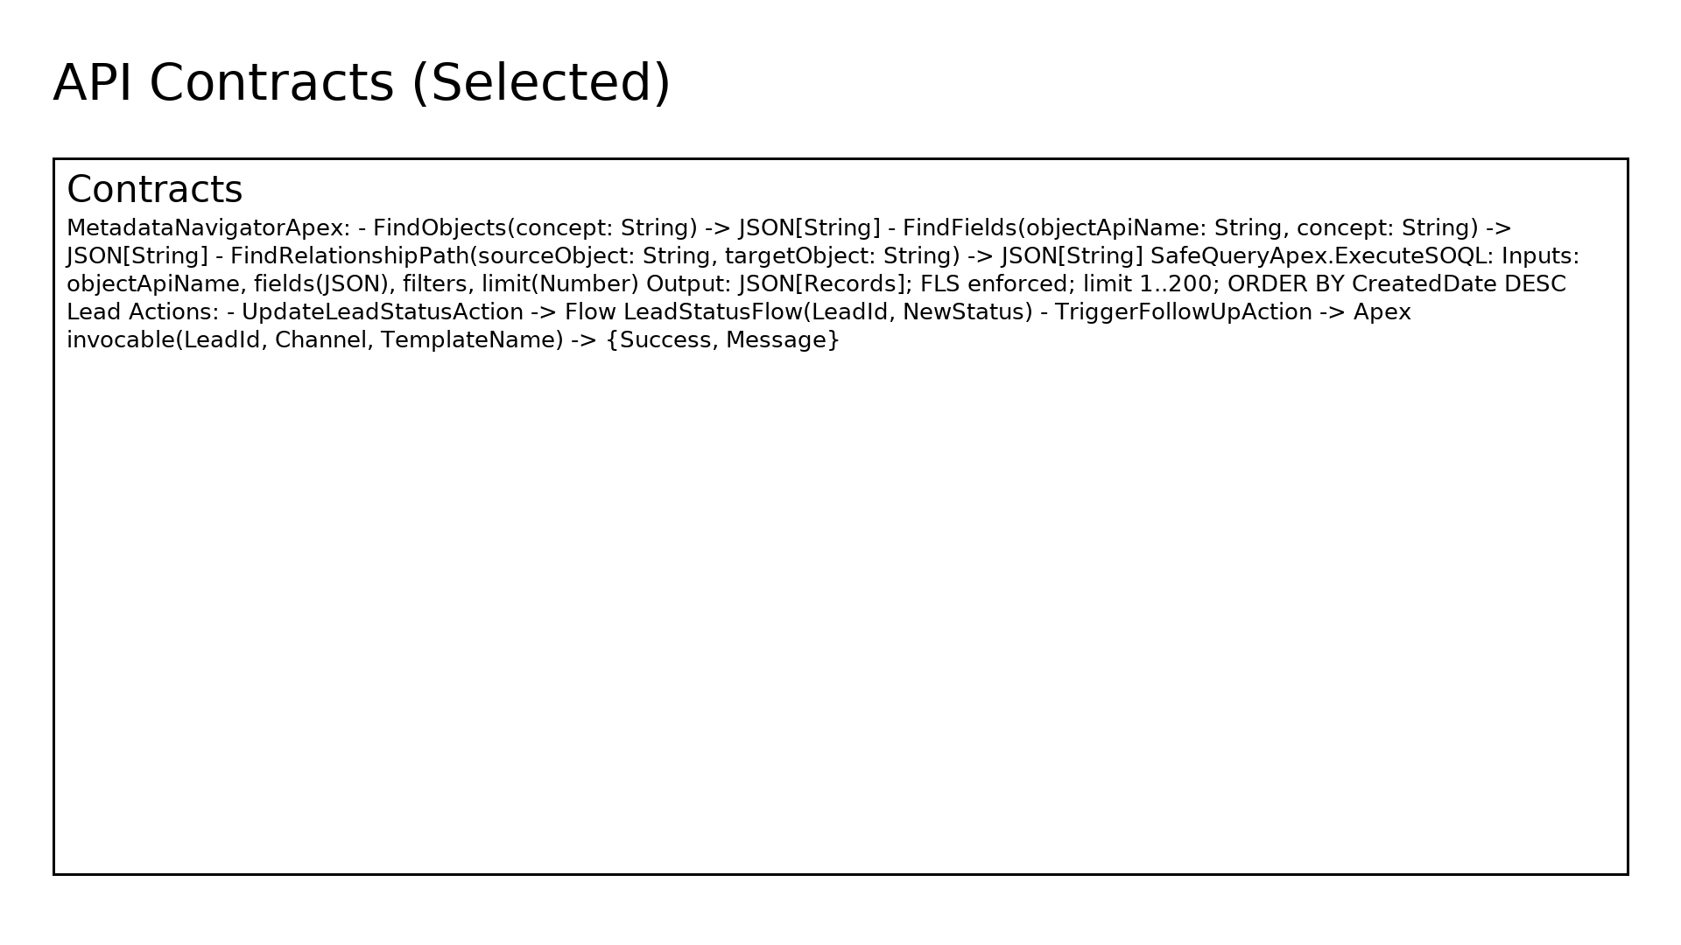
API contracts (selected)

Slide 11
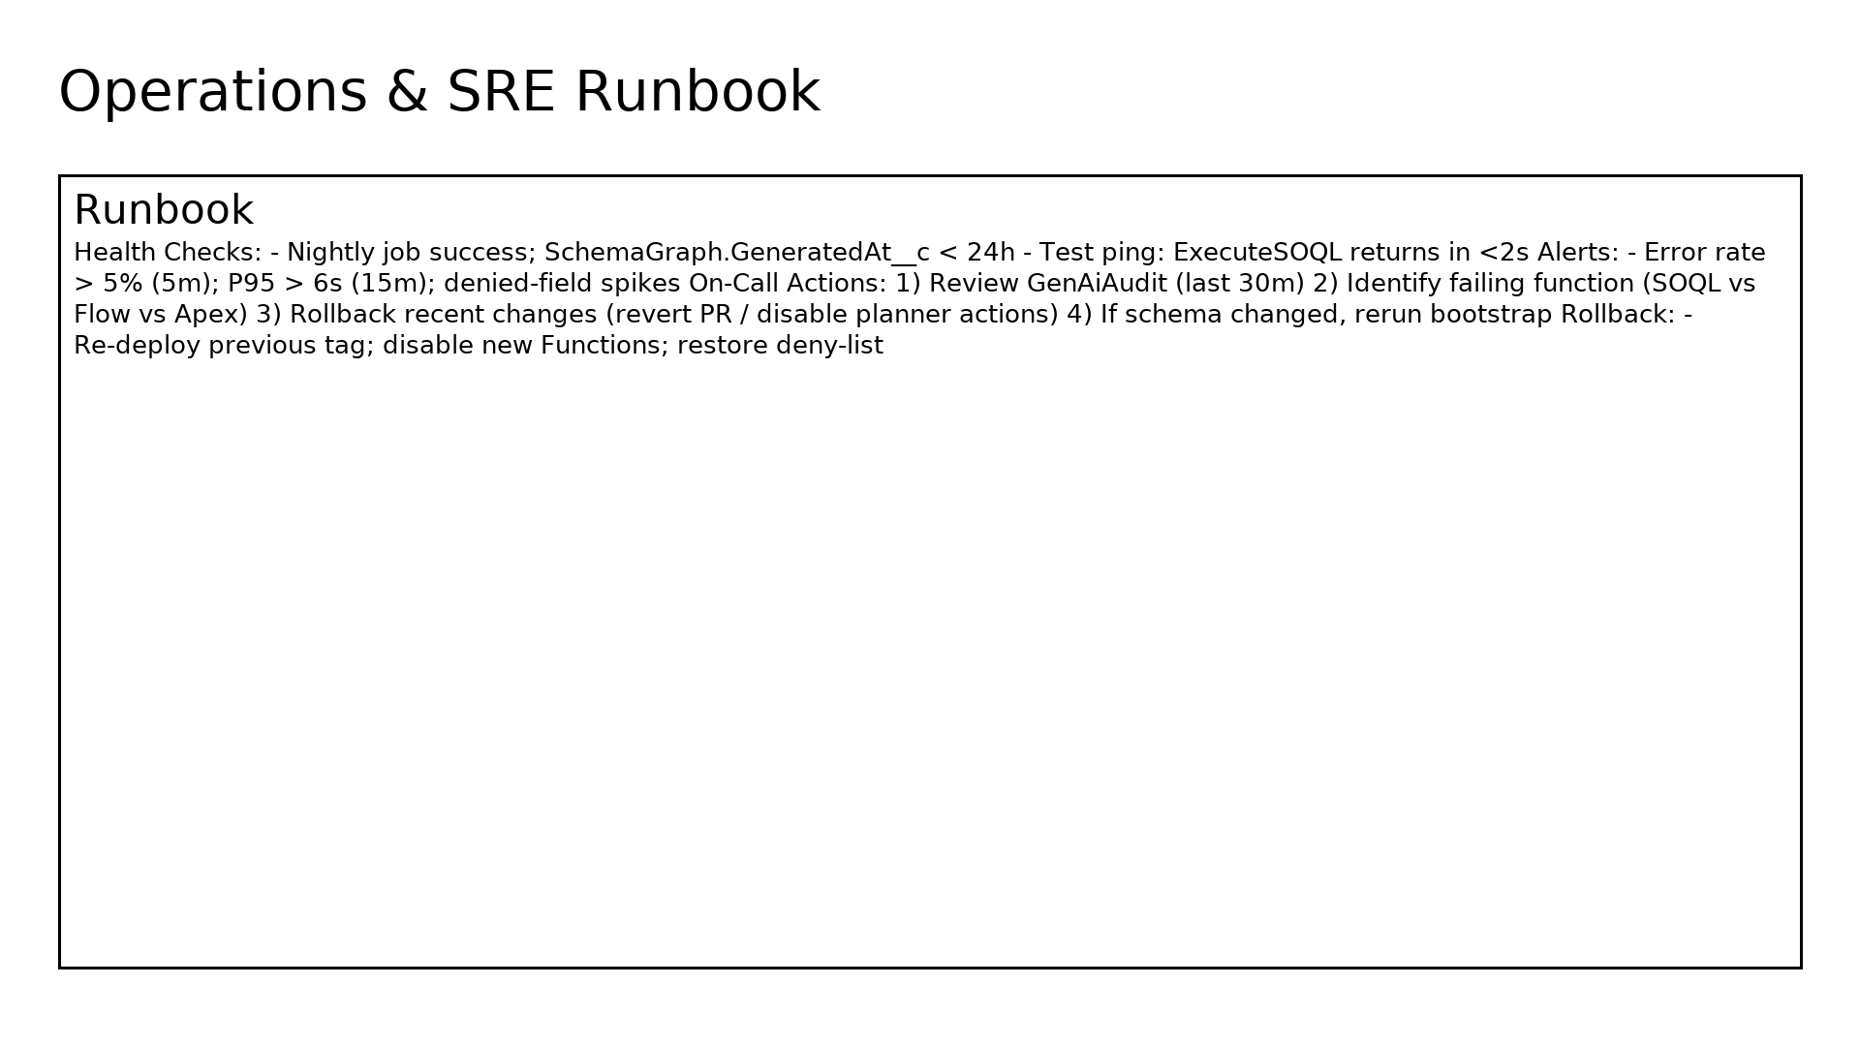
SRE runbook

Slide 12
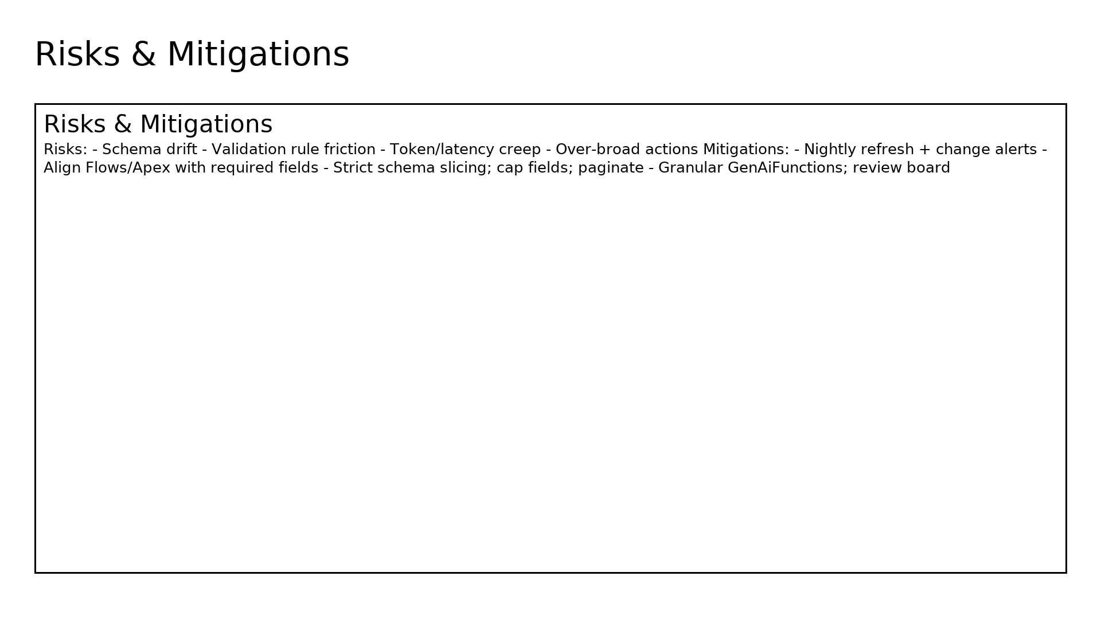
Risks & mitigations

Slide 13
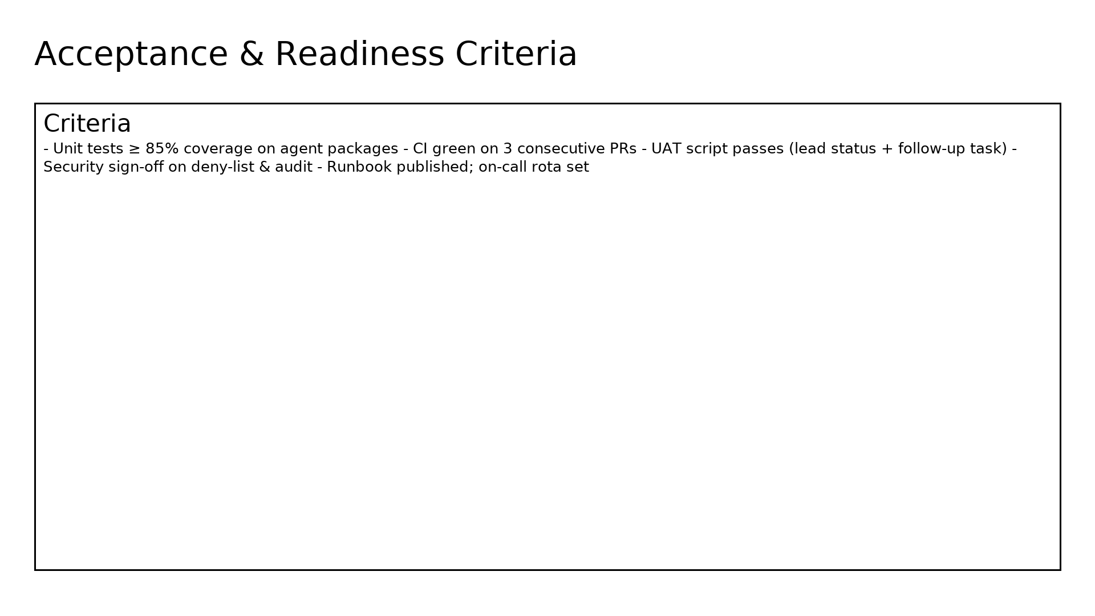
Acceptance & readiness criteria

