Slide 1
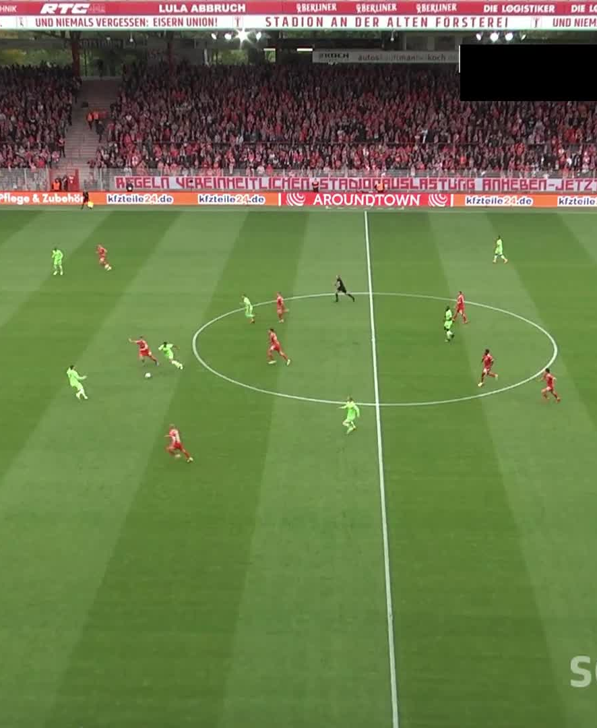
PITCHCLIPERS
Context-aware football
highlight construction
Event proposals, clip policies, and player-ball evidence
Zaid Rafi | Computer Vision project
Notes:
Open with the research question: an action timestamp is not yet a watchable highlight. The system turns proposals into inspectable temporal clips under a viewing-time constraint. Footage is supplied VIDEO.MP4.

Slide 2
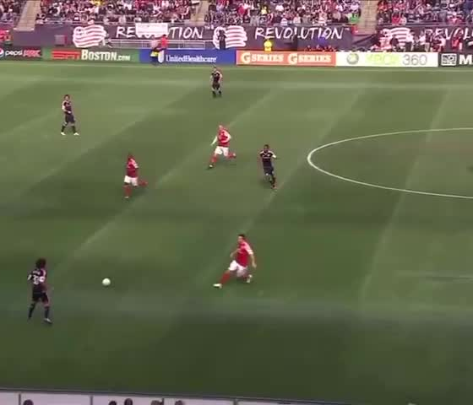
PITCHCLIPERS
Problem and research question
Action spotting answers “when did something happen?”
A highlight must also answer “what context is needed to understand it?”
Research question
How can timestamped action proposals become compact clips that preserve necessary context under a fixed viewing budget?
2 | Zaid Rafi
Notes:
Explain that standard spotting labels evaluate timestamp localization, while a viewer needs build-up and outcome. We separate model confidence from the clip construction decision.

Slide 3
PITCHCLIPERS
System pipeline
Pretrained components
Implemented project layer
Outputs
CALF action spotting
YOLO11 detection
ByteTrack association
Asymmetric / symmetric windows
Overlap-aware merging
Duration-budgeted selection
Context evaluation interface
Per-clip spatial evidence
Timeline
Overlay
MP4 reel
JSON manifest
The contribution is the transparent decoding and evaluation layer. Pretrained models provide evidence; they are not claimed as trained by this project.
3 | Zaid Rafi
Notes:
Be precise in Q&A: CALF, YOLO11, and ByteTrack are pretrained components. Our code implements decoder policies, interval accounting, asynchronous job control, evaluation, tracking summaries, and the interactive workflow.

Slide 4
PITCHCLIPERS
Highlight construction policies
For proposal i = (time, class, score):
Overlap matters
Iᵢ = [max(0, tᵢ - b), min(T, tᵢ + a)]
Raw windows
26.0 seconds
Merged union
17.5 seconds
8.5 seconds removed
Asymmetric baseline: b = 8s, a = 5s
Symmetric baseline: b = a
Budget policy: greedily retain score per added union second
The budget policy is a deterministic proxy. It does not claim to optimize human enjoyment.
4 | Zaid Rafi
Notes:
Explain that merge operates on temporal union, so repeated overlapping footage is not charged twice. The budget heuristic ranks score divided by additional union duration.

Slide 5
PITCHCLIPERS
Context evaluation
Reference interval: the minimum human-judged context needed for an event.
Why union coverage?
Several exported clips may jointly cover an interval. Measuring only the best single clip would understate retained context.
Temporal precision = selected ∩ reference / selected
Context coverage = mean reference fraction covered by selected union
Complete-context rate = reference interval fully contained
Context F1 = harmonic mean of precision and coverage
These are project-defined measures. They require independently reviewed intervals and are intentionally unavailable for the unannotated pilot footage.
5 | Zaid Rafi
Notes:
Do not claim these are standard SoccerNet measures. They are a model-independent evaluation interface for a context-annotation protocol. Without annotations, only duration and decoder behavior are reported.

Slide 6
PITCHCLIPERS
Decoder sensitivity on saved CALF proposals
Fixed confidence threshold: 0.05
Two saved CALF proposals
At default context, merging reduces 26.0s raw windows to 17.5s union duration: 32.7% less repeated viewing.
Recorded from evaluation/decoder_sweep.json. Decoder-only sweep; no accuracy or highlight-quality claim.
6 | Zaid Rafi
Notes:
Evidence source: evaluation/decoder_sweep.json, supplied CALF target. At threshold 0.20, one proposal remains and the default output is 13 seconds. The plot isolates decoder behavior using saved proposals.

Slide 7
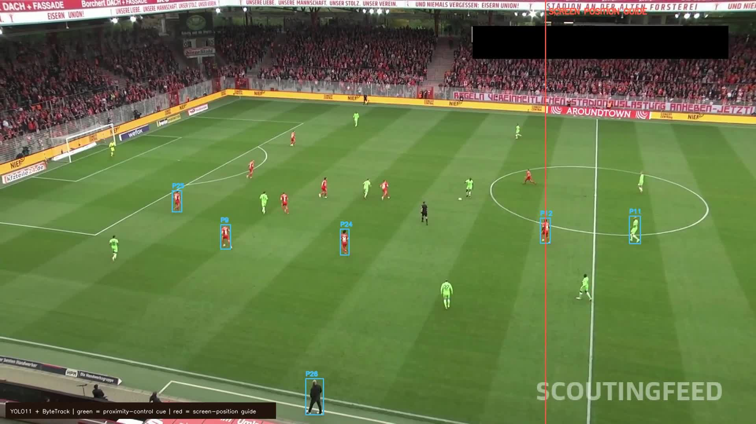
PITCHCLIPERS
Tracking evidence and a visible failure mode
Fresh 30-second run
750 frames
107.4 seconds
6.2 mean players / sampled frame
Ball visible in 1 / 750 frames
1 proximity-control cue
The small ball was mostly missed. The UI reports this as missing evidence, not “no possession.” The red line is a screen-position guide, not an offside decision.
7 | Zaid Rafi
Notes:
This slide is deliberately a failure analysis. The current generic COCO ball detector struggles with a small broadcast ball. A production offside method needs calibrated pitch coordinates, teams, direction, ball, and pass instant.

Slide 8
PITCHCLIPERS
Operational reliability and export
Reliability work implemented
• Serialized CALF fixed output path
• One active job per video
• Asynchronous tracking and export
• Cache-safe tracking result return
• Validated temporal intervals
• Real H.264 MP4 verified at 30.0s
Observed on VIDEO.MP4
8 | Zaid Rafi
Notes:
The fresh tracking time is device-specific. State that the cache makes repeat review near-instant. The actual exported H.264 reel was downloaded and ffprobe confirmed a 30.0-second duration.

Slide 9
PITCHCLIPERS
Live demo
1 Load the supplied sample or a wide-view clip
2 Run CALF event spotting or player-ball tracking
3 Click the timeline, change threshold and context policy
4 Inspect event provenance and per-clip spatial evidence
5 Select clips and download the MP4 reel
Demo fallback
Use the saved sample output if fresh CALF extraction is slow. Make clear that the displayed result is precomputed, then demonstrate policy adjustment and export live.
The interface locks duplicate actions while a job runs and gives a completion message that names the actual completed operation.
9 | Zaid Rafi
Notes:
Live demo script: load sample, run or use saved results, click events, switch to duration budget, show queue duration and exported MP4. Then show tracking overlay and explain the ball-missing limitation.

Slide 10
PITCHCLIPERS
Findings and next experiment
Supported by the current implementation
Next focused experiment
Merging preserves temporal union while removing repeated viewing time.
Context length and score threshold change retained duration independently.
Player detections remain useful when ball evidence is absent, provided missingness stays visible.
Collect independent minimal-context intervals.
Compare fixed, budgeted, and learned policies at equal viewing duration using match-separated splits.
Test whether per-clip spatial evidence improves context coverage.
10 | Zaid Rafi
Notes:
Close with a modest claim: we built and verified an explainable clip-construction system. The next contribution is a proper annotated evaluation, not unsupported accuracy claims.

Slide 11
PITCHCLIPERS
Backup: technical questions
What is learned here?
The app currently uses pretrained CALF, YOLO11 and ByteTrack. Threshold grid fitting is parameter selection, not a learned neural selector.
Why is offside not solved?
The current red guide only uses screen coordinates. Offside requires field calibration, team identity, attack direction, ball location and pass timing.
What prevents leakage?
Any future selector must use match-separated splits; overlapping windows from a match cannot cross train/test boundaries.
11 | Zaid Rafi
Notes:
Use for Q&A. Be direct about reused pretrained components and distinction between the tested deterministic policy and a future learned selector.

Slide 12
PITCHCLIPERS
Backup: references
A. Deliège et al., SoccerNet-v2, CVPRW 2021.
A. Cioppa et al., A Context-Aware Loss Function for Action Spotting in Soccer Videos, CVPR 2020.
Y. Zhang et al., ByteTrack, ECCV 2022.
J. Redmon et al., You Only Look Once, CVPR 2016.
S. Giancola and B. Ghanem, Temporally-Aware Feature Pooling, CVPRW 2021.
C.-L. Zhang et al., ActionFormer, ECCV 2022.
Experiment artifacts: evaluation/decoder_sweep.json; local job records for VIDEO.MP4; exported H.264 reel.
12 | Zaid Rafi
Notes:
References used in report and presentation. Numbers on result slides trace to saved evaluation artifacts and local job records.

