Slide 1


Practical intro to Seurat R package for scRNAseq analysis: Details tutorials did not specify but you should know
11 Nov 2022
Quang Nguyen
PhD student, Persephone Borrow, OXCIO
CD8 T cell immunology
quang.nguyen@ndm.ox.ac.uk
QNNDuke
QNNDukeNguyen

Slide 2
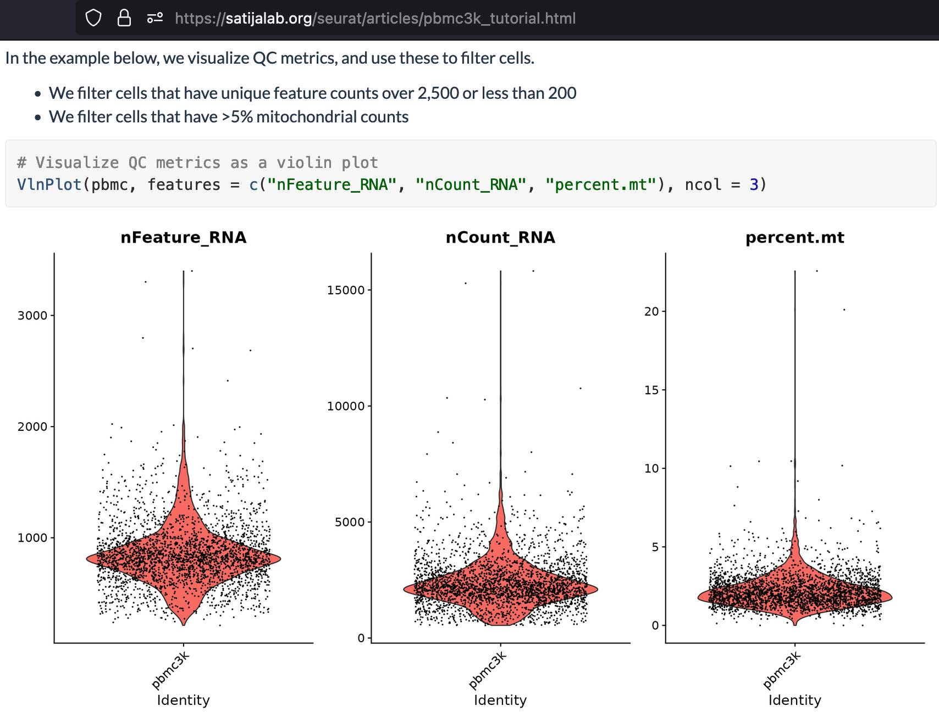
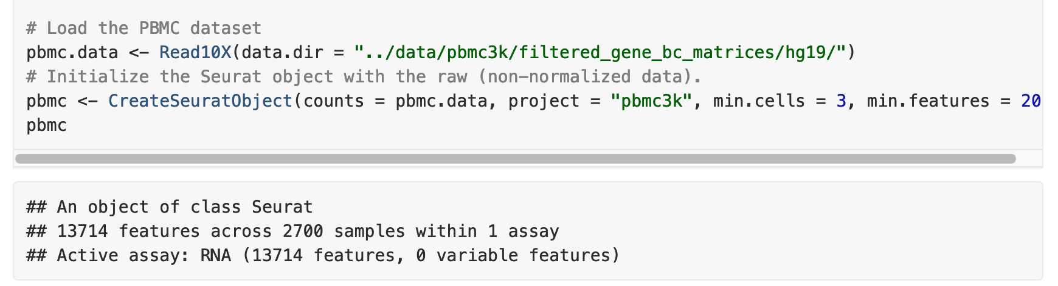
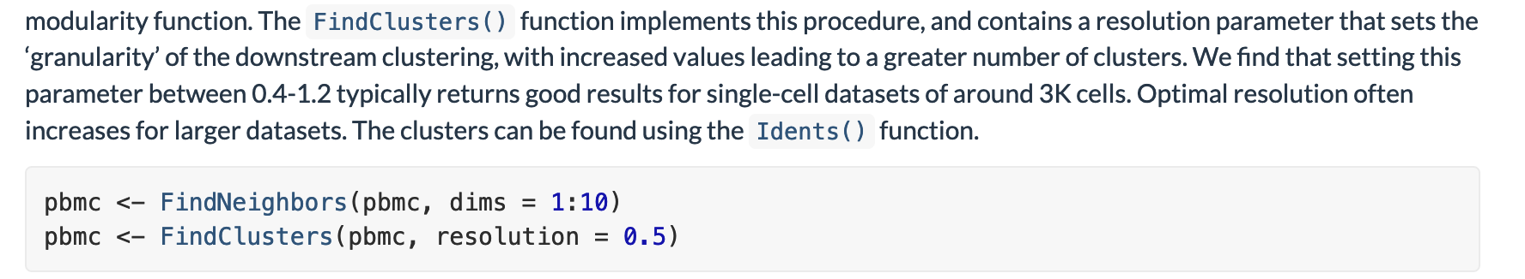
Online resources often assumed you who why and how
But, QC
is
data-specific exercise!
😱 😱 😱
https://satijalab.org/seurat/articles/pbmc3k_tutorial.html

Slide 3
What will we discuss today?
Objectives | mins
Sign in Enter poll: https://bit.ly/IntroSeurat_Enter Install packages | 5
Overview of Seurat pipelines from count matrix to clusters | 5
QC of count matrix 1. Remove low-quality genes 2. Remove low-quality cells SMALL EXERCISE: Why this nFeatures threshold? – 10mins 3. Clustering resolution (clustree R package) | 25
Cluster annotation methods manually with DEGs MEGA EXERCISE: Are there more CD8 or CD4 T cells in PBMCs?– 10mins | 20
Exit poll: https://bit.ly/IntroSeurat_Exit | 5
Notes:
https://admin.typeform.com/accounts/01GHHK0YY4MX65ECJ7MJGWEKKE/workspaces/DTErwe

Slide 4
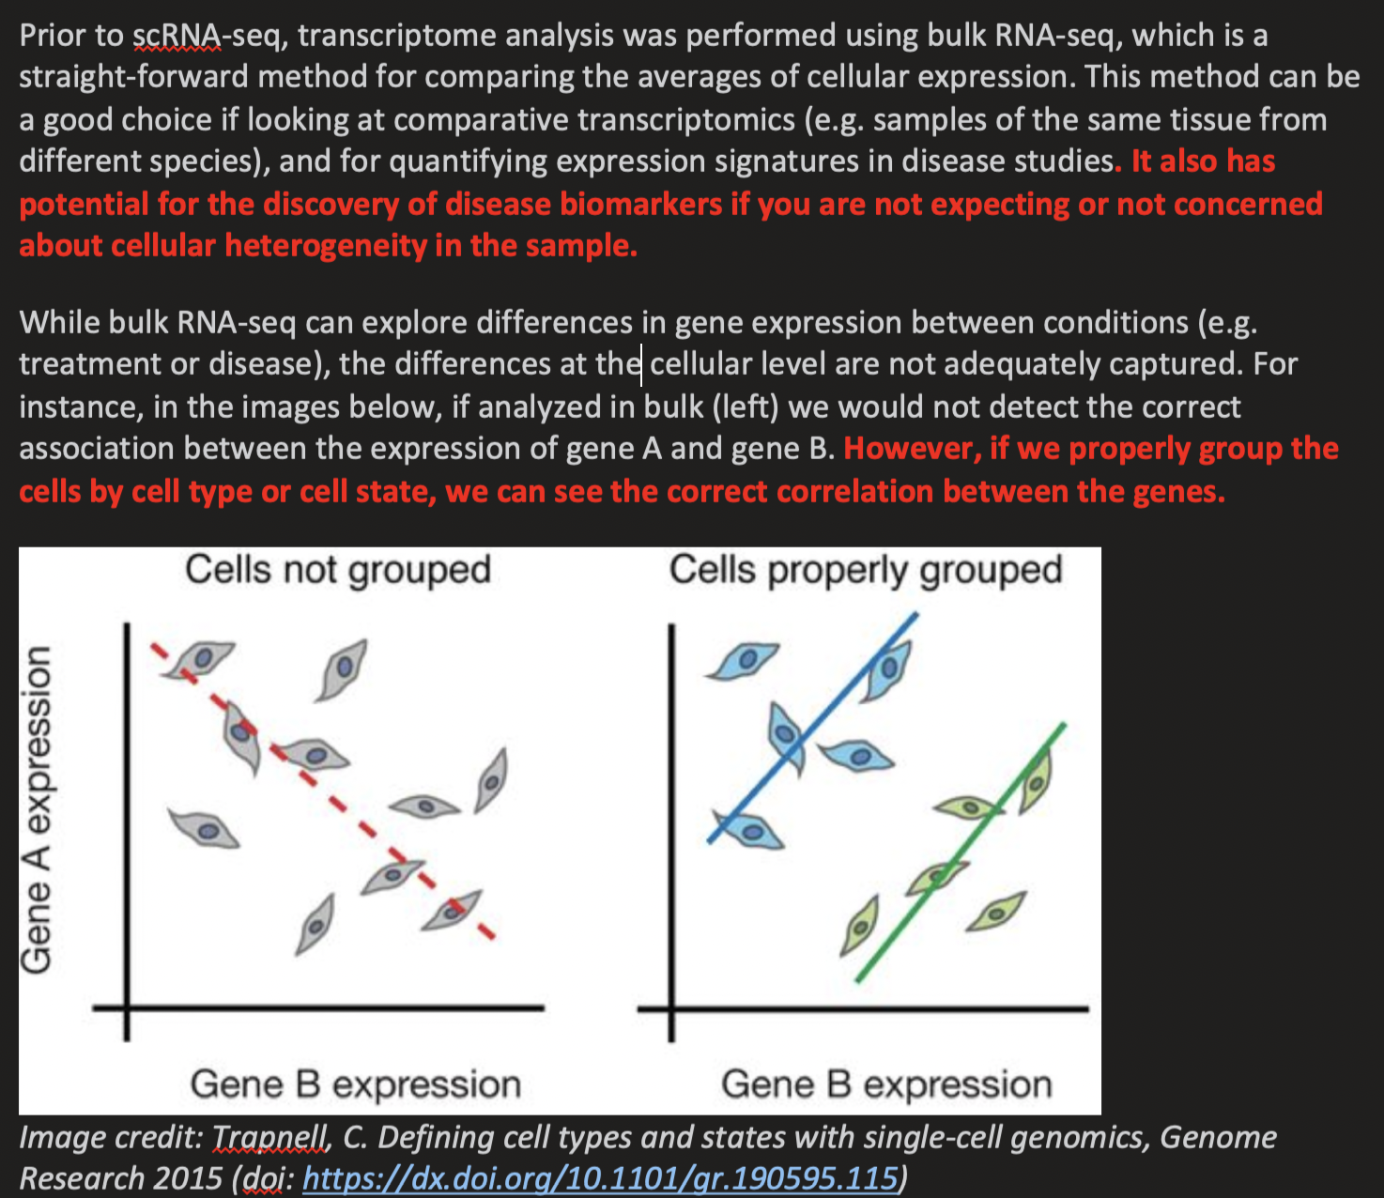
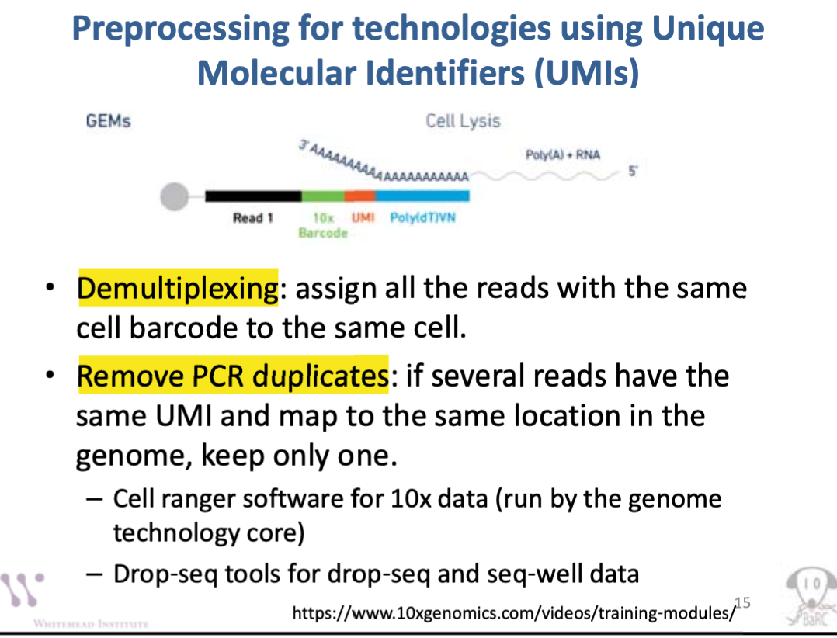
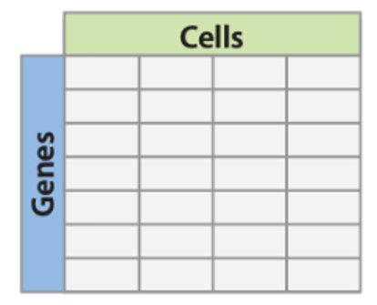
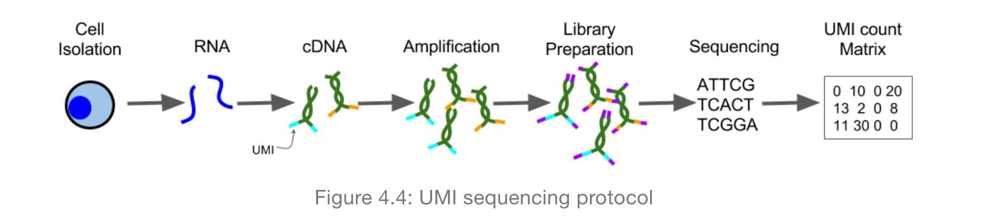
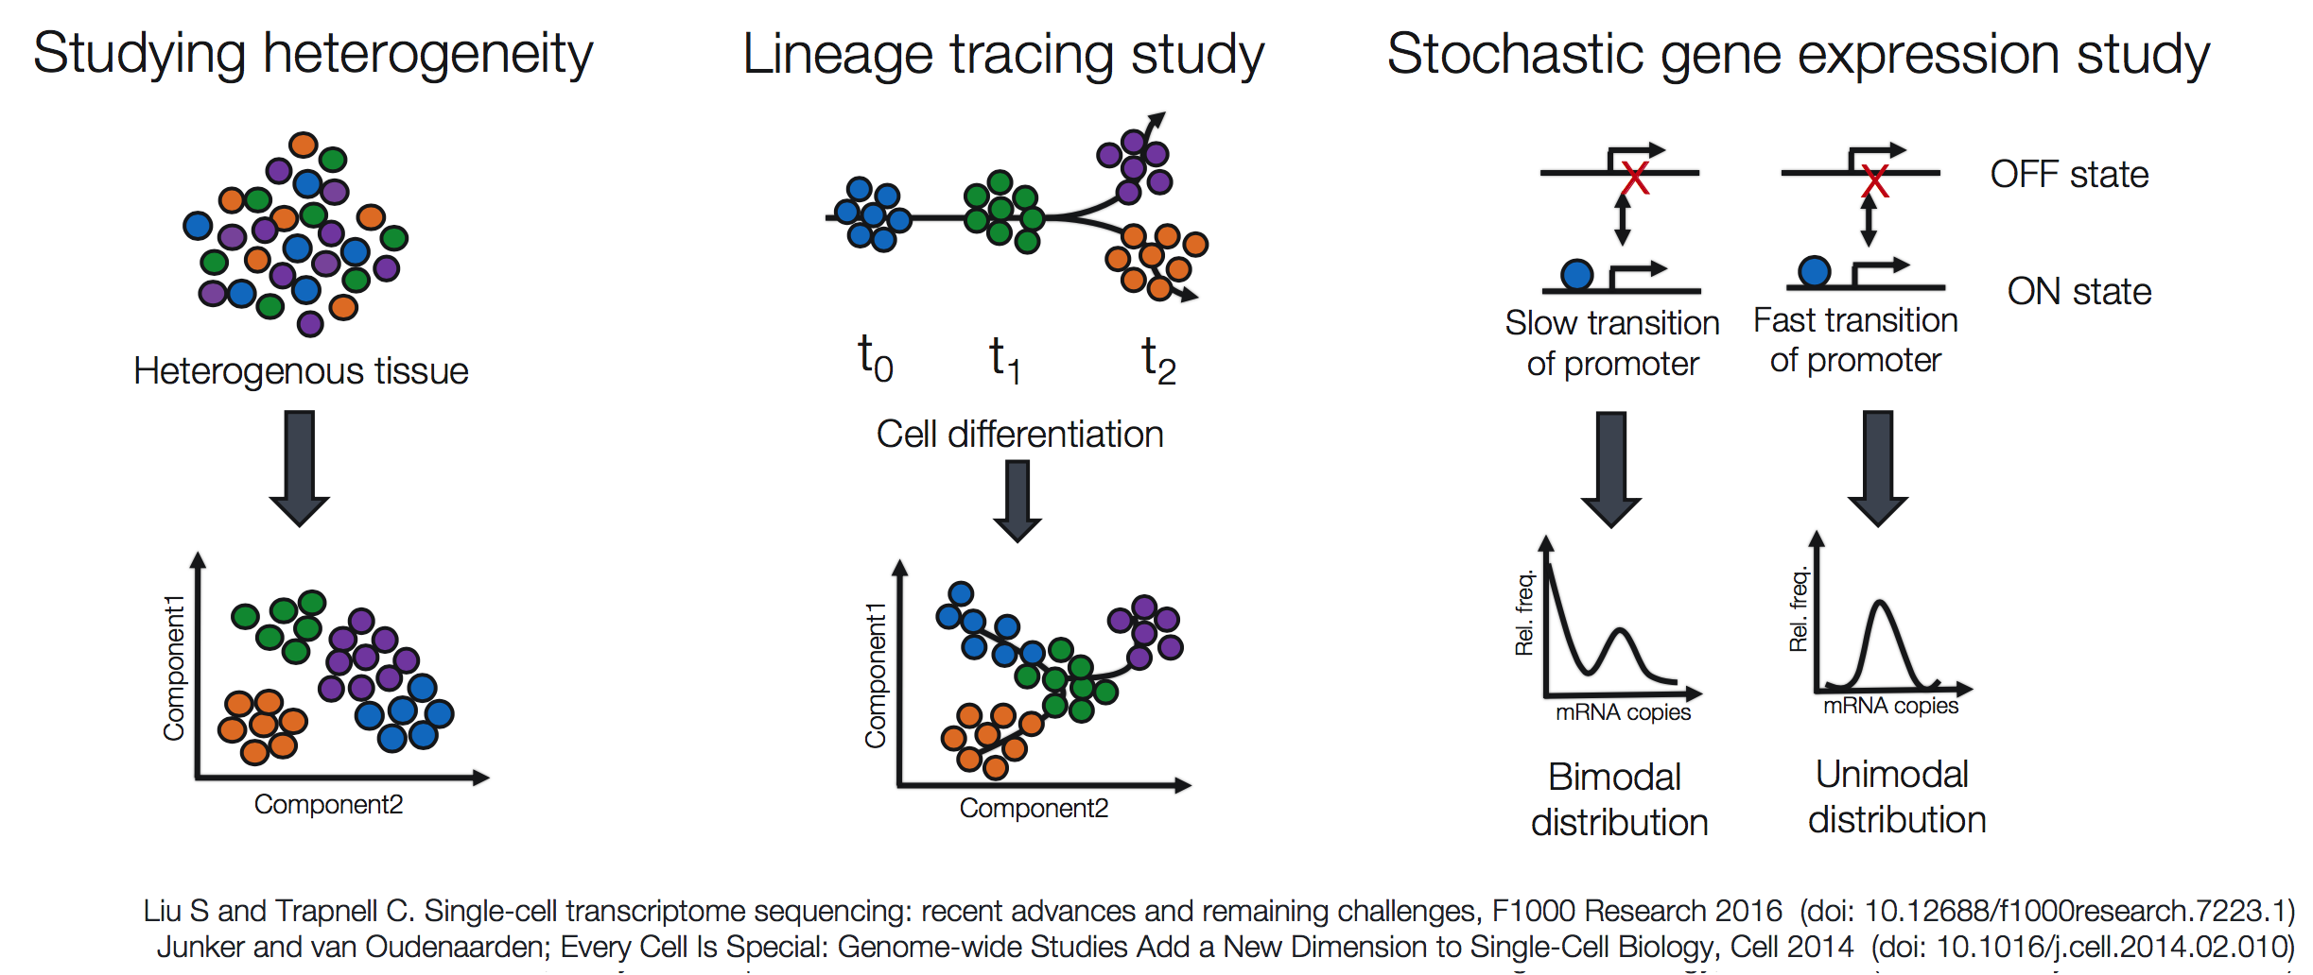
Overall Seurat pipeline
Regression during normalization
Adjust during DEG
Normalization & scaling
UMI count matrix from RNA-seq of 2,700 single PBMCs from 10X
Remove low-quality genes & cells
Identify cell-cell highly variable genes
Filter
low-quality genes
Filter
low-quality cells
Number of RNA molecules for each gene detected in each cell
Dimensionality reduction
Clustering
PC selection
DEG & Cluster annotation
Notes:
Multiple reads that map to the same UMI will only count once.
For UMI-based protocols, which is what most people use, each transcript is labeled with a barcode, so longer genes would not be expected to have more counts.
For UMI-based protocols, which is what most people use, each transcript is labeled with a barcode, so longer genes would not be expected to have more counts.
Counts per gene is counting all transcripts mapping to a gene, referred as transcript
For example, the 50th percentile (the median) is the score below which 50% (exclusive) or at or below which (inclusive) 50% of the scores in the distribution may be found. The percentile (or percentile score) and the percentile rank are related terms.
Filtering out low-transcript count cells also helps with doublet removal!
Number of genes nFeature and nUMIs (nCount) are automatically calculated for every object by Seurat.
For non-UMI data, nUMI = sum of non-normalized values in a cell.
nFeature_RNA is genes/cell
nCount_RNA is UMIs/cell
Question: Which reads are considered for UMI counting in cellranger count?
Answer: When counting UMIs, Cell Ranger only consider reads that have a valid UMI and a valid 10x barcode. Further, Cell Ranger considers reads which meet all of the following criteria:
Has a MAPQ of 255
Maps to exactly one gene (as shown in the GX tag of the BAM file alignment record)
Overlaps an exon by at least 50% in a way consistent with annotated splice junctions and strand annotation.
Multiple reads that map to the same UMI will only count once.
For more information please see Algorithms Overview.
Seurat workflow (green) begins with gene and cell filtering and log2-normalization of filtered raw RNA UMI count matrices. Normal
ized data are then centered and scaled prior to regression of the undesirable sources of variation.
Genes that are abundantly and
variably expressed are then defined and used as input for PCA and unsupervised clustering and subsequent literature annotation.
These results can then be applied to miscellaneous downstream analyses.
In the standard Seurat workflow, variably expressed genes are then defined via dispersion and mean expression
thresholds. In this study, thresholds were chosen that identified 2000 total genes, as described previously (Satija et al., 2015; Butler
et al., 2018). PCA is then performed using this set of variably expressed genes, and statistically-significant PCs are selected (e.g., via
inflection point estimation on PC elbow plots).
Because the distribution of our data (with a lot of “outliers”/ very skewed) differ greatly from that of the tutorial, we decided to use percentiles as thresholds and not the mean and SDs
Unique molecular identifiers (UMIs) make it possible to count the absolute number of molecules and they have proven popular for scRNA-seq.
Unique Molecular Identifiers are short (4-10bp) random barcodes added to transcripts during reverse-transcription.
They enable sequencing reads to be assigned to individual transcript molecules and thus the removal of amplification noise and biases from scRNASeq data.
When sequencing UMI containing data, techniques are used to specifically sequence only the end of the transcript containing the UMI (usually the 3’ end).
The transcriptome is the complete set of transcripts, including mRNA, rRNA, tRNA,
and other non-coding RNA produced in one or a population of cells for a specific
developmental stage or physiological condition.
Trajectory: https://www.frontiersin.org/articles/10.3389/fimmu.2018.01435/full
Run pseudo-time analysis to identify trajectories of differentiation
Because our data probably captured T cells asynchro-nously transitioning from one transcriptomic state to the next,
we performed pseudotime analysis, capturing a linear trajectory pro-gressing from naïve-like cells at the start to memory, TRM, GZMK+ effectors and culminating with IL26+ cells (Fig. 3b,c).
To understand the biological processes driving pseudotime components, we asked which genes covary in expression with pseudotime.
# orderCells function to capture cell trajectories
# with starting pseudotime state denoted as the end of the trajectory that was found to be enriched for naive T cell clusters
# Like DGE analysis, R package MAST to detect genes significantly covary with pseudotime
# based on log-likelihood ratio test between model formula including cell pseudotime
# and a reduced model formula
Compare with public dataset:
Employ data from CXCR5-CD8 T cells as a control transcription profile in clustering algorithm.
Also compare to data from CXCR5+PD1hi CD4 Tfh cells
Determine if dual-expressor cells (or progenitors) are present in the bone marrow (Todd’s dataset)
Future directions:
Multi-omic CITE-seq analysis to validate single cell signatures at (surface, not secreted – can be by ELISA) protein level and further sub-clustering (to map proteins to clusters defined by transcriptomes) [1]
Multimodal single-cell analysis with CyTOF to define protein-expression-driven clusters and signature co-expression in both proteins and mRNA [1] (Loose cells which is problematic for rare cell types, low throughput) → Spectral flow cytometry instead
Analyses in HIV+ versus HIV- and BNAb versus non-BNAbers

Slide 5
Let’s do some R
Download and open R notebook: https://github.com/denvercal1234GitHub/learntoRfromNothing/blob/043c9af5500d7d7bf09676f4c9e0c7e07177a834/2022Nov11_IntroToSeuratWorkshop_QNN/2022Nov11_IntroToSeuratWorkshop_QNN.Rmd

Slide 6
Best QC practices
QC is data-specific, iterative process, e.g., cell types, post-clustered visualization
Visualize your data by different ways when setting thresholds
Automated QC thresholds can serve as a guide
Use a combination of QC metrics to filter your own data
For cluster annotation, use biological knowledge (and automated cluster prediction)

Slide 7
Useful resources
Seurat | https://github.com/satijalab/seurat/issues
About Seurat object as a class (slots, …) | https://github.com/satijalab/seurat/wiki
Classification of low quality cells from single-cell RNA-seq data (Sarah A. Teichmann, 2016) | https://www.ncbi.nlm.nih.gov/pmc/articles/PMC4758103/
RNA-seq analysis workshops | https://github.com/hbctraining/scRNA-seq_online/blob/master/lessons/readMM_loadData.md https://broadinstitute.github.io/2020_scWorkshop/

