Slide 1
Next step

Slide 2
Song 000
Song 001
Song 002
…
Song 007
Select song
Song 008
…
Song 015
Change instrument
Song 016
…
Reset position

Slide 3
Pimironi PICO
Audio
Audio Out
I2S interface via GPIO
Raspberry PICO
(MIDI USB host)
Novation Launchpad mini
MIDI via USB
reset position(GPIO 13)
stay in position / progress position (GPIO 14)
stay in position / progress position (GPIO 15)

Slide 4
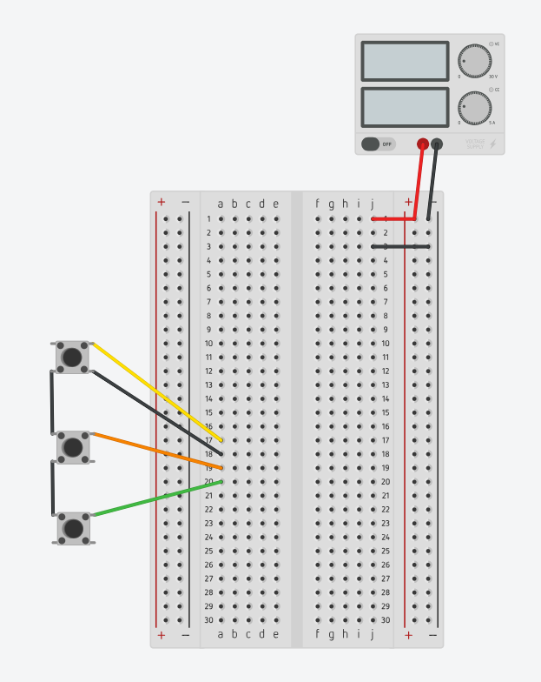
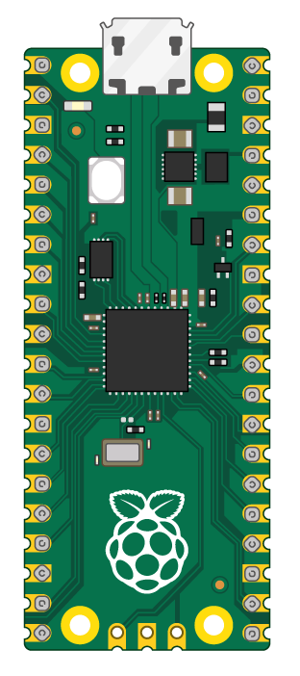
5V DC
1A
USB to Launchpad
Stay / progress
GND
GND
Stay / progress
GND
Reset position

Slide 5
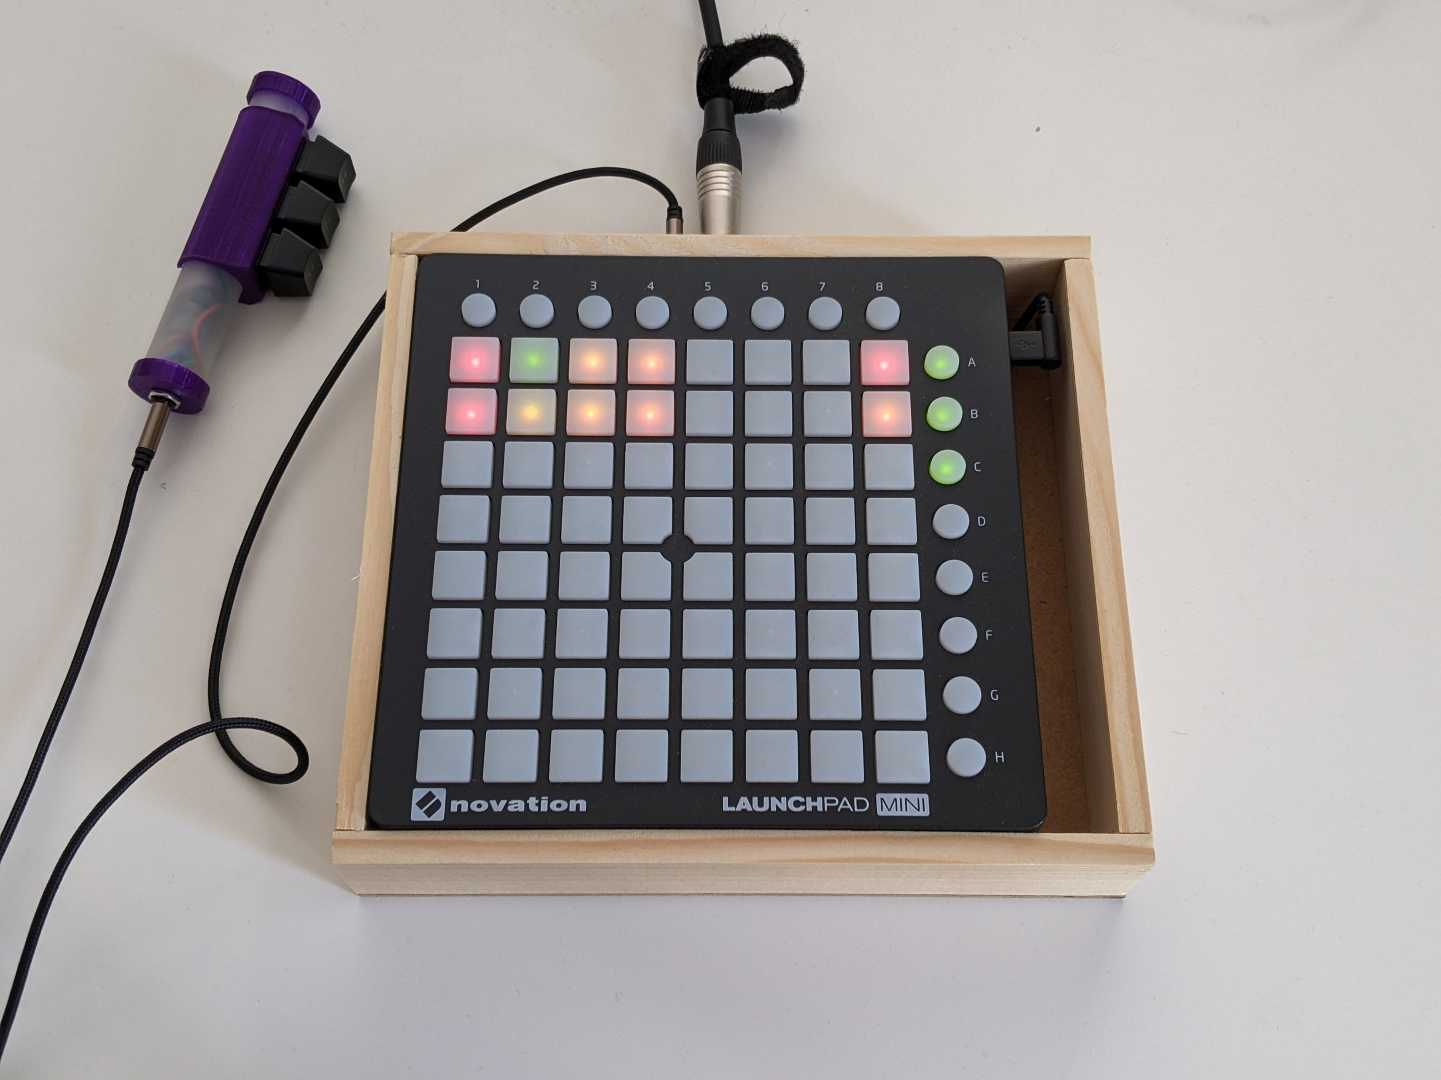
TRRS cable for external optional controller
Audio out (line out)
Novation Launchpad mini
external optional controller

Slide 6
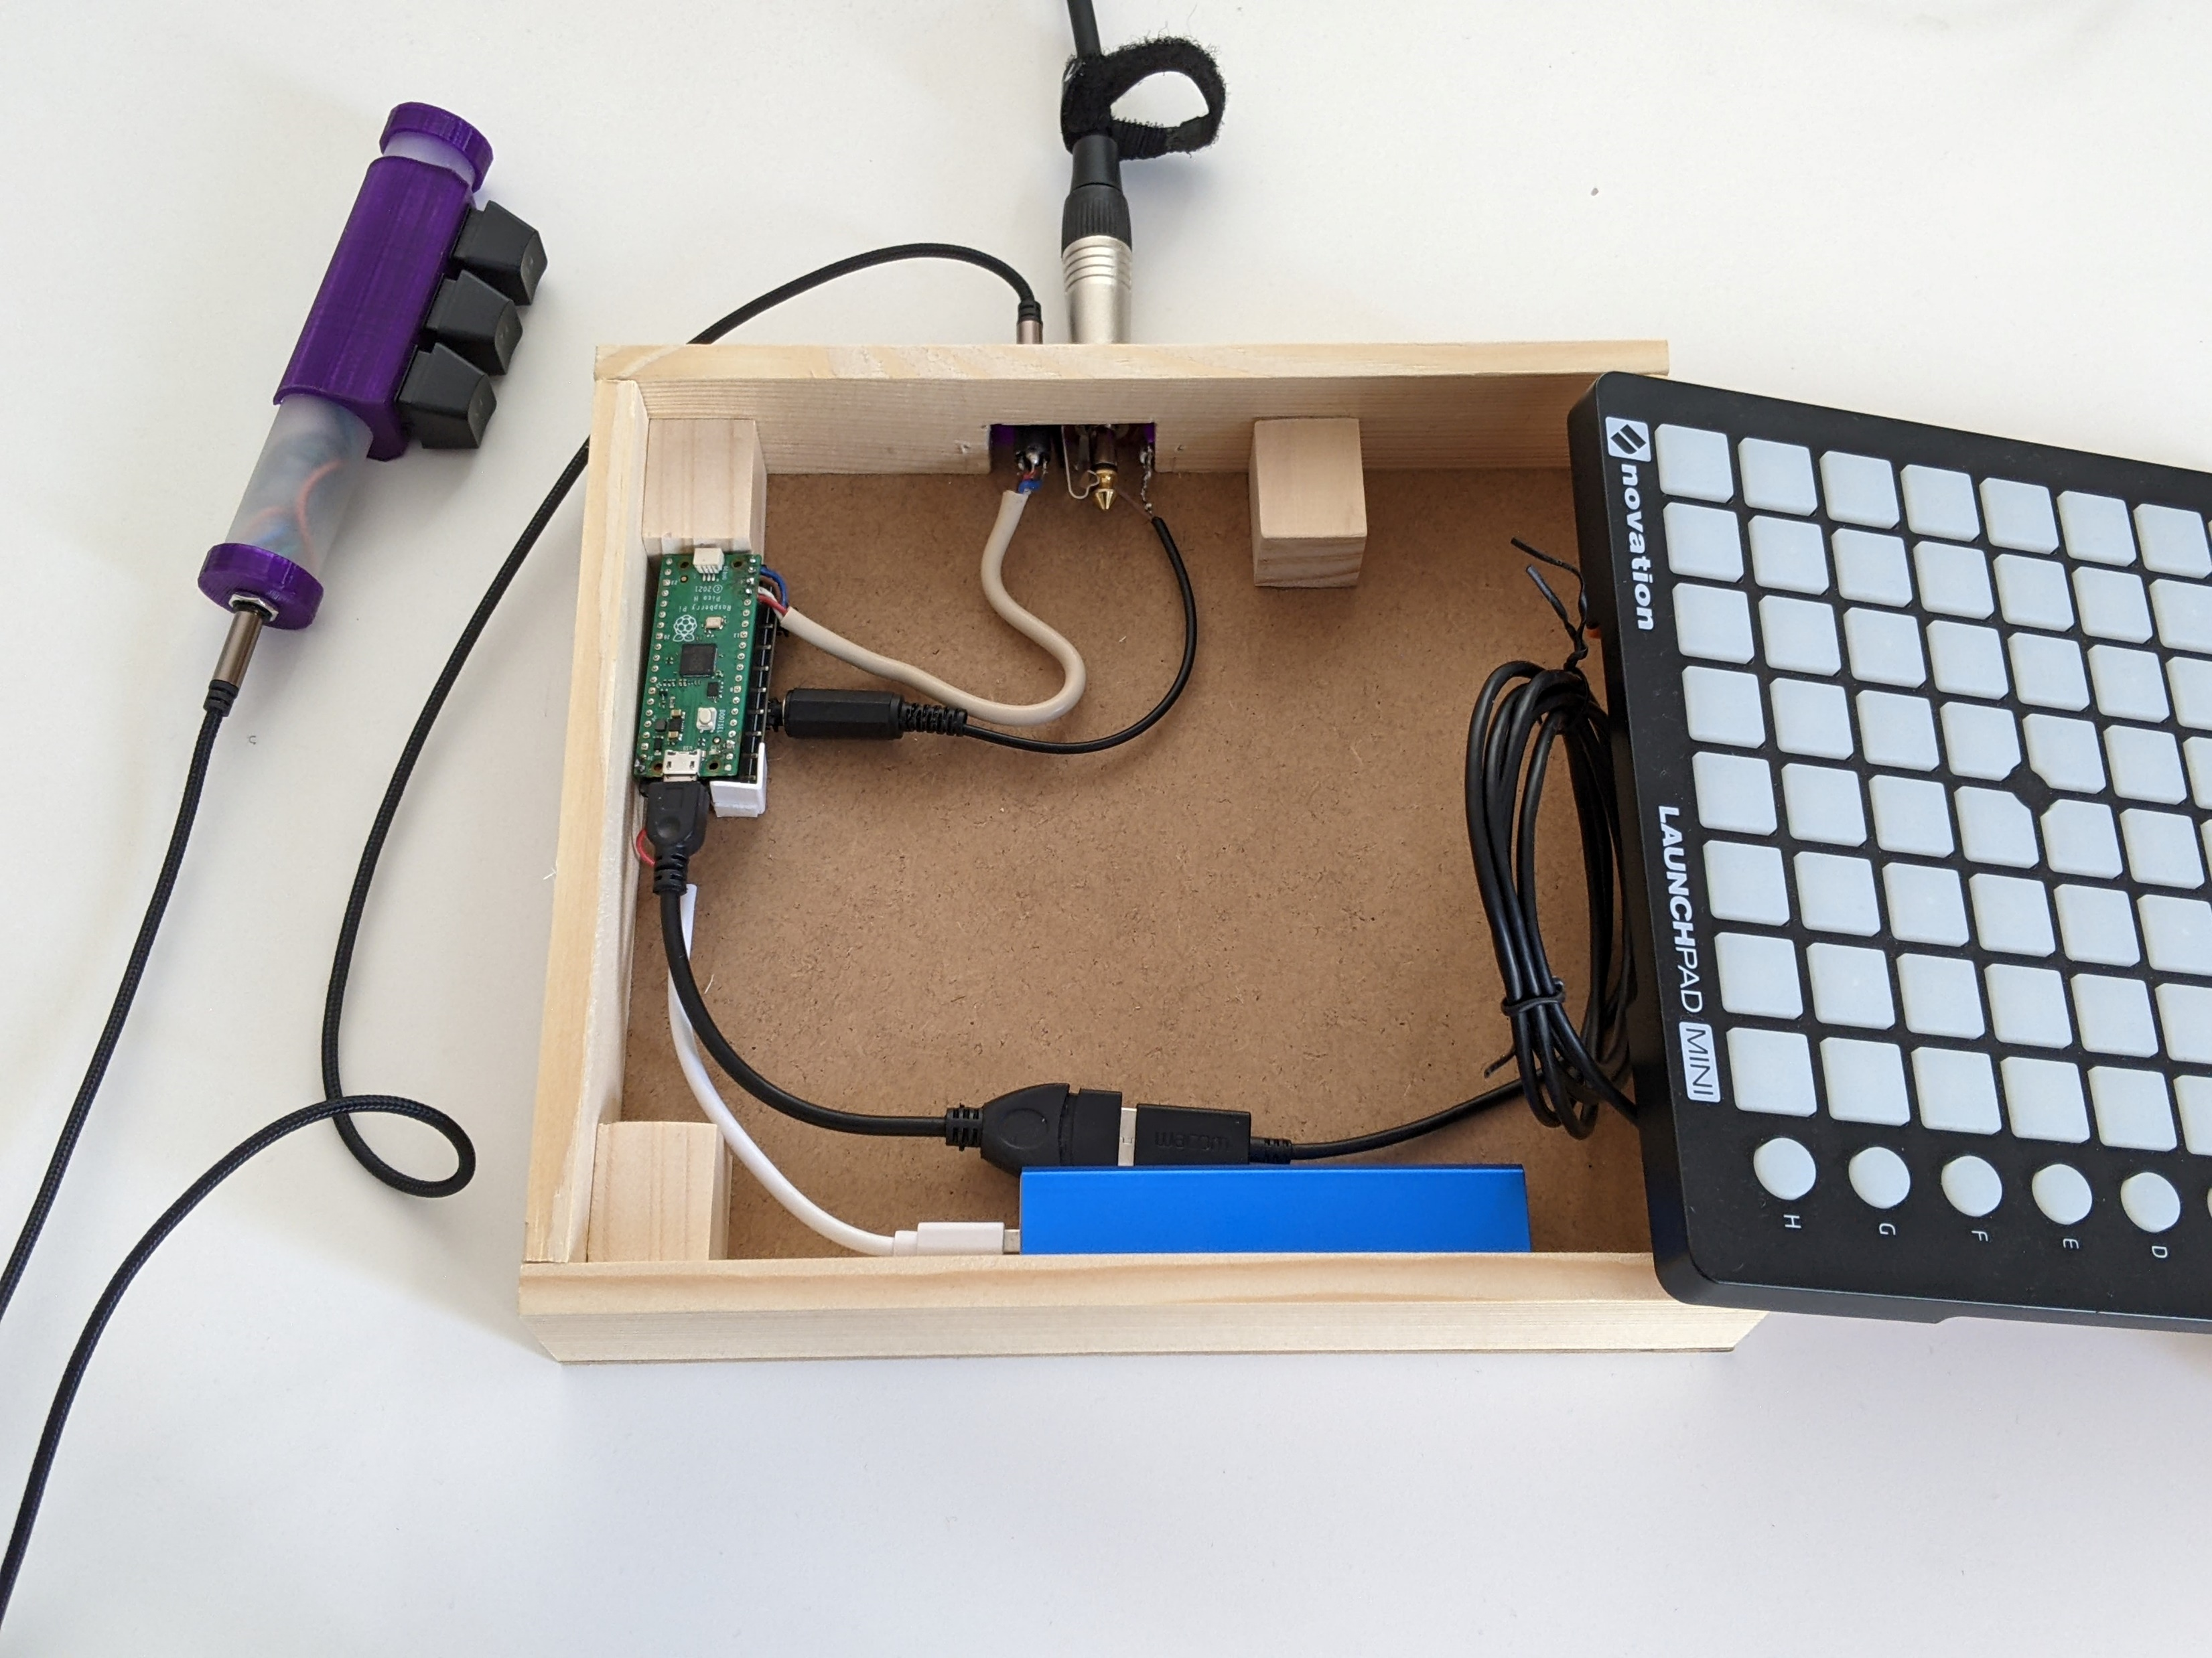
GPIOs for external controller
Novation Launchpad mini
Audio out (line level)
Raspberry PICO + Pimironi pico audio hat
Micro USB to USB A female, USB A male to USB B male
Power bank, 5V 1A

Slide 7
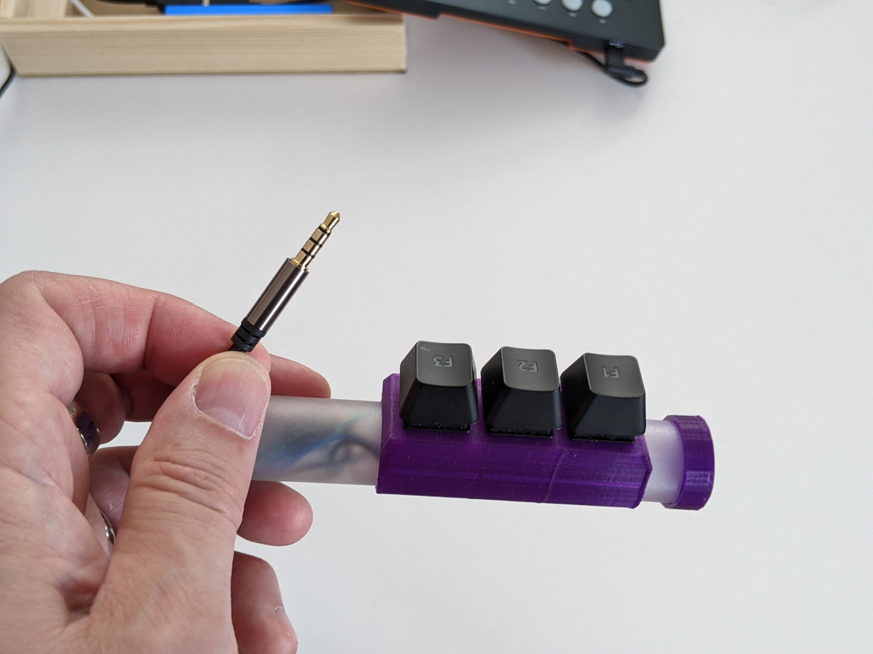
TRRS cable for connection to 3 GPIOs + GND
Recycled PC keyboard switches and key caps
PVC tube + 3D printed keys holdster

Slide 8
