Slide 1
Next step

Slide 2
Song 000
Song 001
Song 002
…
Song 007
Select song
Song 008
…
Song 015
Change instrument
Song 016
…
Reset position

Slide 3
Pimironi PICO
Audio
Audio Out
I2S interface via GPIO
Raspberry PICO
(MIDI USB host)
Novation Launchpad mini
MIDI via USB
reset position(GPIO 13)
stay in position / progress position (GPIO 14)
stay in position / progress position (GPIO 15)

Slide 4
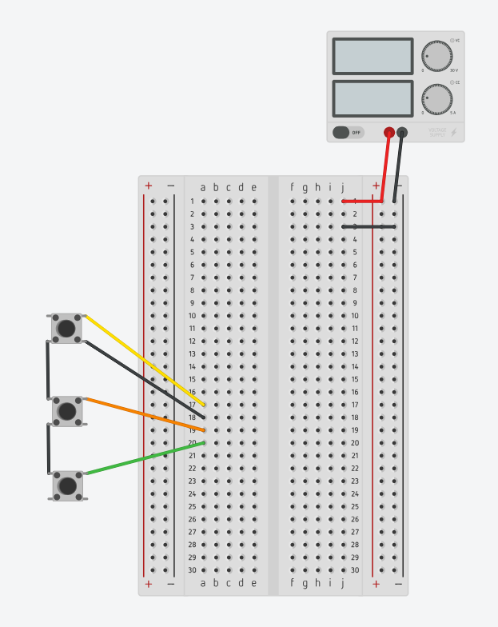
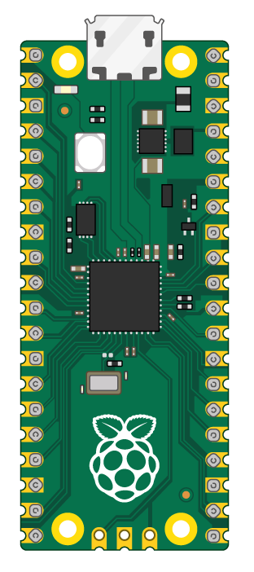
5V DC
1A
USB to Launchpad
Stay / progress
GND
GND
Stay / progress
GND
Reset position

Slide 5
