Slide 1
Raspberry PICO
(MIDI USB host)
Novation Circuit groovebox
MIDI via USB
Audio Out
PLAY/STOP pedal (GPIO)
PAUSE pedal (GPIO)
NEXT song pedal (GPIO)
PREVIOUS song pedal (GPIO)

Slide 2
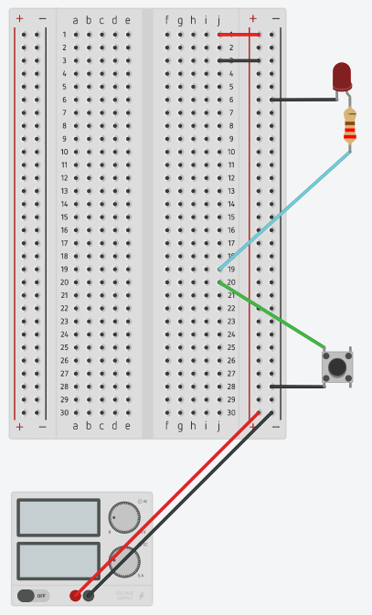
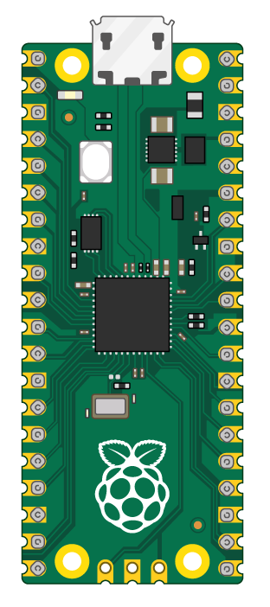
USB to groovebox
LED + 220 Ohm
GP17
GP16
switch
5V DC
1A

Slide 3
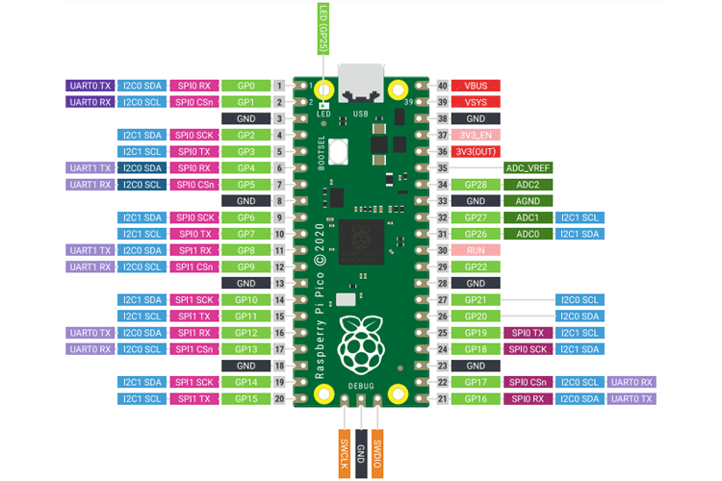

Slide 4
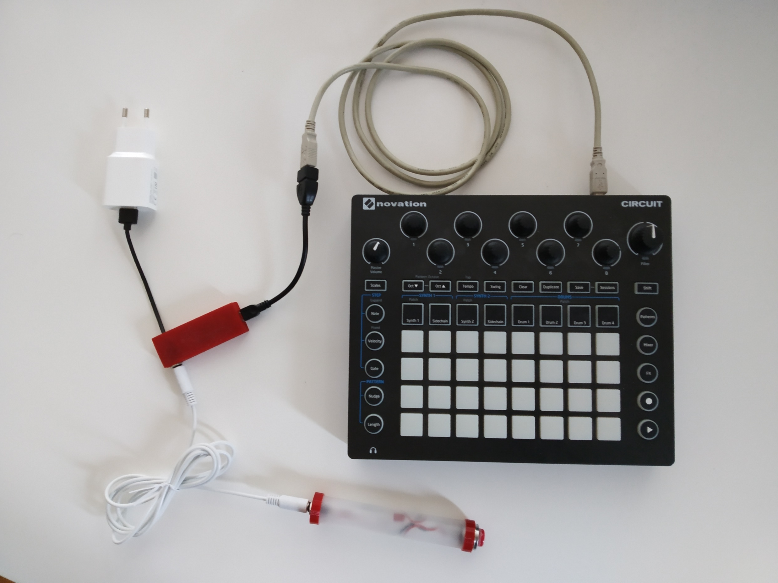
Pico USB plug
Power pack
MIDI over USB
Groovebox (Novation Circuit)
Pico in a case
Switch + LED
Cable to connect switch to pico

