Slide 1
Raspberry PICO
(MIDI USB host)
Novation Circuit groovebox
MIDI via USB
Audio Out
TAP TEMPO pedal (GPIO 13)
PLAY/STOP pedal (GPIO 14)
CONTINUE pedal (GPIO 12)
NEXT song pedal (GPIO 15)
PREVIOUS song pedal (GPIO 11)

Slide 2
To USB slave device (eg. Novation circuit)
Previous session
CONTINUE / STOP
TAP TEMPO
PLAY / STOP
Next session
To USB slave device (eg. Novation circuit)
Previous session
CONTINUE
TAP TEMPO
PLAY
Next session
12
13
14
11
GPIOs
15
Raspi PICO
GND

Slide 3
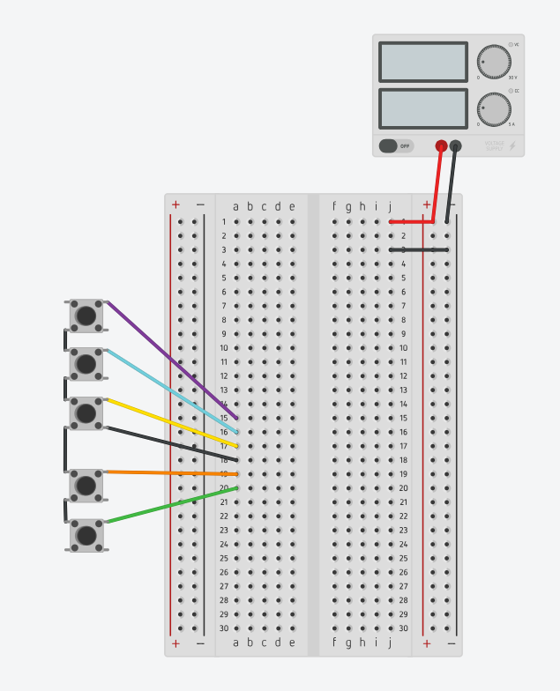
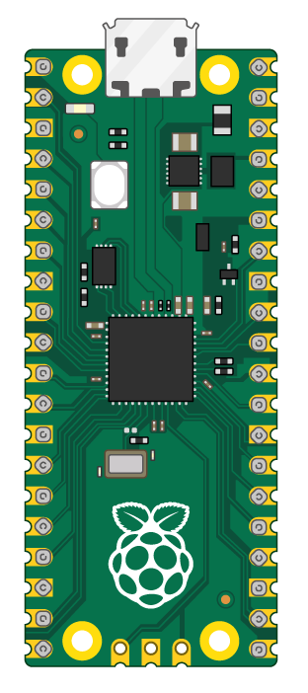
5V DC
1A
USB to groovebox
GND
GND
GND
GND
GND

Slide 4
