Slide 1
Raspberry PICO
(MIDI USB host)
Novation Circuit groovebox
MIDI via USB
Audio Out
TAP TEMPO pedal (GPIO 13)
PLAY/STOP pedal (GPIO 14)
CONTINUE pedal (GPIO 12)
NEXT song pedal (GPIO 15)
PREVIOUS song pedal (GPIO 11)

Slide 2
To USB slave device (eg. Novation circuit)
Previous session
CONTINUE
PLAY
TAP TEMPO
Next session
To USB slave device (eg. Novation circuit)
Previous session
CONTINUE
TAP TEMPO
PLAY
Next session
12
13
14
11
GPIOs
15
Raspi PICO
GND

Slide 3
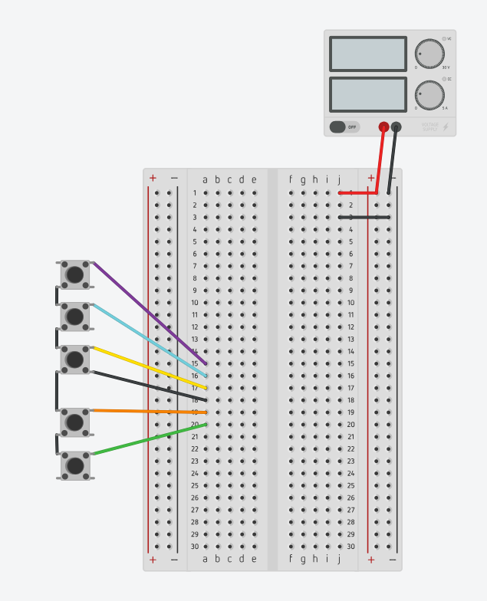
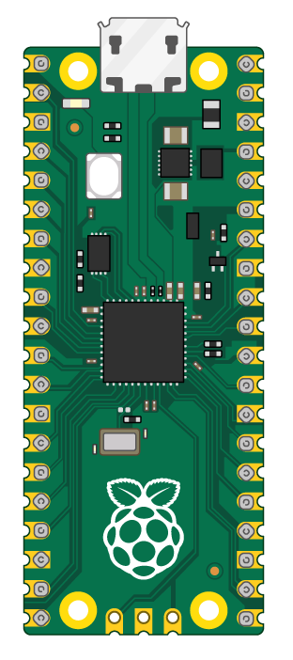
5V DC
1A
USB to groovebox
GND
GND
GND
GND
GND

Slide 4
