Slide 1
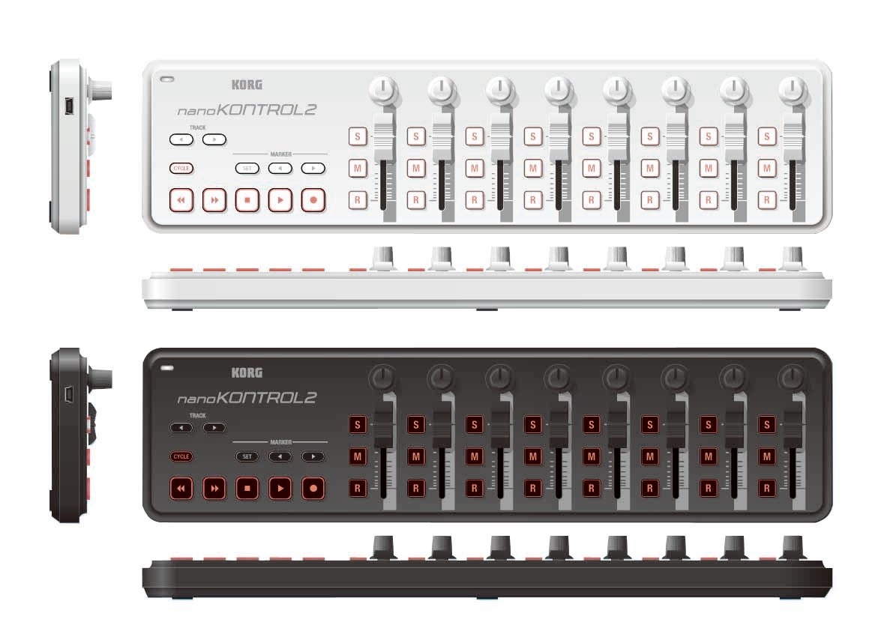

Slide 2
Channels 1-8 and 9-16 (with R key)
Mute
Shift per channel (channels 9-16)
Solo
Volume of channel
Balance of channel

Slide 3
Set marker
Previous marker
Next marker

Slide 4
STOP
PLAY / LOAD
SAVE

Slide 5
BPM - Shift: Vol -
BPM + Shift: Vol +
Shift key for << >>

Slide 6
Shift key for < >
Previous MIDI song shift: previous soundfont
Next MIDI song
Shift: next soundfont

