Slide 1
JUNOS Automation Project Walk Trough
Levent Ogut (logut@juniper.net)
February 2014

Slide 2
Agenda
Requirement Gathering
Review of Requirements
Very High Level Pseudo Code
Development Environment
Script Documentation
Debug / Trace
Local Development Options
Local Development vis RPC output
Simple Juise Demo
Juise Debugging Demo
Juise Profiling Demo
Slacproc Syntax Checking
Testing
Versioning (Local) - Git Demo
Py-junos-eznc Demo
Resources

Slide 3
Customer’s Requirements – Fastweb ITaly
CGNAT DETNAT Configuration Tracker
XML output of the NAT Rule and NAT Pool configuration when there is a configuration change on [services] stanza
Filename should in the following format:
<router-name>_<YYYYMMDD>_<HHMMSS>_<counter>.xml
<router-name> = network element unique name
<YYYYMMDD> = validity configuration starting date (ex: “20130917” for the day 2013-09- 17)
<HHMMSS> = validity configuration starting time (ex: “173404” for the time 17 h 34 m 04 s) <counter>=progressiveindex (ex:“7”)
e.g. milano_20130917_173404_7.xml
Transfer of the file to a remote server via SFTP with *.tmp extension
Rename the remote file from *.tmp to *.xml (so that server side knows transfer is completed)

Slide 4
Customer’s Requirements – Fastweb ITaly
<juniper-configuration>
<pools>
<pool>
<public>
<ip_min>32.32.32.1</ip_min>
<ip_max>32.32.32.254</ip_max>
</public>
<private>
<network>10.1.0.0/16</network>
</private>
<block_size>50</block_size>
<port_range_per_pu_ip>50</port_range_per_pu_ip>
</pool>
</pools>
</juniper-configuration>

Slide 5
What can we do and what we can’t do
After a research I found:
SFTP is not supported on customer’s JUNOS version (11.4)
SCP is recommended to customer
We can not rename the file we transferred
Instead, an empty file will be transferred to server after SUCCESSFUL transfer of the original XML file. So server side script need to look to this file to determine transfer success.
All agreed with customer, now we can develop!

Slide 6
Very High Level PseUdoCODe
Check if we are running in master RE
if not, then do nothing i.e. exit silently
Check if this is a “commit check” operation
if yes, then do nothing i.e. exit silently
Check if there is change in [services] stanza continue
if not, then do nothing i.e. exit silently
Traverse all NAT Rules to gather following:
Traverse each term for “source-address” and “source-address-range”
Translated [source-pool] name
For each pool gather:
Address and address-range
Put all information into predetermined format and write to a file
Transfer the file
If transfer is successful, upload a *.CMP empty file to server as well
If transfer fails then do not delete the CMP file in local

Slide 7
Development Environment
Any editor that you are comfortable with
Sublime Text 2 / 3
Text Mate
Vim
emacs
MacVim
Notepad++
Jedit
Etc.
Juise
import "../import/junos.xsl";
SCP / CyberDuck / WinSCP etc. for transferring files

Slide 8
Directory Hierarchy - LOCAL
PIDxxx_Customer_Project_Name/
Customer.Provided/
Customer docs etc
dev/
import/
junos.xsl
commit/op/event/
SCRIPT_name.slax
test.slax

Slide 9
Directory Hierarchy - ROUTER
--- JUNOS 12.3R5.7 built 2013-12-18 01:32:46 UTC
logut@flint> start shell
% cd /var/db/scripts/
% ls -al
total 64
drwxr-xr-x 7 root wheel 512 Feb 5 12:11 .
drwxr-xr-x 15 root wheel 1024 Feb 5 12:49 ..
drwxrws--- 2 root wheel 512 Feb 5 12:11 commit
drwxrws--- 2 root wheel 18944 Feb 5 12:11 event
lrwxr-xr-x 1 root wheel 27 Feb 5 12:11 import -> /usr/libdata/cscript/import
drwxrws--x 2 root wheel 512 Oct 8 2011 lib
drwxrws--- 2 root wheel 512 Feb 5 12:11 op
drwxrws--- 2 root wheel 512 Feb 4 14:27 snmp
%

Slide 10
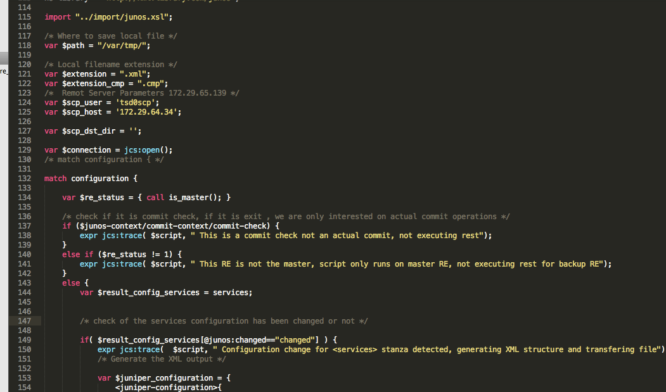
Screen Capture from Editor

Slide 11
Script Documentation
/*
* Filename : <script_name>.slax
* Author : <Author Name> / <author_email>
* version : 0.1
* Platform : xx
* Release : Junos 11.4+
*
* Copyright 2014 Juniper Networks. All rights reserved.
*/
/*
### Description
### Installation
xxxx
xxxxx

Slide 12
Script Documentation
### Configuration
[ system scripts ]
commit {
file <script_name>.slax;
}
### Enabling Traceoptions
[ system scripts ]
commit {
traceoptions {
file commit.trace size 1m world-readable;
}
}

Slide 13
Script Documentation
### Caveats and Notes
### Change Log
0.1 initial script
0.2 New feature: script to communicate with other scripts via Morse code
1.0 release
1.1 bug fix: script shouldn’t trigger “blow up” datacenter, unless...
### Sample Output
<?xml version="1.0"?>
<juniper-configuration>
<pools>
<pool>
<public>
<ip_min>80.2.0.161</ip_min>
<ip_max>80.2.0.166</ip_max>
</public>

Slide 14
Script Documentation
### Parameters / Variables
## Set on top of the script
#### Where to save local file
var $path = "/var/tmp/";
#### Local filename extension
var $extension = ".xml";
var $extension_cmp = ".cmp";
#### Remote Server Parameters 172.29.65.139
var $scp_user = 'tsd0scp';
var $scp_host = '172.29.64.34';
var $scp_dst_dir = '';
END OF DOCUMENTATION
*/

Slide 15
Script Documentation
Documentation is crucial
Someone else might need to work on that script after you.
And you would want to avoid customer / calls for small installation/configuration/parameter change issues.

Slide 16
Development
Templates I think I need (some of them thought throughout development):
# Delete file
template file_delete ($filename)
# Transfer file
template tx_file ($file_path, $filename, $host, $user, $dst_path)
# convert 1.1.1.0/24 to 1.1.1.1 1.1.1.254
template prefix2min_max ($address)
# convert IP to decimal for calculations
template ip2decimal($ip)
# convert 1.1.1.1 1.1.1.254 to 1.1.1.0/24
template low_high2prefix ($low="",$high="”)
# generate filename using host / datetime / sequence number / extension
template generate_filename ()
# write a file to local
template write2file ($filename, $content)
# Check if the RE that script is running is master
template is_master ()

Slide 17
Development
With the templates above now the main code is clean and more understandable

Slide 18
Development
var $re_status = { call is_master(); }
/* check if it is commit check, if it is exit , we are only interested on actual commit operations */
if ($junos-context/commit-context/commit-check) {
expr jcs:trace( $script, " This is a commit check not an actual commit, not executing rest");
}
else if ($re_status != 1) {
expr jcs:trace( $script, " This RE is not the master, script only runs on master RE, not executing rest for backup RE");
}

Slide 19
Development
else {
var $result_config_services = services;
/* check of the services configuration has been changed or not */
if( $result_config_services[@junos:changed=="changed"] ) {
expr jcs:trace( $script, " Configuration change for <services> stanza detected, generating XML structure and transfering file");

Slide 20
Development
var $juniper_configuration = {
<juniper-configuration>{
<pools> {
for-each ($result_config_services/nat/rule) {
for-each (./term) {
<pool> {
/*
NAT source definitions and calculations
Private Block format:
<private>
<network>10.1.0.0/16</network>
</private>
*/
var $private_prefix = ./from/source-address/name;
var $private_low = ./from/source-address-range/low;
var $private_high = ./from/source-address-range/high;
var $private_actual := {

Slide 21
Development
Error Handling
template tx_file ($file_path, $filename, $host, $user, $dst_path) {
var $file-copy-rpc =
<file-copy> {
<source> $file_path _ $filename _ $extension;
<destination> "scp://" _ $user _ "@" _ $host _ ":" _ $dst_path;;
}
var $results = jcs:execute( $connection, $file-copy-rpc );
/* Report any errors or success */
if( $results/..//xnm:error ) {
for-each( $results/..//xnm:error ) {
expr jcs:syslog( "external.error", "File Copy Error: ", message );
}
expr jcs:trace( $script, " tx_file : there was a proble with file transfer : ", $results);
}
else {
var $file-cmp-copy-rpc =
<file-copy> {
<source> $file_path _ $filename _ $extension_cmp;
<destination> "scp://" _ $user _ "@" _ $host _ ":" _ $dst_path;;
}
var $results_cmp = jcs:execute( $connection, $file-cmp-copy-rpc );
expr jcs:syslog( "external.info", "services XML structure sucessfully transfered." );
expr jcs:trace( $script, " tx_file : file transfer successful!");
/* when file transfer is successful, delete the CMP file on local,meaning file tx'd sucessfully, if there is errors we don't delete the files */
call file_delete ($filename=$path _ $filename _ $extension_cmp);
}
}

Slide 22
Debug / TRACE
Always use jcs:trace()
In script:
if( $result_config_services[@junos:changed=="changed"] ) {
expr jcs:trace( $script, " Configuration change for <services> stanza detected, generating XML structure and transferring file");
/* Generate the XML output */
In Config:
[edit system scripts commit]
logut@death# show
traceoptions {
file mycommitScript.trace world-readable;
}
file cgnat_cfg_tracker_comm.slax;
Log:
Feb 7 11:28:05 running commit script 'cgnat_cfg_tracker_comm.slax'
Feb 7 11:28:05 cgnat_cfg_tracker_comm.slax No configuration change for <services> stanza detected, skipping generating XML structure
Feb 7 11:28:05 processing commit script 'cgnat_cfg_tracker_comm.slax'

Slide 23
OP / EVENT / COMMIT Script
I write every script as an op script initially.
This allows me to run/debug with ease.
After all parsing modification is complete I convert it to event/commit where needed.

Slide 24
Local Development
If you are going to work on parsing an RPC reply and modify it / display it differently / log it then you can also work on your local machine by getting the RPC reply from a router and providing that on to the script.

Slide 25
Local Development
var $result_config_services := {
<nat> {
<pool> {
<name>"test_pool1";
<address> {
<name>"80.1.0.0/16";
}
<port> {
<range> {
<low>"1025";
<high>"1074";
}
<deterministic-port-block-allocation>{
<block-size>"50";
}
}
}
<pool> {
<name>"test_pool2";
<address> {
<name>"80.2.0.0/16";
}
<port> {
<range> {
<low>"1025";
<high>"1074";
}
<deterministic-port-block-allocation>{
<block-size>"50";
}
}
}

Slide 26
Local Development
logut-mba13:zArchive logut$ juise cgnat_cfg_tracker_prototype.slax
logut-mba13:zArchive logut$ cat /var/tmp/proto_test.xml
<?xml version="1.0"?>
<juniper-configuration>
<pools>
<pool>
<public>
<ip_min>80.1.0.1</ip_min>
<ip_max>80.1.255.254</ip_max>
</public>
<private>
<network>10.1.0.0/16</network>
</private>
<block_size>50</block_size>
<port_range_per_pu_ip>50</port_range_per_pu_ip>
</pool>
<pool>
<public>
<ip_min>80.2.0.1</ip_min>
<ip_max>80.2.255.254</ip_max>
</public>
<private>
<network>10.2.0.0/16</network>
</private>
<block_size>50</block_size>
<port_range_per_pu_ip>50</port_range_per_pu_ip>
</pool>
</pools>
</juniper-configuration>
logut-mba13:zArchive logut$

Slide 27
Execution via Juise
version 1.0;
ns junos = "http://xml.juniper.net/junos/*/junos";
ns xnm = "http://xml.juniper.net/xnm/1.1/xnm";
ns jcs = "http://xml.juniper.net/junos/commit-scripts/1.0";
import "../import/junos.xsl";
match / {
var $rpc_show_version = <get-software-information>;
var $results_show_version = jcs:invoke($rpc_show_version);
expr "hostname : " _ $results_show_version/host-name _ '\n';
expr "model : " _ $results_show_version/product-model _ '\n';
for-each ($results_show_version/package-information) {
expr ./comment _ '\n';
}
}

Slide 28
Execution via Juise
logut-mba13:op logut$ juise logut@death.jtac-emea.jnpr.net show_version.slax
logut@death.jtac-emea.jnpr.net's password:
<?xml version="1.0" standalone="yes"?>
hostname : death
model : m120
JUNOS Base OS boot [10.4S7.1]
JUNOS Base OS Software Suite [10.4S7.1]
JUNOS Kernel Software Suite [10.4S7.1]
JUNOS Crypto Software Suite [10.4S7.1]
JUNOS Packet Forwarding Engine Support (M/T Common) [10.4S7.1]
JUNOS Packet Forwarding Engine Support (M120) [10.4S7.1]
JUNOS Online Documentation [10.4S7.1]
JUNOS Voice Services Container package [10.4S7.1]
JUNOS Border Gateway Function package [10.4S7.1]
JUNOS Services AACL Container package [10.4S7.1]
JUNOS Services LL-PDF Container package [10.4S7.1]
JUNOS Services PTSP Container package [10.4S7.1]
JUNOS Services Stateful Firewall [10.4S7.1]
JUNOS Services NAT [10.4S7.1]
JUNOS Services Application Level Gateways [10.4S7.1]
JUNOS Services Captive Portal and Content Delivery Container package [10.4S7.1]
JUNOS Services RPM [10.4S7.1]
JUNOS AppId Services [10.4S7.1]
JUNOS IDP Services [10.4S7.1]
JUNOS Runtime Software Suite [10.4S7.1]
JUNOS Routing Software Suite [10.4S7.1]
JUNOS AIS Script Suite [3.7R3.0]

Slide 29
Local Development – Juise - Debuging
logut-mba13:dev logut$ juise --debug test.slax
sdb: The SLAX Debugger (version 0.14.4)
Type 'help' for help
(sdb) next
junos.xsl:23: <xsl:param name="localtime-iso"/>
(sdb) next
junos.xsl:25: <xsl:param name="script"/>
(sdb) next
test.slax:15: var $debug=1;
(sdb) print $debug
[number] 1.000000
…………(cut for brevity)
(sdb) next
test.slax:19: var $hello = "script is running";
(sdb) next
test.slax:20: <output> $hello;
(sdb) print $hello
[string] "script is running"
(sdb)

Slide 30
Local Development – Juise - Callflow
logut-mba13:dev logut$ juise --debug cgnat_cfg_tracker_prototype.slax
sdb: The SLAX Debugger (version 0.14.4)
Type 'help' for help
(sdb) callflow
Enabling callflow
(sdb) run
callflow: 0: enter <xsl:template> in match / at cgnat_cfg_tracker_prototype.slax:102
callflow: 1: enter <nat> at cgnat_cfg_tracker_prototype.slax:119
callflow: 1: exit <nat> at cgnat_cfg_tracker_prototype.slax:119
callflow: 1: enter <juniper-configuration> at cgnat_cfg_tracker_prototype.slax:195
callflow: 2: enter <xsl:for-each> at cgnat_cfg_tracker_prototype.slax:198
callflow: 3: enter <pool> at cgnat_cfg_tracker_prototype.slax:199
callflow: 4: enter <xsl:if> at cgnat_cfg_tracker_prototype.slax:212
callflow: 5: enter <prefix> at cgnat_cfg_tracker_prototype.slax:213
callflow: 5: exit <prefix> at cgnat_cfg_tracker_prototype.slax:213
callflow: 4: exit <xsl:if> at cgnat_cfg_tracker_prototype.slax:212
callflow: 4: enter <xsl:if> at cgnat_cfg_tracker_prototype.slax:235
callflow: 5: enter <xsl:variable> at cgnat_cfg_tracker_prototype.slax:240
callflow: 6: enter <xsl:call-template> at cgnat_cfg_tracker_prototype.slax:240
callflow: 7: enter <xsl:template> in template prefix2min_max at cgnat_cfg_tracker_prototype.slax:323

Slide 31
Local Development – Juise - Profiling
logut-mba13:zArchive logut$ juise -d cgnat_cfg_tracker_prototype.slax
sdb: The SLAX Debugger (version 0.14.4)
Type 'help' for help
(sdb) run
Script exited normally.
(sdb) profile report brief
Line Hits User U/Hit System S/Hit Source
90 1 3 3.00 2 2.00 var $debug = 1;
92 1 2 2.00 1 1.00 var $path = "/var/tmp/";
93 1 2 2.00 1 1.00 var $extension = ".tmp";
96 1 2 2.00 1 1.00 var $scp_user = 'slax';
97 1 6 6.00 5 5.00 var $scp_host = '172.29.65.139';
98 1 2 2.00 1 1.00 var $scp_dst_dir = '';
102 2 4 2.00 3 1.50 match / {
118 2 21 10.50 5 2.50 var $result_config_services := {
119 1 5 5.00 1 1.00 <nat> {
120 1 2 2.00 1 1.00 <pool> {
121 1 3 3.00 1 1.00 <name>"test_pool1”;

Slide 32
Local Development – Juise - Profiling
Line—Line number in the source file.
Hits—Number of times this line was executed.
User—Number of microseconds of "user" time spent processing this line.
U/Hit—Average number of microseconds of "user" time per hit.
System—Number of microseconds of "system" time spent processing this line.
S/Hit—Average number of microseconds of "system" time per hit.

Slide 33
SLAXPRoC – Local Syntax Checking
logut-mba13:dev logut$ slaxproc --check cgnat_cfg_tracker_comm.slax
script check succeeds
logut-mba13:dev logut$

Slide 34
Testing
Testing is an important part, this is a product of CS/AS/PS/What’s your name!
Testing depends type of script, make sure errors are handled.
Obviously develop & test on the target JUNOS and architecture / platform.
Dual-RE tests are important for commit scripts
Changing configurations is not trivial task, make sure it is clean.

Slide 35
General Rules
DRY ( Don’t Repeat Yourself)
While developing customer scripts think about the future, if a part of the script is reusable, make it as a template ().
As AS/JTAC/PS/JNPR we develop lots of scripts but collaboration on this regard is poor IMHO.
Ask, everyone in JNPR is willing to help.

Slide 36
Workflow – GIT – Create Repository
logut-mba13:tmp logut$ mkdir automation_demo
logut-mba13:tmp logut$ cd automation_demo/
logut-mba13:automation_demo logut$ ll
Initializing GIT Repo
logut-mba13:automation_demo logut$ git init
Initialized empty Git repository in /Users/logut/tmp/automation_demo/.git/
Creating Our File
logut-mba13:automation_demo logut$ touch test.slax
logut-mba13:automation_demo logut$ echo "deneme" > test.slax

Slide 37
Workflow – GIT – STATUS – Adding a FILE
After Our Changes Looking to Git
logut-mba13:automation_demo logut$ git status
# On branch master
#
# Initial commit
#
# Untracked files:
# (use "git add <file>..." to include in what will be committed)
#
# test.slax
nothing added to commit but untracked files present (use "git add" to track)
Adding our new file to Git for tracking
logut-mba13:automation_demo logut$ git add test.slax

Slide 38
Workflow – GIT – STATUS and first commit
logut-mba13:automation_demo logut$ git status
# On branch master
#
# Initial commit
#
# Changes to be committed:
# (use "git rm --cached <file>..." to unstage)
#
# new file: test.slax
#
logut-mba13:automation_demo logut$ git commit -m "initial commit"
[master (root-commit) 68a1b15] initial commit
1 file changed, 1 insertion(+)
create mode 100644 test.slax

Slide 39
Workflow – GIT – Second change and commit
logut-mba13:automation_demo logut$ echo "second line change" >> test.slax
logut-mba13:automation_demo logut$ git add test.slax
logut-mba13:automation_demo logut$ git commit -m "my second commit"
[master 5f4f038] my second commit
1 file changed, 1 insertion(+)

Slide 40
Workflow – GIT - LOG
logut-mba13:dev logut$ git log
commit 97660ab5f910940d94f2ef6efd7713024b2d82ba
Author: Levent Ogut <logut@juniper.net>
Date: Wed Feb 5 01:06:50 2014 +0200
public/private low/high & prefix input support
commit c52c302215800c03ec1ca2be4a8563408810cb76
Author: Levent Ogut <logut@juniper.net>
Date: Fri Jan 31 12:50:12 2014 +0200
fix for backup RE error, preventing the commit
commit 496a2b885ecde9df2114940364ffe46296fc766f
Author: Levent Ogut <logut@juniper.net>
Date: Thu Jan 9 13:15:51 2014 +0200
archive update
commit 5619c6cfb331ac2ebbe1c755440716d0e25394eb
Author: Levent Ogut <logut@juniper.net>
Date: Wed Dec 18 18:28:44 2013 +0200
file tx changes and error handling
commit 10d67fb614f9162daa2c158b91baf8b3cc3091cb
Author: Levent Ogut <logut@juniper.net>
Date: Wed Dec 18 17:24:20 2013 +0200
f
commit 8da4013dd20c6d8d749eaefe46614f2d4c7bbad3
Author: Levent Ogut <logut@juniper.net>
Date: Wed Dec 18 17:11:18 2013 +0200
change of fle transfer
commit 85e7be3009bb7155c46e0fde0fb3e6148b7d98a3
Author: Levent Ogut <logut@juniper.net>
Date: Wed Dec 18 16:06:17 2013 +0200

Slide 41
Workflow – GIT - DIff
logut-mba13:dev logut$ git status
# On branch master
# Changes not staged for commit:
# (use "git add <file>..." to update what will be committed)
# (use "git checkout -- <file>..." to discard changes in working directory)
#
# modified: cgnat_cfg_tracker_comm.slax
#

Slide 42
Workflow – GIT – Diff – Changes file
logut-mba13:dev logut$ git diff
diff --git a/cgnat_cfg_tracker_comm.slax b/cgnat_cfg_tracker_comm.slax
index 4d2fd31..2fbbbef 100644
--- a/cgnat_cfg_tracker_comm.slax
+++ b/cgnat_cfg_tracker_comm.slax
@@ -1,7 +1,7 @@
/*
* Filename : cgnat_cfg_tracker_comm.slax
* Author : Levent Ogut logut@juniper.net
- * version : 1.4
+ * version : 1.5
* Platform : MX
* Release : Junos 11.4+
*
@@ -44,6 +44,7 @@ commit {
1.2 fix of backup RE commit error.
1.3 fix of private_prefix
1.4 multiple input styles (low / high / prefix) can be accepted now
+1.5 fix for public multiple format
### Sample Output
<?xml version="1.0"?>
@@ -195,7 +196,7 @@ match configuration {
<high> $public_high;
}
if ($public_prefix != "") {
- var $prefix = { call prefix2min_max ($address=$public_prefix); }
+ var $prefix := { call prefix2min_max ($address=$public_prefix); }
<prefix> $public_prefix;
<low> $prefix/min;
<high> $prefix/max;
@@ -410,7 +411,7 @@ template generate_filename () {
/* first we find the new sequence number */
var $rpc_file_list = <file-list> {
- <path> $path _ $hostname _ "*";
+ <path> $path _ $hostname _ "*" _ "xml";
}
var $file_list = jcs:execute( $connection, $rpc_file_list );
/* filename last will be presented as "/path/to/file/filename" e.g. /var/tmp/flint_20131211_000000_10.tmp */

Slide 43
Workflow – GIT – Diff – between commits
logut-mba13:automation_demo logut$ git diff 5f4f038d9dbf6a8704d7e58bc81778aa6e884aed 68a1b1529fda9e72e01817c1eb941f6ee23de2ae
diff --git a/test.slax b/test.slax
index e9e6ac3..8836a06 100644
--- a/test.slax
+++ b/test.slax
@@ -1,2 +1 @@
deneme
-second line change
logut-mba13:automation_demo logut$

Slide 44
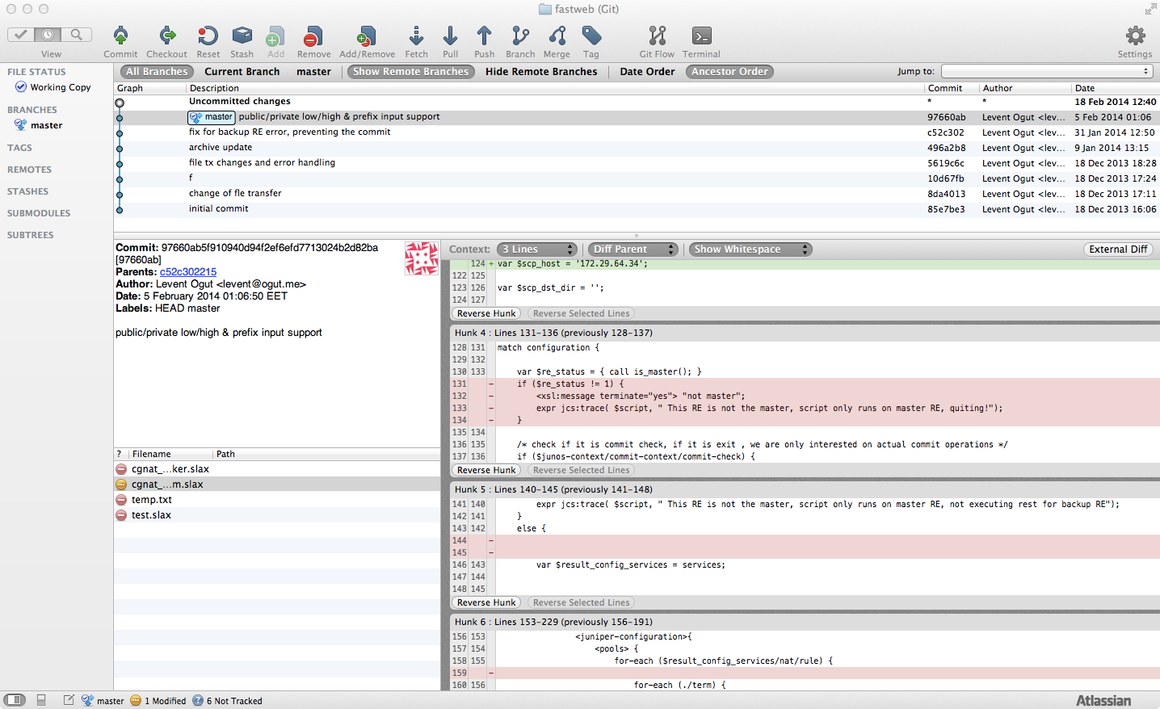
SourceTree Free Client for GIT sourcetreeapp.com

Slide 45
Py-junos-eznc
http://techwiki.juniper.net/Automation_Scripting/Junos_OS_PyEZ
https://github.com/Juniper/py-junos-eznc
http://techwiki.juniper.net/Automation_Scripting/Junos_OS_PyEZ/Hello%2C_World!

Slide 46
Py-junos-eznc – Hello World Example
logut@death> show configuration | find services
services {
ftp;
ssh;
telnet;
xnm-clear-text;
netconf {
ssh;
}
}

Slide 47
Py-junos-eznc – Hello World Example
from pprint import pprint
from jnpr.junos import Device
my_junos_router = Device(host='death.jtac-emea.jnpr.net', user=’xxxxxx', password=’xxxxx' )
my_junos_router.open()
pprint( my_junos_router.facts )
my_junos_router.close()

Slide 48
Py-junos-eznc – Hello World Example
logut-mba13:tmp logut$ python j.py
{'2RE': True,
'HOME': '/var/home/remote',
'RE0': {'last_reboot_reason': 'Router rebooted after a normal shutdown.',
'mastership_state': 'master',
'model': 'RE-A-1000',
'status': 'OK',
'up_time': '7 days, 24 minutes, 55 seconds'},
'domain': 'jtac-emea.jnpr.net',
'fqdn': 'death.jtac-emea.jnpr.net',
'hostname': 'death',
'ifd_style': 'CLASSIC',
'master': 'RE0',
'model': 'M120',
'personality': 'M',
'serialnumber': 'JN109064CAEA',
'switch_style': 'NONE',
'version': '11.4R9-S1',
'version_RE0': '11.4R9-S1',
'version_info': junos.version_info(major=(11, 4), type=R, minor=9-S1, build=9-S1)}
logut-mba13:tmp logut$

Slide 49
Resources
Script Hackers @ Matrix
JUNOS as a Scripting Language On Demand Course
This Week: Junos Automation Reference for SLAX 1.0
This Week: Mastering Junos Automation
This Week: Applying Junos Automation
Navigating The Junos XML Hierarchy
Docs @ Techpubs
Junos OS Configuration and Operations Automation Guide
Junos XML API Operational Reference
Junos XML API Configuration Reference
Junos XML Management Protocol Guide

Slide 50
Resources Cont’d
https://github.com/Juniper/juise
https://github.com/Juniper/py-junos-eznc
Sublime SLAX Plugin by David Gethings
Vim SLAX Plugin
JUNOScriptorium
https://techwiki.juniper.net/Automation_Scripting
https://www.juniper.net/us/en/community/junos/script-automation/library/configuration/
https://www.juniper.net/us/en/community/junos/script-automation/library/event/
https://www.juniper.net/us/en/community/junos/script-automation/library/operations/
Subscribe to script-hackers at JAM

Slide 51
New To scripting?
Use all resource as above but also :
Ask your manager to shadow a colleague for a scripting project
Ask your manager to get a mentor/reviewer for your first few projects
Do not forget you are never alone.

Slide 52
Q&A
2014-02-20: LO
Notes:
52

