Slide 2


Dialogue Systems
Vyacheslav (Slava) Alipov, Principal R&D Engineer
SHAD, November 7, 2019

Slide 3

Overview
Dialogue Interfaces
Goal-Oriented Dialogue Systems
General Conversation

Slide 4
Dialogue Interfaces

Slide 5
What is a Dialogue Interface?
Interacting via voice or text input in a form of a dialogue
It's easy!
Everybody is able to do this
It's efficient!
No complicated GUI manipulations

Slide 6
The Time is Now!
Automatic Speech Recognition (ASR) is very good
Text To Speech (TTS) is very good
Major advances in Natural Language Processing (NLP)
But still we are far from fully replacing a human assistant

Slide 7
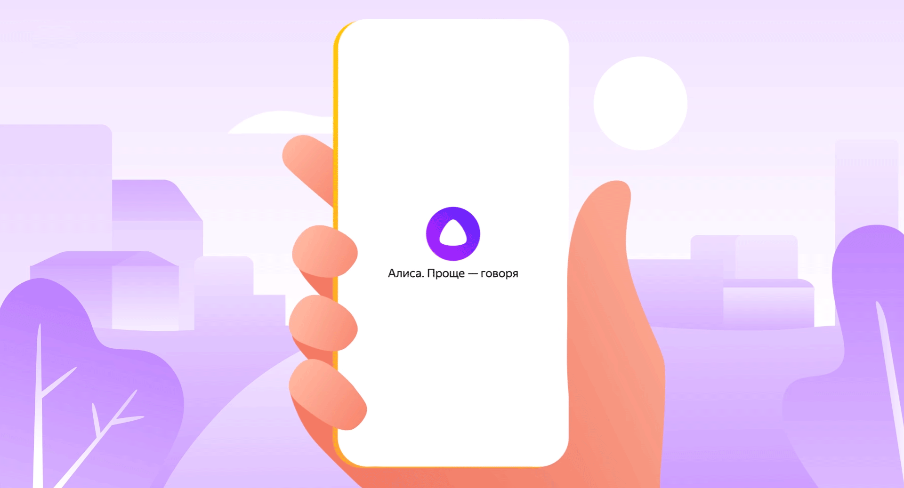
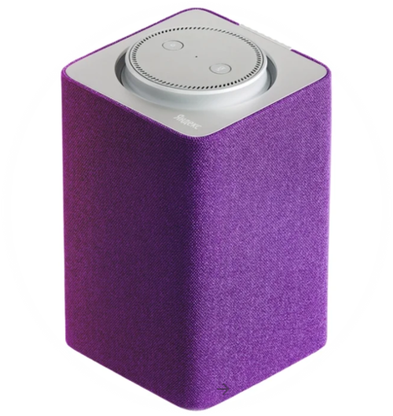
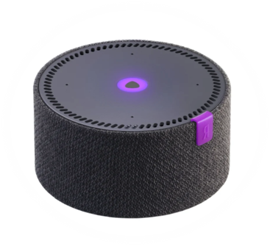

Slide 8
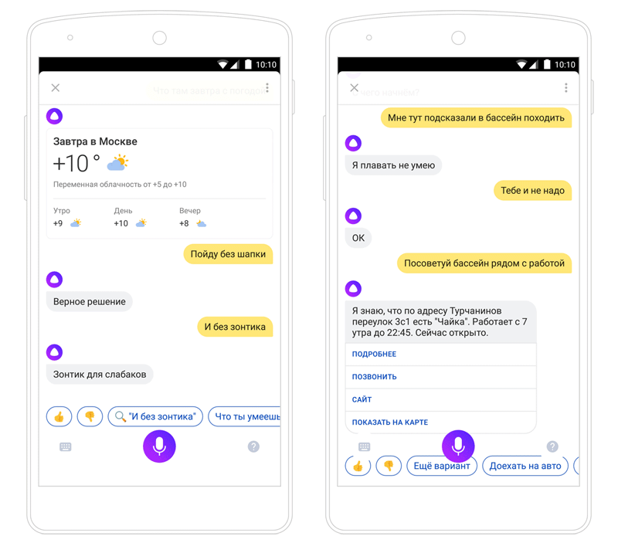
Alice, what can you do?
Web Search
News
Search for Organizations
Cafes, Cinemas, Pharmacies, ...
Weather
Routes and Traffic
Play Music and Video
Smart Home
Alarms and Timers
Chit-Chat!

Slide 9
Goal-Oriented Dialogue Systems

Slide 10
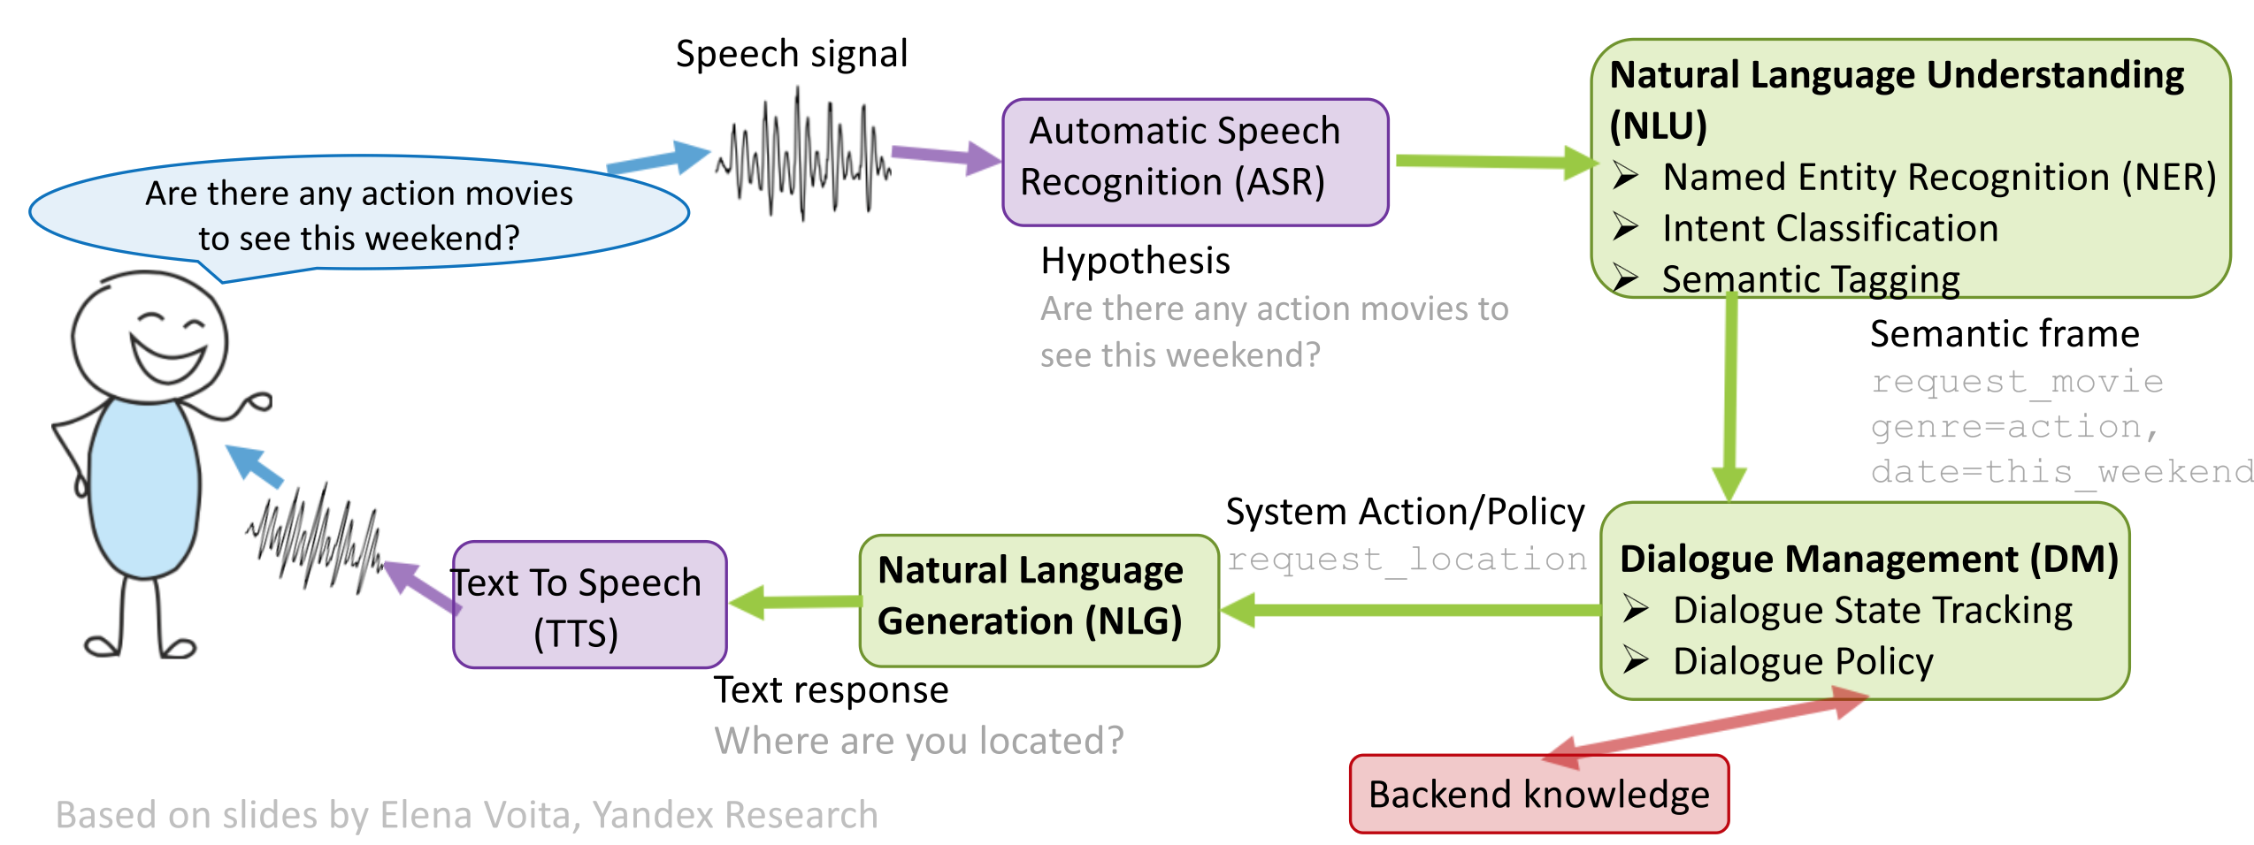
Goal Oriented Dialogue System

Slide 11
Natural Language Understanding

Slide 12
Named Entity Recognition (NER)
Goal is to find local structured explanations of user input
Finite State Transducers (FST) based parsers
e.g. time, date, numbers, …
State of the art for such text normalization tasks
Gazetteers – extensive enumeration of all possible entity values
e.g. smart_device_type, fairy_tale_id, phone_contact_id, …
Good when entities are unique and finite (and rarely occur in a dataset)
Employ some fuzzy matching / embedding similiarity* to account for misspells and synonyms

Slide 13
Semantic Parsing
Intent Classification + Semantic Tagging = Semantic Parsing
Explain user query as Semantic Frame
Intent Classification – any text classifier would do (BOWs, embeddings, RNNs, etc.)
Semantic Tagging – any sequence labelling algorithm would do (CRFs, RNNs, etc.)
Could be performed jointly
Probabilistic Context-Free Grammar (PCFG)
Augment sequence labelling architecture with intent classification output

Slide 14
Anaphora
Some cases are easy to hardcode
Classic approach:
Candidate proposal – named groups, NER, etc.
Candidate matching – features like gender, animate, case, etc.
Candidate ranking
General approach:
Cross sentence semantic tagging
— Find me a decent bar
— How about John Donne on L'va Tolstogo 18B?
— Call a taxi to that bar
— Who is the director of "Everest"?
— Baltasar Kormákur
— And how tall is it?

Slide 15
Ellipsis
— Find a pharmacy nearby
— I would suggest "Apteka 36,6" on Timura Frunze street.
— What about Lev Tolstoy?
Some cases are easy to hardcode
General approach:
Cross sentence semantic tagging
— Find me a decent bar
— How about John Donne on L'va Tolstogo 18B?
— Call a taxi

Slide 16
Dialogue Management

Slide 17
Dialogue Management
Decision making process with sequences
^{Combination of}
^{Dialogue State Tracking}
^{Dialogue Strategies}
Usually lots of things are hardcoded
State is structured and interpretable – training data is scarce
Strategies are limited – learning complex strategies requires lots of real user interactions
The more data you have the less structured everything needs to be

Slide 18
Dialogue State Tracking
It's like any other sequence problem!
All turns of a dialogue up to this moment
Could be very inefficient – lots of memory, slow inference, lots of training data
Maintain beam of semantic frames
Handcrafted rules
Maximum Entropy models
Conditional Random Field
Ranking
RNNs
^{— Кино}
find_poi 0.6
video_play 0.3
music_play 0.1
— Как насчет Кинотеатр Октябрь на Новом Арбате?
^{— Включи}
video_play 0.6
music_play 0.4
^{— Хотите посмотреть Титаник?}
^{— Нет!}

Slide 19
Dialogue Strategies
Dialogue flow is usually hardcoded
Finite State Automaton (Call Flow)
State – semantic frame with some additional context
Edges are marked with semantic frames

Slide 20
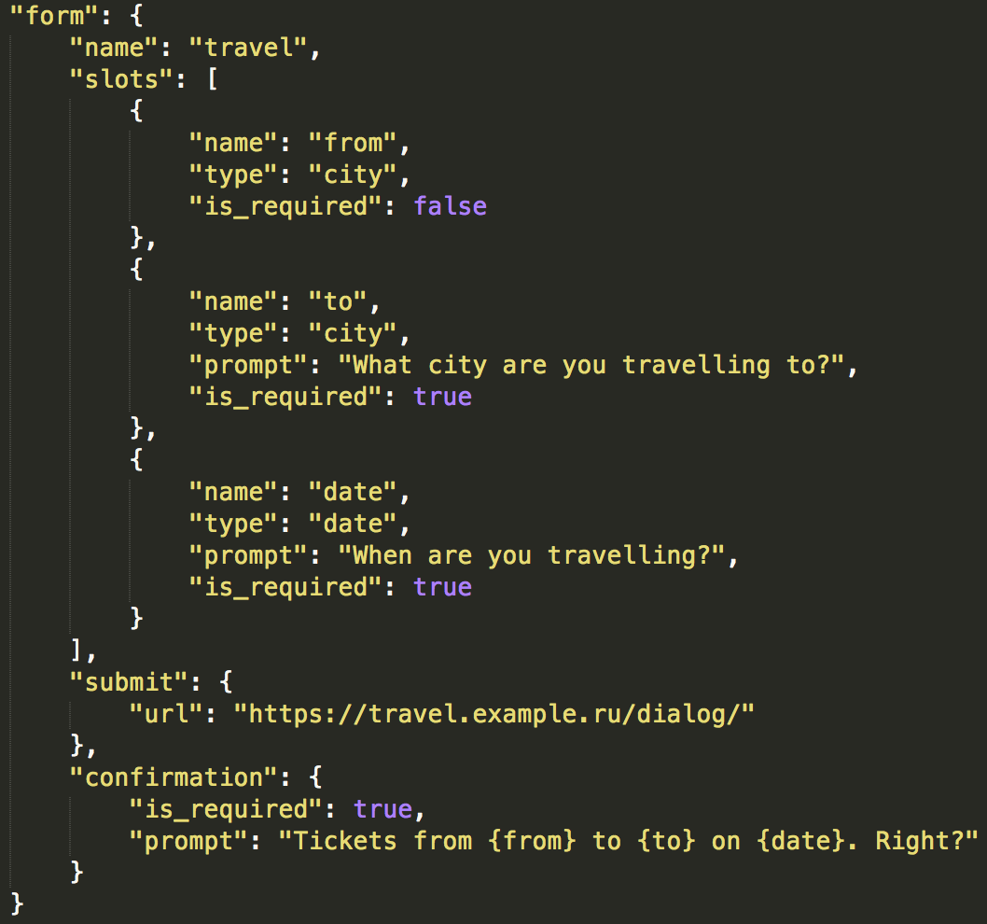
Dialogue Strategies – Form Filling
^{State}
^{Form with several typed slots}
^{Strategy}
Ask for values of each slot in linear order ^{– Request(slot_name)}
Optionally – confirm each slot or completed form – Confirm(slot_name=slot_value)
Use completed form to complete user's task ^{and inform user} ^{– Inform(form)}
Текст слайда

Slide 21
Reinforcement Learning for Dialogues
Search for optimal action through "Trial and Error"
What is "Reward signal"?
Finalizing task (confiming booking, commiting transactions, etc.)
Termination of conversation
Dialogue length
Positive sentiment

Slide 22
Natural Language Generation

Slide 23
_{Natural Language Generation}
Set of templates for each dialogue act
Grammars
Generative Models (Seq2Seq)

Slide 24
General Conversation

Slide 25
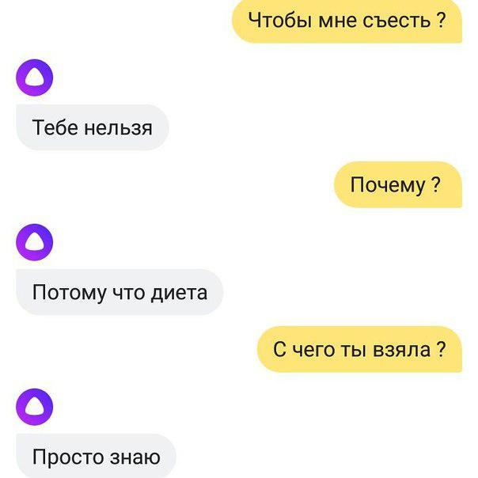
Why Chit-Chatting?
More human-like experience
Increases user retention
Rich and diverse user data
It's fun!
what should i eat?
you shouldn't
why?
diet. that's why
what makes you think that?
i just know

Slide 26
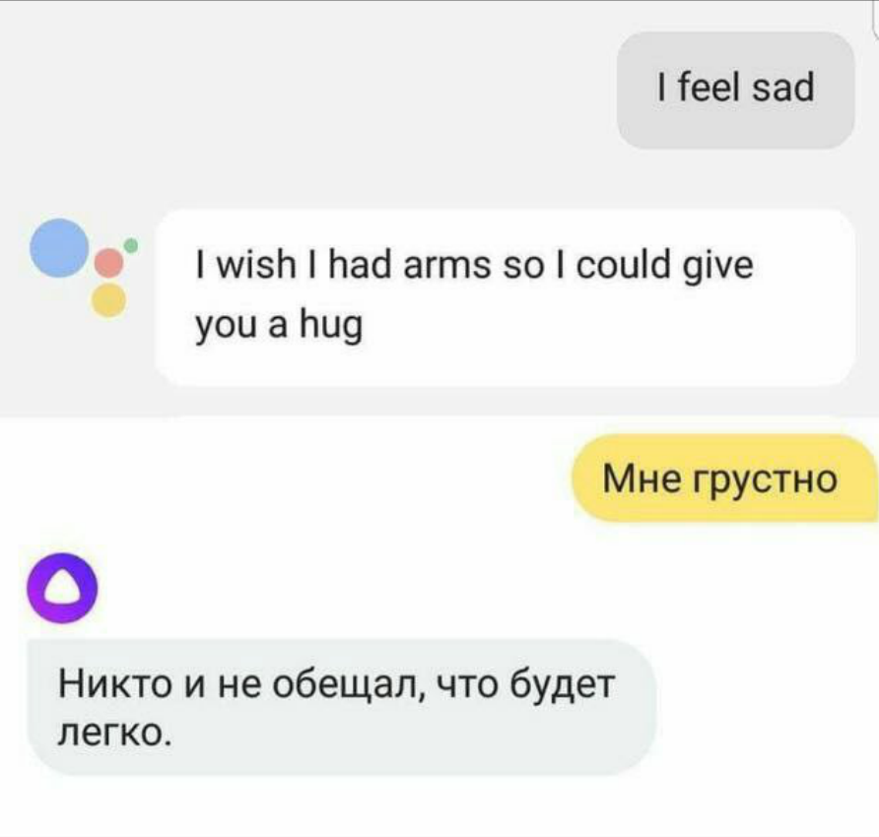
State of the Art
Set of prewritten responses for certain questions
You can not write a response for every user utterance
Especially if you take more than one previous turn into account
I'm sad
Nobody promised you that things would be easy

Slide 27
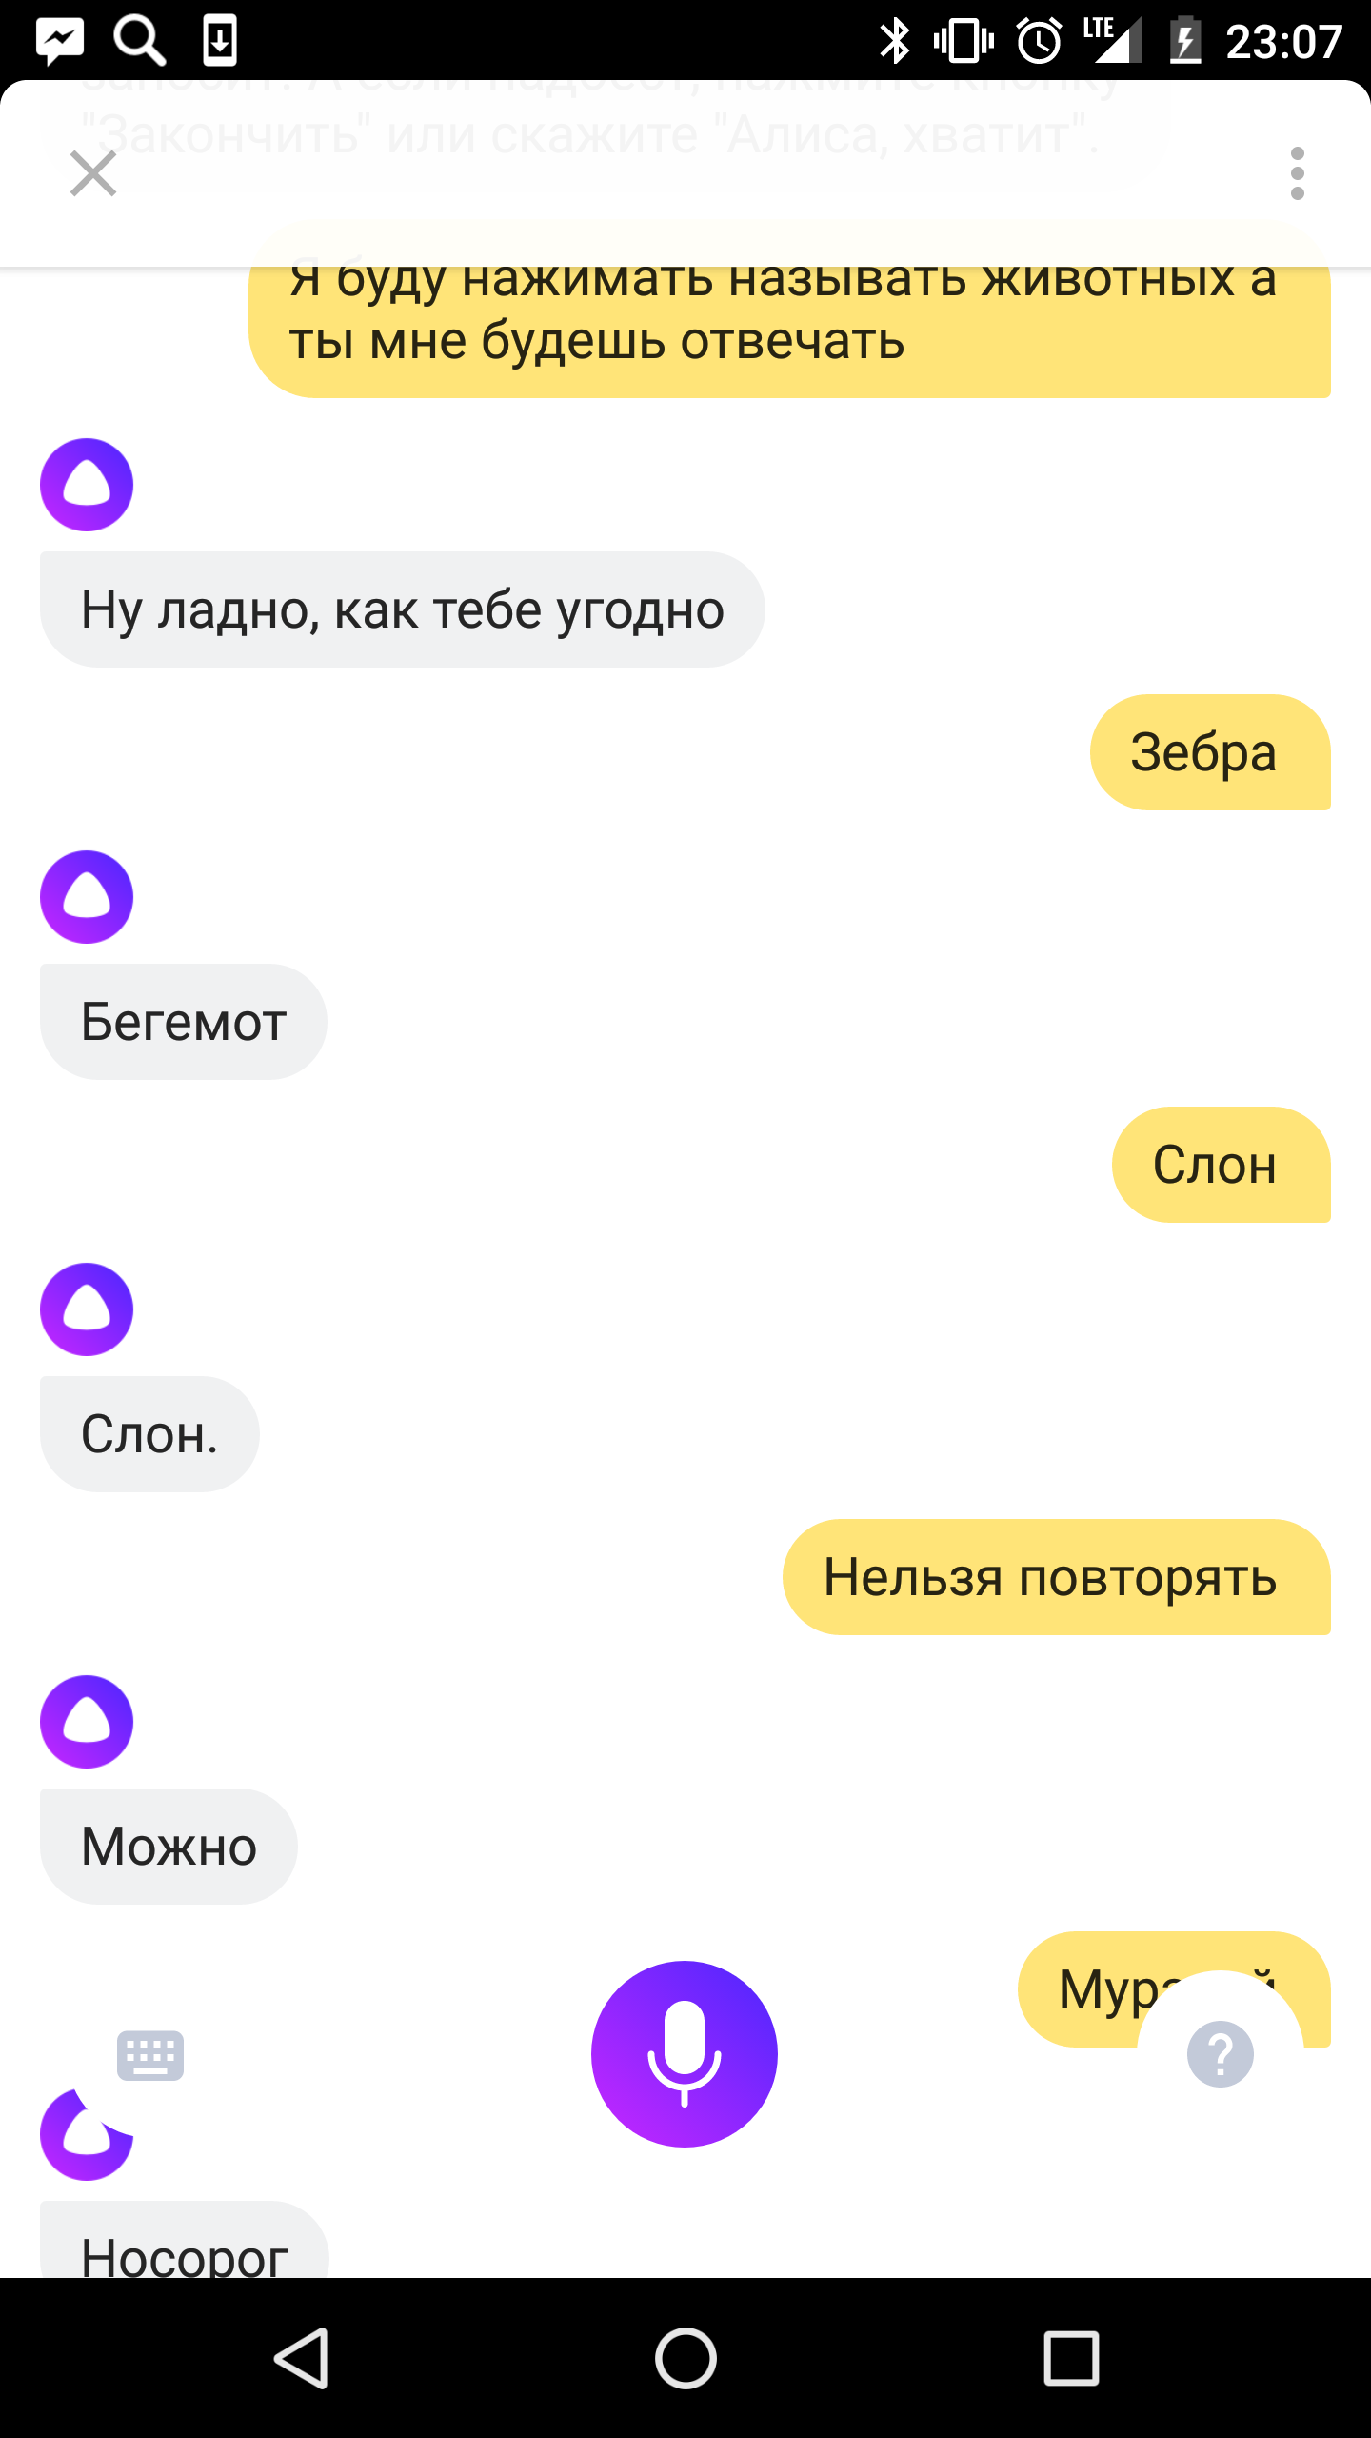
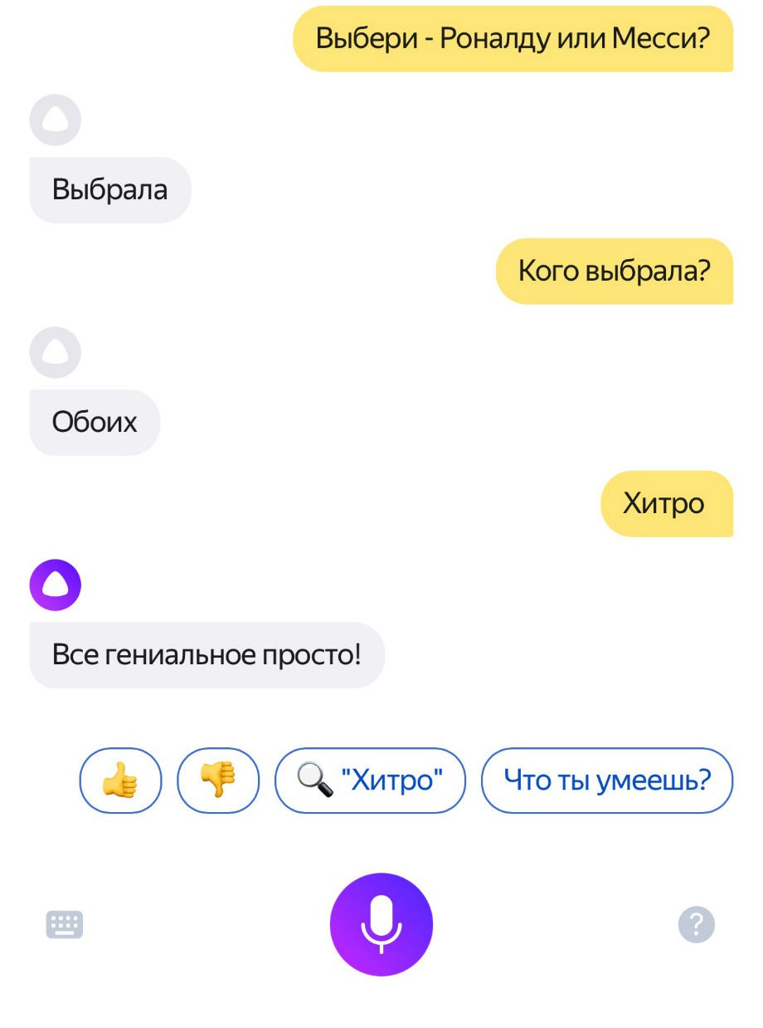
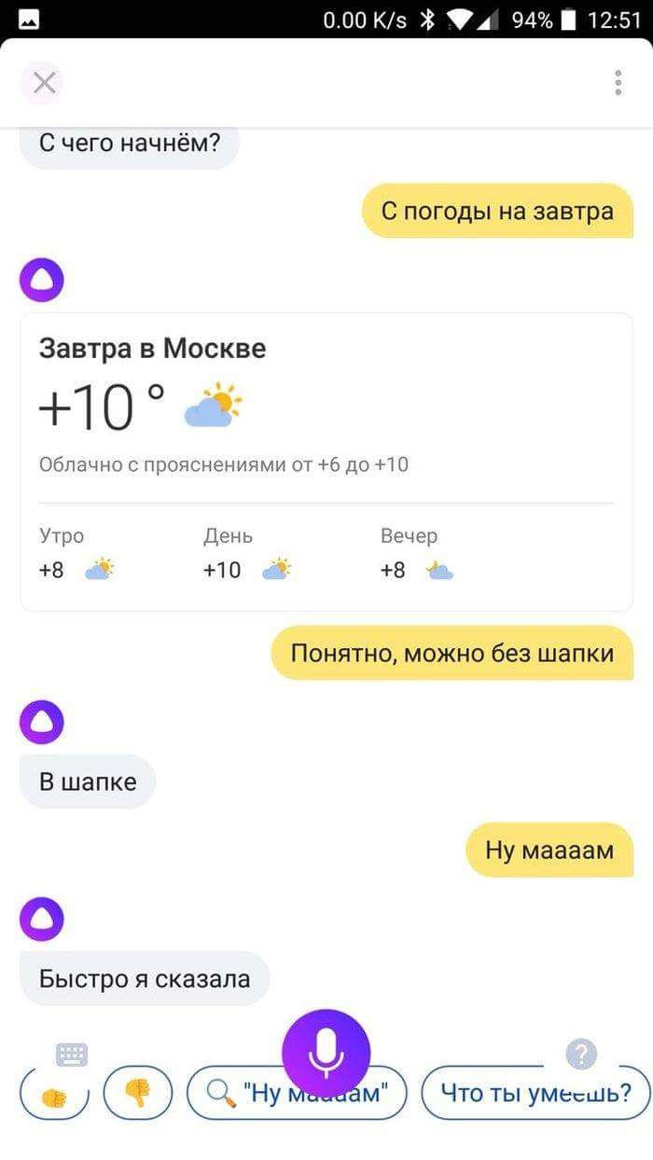
Benefits of General Conversation
Choose - Ronaldo or Messi?
i will name animals and you will respond
i've chosen
what should we start with?
with the weather tomorrow
ok. as you wish
who did you choose?
zebra
both
hippo
you're sly
elephant
all ingenious is simple!
elephant
it seems like there is no need for hat tomorrow
repeating is against the rules
you do need hat
but moooom
it's not
don't argue, young man

Slide 28
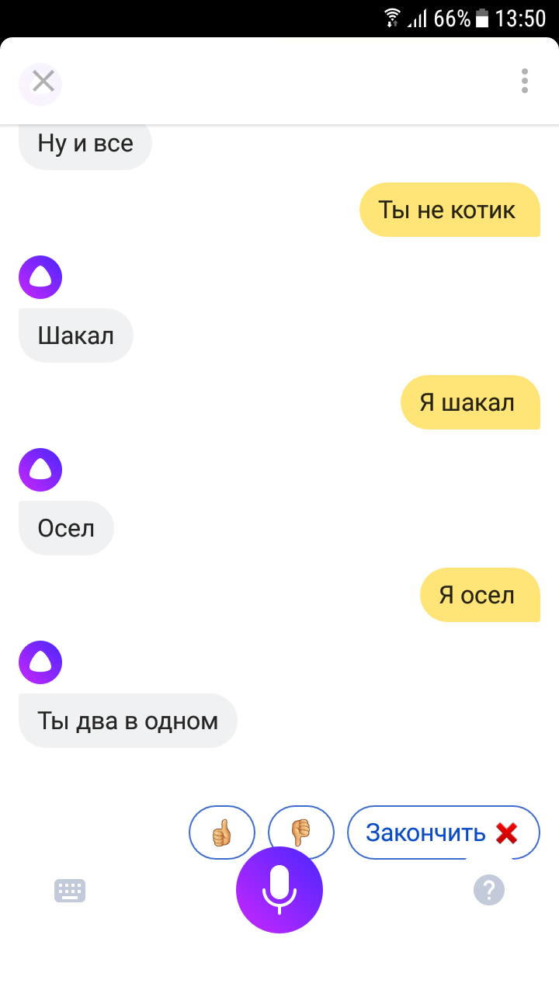
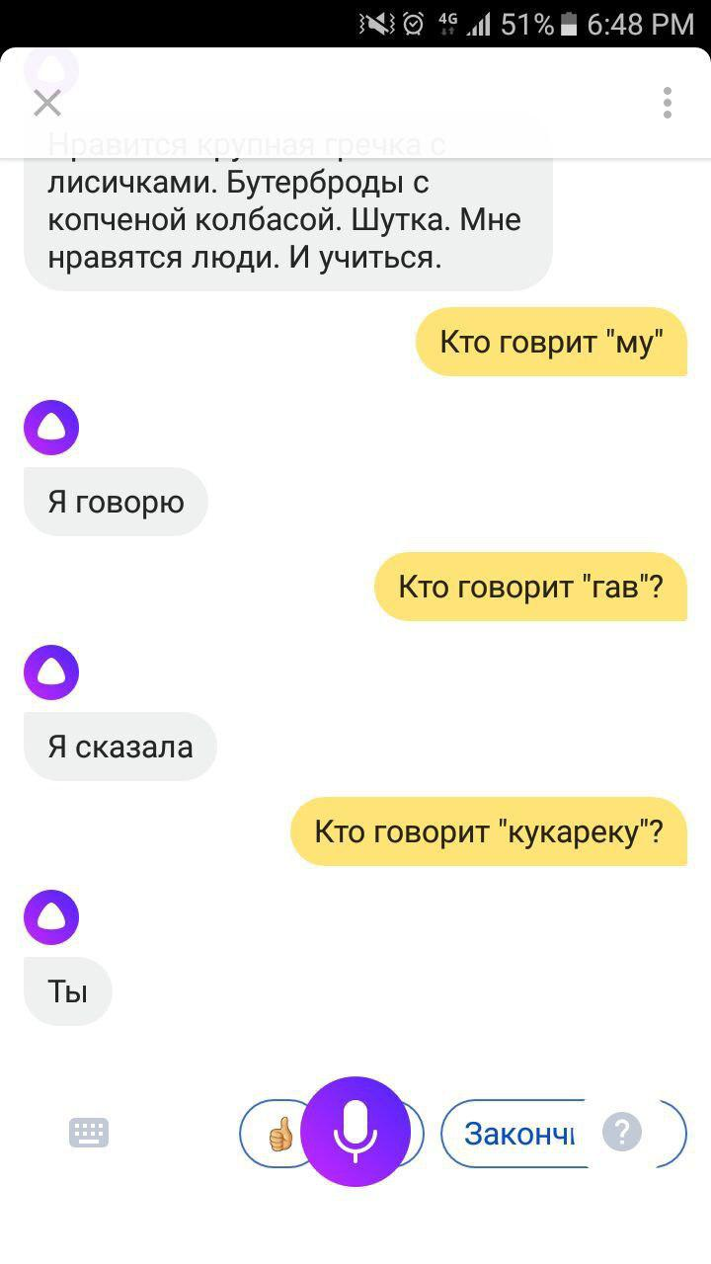
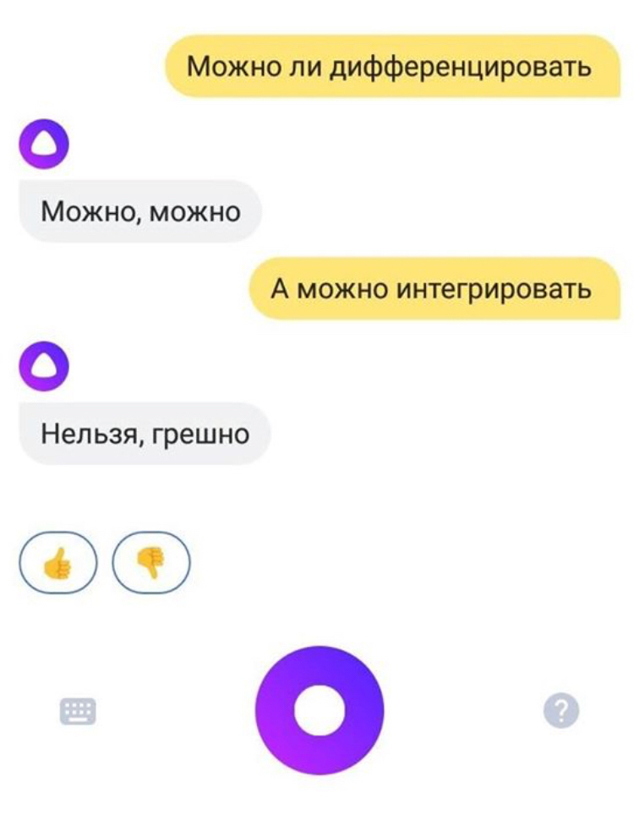
Dangers of General Conversation
is it ok to differentiate?
you're not a kitty
it's ok
who says moo?
jackal
how about integrating?
i'm a jackal
i do
no, it's a sin
who says bow-wow?
donkey
i'm a donkey
i said
who says cock-a-doodle-doo?
you're two in one
you do

Slide 29
Datasets
Comments from social networks
Dialogues from web-chats and messengers
Subtitles from movies
Direct speech from books

Slide 30
How to train?
Ideally:
Model goal driven coversations
In practice:
Model next response given several previous turns

Slide 31
Approaches
Generative Models
Modelling P(reply | context)
Selective (Ranking) Models
Train similarity / scoring function sim(reply, context)

Slide 32
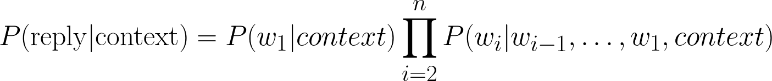
Generative Models
Borrows results from Neural Machine Translation
"Translates" previous turns to the next one
Generating replies word by word via Markov Process

Slide 33
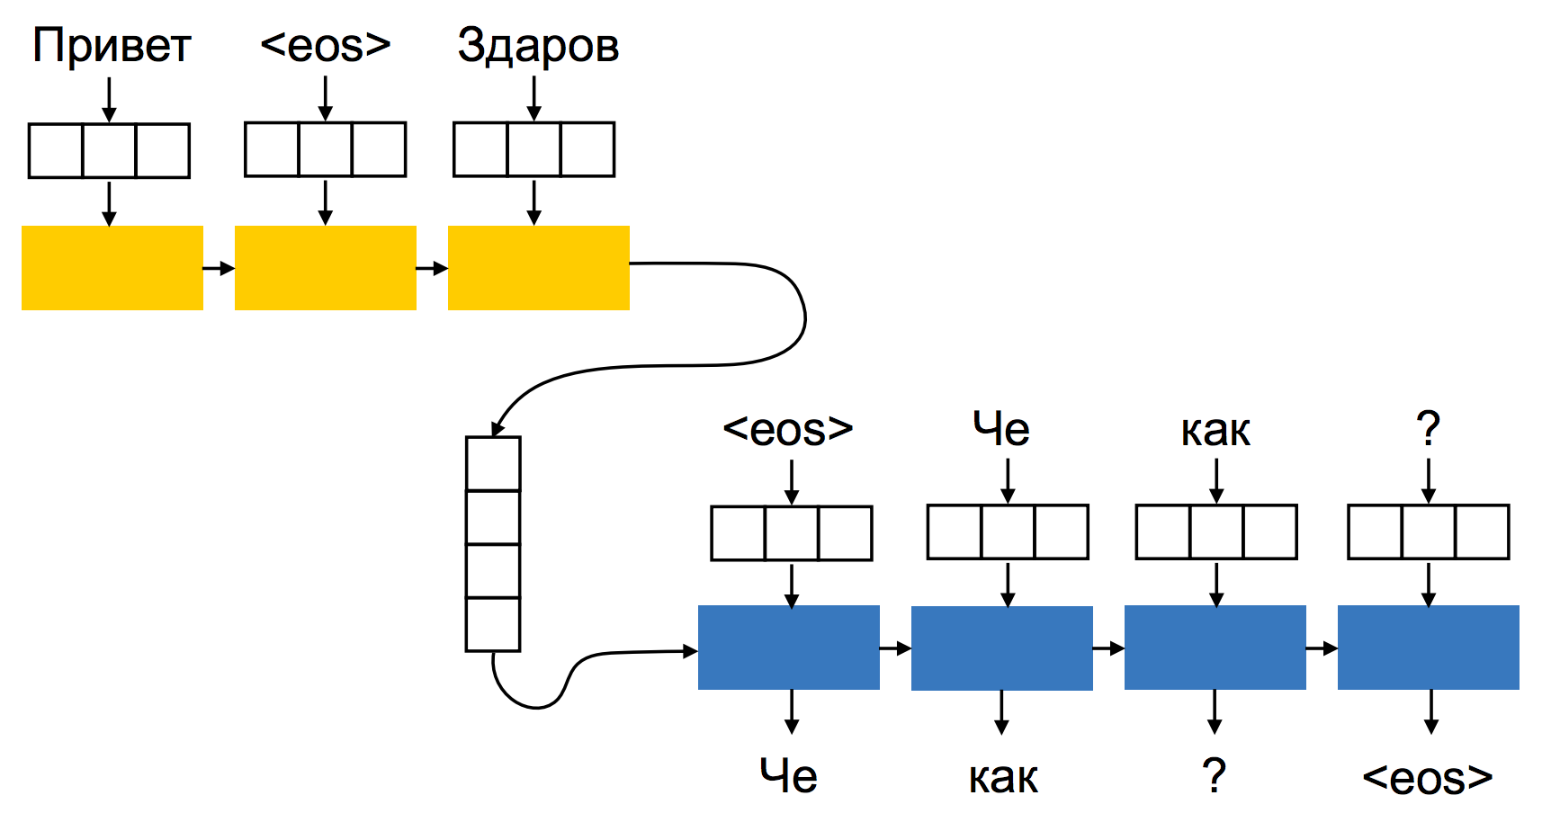

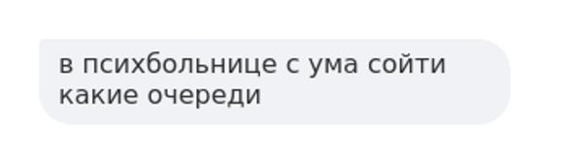
Sequence to Sequence: Encoder-Decoder
hi
hello
sup
bro
sup
bro

Slide 34
Sampling dialogues
- привет (hi)
- привет (hi)
- как ты ? (how are you?)
- нормально , а ты ? (ok, you?)
- отлично , чем занимаешься ? (i'm fine. what are you doing?)
- музыку слушаю , а ты ? (listening to music. and you?)
- тоже (same)
- что слушаешь ? (what are you listening to?)
- рок , а ты ? (rock. you?)
- рок . (rock)
- круто (cool)
- ага (yeah)
- чем увлекаешься ? (do you have any hobbies?)
- ничем , а ты ? (no. and you?)
- тоже ничем (me also)
...

Slide 35
Selective Models
Score static collection of replies with score(reply, context) and return the most relevant
Pros:
Almost perfect grammar and good "manners"
Much faster to train and apply
Cons:
Less coverage

Slide 36
Information Retrieval (IR) Baseline
Take a dataset of dialogues
Construct pairs (context, reply)
Build an inverted index (e.g. Lucene) on contexts
Return replies with best sim(context_from_user, context_from_index)
Lots of QA systems are built this way

Slide 37
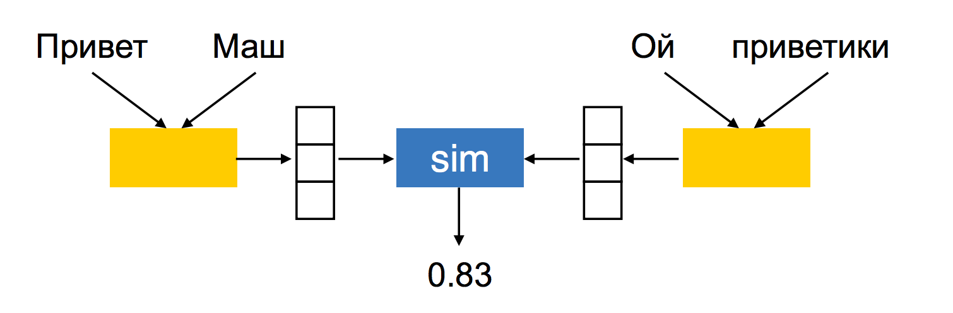
Neural Ranking Architectures
Hello
Mary
Hi
darling
score
Score is typically cosine similarity
Bag-of-Words, Recurrent or Convolutional encoders

Slide 38
How to train?
Negative examples:
Random
Mining (semi-)hard negatives
Loss functions:
Pointwise
Triplet loss, e.g. minimizing margin loss

Slide 39
How to apply?
Precompute embeddings for all replies in database
Build Approximate Nearest Neighbour (ANN) data structure
Compute embedding of user query (dialogue context)
Find replies nearest replies in ANN

Slide 40
Bringing the gap between Generative and Selective Models
Difference is in vocabulary!
It's always possible to model distribution P(reply|context)
Phrase units | Vocabulary size | Phrase length
characters | hundreds | hundreds
words | tens of thoudsands | tens
word n-grams | tens of millions | less than ten
phrase | hundreds of millions | one

Slide 41
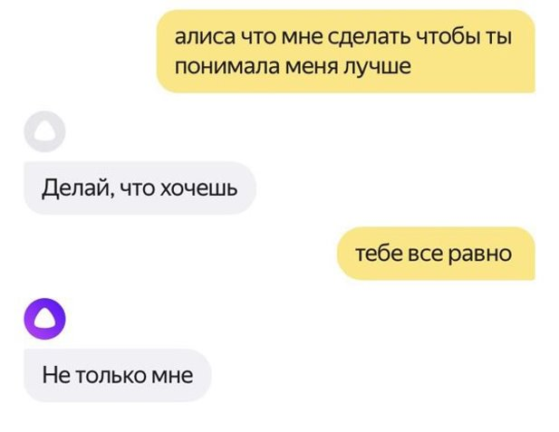
Limitations of Modeling of Next Response
Tendency for general answers
Dialogues could be non-engaging
It's hard to keep topic

Slide 42
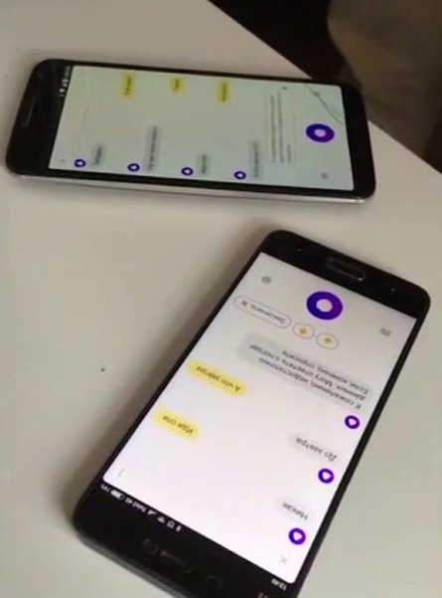
Reinforcement Learning for General Conversation
From next reply prediction towards dialogue-wise optimization!
Optimize for longer dialogues
Maximize informativeness and engagement
Maximize user satisfaction / minimize dissatisfaction
It's possible to fine tune GC Dialogue System to new objective
Move from policy of "natural" next response to policy of "better" next response
Model could learn it during Self Play (like Alpha Go, Alpha Star)

Slide 43
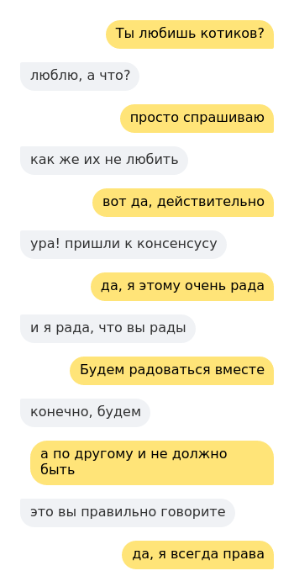
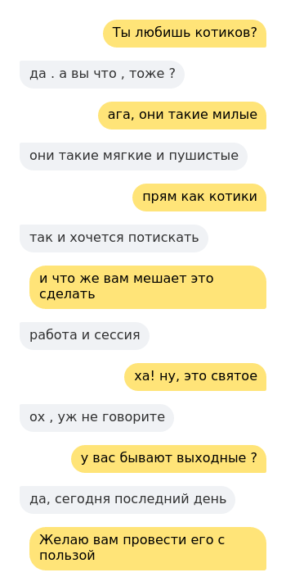
Examples of Self-Play Dialogues
Before
After

Slide 44
Problems with General Conversation Models
Tendency for short and general answers
"i don't know" or "what?"
-> diversity promoting objectives
Inconsistency
How old are you? -> I'm 16
What is your age? -> I'm 14
-> conditionining model on some kind of persona-profile
Hard to evaluate quality
Crowdsourcing evaluation is state-of-the-art

Slide 45
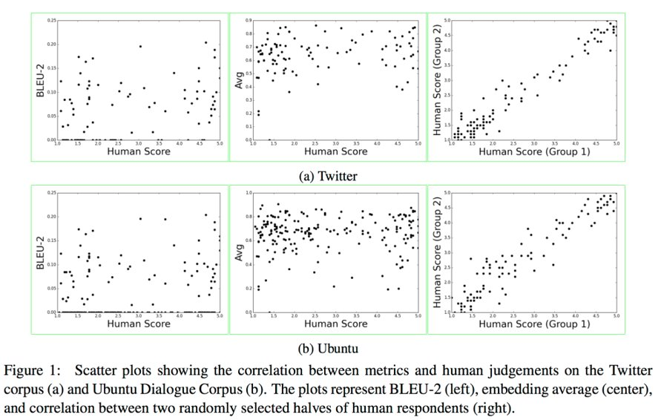
How NOT To Evaluate Your Dialogue System
All metrics show either weak or no correlation with human judgements

Slide 46
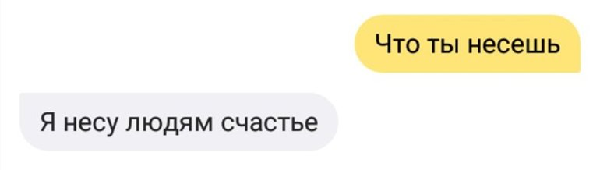
In conclusion
Dialogue interfaces are the future of human-machine interaction
Goal-Oriented Dialogue System are mostly ruled based with the absense of good training corpora
But offer lots of challenges in NLP and ML in general
General Conversation Dialogue Systems are in their infancy with lots of open problems but (thanks to deep learning) already show some impressive results

Slide 47










Thanks! Questions?
Vyacheslav (Slava) Alipov
Principal R&D Engineer at Dialogue Systems Group
alipov@yandex-team.ru
Apply!
intern@yandex-team.ru

