Slide 1

The Technology Value Stream
From Idea to Customer Delivery
Abram Denzlinger
June 7, 2026
CSD380 - Assignment 1.2

Slide 2
01. Defining the Stream
Understanding the conceptual blueprint of value delivery in contemporary software development.

Slide 3


What is a Value Stream?
The General Definition
The Technology Stream
A value stream is the end-to-end sequence of operational activities required to design, produce, and deliver a product or service directly to a customer.
In technology, the value stream is largely "invisible" and highly digital, consisting of code, configurations, deployments, and database updates.
It explicitly focuses on converting business-driven hypotheses into fully realized, technology-enabled services delivered to the user.
In physical manufacturing, these steps are highly tangible and observable on the physical factory plant floor.
Reference: Kim et al., 2016, p. 8
Reference: Kim et al., 2016, p. 8

Slide 4

Lead Time vs. Processing Time
Crucial Metrics to Differentiate
99%
Lead Time (The Clock of the Customer): Starts immediately when a request is initiated and stops when the deployment goes live. This measures the complete customer experience and includes all wait times in queues.
TYPICAL WASTE GAP
Processing Time (The Clock of the Engineer): Commences only when active execution begins. It excludes inactive downtime or waiting phases.
Reference: The DevOps Handbook, Page 9

Slide 5
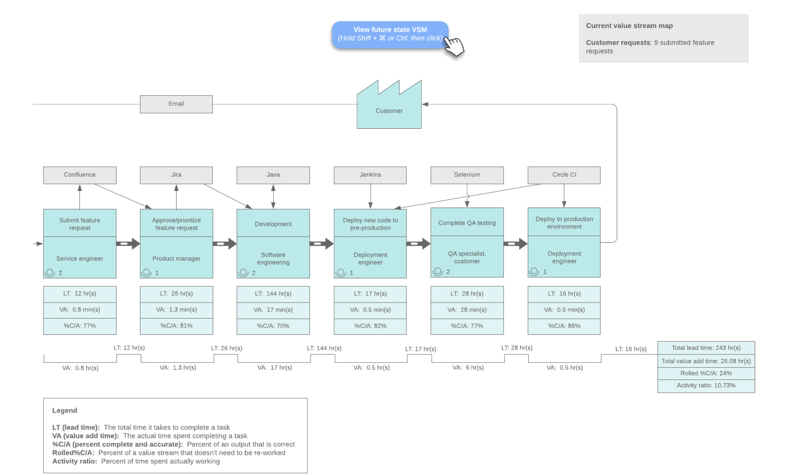
The Bottleneck of Manual Silos
The Core Issue: Inactive Queue Time
In classical organizations, work must slowly progress through rigid functional silos (product managers, development, QA, security, database administration, and operations).
Siloed Environments: Multiple handoffs generate extreme delays.
Long Queue Delays: Work spends up to 99% of its total lead time idle in various queues.
High Failure Rate: Large batches increase production deployment risks.
Reference: Kim et al., 2016, p. 10

Slide 6

Deployment Times: Common vs. Ideal
The Common Scenario (Months)
Our DevOps Ideal (Minutes)
Traditional deployment setups require months to pass testing, change management boards, and infrastructure handoffs.
DevOps transforms the paradigm so developers receive constant, rapid feedback, allowing deployments to occur routinely.
This slow cycle prevents quick responses to market changes, raises project stress, and introduces massive system fragility.
By automating testing and environments, lead times shrink from months to minutes, making deployments low-risk operations.
Reference: Kim et al., 2016, p. 10
Reference: Kim et al., 2016, p. 10

Slide 7






How DevOps Shrinks Deployment Time
Continuous Integration
Automated QA
On-Demand Deploy
Manual regressions and staging tests are fully automated, shifting validation left to catch integration defects in real time.
Infrastructure is managed as code. Standardized deployment pipelines handle builds safely without lengthy manual configurations.
Developers routinely check code into a shared repository, running automatic unit tests immediately to pinpoint regressions early.

Slide 8
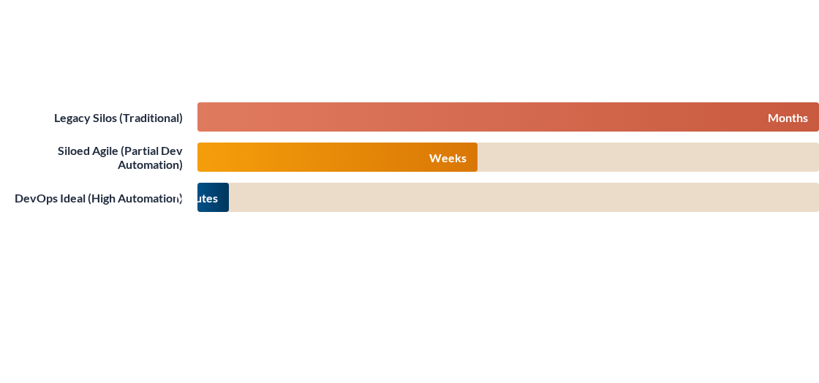
Typical Lead Time Comparison
The standard DevOps implementation focuses entirely on reducing wait states in queues, shrinking total lead time to mirror processing time as closely as possible.

Slide 9



The Three Ways of DevOps
1. Fast Flow
2. Fast Feedback
3. Continuous Learning
Accelerating the movement of work from left to right (from development to operations and the end customer).
Injecting continuous feedback loops from right to left to address and resolve defects immediately at the source.
Fostering a high-trust culture that encourages scientific experimentation, safe failure, and organizational learning.

Slide 10

Thank You!
Questions & Academic References
Primary Textbook Reference:
Kim, G., Humble, J., Debois, P., & Willis, J. (2016). The DevOps Handbook: How to Create World-Class Agility, Reliability, and Security in Technology Organizations (1st ed.). IT Revolution Press.
"By understanding our technology value stream, we can systematically eliminate work-in-progress, automate manual processes, and transform months of delay into minutes of reliable delivery."

Slide 11

Image Sources
https://corporate-assets.lucid.co/chart/563c02fb-dbec-495d-a9d7-532b598ed985.png?v=1707843654752
Source: www.lucidchart.com

