Slide 1
Securing Shared Source Code
Abram Denzlinger
July 25, 2026
CSD-380 - Assignment 10.2

Slide 2
Best Practices Overview
1. Identity & Access Management (IAM)
2. Secret Management & Data Protection
3. Branch Protection & Collaboration
✓
✓
✓
4. Dependency & Supply Chain Governance
5. CI/CD Pipeline & Automation Security
6. Monitoring, Response & Policies
✓
✓
✓

Slide 3
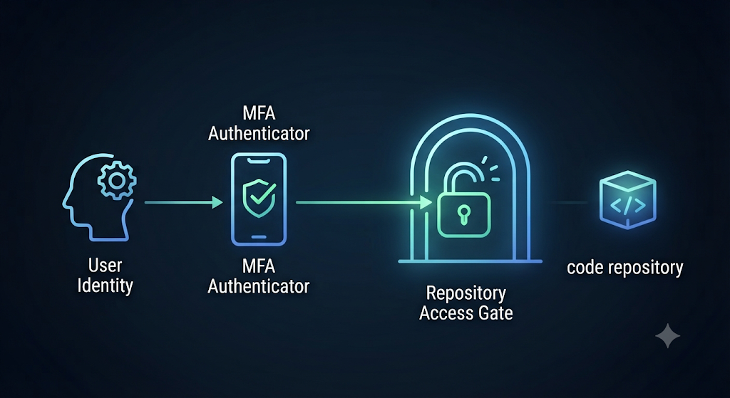
1. Identity & Access Management
✓
Enforce Least Privilege RBAC.
✓
Mandate MFA for all contributors.
✓
Verify commits via Cryptographic Signing.

Slide 4
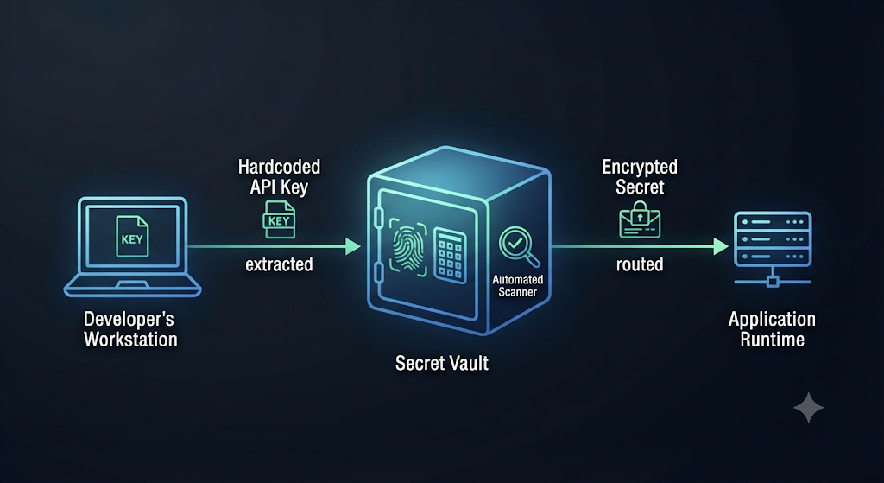
2. Secret Management
✓
Never hardcode sensitive tokens or keys.
✓
Use dedicated secret vaults (e.g., HashiCorp Vault).
✓
Automate scanning with tools like Gitleaks.

Slide 5
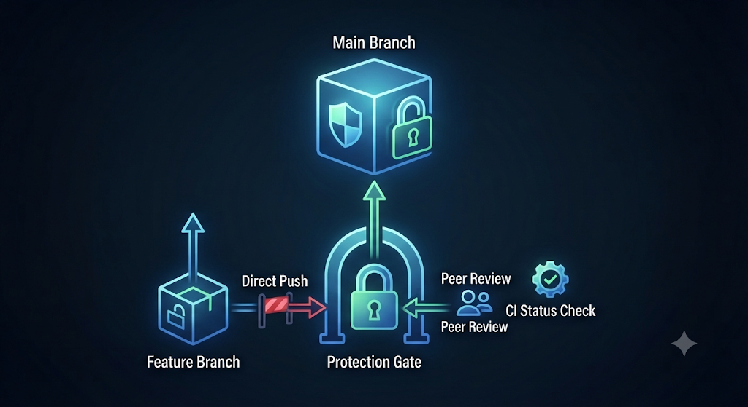
3. Branch Protection
✓
Block direct pushes to main branches.
✓
Require peer reviews for every PR.
✓
Enforce successful CI/CD status checks.

Slide 6
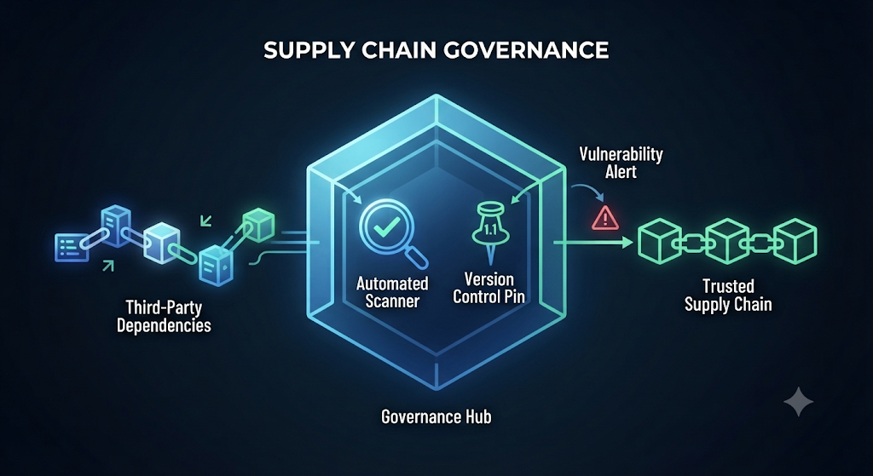
4. Supply Chain Governance
✓
Use lock files for dependency pinning.
✓
Run SCA scans on third-party libraries.
✓
Automate patches with tools like Dependabot.

Slide 7
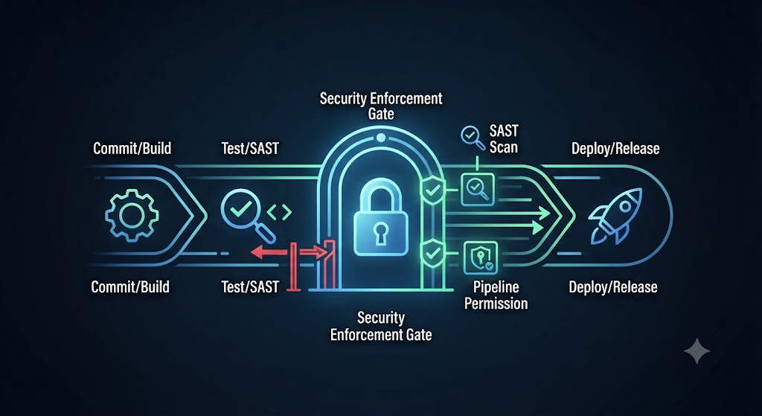
5. CI/CD & Automation Security
✓
Run automated SAST scans before merging.
✓
Harden CI/CD workflows (restrict permissions).
✓
Pin actions to specific commit SHAs.

Slide 8
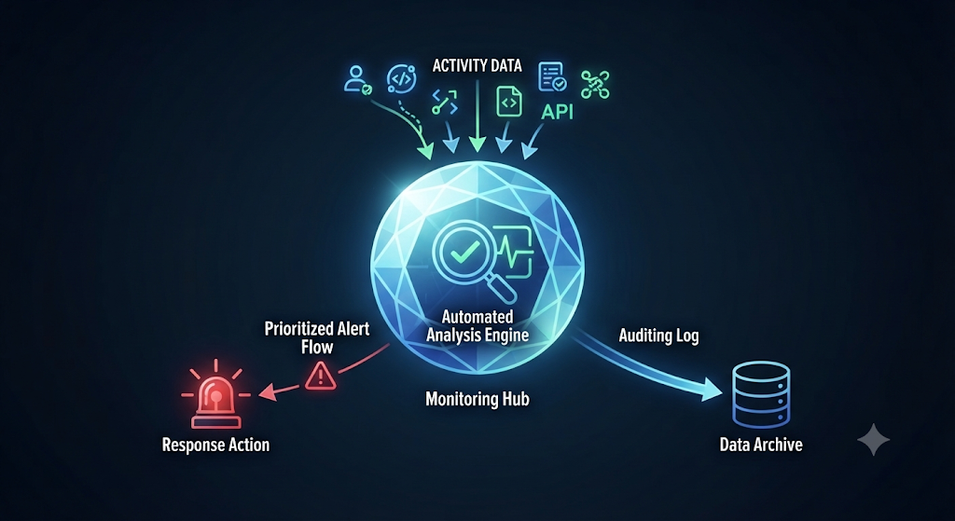
6. Monitoring & Response
✓
Alert on suspicious repository activity.
✓
Publish SECURITY.md at root.
✓
Define clear disclosure procedures.

Slide 9
Sources
Harness (DevOps Academy & Infrastructure as Code Management Guides):
Best Practices for Securing Code Repositories | Harness Glossary
Best Practices | Harness Developer Hub
Salesforce (Security Guidance & AppExchange Documentation):
Salesforce Security Best Practices
The Complete Guide to Salesforce Data Security (AppExchange PDF)

Slide 10
Image Generation
Images created with Gemini
Prompt: Create a graphic that represents (topic) as outlined here. No explanations. Single focus point. Simple graphic.

