Slide 1
Pager Rotation Duties in the DevOps Model
Abram Denzlinger
July 11, 2026
Assignment 7.2 - CSD380

Slide 2
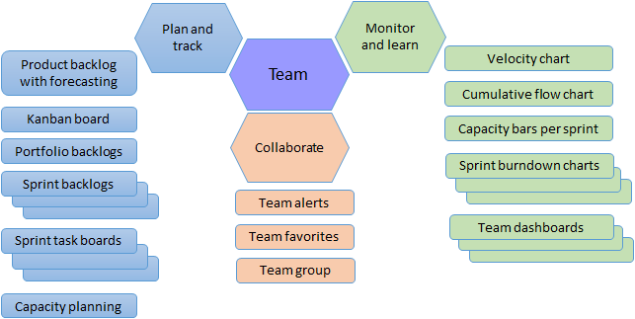
The Need for a New Approach
Bridging Dev & Ops
Traditional siloes often led to "throwing code over the wall." Pager rotation duties ensure those who build the software are the ones managing its reliability in production.
The Outcome: Higher code quality, faster feedback, and shared ownership of the product's lifespan.

Slide 3






Principles for the On-Call Era
Feedback Loops
Swarming
Blamelessness
Rapid detection is the first step toward system improvement.
Cross-functional teams resolve incidents, not just individuals.
Treating failures as system flaws, not human error.

Slide 4
Designing the Rotation Model
Model | Purpose
Weekly Rotation | High context retention; prevents fatigue.
Follow-the-Sun | Global teams; removes 3 AM pages.
Shadowing | Training path for new engineers.

Slide 5
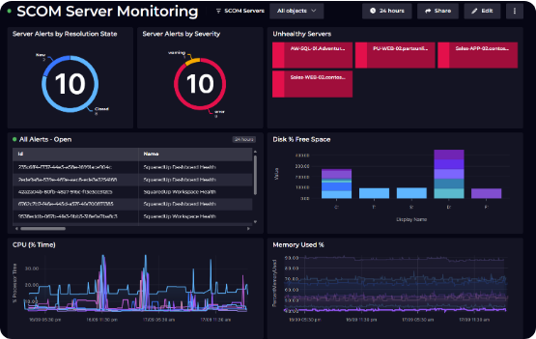
Combating Alert Fatigue
The 90-Day Audit
Noise obscures the signal. Google SRE standards recommend an audit every 90 days—if an alert required no action, delete it.
Focus: Distinguish between urgent pages and informational logs.

Slide 6
The "Coordination Tax" (Handoffs)
Active Incidents: Status updates on ongoing fires.
Silenced Alerts: Documentation on why noise was ignored.
Upcoming Risks: Syncing on planned deployments.
The Sync: A 30-minute weekly meeting is non-negotiable.

Slide 7
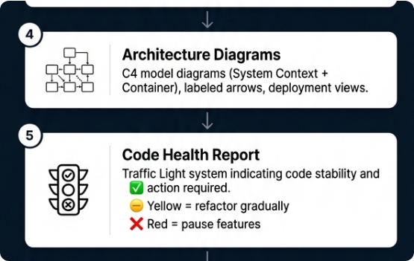
Runbooks & Escalation
Checklists, Not Manuals
A runbook should get you to "Mitigation" in under 15 minutes. It must include dashboards, commands, and clear escalation paths.
If the primary can't fix it, the path to L2/Manager must be automatic and predefined.

Slide 8
Engineering Well-being
Sustainability = Reliability
Burnout is the enemy of reliability. By capping pager load and fostering psychological safety, we keep engineers focused and effective.

Slide 9


Key Performance Metrics
What Makes a Good Metric?
Key Indicators
•
Actionable: Does it trigger a decision or change?
•
Signal-to-Noise: Ratio of actionable alerts vs. noise.
•
Contextual: Does it relate to system health?
•
MTTR (Mean Time to Resolve): Speed of recovery.
•
Fair: Does it avoid punishing individuals for system-level issues?
•
Off-hours Frequency: Proxy for systemic fragility.

Slide 10
Conclusion & References
Conclusion: A healthy rotation model is a dynamic system, evolving alongside your architecture.
References:
•
Kim, G., et al. (2021). The DevOps Handbook. IT Revolution Press.
•
Beyer, B., et al. (2018). The Site Reliability Engineering Workbook. Google.
•
Incident.io (2026). "On-call best practices: handoffs, schedules, and alert fatigue."

Slide 11



Image Sources
https://learn.microsoft.com/en-us/azure/devops/organizations/settings/media/agile-tools/agile-tools-team-assets-post-2018.png?view=azure-devops
Source: learn.microsoft.com
https://cdn.sanity.io/images/z7wg6mcy/production-2025/deef8e6ada84a7650d12c576cbfc7b6370c9cf7e-1545x991.png?fm=png&q=100&fit=max&auto=format
Source: squaredup.com
https://assets.seobotai.com/undefined/6a1396c95ded517781caa2a4-1779676268449.jpg
Source: altersquare.io

