Slide 1

MODERN IDENTITY STRATEGY
Reviewing SSO, OAuth 2.0, and OpenID Connect
Balancing user friction and seamless, secure access

Slide 2


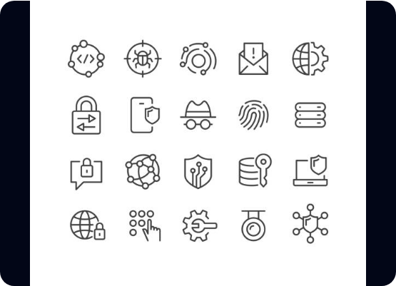
"Who Are You?" vs. "What Can You Do?"
Core Definitions
Authentication (AuthN): Verifying identity. Does the user possess valid credentials? (e.g., "This is definitely Jane Doe").
Authorization (AuthZ): Verifying permissions. What is the user allowed to do? (e.g., "Jane can read files but not delete them").
The Dilemma: Using the wrong tool leads to "leaky" security or a frustrating, fragmented user experience.

Slide 3





The Unified User Experience (SSO)
Concept & Mechanics
Pros & Cons
One set of credentials to rule them all. Authenticate once, access everything across the network.
Pros: Eliminates password fatigue and allows for centralized user offboarding.
Cons: Single point of failure and complex trust configurations via Metadata/Certs.
•
IdP: The "Source of Truth" (Okta, Azure AD).
•
SP: The Apps receiving the user.

Slide 4
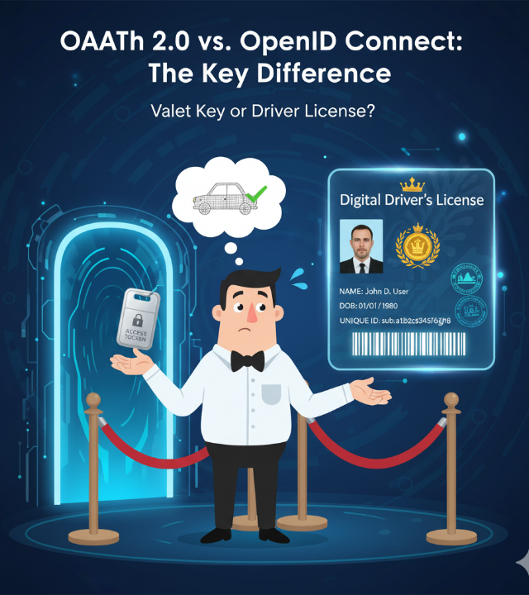
OAuth 2.0 (The Valet Key)
Delegated Authorization
Allows an app to access data on behalf of a user without seeing their actual password.
Scopes: Granular permissions (read:profile).
Access Tokens: Temporary digital passes.
Note: Not an identity protocol; it knows if a token is valid, not who you are.

Slide 5


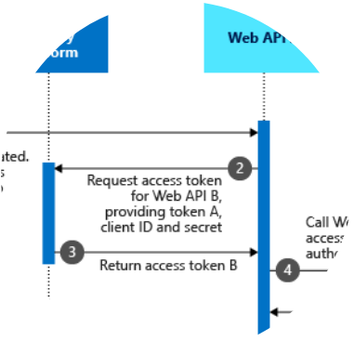
OpenID Connect: The Identity Layer
OAuth 2.0 + Identity Layer
The ID Token: A signed JSON Web Token (JWT) containing user profile data and "Claims".
•
Standardized "Userinfo" endpoints.
•
Optimized for mobile and modern cloud environments.
•
Highly secure, developer-friendly (JSON vs XML).

Slide 6
Comparative Analysis
Goal | SAML (Legacy SSO) | OAuth 2.0 | OpenID Connect
Primary Function | Enterprise Web Auth | Delegated Authorization | Modern Identity/AuthN
Data Format | XML (Complex) | JSON (Lightweight) | JSON / JWT
Native Apps | Difficult / Clunky | Excellent | Native Standard
Best For | Internal Corporate Tools | API & Resource Access | Social Login / Modern SSO
Choose the protocol that matches your application's architecture and security requirements.

Slide 7

Choosing the Right Tool
Protocol | Format | Best For | When to Use
SAML (SSO) | XML | Enterprise/Gov | Legacy apps, high-compliance, air-gapped networks.
OAuth 2.0 | JSON | API Access | Microservices, 3rd party data delegation (No Identity).
OIDC | JWT | Modern Web | Consumer apps, Mobile SSO, "Sign in with..." standards.
General Guidance: Standardize on OIDC unless legacy constraints force SAML usage.

Slide 8
A Solid Path Forward for your Organization
Adopt OpenID Connect (OIDC): Make this the primary protocol for all new web and mobile applications to ensure future-proofing.
Leverage OAuth 2.0: Secure all internal microservices and third-party API integrations using scoped access tokens.
Bridge Legacy Systems: Retain SAML only where strictly necessary for older enterprise SaaS tools.
The Result: A scalable, mobile-ready, and developer-friendly identity ecosystem that balances security and UX.

Slide 9




Image Sources
https://media.istockphoto.com/id/1348086717/vector/cyber-security-icons-classic-line-series.jpg?s=612x612&w=0&k=20&c=OZOw4dqt49IQRkozkyu7Fw_yUM3XkeEKLFiz3b23m2M=
Source: www.istockphoto.com
https://miro.medium.com/1*S7x2vSIKsP7CsZblyS8wxw.png
Source: medium.com
https://learn.microsoft.com/en-us/entra/identity-platform/media/v2-oauth2-on-behalf-of-flow/protocols-oauth-on-behalf-of-flow.png
Source: learn.microsoft.com
https://elements-resized.envatousercontent.com/elements-video-cover-images/files/86061893-2087-4aa6-9088-d340b5782e32/inline_image_preview.jpg?w=500&cf_fit=cover&q=85&format=auto&s=e631d9b34a493410f283a1a1d8066a9f0f6733405ad49799c1e953748085ec57
Source: elements.envato.com

