Slide 1

Data Management
Surya Raj Bista
NP000689
July 2022
Assignment 1& 2
Lecturer- Deepak Karna

Slide 2

Feature Engineering
Feature Creation
Feature Transformation
Feature Extraction
Exploratory Data Analysis
Benchmark

Slide 3
Principal Component Analysis
Feature extraction
This technique transforms the dataset into more smaller and meaningful features by reducing the dimensions of the data. The most important application of feature extraction includes the recognition of patterns, processing of images, and unsupervised learning of machine learning. Furthermore, it improves speed and accuracy and improves the visualization of data. (Malik, 2021)
Used in machine learning for the reduction of dimension, analysis of the exploratory data as well as prediction of the models
The processing of the images, building a system for a recommendation of movies, and optimization of information.
Algorithms in the principal component analysis include the covariance matrix, correlation, and Orthogonal, and the most popular steps include standardizing, calculating covariance, sorting, and removing less important features soon after the dataset has been collected.

Slide 4
Label encoding
One-hot encoding
Label encoding involves the conversion of labels into a readable form of a number, which the machine can understand.
Categorical variables can be better solved with the one-hot encoding, which creates dummy-like variables before the actual encoding is performed for prediction purposes. The one-hot encoding process is usually carried out when the categorical variable is not ordinal.

Slide 5
Metadata - Exploration
No | Name of variable | Description | Data Type | Length | Sample Data (Instances)
1 | SME_LOAN_ID_NO | Unique id for Loan | Char | 8 | LP001024
2 | GENDER | Gender of the customer | Char | 6 | Female
3 | MARITAL_STATUS | Marital Status of a customer | Char | 11 | Married
4 | FAMILY_MEMBERS | Count of family members | Char | 2 | 1
5 | QUALIFICATION | Qualification of the customer | Char | 14 | Graduate
6 | EMPLOYMENT | Employment status of the customer | Char | 3 | Yes
7 | CANDIDATE_INCOME | Income of the candidate | Number | 8 | 5849
8 | GUARANTEE_INCOME | Amount guaranteed | Number | 8 | 2358
9 | LOAN_AMOUNT | Amount took as loan | Number | 8 | 128
10 | LOAN_DURATION | Duration of loan taken | Number | 8 | 360
11 | LOAN_HISTORY | Number of loans taken in the past | Number | 8 | 1
12 | LOAN_LOCATION | The location where the loan was taken | Number | 7 | City
13 | LOAN_APPROVAL_STATUS | Status whether the loan is approved or not | Char | 1 | Y

Slide 6
PROC CONTENT, FREQ & Analysis
PROC CONTENT shows very important aspects of the data by checking the contents in the file.
Proc Freq
Single Variable Analysis:
Cross Tab Analysis:

Slide 7
Company Assumption
“XYZ Loan” is a financial institution that provides loan based on income and guaranteed income, qualification, employment, and gender.
Objectives
To explore the dataset for analysis through its classification in terms of nominal, interval, ordinal, and ratio data.
To identify the mean, median, frequency, percentile, and variances to further support the initial exploration.
To identify the outliers, treatment of outliers, and the missing values in the dataset.
To perform data preprocessing to clean and organizes the data.
To perform the Exploratory Data Analysis (EDA) to explain the relationships and characteristics of the various data using a graph for better visualization.
To perform the hypothesis to interpret the query and visualization, and decide the conclusion.

Slide 8

Tools used

Slide 9
Dataset
SME_LOAN_ID_NO
GENDER
MARITAL_STATUS
FAMILY_MEMBERS
QUALIFICATION
EMPLOYMENT
CANDIDATE_INCOME
GUARANTEE_INCOME
LOAN_AMOUNT
LOAN_DURATION
LOAN_HISTORY
LOAN_LOCATION
LOAN_APPROVAL_STATUS

Slide 10
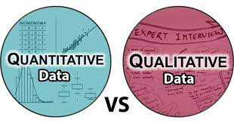
GENDER
QUALIFICATION
EMPLOYMENT
LOAN_LOCATION
LOAN_APPROVAL_STATUS
CANDIDATE_INCOME
GUARANTEE_INCOME
LOAN_AMOUNT
LOAN_DURATION

Slide 11
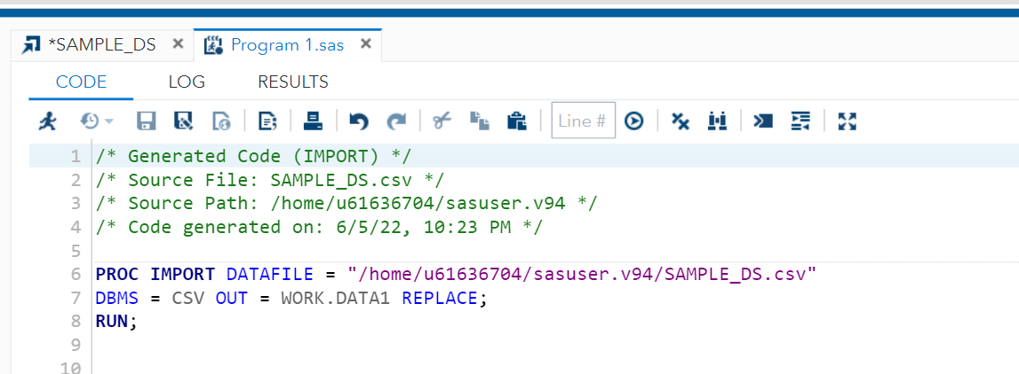
Initial Data Exploration (Data Import in SAS)

Slide 12
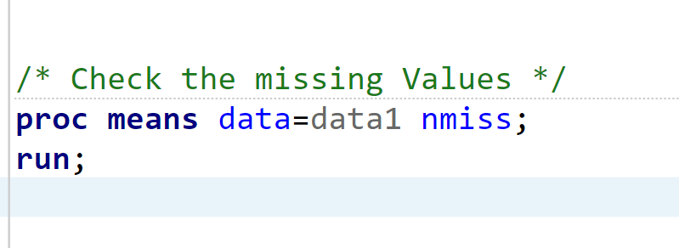
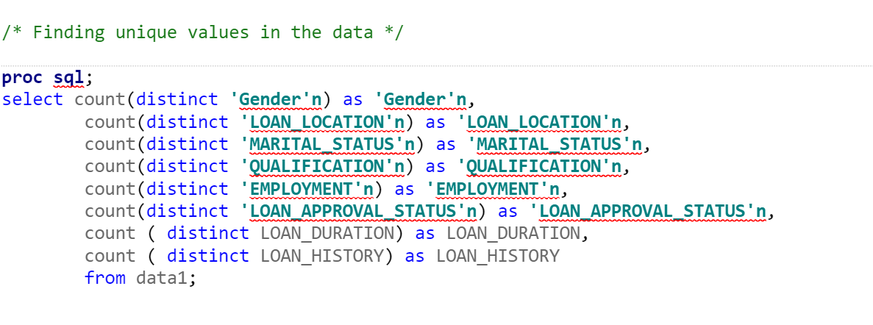
Outliers, Missing Values, and Outliers Treatment

Slide 13
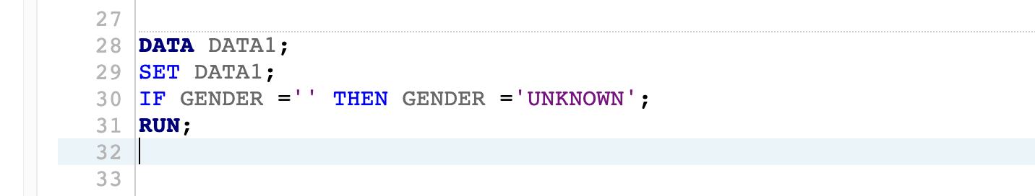
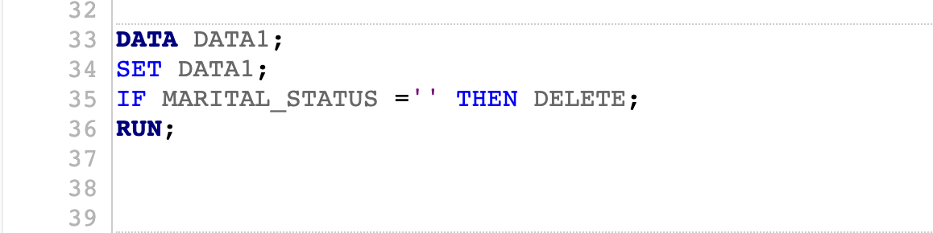
Data Pre-processing ( Handling incomplete, noisy and inconsistent data )

Slide 14

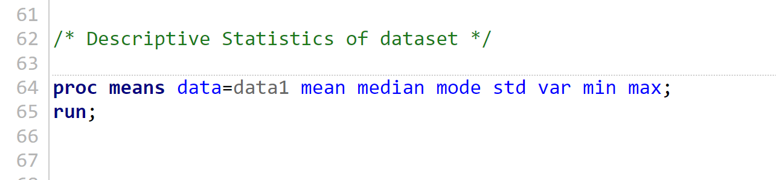
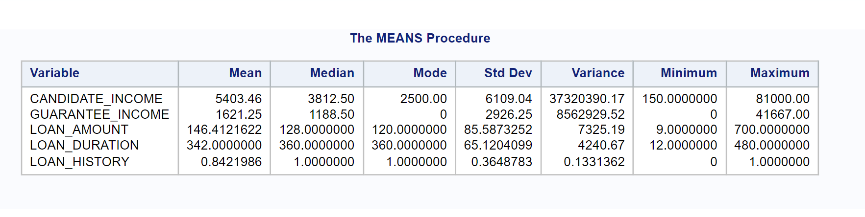
Exploratory Data Analysis (EDA) Graph Descriptive Analysis:

Slide 15
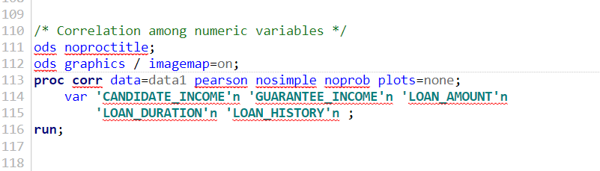
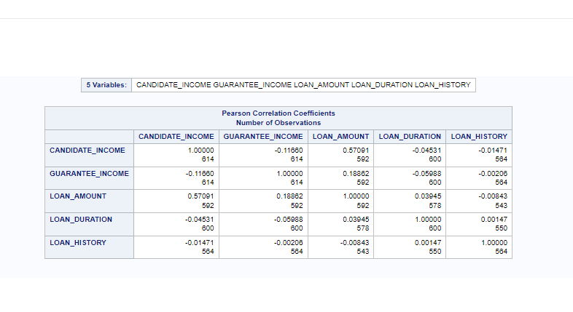
6.2 Correlation:

Slide 16
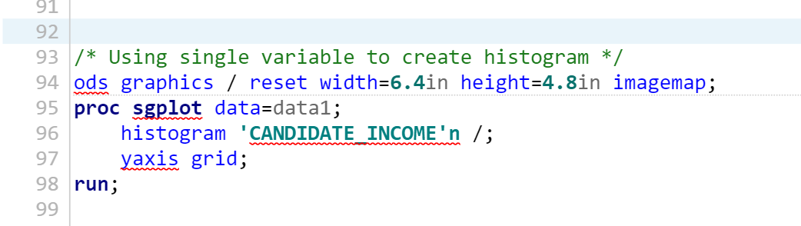
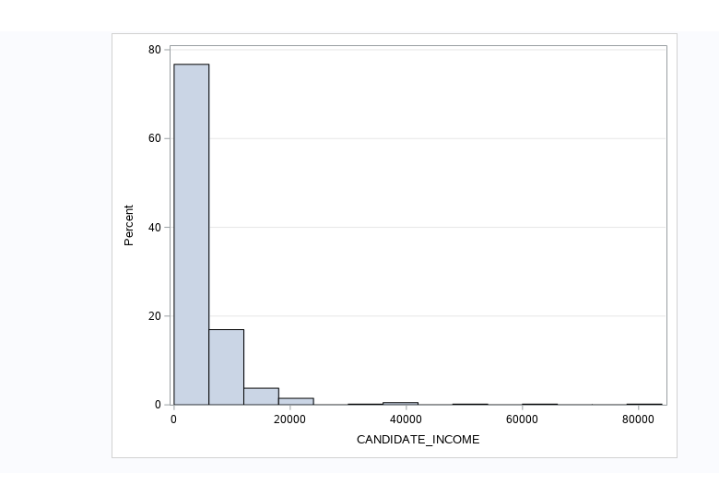
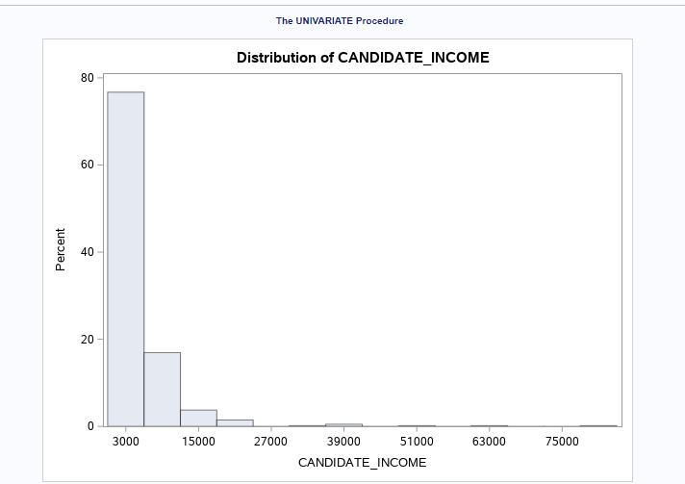
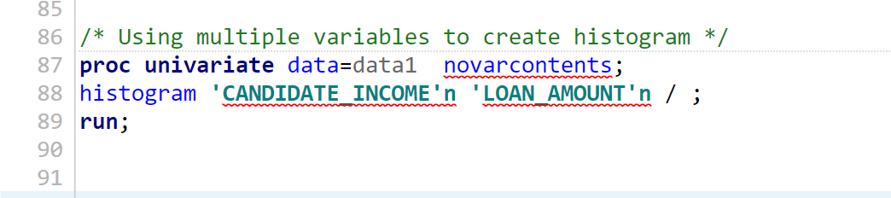
Univariate Analysis (Using a Single variable)
Using Multiple Variable

Slide 17
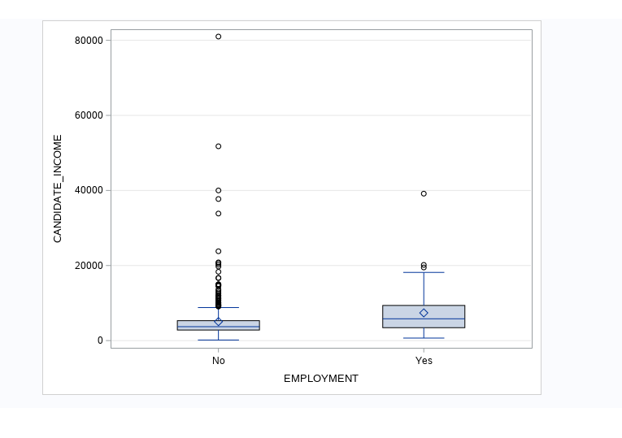
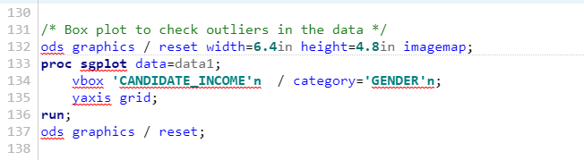
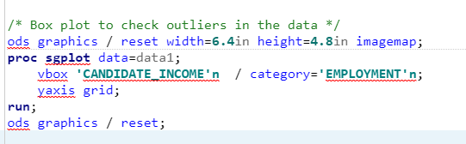
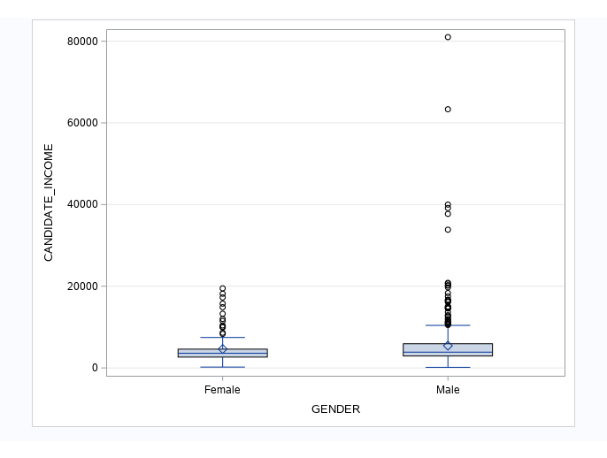
6.4 Identify Outliers in the data

Slide 18
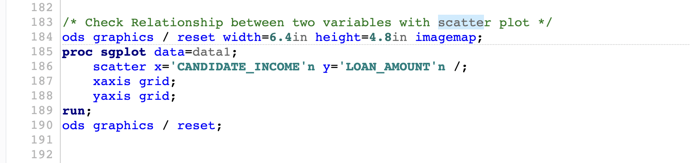
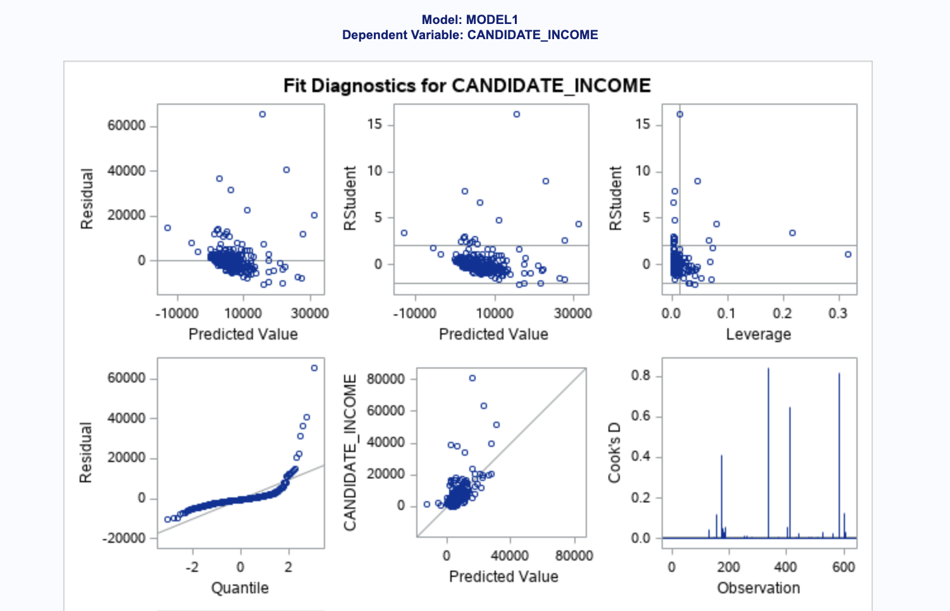
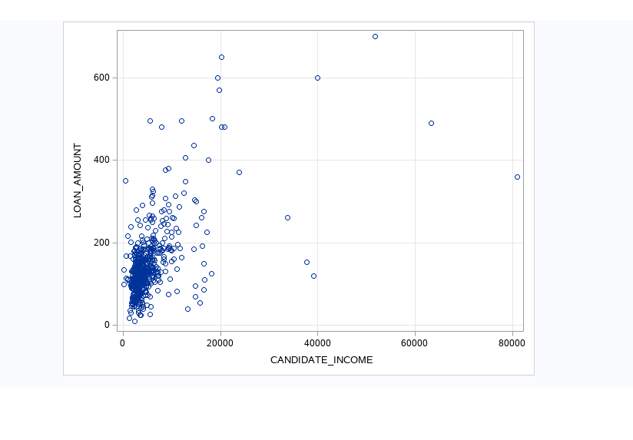
Scatter plot
Simple Linear Regression:

Slide 19
Apache Hadoop
I will use AWS EMR for Hadoop in this project. Amazon web services is a cloud-based application whereas EMR stands for Amazon Elastic MapReduce, which is an important tool of AWS used in big data analysis and processing.

Slide 20
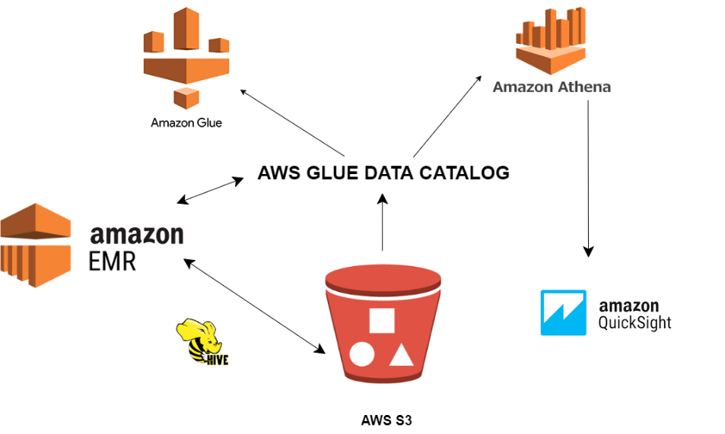
Architecture of Hadoop using the AWS services

Slide 21
First of all, the S3 bucket will be created, then our cleaned data will be uploaded to the S3 bucket using the AWS CLI. Now, a 1 m5* large EMR instance will be created. The next step is to create an aggregate table using the HiveQL in EMR, and the result is now stored back to S3. Athena is now used to read the result from the aggregate table. Finally, AWS Quick Sight is used to generate the chart from Aggregated table.
The services used are the S3 bucket, EMR, Glue, Athena and Quick Sight. S3 is used for storage purposes, EMR to read and process the data, Glue to store hive metadata, Athena to access S3 and Quick sight for analytics.

Slide 22
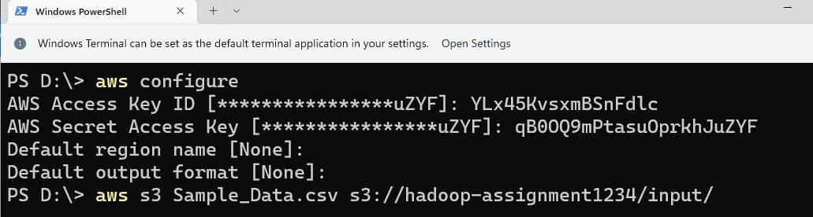
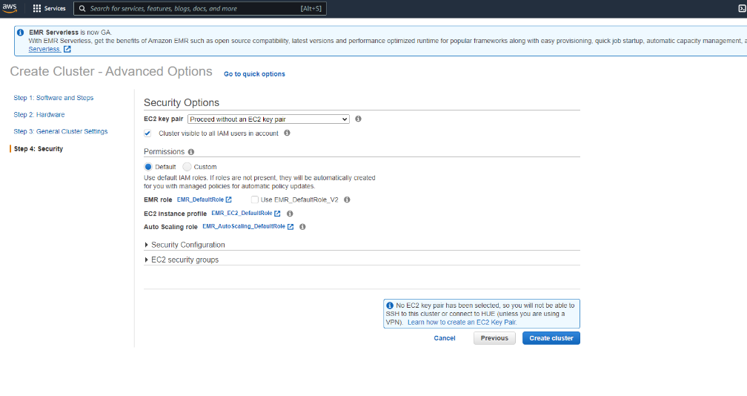
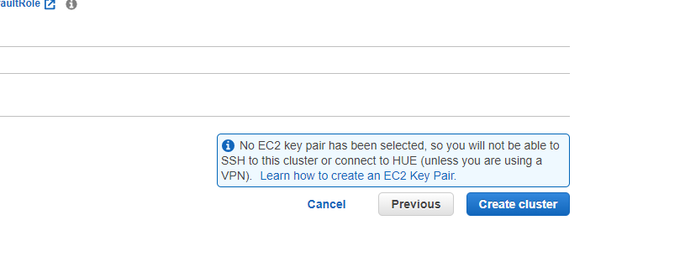
Screenshots of the process

Slide 23
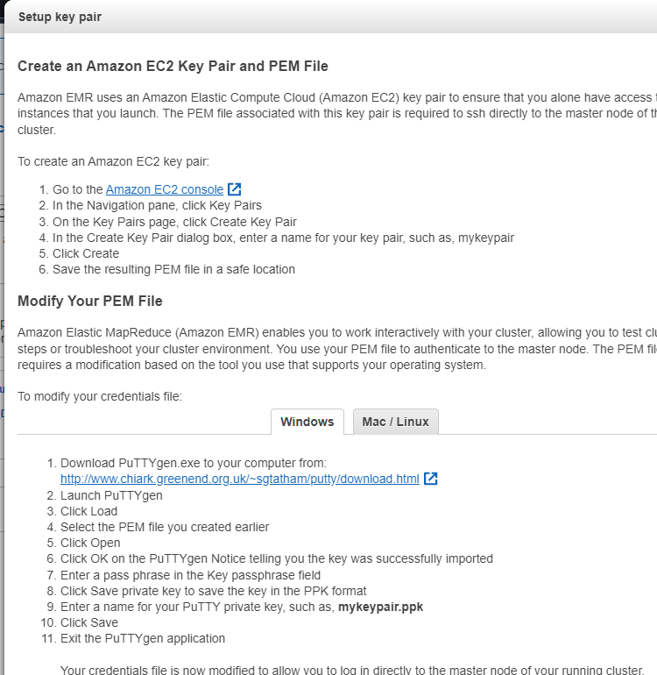
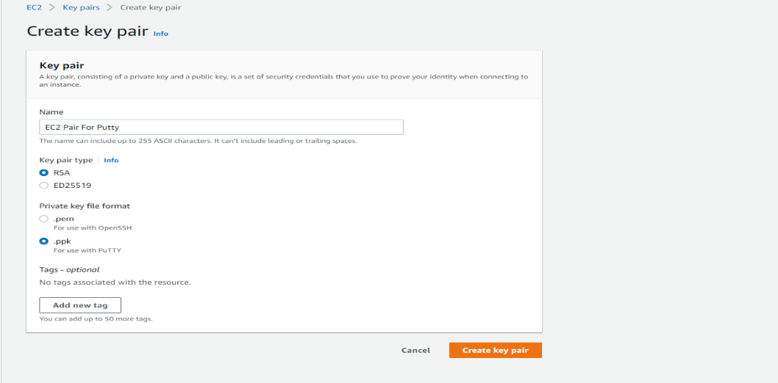
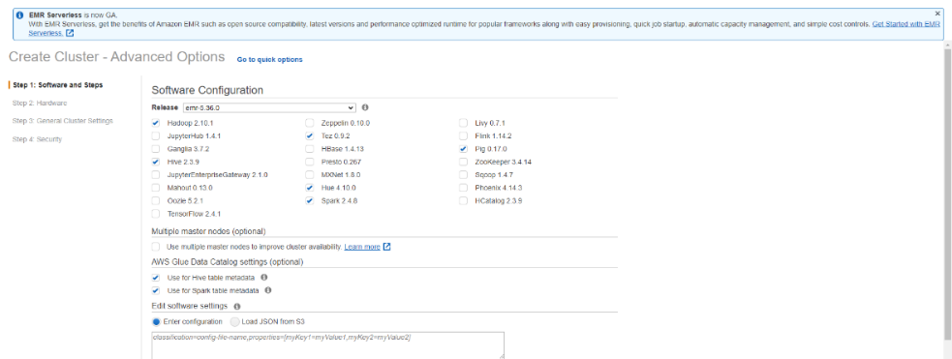

Slide 24
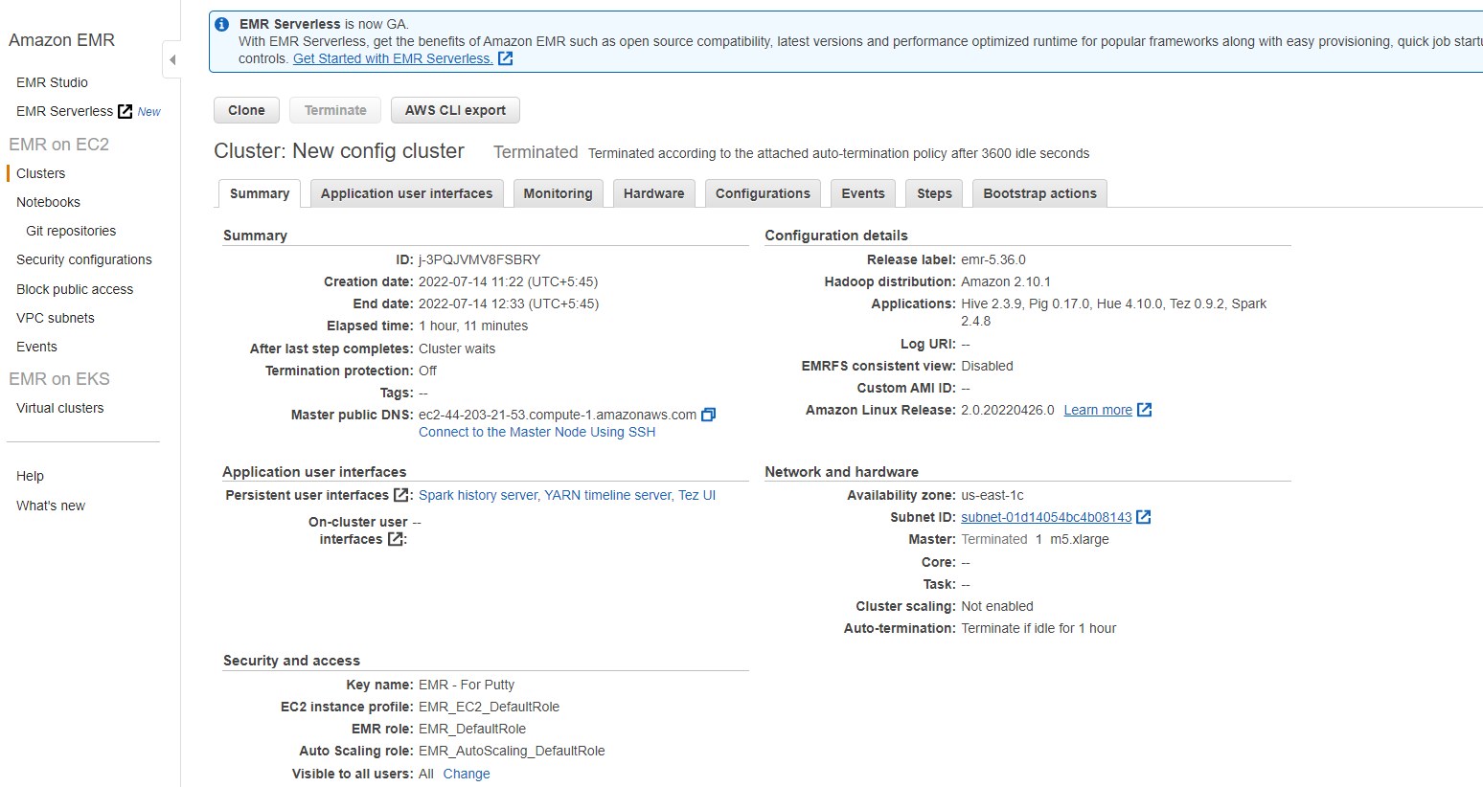
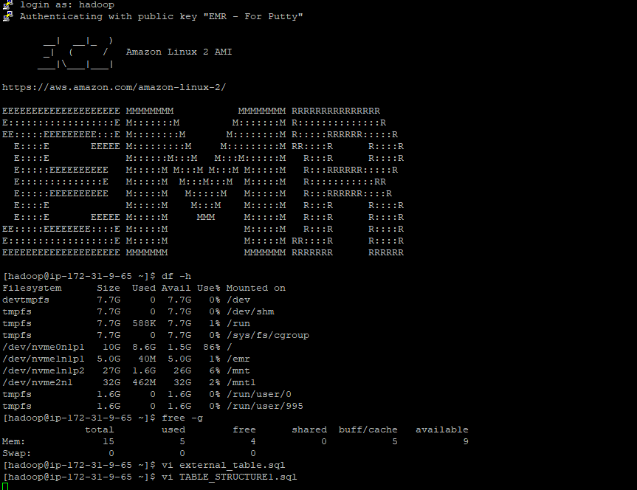
Making DNS connection in EMR

Slide 25
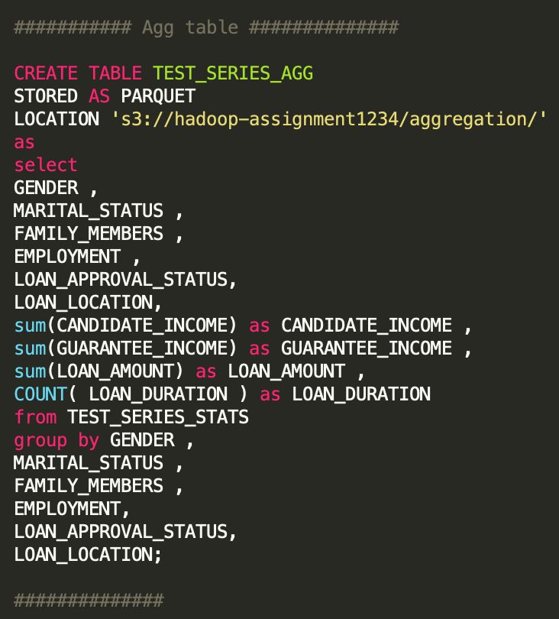
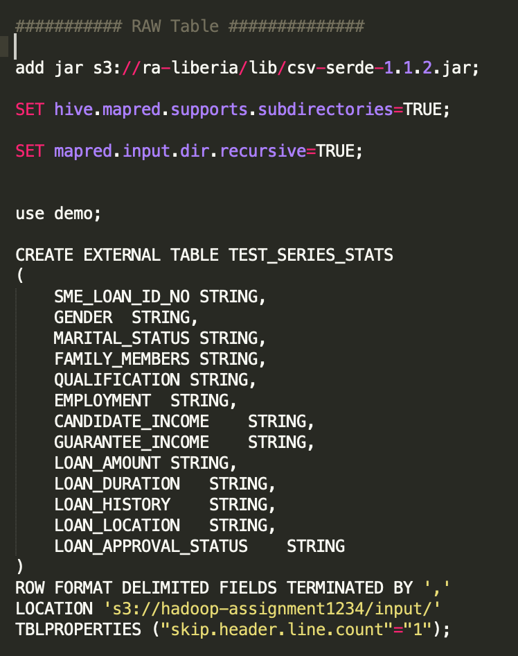
Adding Codes into Putty

Slide 26
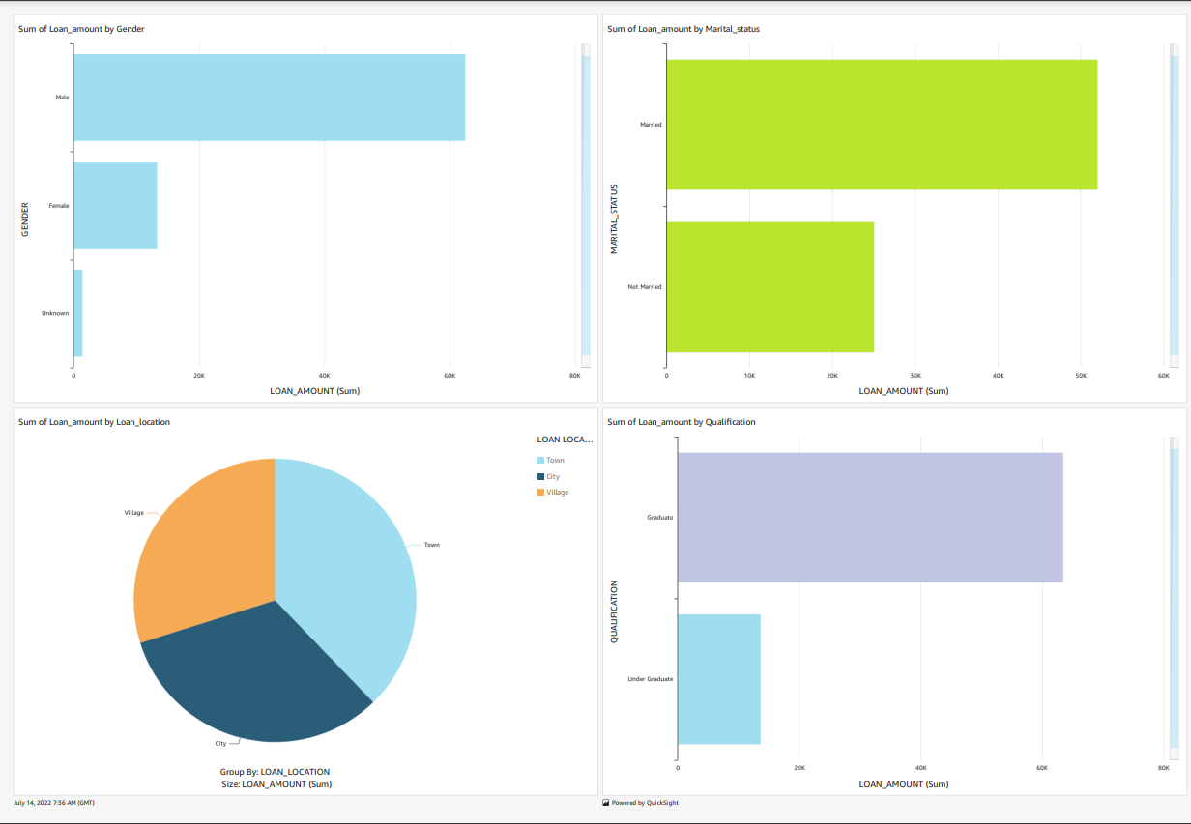
Visualizations using AWS QuickSight

Slide 27
Hypothesis
SAS PROC | Test | Application
PROC TEST | T-Test | Checks if the mean value is different from the hypothesis value. The mean value includes both the paired and independent groups.
PROC FREQ | Chi-Square | To find the probability of frequency occurring by chance.
PROC ANOVA | ANOVA | They compare and evaluate if the means of an independent and categorical variable are different from the interval-dependent variable.
PROC REG | Linear Regression | It tells how one variable predicts another.

Slide 28
Hypothesis 1
Null Hypothesis: Male population has a low chance of loan approval than the female population.
Alternate Hypothesis: Male population has a high chance of loan approval than the female population.
Chi-Square Test = 0.6264
Alpha = 0.6514
P<Alpha, therefore, the Null Hypothesis is rejected.
Hypothesis 2
Null Hypothesis: The married population has a high chance of loan approval.
Alternate Hypothesis: The married population has a low chance of loan approval.
Chi-Square Test = 0.0273
Alpha = -0.0893
P>Alpha therefore, NULL Hypothesis is accepted.
Similarly, the other hypothesis set in the data is shown below.

Slide 29
Hypothesis 3
Null Hypothesis: Population with High Incomes have more chances of approval for loans.
Alternate Hypothesis: Population with high incomes have low chances of approval for the loan.
Hypothesis 4
Null Hypothesis: A population with less loan amount has a high chance of loan approval.
Alternate Hypothesis: A population with less loan amount has a low chance of loan approval
Hypothesis 5
Null Hypothesis: A population with a high guarantee income has a high chance of loan approval.
Alternate Hypothesis: A population with a high guarantee income has a low chance of loan approval

Slide 30
Thank You
Any Questions

