Slide 1
ArtShare
Huseyin Deniz Ulu
Project for Mobile Application Development

Slide 2

Introduction
ArtShare is a platform for artists and art enthusiasts to share, discover, and interact with artworks.
Primary Features:
User Authentication
Artwork Upload
Gallery View
Commenting System

Slide 3
Core Features
Artwork Upload:
Upload artworks via URL or device with title, description, and tags.
User Authentication:
Register, log in, and manage profiles seamlessly.
Gallery View:
Explore and filter artworks by tags, categories, or dates.
Commenting System:
Comment, like, and interact with other users' artworks.

Slide 4
Above and Beyond
1. Dynamic Tagging and Search Filters
2. Google Sign-In Integration
3. Responsive Design

Slide 5
User Flow
1. Sign up/Login
2. Explore Gallery
3. Upload Artwork
4. Interact via Comments

Slide 6
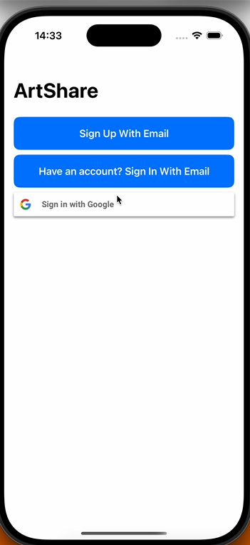
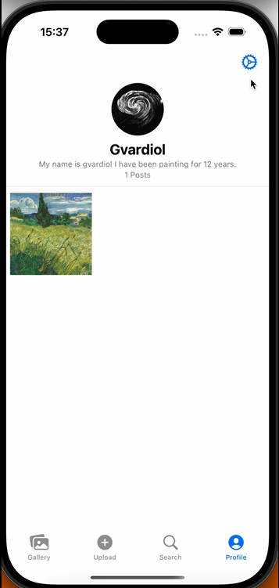
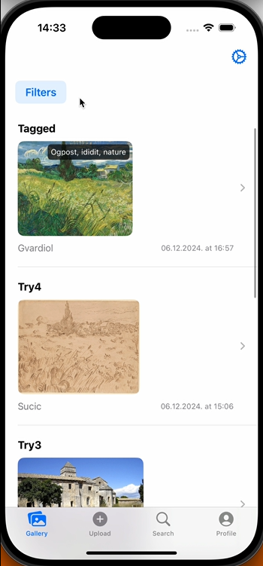
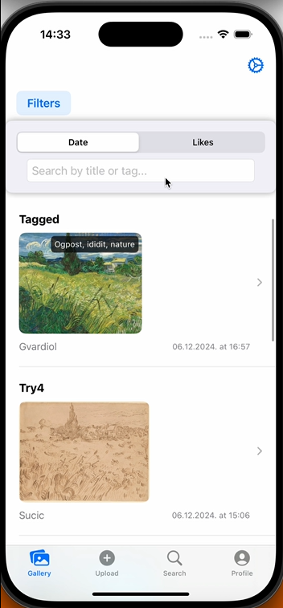
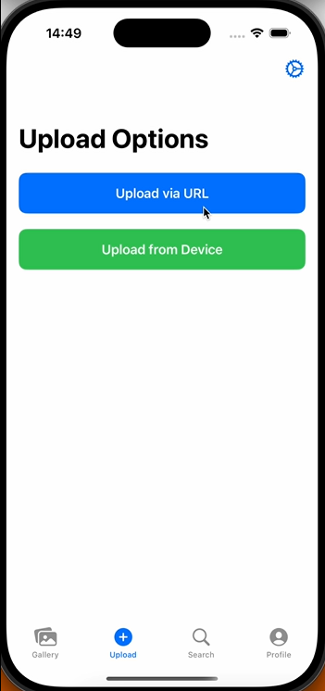
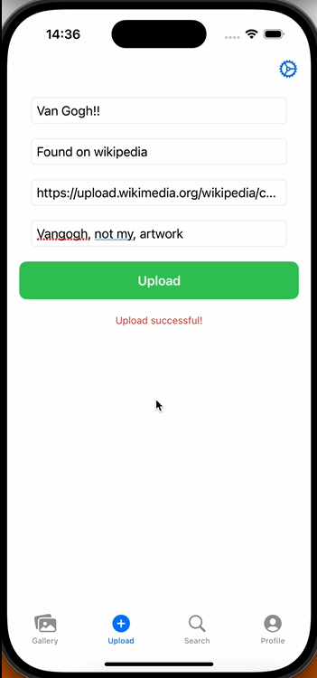
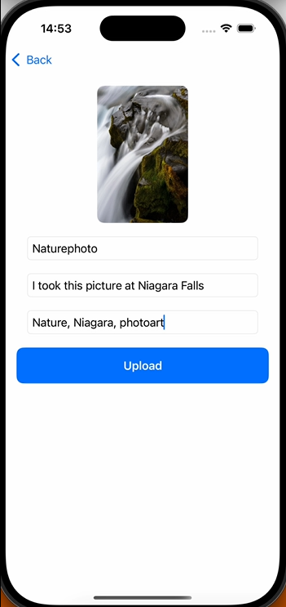
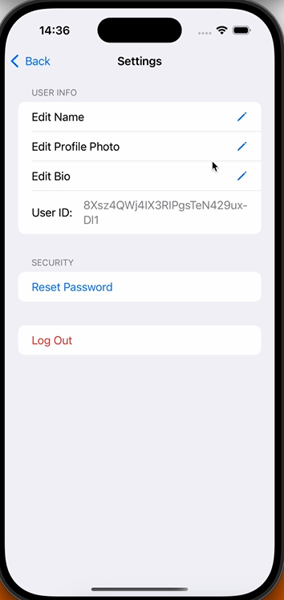

Slide 7
Challenges and Learnings
Challenges:
Google Sign-In integration
Handling asynchronous Firebase operations
Learnings:
Working with SwiftUI and Firebase
Implementing advanced Swift features like async/await

Slide 8


Third-Party Libraries
Firebase
Reason: Backend solution for user authentication, real-time database,
and file storage.
Used for:
  User Authentication (email, Google Sign-In)
  Storing user profiles, posts, and comments.
Google Sign-In SDK
Reason: To simplify social login via Google accounts.
Used for:
  Providing an easy and secure login option for users.

Slide 9
Helpful Tips
Plan Your Architecture Early
Decide on the app structure and break tasks into manageable components.
Firebase Considerations
Be cautious of data reads/writes to manage costs effectively.
Use Firestore rules for secure access to data.
Error Handling
Always provide user-friendly error messages for failed authentication or upload attempts.
User Interface Consistency
Follow design guidelines for a seamless user experience.Testing Across DevicesEnsure the app works well on different screen sizes and orientations.Leverage Third-Party LibrariesUse libraries to save development time, but only when necessary.

Slide 10
Conclusion
Summary:
ArtShare allows users to share, explore, and interact with artworks.
Future Improvements:
Enhanced UI/UX design
Additional features like social sharing and private messaging

