Slide 1
2025-06-03 Board Fundraising Pitch
Steven Deobald

Slide 2

Please Take Notes
If you have a clarifying question, please ask it live.
Otherwise, please write down your question/comment until the end. We have a lot (50 slides) to get through.

Slide 3
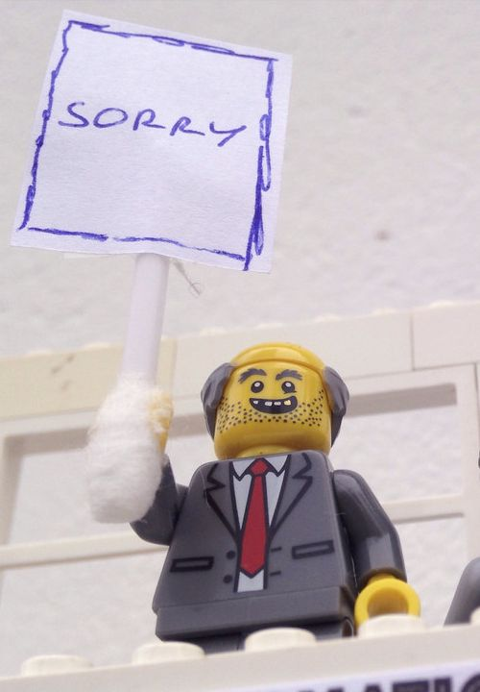
Apology
I’ll be using some marketing, sales, and growth terminology.
It doesn’t quite apply everywhere and some of it may sound weird in the context of a non-profit.

Slide 4
Table of Contents
Preparation
Execution
5-Year Plan
Definitions
Current Financial Position: Bad
Problem: Our Revenue Is Inside-Out
Solution: Right-Side-Out Revenue
Diversified Portfolio
Market Research: Our Audience
Timelines
CTA: Shaping Up The Experience
Non-Functional Requirements (NFRs)
The Message
Marketing (“Where do we take the message”?)
Strategic Buy-In
Coda: Parallel Activities
Questions?

Slide 5
5-Year Plan
The 5-year plan is incredibly hard to read, partly due to the inclusion of brainstorming “tactics”.
Once we take those out, it’s very sensible and something the we already all agree upon.

Slide 6
People
Services
Foundation
✅ Shared Vision
🟩 Big #a11y
(access for all)
🟨 Economy
(Flathub, hardware, mobile)
🟥 Fund Development
🟨 Strong Infra
(security, Flatpaks)
🟨 GUADEC++
🟨 25+ Years! 🎉
🟥 Funding
🟥 Health & Wellness
Notes:
The 5-year plan lays these out LTR, but we of course need to pursue them RTL.
The legend here is green has a strong start, yellow has some good work toward it, and red is failing.
The 5YP says “double revenue” but as we’re about to see, that’s not nearly enough.

Slide 7
Definitions

Slide 8
Recurring
Repeatable
One-Off
🔁 Annual...ish
🙎 Automatic...ish
🟠 The action is to STOP
...but it is noticed.
We might have to ask.
💳 Credit Cards, Ad Board contributions, GUADEC sponsorships, merch, etc.
🔄 Monthly
🤖 Automatic
🟢 The action is to STOP
💳 Credit Cards (mostly)
❌ No symmetry
😴 Manual
🔴 Action is to START
🏦 Wire transfers

Slide 9
Principles

Slide 10
Recurring
>
Repeatable
>
One-Off
🔴 We won’t stop doing this, but it will never make us sustainable.
🟢 This is the focus.
This is the lesson learned by every software company.
Subscriptions / SaaS are sticky.
🟠 When we have to.
It’s tempting to chase one-time donations because they’re big cheques ... but then we double our staff one year and fire half of them the next.
This is not respecting the health or wellbeing of staff — and it really damages the brand.

Slide 11
Current Financial Position: Bad

Slide 12
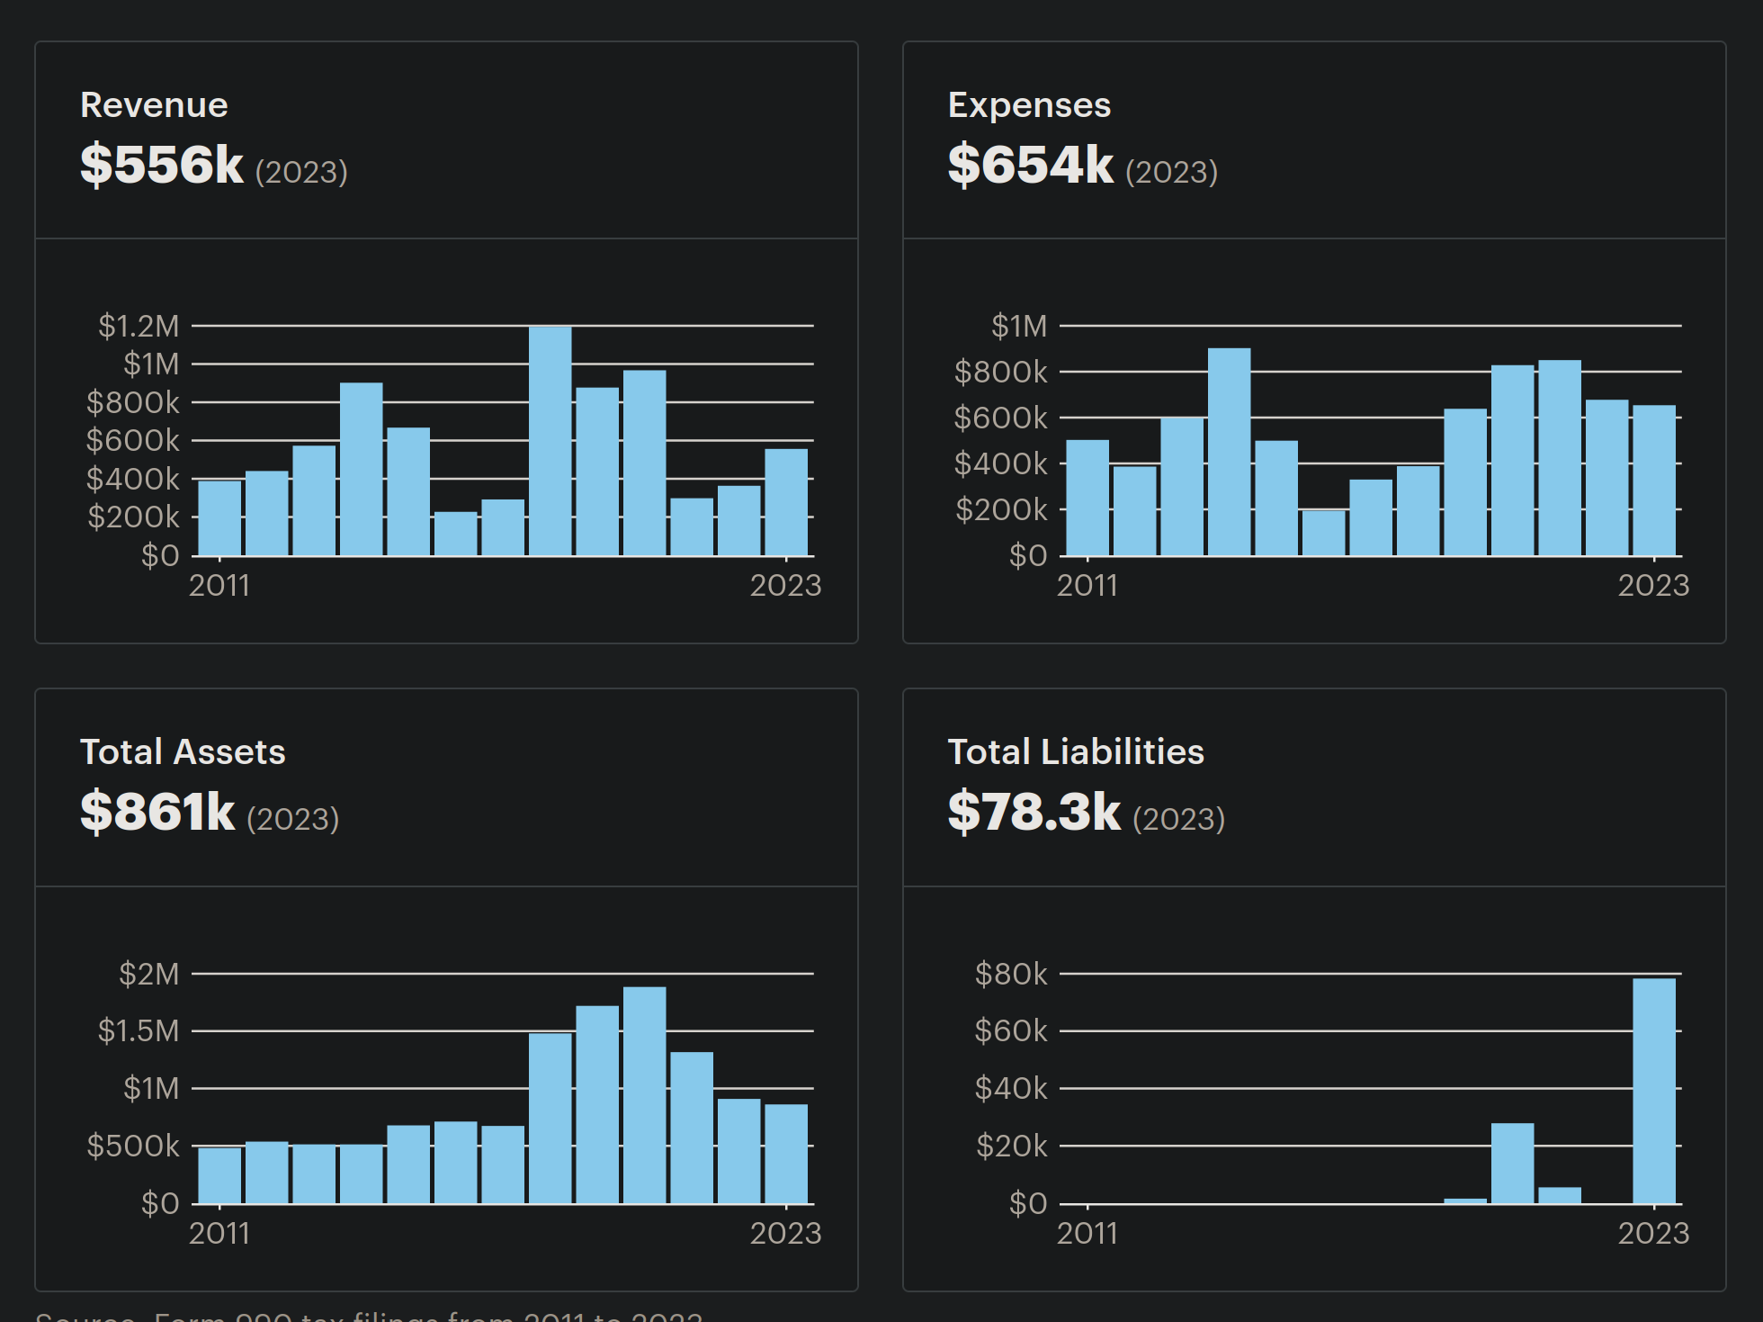
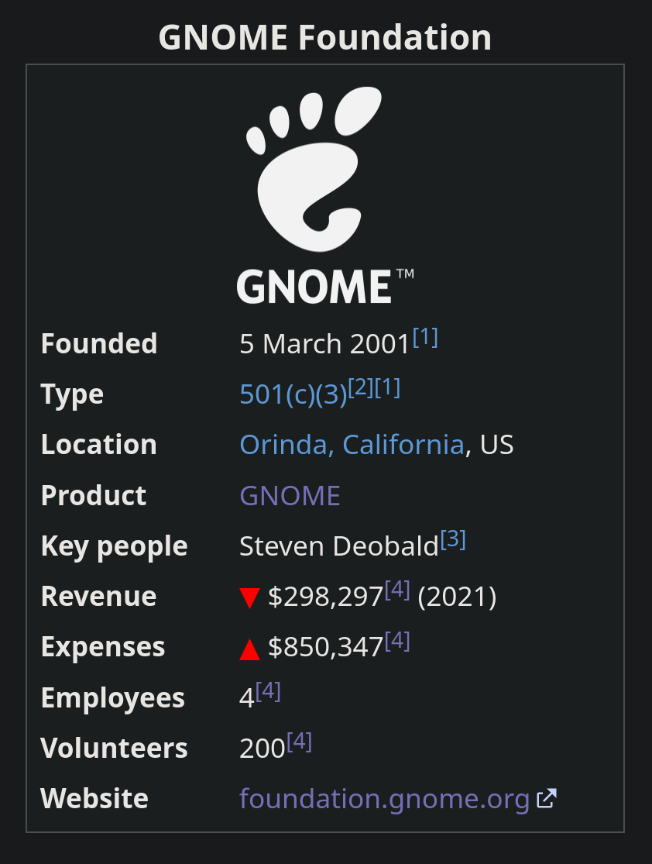
990s In The Public Eye (Brand Repair)

Slide 13
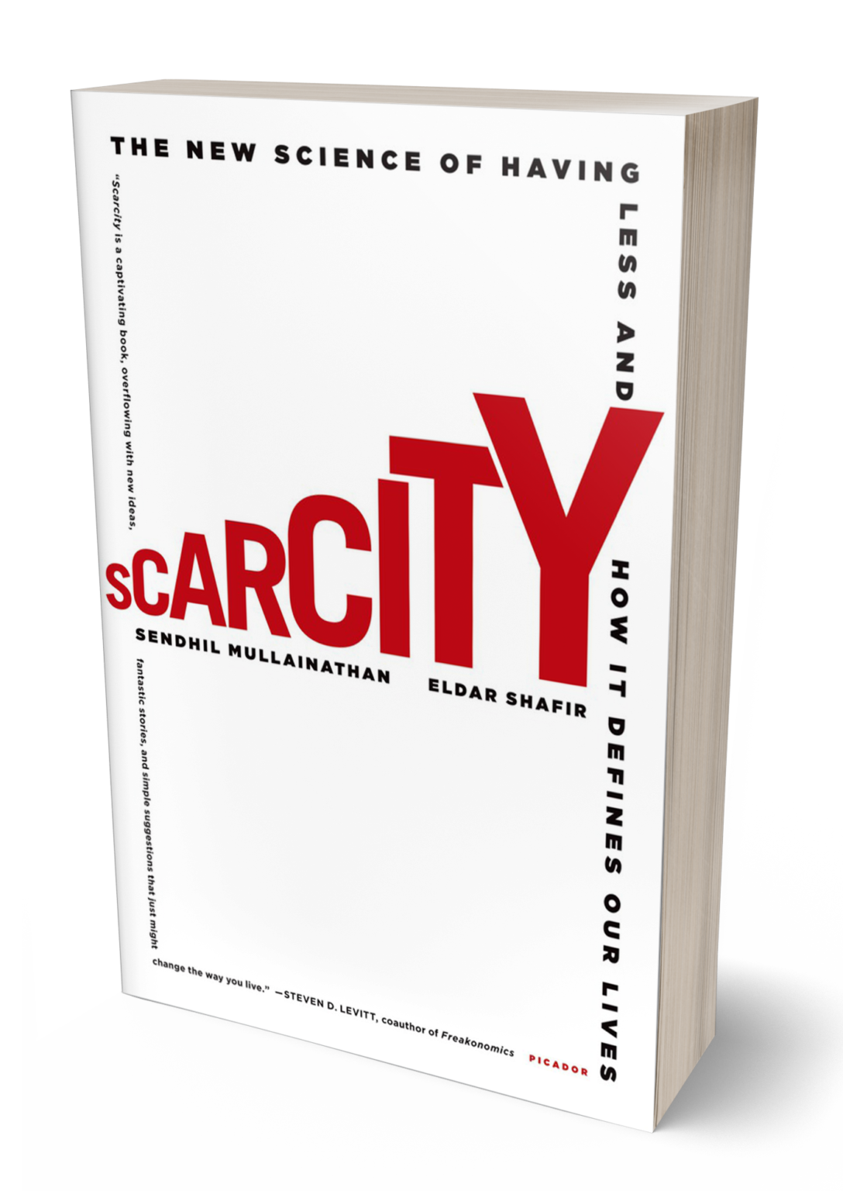

Poverty Trap: Treading Water
yes, these books primarily address individuals - but we currently operate the entire org on the order of a normal senior staff engg or director salary, so the scale isn’t as strange as it might seem.
Psychology: all brain cycles are wasted on survival, not the mission
Goal inhibition: focus on immediate concerns at the expense of long-term goals
Juggling / No Slack: patch crises by shifting resources toward imminent needs
Shock Risk: Covid, ED exit, big political shifts, etc. grind the org to a halt - they shouldn’t

Slide 14
Monthly Expenses
Monthly Revenue
{ elided
– these slides contained salary data }
{ the salient point was that the Foundation was operating with a $30,000/mo recurring revenue/expenses shortfall when I joined, a fact that can be derived from 990s and annual reports }

Slide 15
Monthly Expenses
Monthly Revenue
{ elided
– these slides contained salary data }
{ the salient point was that the Foundation was operating with a $30,000/mo recurring revenue/expenses shortfall when I joined, a fact that can be derived from 990s and annual reports }

Slide 16
Problem: Our Revenue Is Inside-Out

Slide 17
MRR
ARR
Red Hat
SUSE
Canonical
Google (?)
$2000/mo/ea
=> $25,000/yr/ea
Mostly comprised of GNOME contributors. 🙁
~200 x $10
$10/mo/ea (median)
In our ideal world, we’re handing out grants to contributors instead of taking their disposable income.
We need to find different donors.
We need 3000 - 6000 people.
The ED job description says “your first task is to raise your own salary.”
I think this is the wrong framing.
We should set the bar higher.

Slide 18
Solution: Right-Side-Out Revenue

Slide 19
MRR
MRR++
We want consumer orgs, not producer orgs.
$1000/org/mo
We want users, not contributors.
* Negative lift
* “Donate Less”
* Longevity, not parades
$10/donor/mo
The ED job description could say:
“grow ARR YoY by {{your-salary}}” ex. $60k/mo = $720k/yr
=> grow to $870k/yr for $150k/yr salary
=> ~1250 users/yr or ~13 orgs/yr
This is what I’m asking you to ask of me.
“lift”

Slide 20
Diversified Portfolio

Slide 21
30%?
30%?
AdBoard
100%
corp
CSR
NGOs
Partners
universities
governments
OSPOs
openwash
10%
Users
#a11y
grant
#i18n+
big
cheque
sec
fiscal
guest
eco

Slide 22
Market Research: Our Audience
“What do I want?”
”What do I get?”

Slide 23
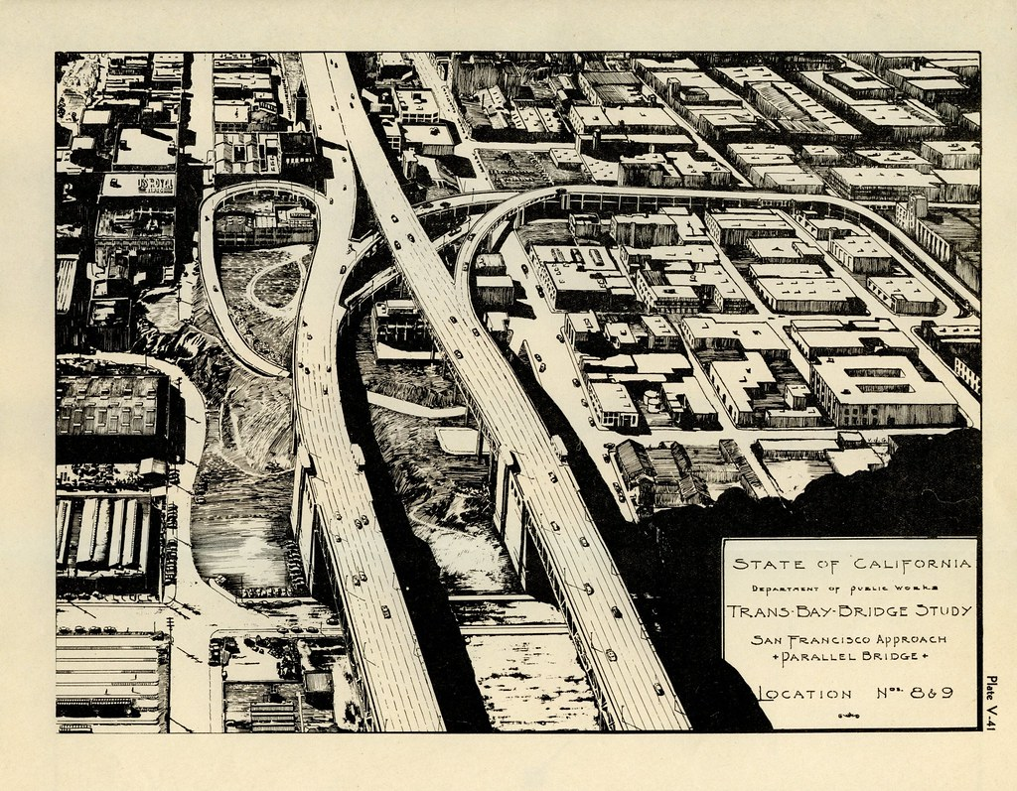
These Are Not Serialized
We’ll discover our value proposition to recurring donors as we go.
We will do this work in parallel.

Slide 24
Individual Donors
(+ Foundation Members)
The truth is, users don’t want much.
”I just wish someone would ask me to give.
I don’t pay attention.”
Users
Note / Suggestion
Quarterly Newsletter
Stickers?
Feedback channel? (but no one’s asked)
I had a friend ask me recently “how does GNOME make money?” — he didn’t know it was a nonprofit.

Slide 25
Partners
We need some kind of CRM because we’ll have to talk to these people every year and the next ED will have no idea who they are.
GitLab and Nextcloud are not CRM.
corp
CSR
NGOs
universities
governments
OSPOs
openwash
Trademark Exchange - #135
Idea Exchange?
Complaints Box?
Support Channel? (later)
Something else?

Slide 26
Advisory Board
The status quo is fine.
But we should figure out how to keep the Advisory Board happy even if we can’t meaningfully grow it.
What do they get now?
Lunch?
Prestige?

Slide 27
Timelines

Slide 28
Timelines: Start Early
Grant Applications
June
July
Aug
Sept
Oct
FY 25/26
Aug 12th:
Sept 12th:
Build donate.g.o
Marketing
Evaluation, iteration
FY25/26 for growth
June 15th:
July 8th:
donate.g.o released
annual report, re-evaluate budget
budget draft #1
budget draft #2
If we don’t build it,
they can’t come.

Slide 29
Table of Contents Reminder
Preparation
Execution
5-Year Plan
Definitions
Current Financial Position: Bad
Problem: Our Revenue Is Inside-Out
Solution: Right-Side-Out Revenue
Diversified Portfolio
Market Research: Our Audience
Timelines
CTA: Shaping Up The Experience
Non-Functional Requirements (NFRs)
The Message
Marketing (“Where do we take the message”?)
Coda: Parallel Activities
Questions?

Slide 30
CTA: Shaping Up The Experience

Slide 31
Attention Span
Our Advantages:
We're not selling anything! We're not onboarding! We do not want to capture the user's attention.
We don't need them to stay on the site, stay engaged, or read more.
We just need them to swipe a credit card and they came to donate.gnome.org to do exactly that.
Users leave in 10 - 20 seconds
Attention flags < 8 seconds
CTA in < 3 seconds
Flow in < 5 seconds

Slide 32
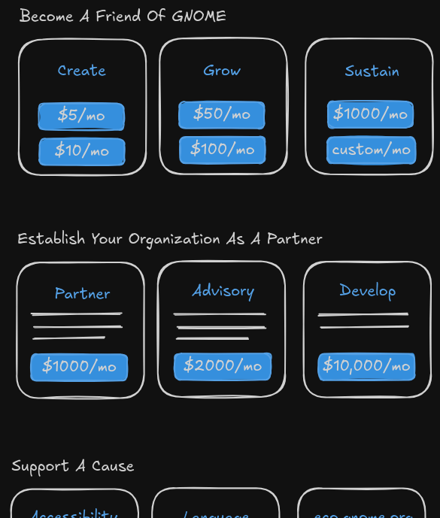
Above The Fold

Slide 33
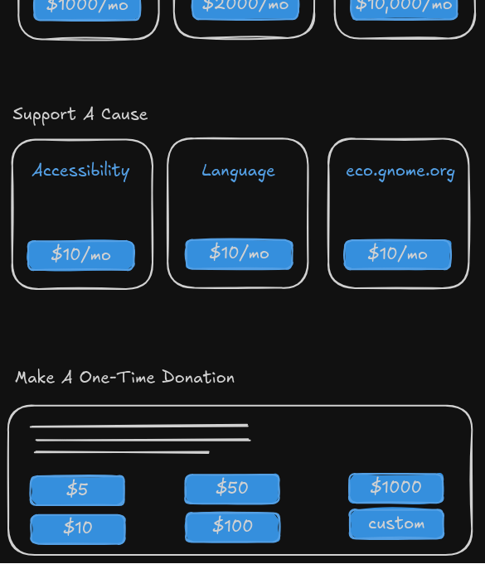
Below The Fold

Slide 34
Non-Functional Requirements

Slide 35
Non-Functional Requirements
{ elided – these slides contained an explanation of why we moved our recurring donation payment processor to Stripe and were quite critical of our previous payment processor }

Slide 36
Non-Functional Requirements (cont)
{ elided – these slides contained an explanation of why we moved our recurring donation payment processor to Stripe and were quite critical of our previous payment processor }

Slide 37
Non-Functional Requirements
Cheap Integration
Expensive Integration
* Emails for quarterly newsletter
* Memo / Suggestion on donation
We’ll do the cheapest things we possibly can, to start with.
* Ideas Exchange
* “Complaints Box”
* Other Channels
* Support Channels
* etc.

Slide 38
The Message

Slide 39
The Message
* GNOME Is Infrastructure
* 25+ years of history! (a good base, but there's no ribbon-cutting for work done in 2008)
* funding security => Flatpak, Flathub => supply chain, clean up old code
* funding #a11y
* funding #i18n++
* funding eco.gnome.org => getting Linux on more dead laptops, dead phones
* funding services (maybe) => location, GOA, whitelists, blacklists
* Being App-Forward in a post-Apple world
* "the youth" hate websites and webapps (Pariyatti, SK Covid Wallet)
* Apps feel like they're "yours", even if Apple and Google own them - and our apps really do belong to the user
* desktop apps are now easier to discover and install than Windows and MacOS
* mobile GNOME is the dreamy future my Gentoo install on a Compaq Presario was back in 2003
* #lofi future depends on Native Apps
* hardware partners: Framework is the new Mac
Hey! It’s part of
the 5-year plan!
But how do we get
people to the CTA?

Slide 40
Marketing: Where do we take the message?
Rule #1: Meet people where they are.

Slide 41
Talk To GNOME Users... Via GNOME

Slide 42
The KDE-style “Popup”
AdwAboutDialog - @alice (libadwaita#865)
os.gnome.org - @alatiera says there are many enthusiasts on the site
Full Popup - KDE-style, desktop-level bi-annual popup

Slide 43
Marketing Phase One: User Donors

Slide 44
Individual User Donors
“Donate Less” - we want to ask for monthly donations users can afford to pay, even on difficult months
YouTube / TikTok / Instagram / etc
Twitter? Our Asian community is still there.
Reddit
Journalists / interviews / news outlets
Non-FOSS developer conferences / networks

Slide 45
Marketing Phase Two: Org Donors

Slide 46
Organization Donors / Partners
CRM, please
A million meet.gnome.org calls for Steven
Industry confs (again, not purely FOSS-focused), giving talks

Slide 47
Marketing Phase Three: Rinse, Repeat

Slide 48
Repeat Our MRR Approach
Avoid attrition / churn
Keep donors happy
Demonstrate that the Foundation supports the project, with evidence

Slide 49
Strategic Buy-In

Slide 50
Why am I asking for strategic buy-in?
This will not happen overnight.
It’s going to be a slog. (For me.)
The end result will be worth it so we can stop treading water.

Slide 51
Coda: Parallel Activities

Slide 52
Parallel Activities
Grants in parallel.
Restricted funds / campaigns in parallel.
One-off donations in parallel.
Conference Sponsorships in parallel.
Fiscal hosting in parallel:
Why aren’t we getting 10%?
Why aren’t we charging for Bitcoin conversion, given all the risk we’re taking on?

Slide 53

Questions?

Slide 54


