Slide 1
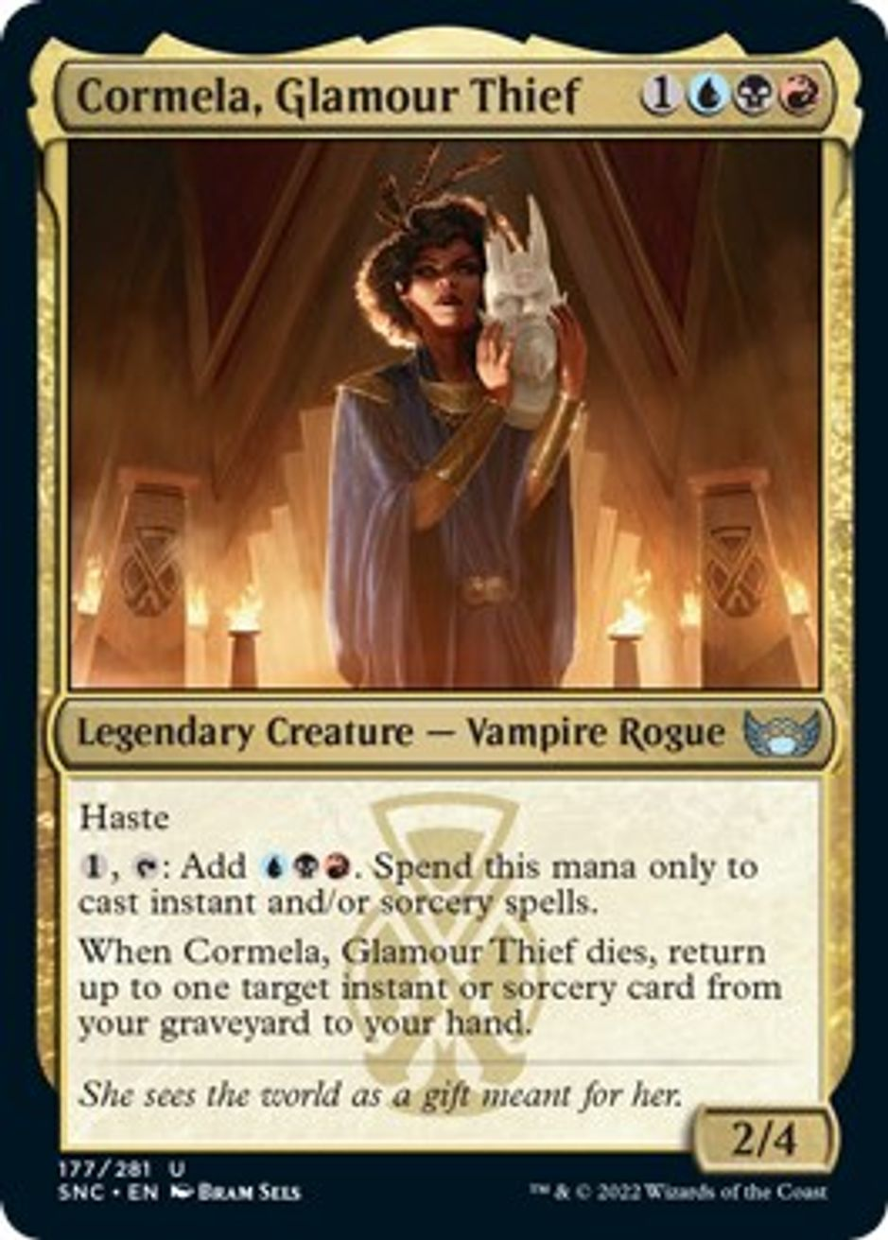
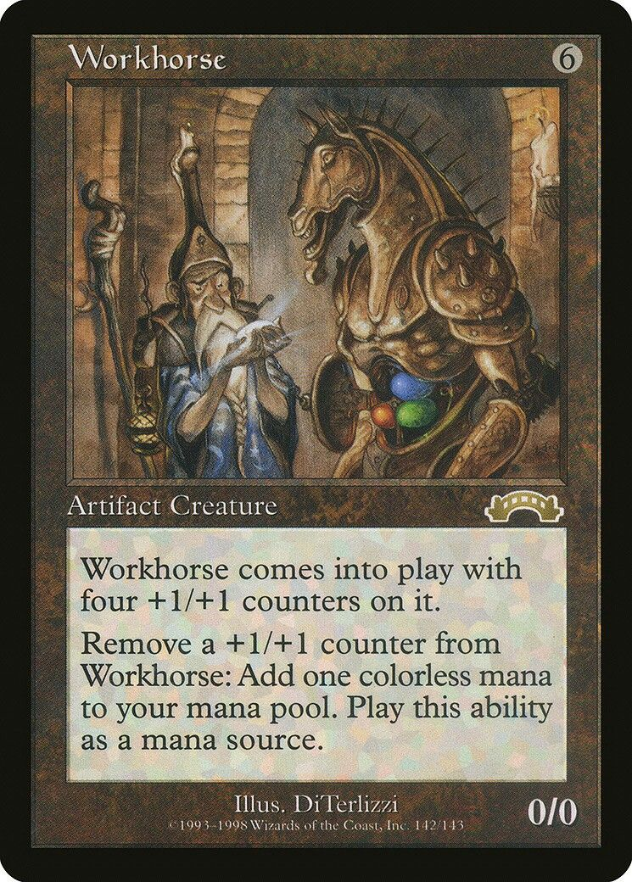
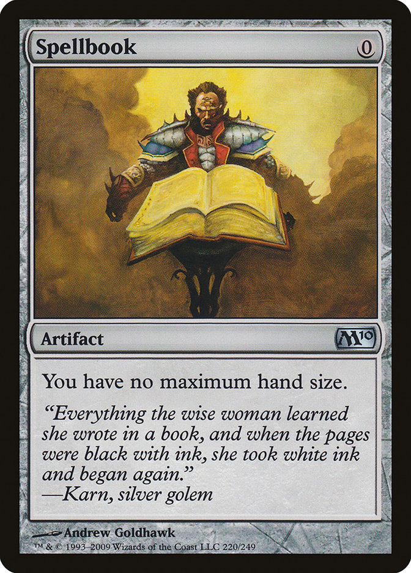
The Grift, the Grind, and the ग्रंथ

Slide 2
Not a language talk
Common Lisp
Visual Basic 3.0
Perl
C#
Ruby
Rust
SQL
Notes:
- talk will sort of be clojure-adjacent
- but we will talk about some programming languages that are very much like clojure

Slide 3


Rather, a personal story
Notes:
- a personal story about something (in computers) I felt I had lost … but that I’m perhaps finding again
- perhaps something I’ve found multiple times
- searching for “born again painting” turns up some interesting results … and perhaps I am this baby, bearing witness to the entire earth
- but I think I’d rather be this naked butterfly in a rose, watched over by the omniscient chrono-lion
- thank you “fine art america”, whatever you are. These are great.

Slide 4
ग्रंथ (san)
Treatise?
Book
Scripture
From "ग्रथ" – knot, a binding … "ग्रथना" - binding, tying, stringing together
संग्रथन – repairing or restoring by tying together
प्रग्रथनम् – stringing together, weaving
ग्रंथ – binding, stringing, and weaving words
Notes:
- it wouldn’t be a clojure conference without some etymology, and hunting for a usage of a word that fits my personal preference, so let’s get that out of the way
- “why granth?” … here we go
- (please don’t be too critical of my pronunciation as we go through this)
- also, as an unrelated sidenote: please, for the love of all that is holy, prefer the 3-character ISO 639-2 codes for representing languages if you’re ever in charge of i18n on a project

Slide 5
गाथा (pli)
Verse, stanza, shloka
गाथापद – a line of a shloka
पद – a footstep, a word
थेरगाथा – hymns of the elders
थेरा – elder, senior monk (deriv. थेरावाद)
महाथेरा – original 80 monks
Notes:
- please don’t be too accidentally critical of my pronunciation here … the trailing incidental vowel of Pali words are always pronounced. Sandhi does not work the same way it does in Hindi (or Sanskrit, but I know nothing about Sanskrit grammar).

Slide 6
Our usage (for now)?
Hymns of the elders; scripture
Weaving, binding, tying words together

Slide 7

Prologue
Notes:
- it’s hard for anyone to get up on stage without indulging in a little narcissism, so this will be that particular segment of our show where we travel back to my childhood.
- take us away, spacetime lion

Slide 8
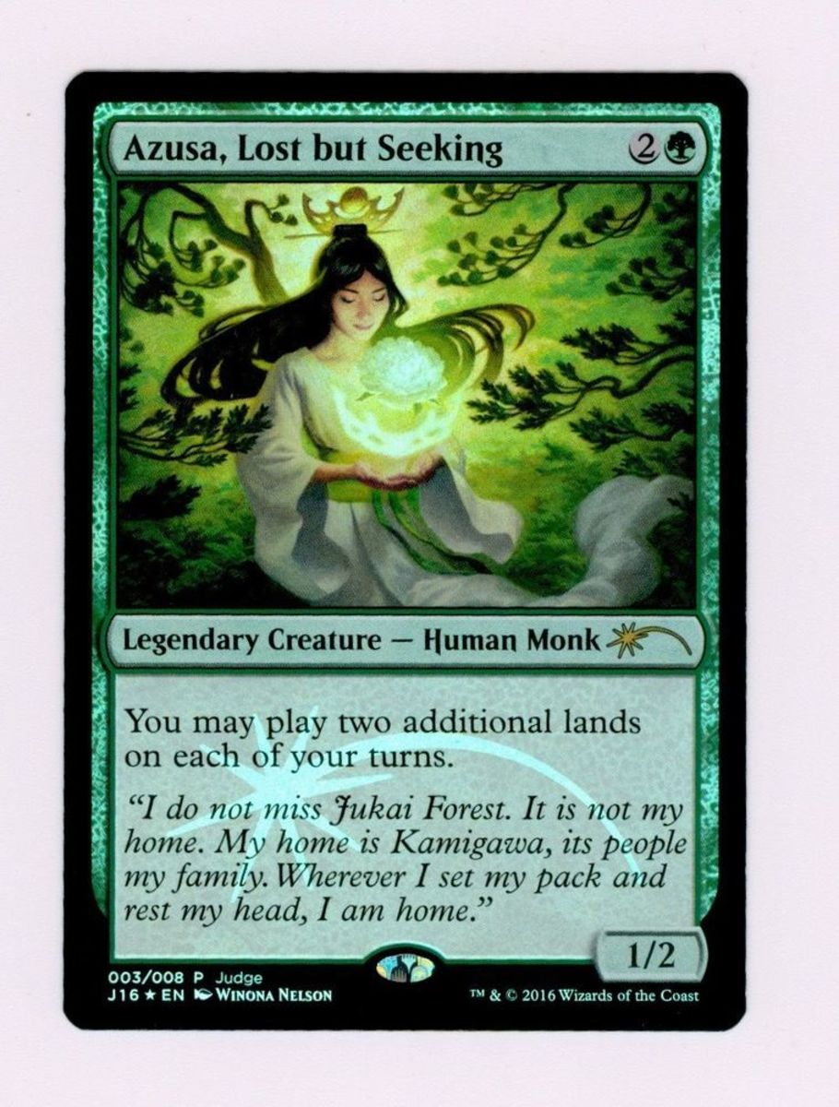
ग्रंथ

Slide 9
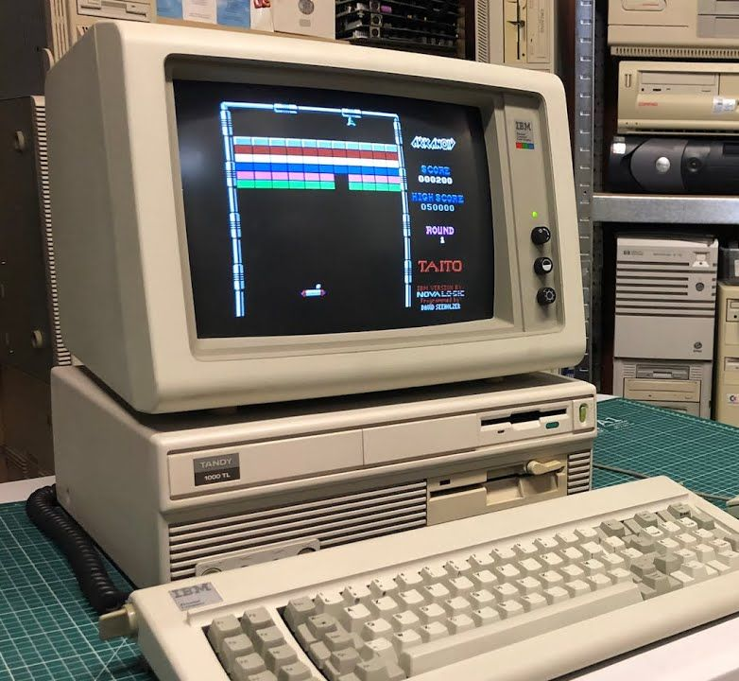
First computer, first language
Tandy 1000, but really Apple IIe, but really 386
QBASIC
Notes:
- my first contact with computers was at a much earlier age, in the school’s computer lab (my dad was a teacher before he retired) … he would sit me at a computer and open ‘talk’ (yes, there’s an old unix program simply called ‘talk’) then walk away to another terminal and pretend to be the computer, talking back to me. I would ask the computer about christmas presents.
- I never really used the Apple IIe (I was 4)
- but on the 386, there were a lot of other mysteries: Gopher, Veronica, Archie… all sorts of programs I could barely believe were real things. I was just completely amazed by the machine’s existence, much less the fact that I could hack it.
- keep QBASIC in mind, we’ll come back to it later
- of course, “first computer” means a lot of different things to different people. Yours might have been earlier — an Amiga, C64, or BBC Micro — or an original Mac or a Pentium III or an iPhone

Slide 10
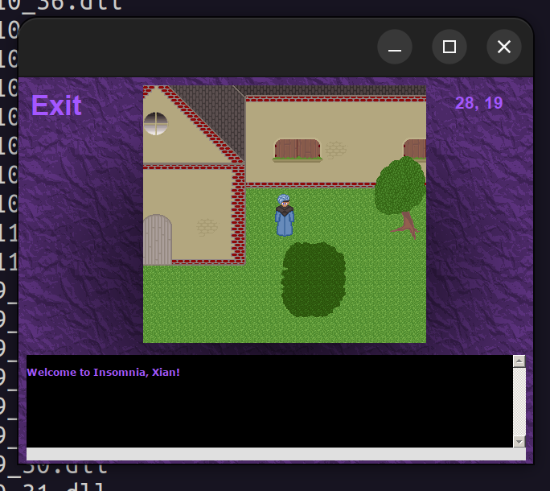
Second computer, second language
Pentium 120Mhz
Visual Basic 3.0 vs C++ (VB3 won)
Visual Basic 4.0, 5.0, 6.0
C++ … eventually
Notes:
- laugh at Visual Basic all you want, but it was a dynamic and visual programming environment that responded to changes immediately … I’ve never worked in a programming env quite so compelling in all my years since.
- because I didn’t spend my time cleaning up memory addresses or playing the pointer arithmetic game, I could just focus on the puzzle-solving of writing a video game with no real knowledge of how to do that. Mixed in with reading a lot of Win32 API docs.
- years later, Clojure held a lot of the same appeal … STM, persistent data structures, and optional functional programming all prevent us from solving the same problems over and over, just like GC
- I recently got my highschool VB project running again. It was a 32x32 tiled graphical MUD (the term MMO hadn’t been coined yet). Visual Basic made fairly annoying Windows Sockets programming accessible to a teenaged doofus like me
- you’ll see Abhinav’s talk this afternoon … he recently joined a C++ team. Proof that everyone has to learn C++ eventually.

Slide 11
Third computer, C++, Linux, C#
C++ was the language de jour at University
Java was… around.
Linux seemed cool
Demoscene seemed cooler
.NET was Java, but new! (C# decimals)
Learning The Rules: Step 1
Notes:
- it was at this age that I began to get a glimpse of what shared software could do… I didn’t understand how powerful Linux and the Open Source movement would become, or what new shapes it would take.
- I also lacked words for the underpinnings of what it was that made Open Source important, and did for many years.
- in a way, University ground me down… forced learning about every conceivable tree-shaped data structure really squeezed every last drop of fun out of computers
- reading the gang of four design patterns book wasn’t much better
- the demoscene was a sort of mysterious saving grace

Slide 12
fr-08 .the .product
64kb
66 textures = 16mb (178mb w intermediates)
15 mins of sound = 159mb of wave, 12 tracks
80,000 coloured/textured triangles in 5.7mb static vertex buffers (not including animated geometry)
Total: 1.9gb
Compression: 30,000 to 1

Slide 13
First job, first conf
Quit, went to RubyConf 2005, fell in love
Austin Ziegler: PDF::Writer (PDFs, SVGs)
Jim Weirich: DSLs
Eric Hodel: implementing Ruby in Ruby
Ryan Davis: AST processing
Lucas Carlson: Bayesian classification, Latent Semantic Indexing (for RSS, blogs, wikis)
Brent Roman: Ruby in marine robots
Charles Nutter: Introducing Jruby
Karlin Fox: System testing in Ruby, Aslak Hellesoy: CI in Ruby, Kevin Baird: refactoring a generative music system that uses audience participation, Akira Tanaka: virtual filesystems in Ruby, Koichi Sasada: YARV
Also DHH, some Rails people, and Matz, I guess
Notes:
- honestly, rubyconf 2005 blew my mind … nothing made me so excited about programming in my entire life up to that point

Slide 14
Second job, move to India
Ruby @ Work … yay?
TDD, CI/CD, IoC … Learn The Rules, Step 2.
Static / dynamic religious wars of the mid-2000s
While at ThoughtWorks, this insane conf...

Slide 15
Third job, lose my soul
Clojure @ Work = yay?
Linux @ Work = yay?
“What am I doing with my life?”

Slide 16
Second conf, XTech Paris
Amazingly, almost every mention of this conference seems wiped off the internet
Wii + OSM, Microformats, QR codes for an internet that talks to the physical world, digital identity, “Ubiquitous Computing”
3 tracks, 1 honeypot
...should we run all conferences this way?
Notes:
- a friend recently told me that many conferences accept talks based on what will be “useful on Monday morning” … which seems asinine.
- if there needs to be corporate garbage or the butting heads of standards folks obsessed with minutiae, give them their own room!

Slide 17
Third conf, The Conj 2010
Are We There Yet? = SOLD!
www.contalks.com/events/66/clojure-conj-2010
...my mind was blown again
“Choose Your QBASIC” = my new religion
TDD bad, frameworks bad, metaprogramming bad, tiny libs good. Learning The Rules, Step 3
"I didn't title the book The Joy of Connecting to a MySQL database"
Notes:
- I won’t list all these talks, since you can still watch them.
- I was already in love with LISP ... Clojure validated a bookcase full of "On Lisp", "Lisp In Small Pieces", "Practical Common Lisp", "Little/Reasoned/Seasoned Schemer", "Immutable Data Structures"

Slide 18


Fourth job, start nilenso
Help founding
Force everyone to use Clojure, because religion
Happily ever after

Slide 19



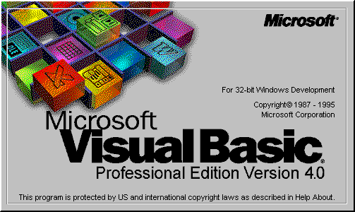

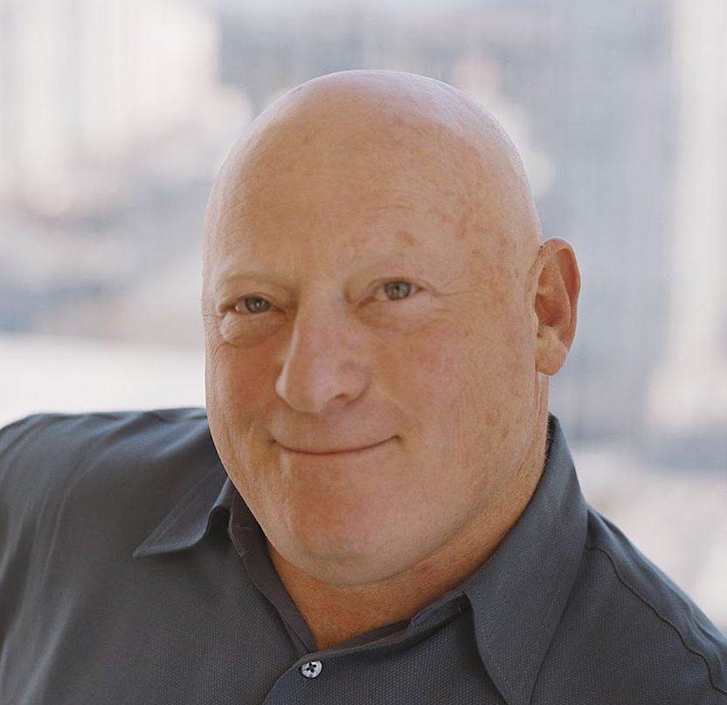

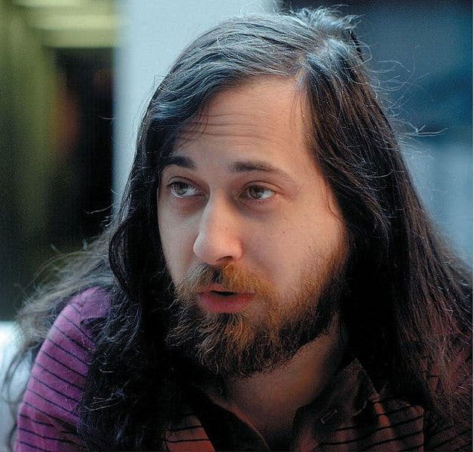

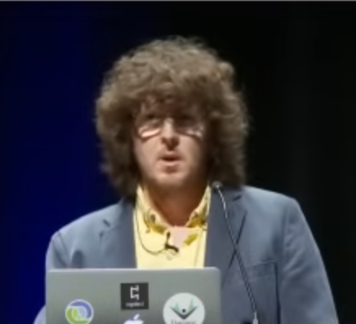
Every new religion had its messiah
Notes:
- you’ll note that over time, the logos transition to smooth, clean SVGs
- you’ll also note that, like any collection of messiahs, some of them may be, uh, problematic
- you’ll also note two things about the VB logo: (1) VB4 logo, even though I started with VB3 … 32-bit binaries were a huge deal. (2) Legal notice. I stole this, hated the feeling (mostly because I was 14 and warez was annoying)

Slide 20
There was a shared core, though
???
Notes:
- gravity
- flexibility
- creation
- discovery
- puzzle-solving
- sharing
- levity (assoc = “a sock”)

