Slide 1

Context Based Email Ranking system for enterprise
Project Guide: Prof. K.v.Sakhare
BY
Manas bedekar : 42309
Aditi Deodhar : 42319
Arnav Deshmukh : 42320

Slide 2

Problem Definition
To design and develop email recommendation system for enterprise communication based on context which includes email content and social structure of communication.

Slide 3

Scope
To scrutinize and rank the emails with their contextual importance to an individual resulting in the email prioritization
We are proposing a system which will be used for improving enterprise / company communication.
Along with the contextual importance the communication frequency will be used for prioritization.

Slide 4

Objectives
To collect an email dataset with large no. of emails having enterprise conversations on different topics and will have multiusers in conversations.
To study different research paper on a dataset to get different features of a dataset.
To design a process sequence which will state detail approaches for a project, also, to design a customizable pipeline for NLP analysis on a dataset.
To scrap an email dataset into csv and converting a raw messages into different columns in single csv, so that processing on data will be easier as data will be separated in different columns.
To perform dataset cleaning for removing duplicate emails, which will result into unique value dataset and can be further used for threading operation in which dataset will be divided into subgroups.
Design a topic extracting model by applying customizable NLP pipeline on email dataset.
Observe effect of customizable NLP pipeline on the email recommendation and validate result using Train Test Split method.
Design a graphical user interface for a system.
Implement a model with a pipeline giving maximum accuracy in email recommendation.

Slide 5




Resources
Dataset :
The Enron Email Dataset (Source -> https://www.cs.cmu.edu/~./enron/ )
Softwares :
1. Google Colab
2. JuPyter Notebook
Programming languages :
1. Python
2. HTML
3. CSS
4. MongoDB
Frameworks :
1. Flask

Slide 6
Design Flow
Data Preprocessing
Dataset to CSV
Scraping
Threading
Tokenization
Analyzing Social Graph
Remove Regular Expression
Lemmatization
Removal of Stop Words
Final Model
Mail Thread
Embedding
Deep Network
GUI
Flask
HTML
CSS
MongoDB
Fully Dense Connected
Users
User Vector
(Social Network)
Deep Learning Model
Front-End

Slide 7
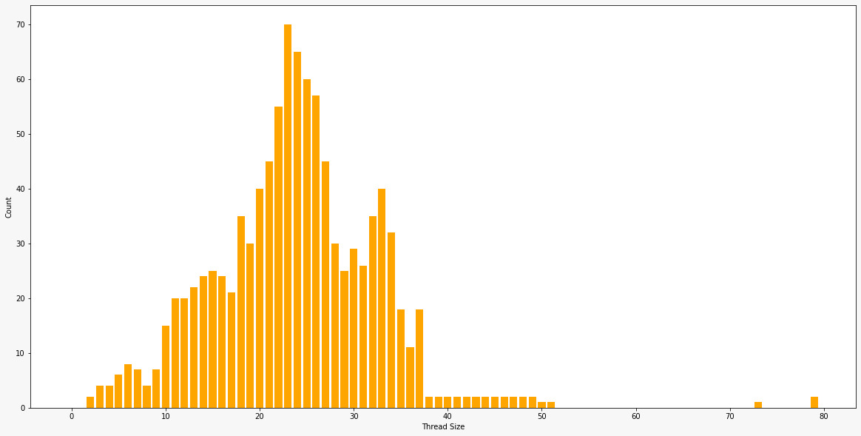
Analysis of threading

Slide 8
Topic Modelling
Topic modeling is a type of statistical modeling for discovering the abstract “topics” that occur in a collection of documents.
Latent Dirichlet Allocation (LDA) is an example of topic model and is used to classify text in a document to a particular topic. It builds a topic per document model and words per topic model, modeled as Dirichlet distributions.
Characteristics of LDA:
Probabilistic topic modelling technique
Work in an unsupervised way
Can create it in Gensim
e.g. → Model=models.LdaModel(corpus, id2word=dictionary, num_topics=100)

Slide 9
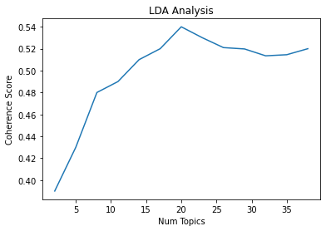
Analysis of LDA model

Slide 10
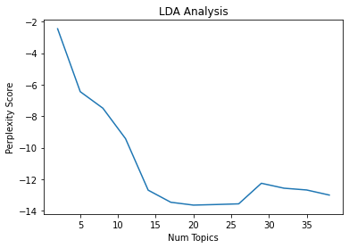
Analysis of LDA model

Slide 11
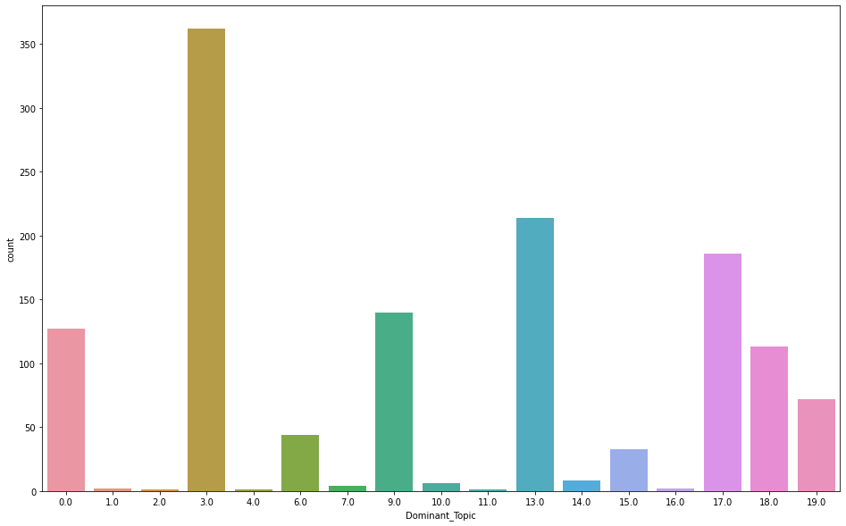
Analysis (Sample User XYZ)

Slide 12
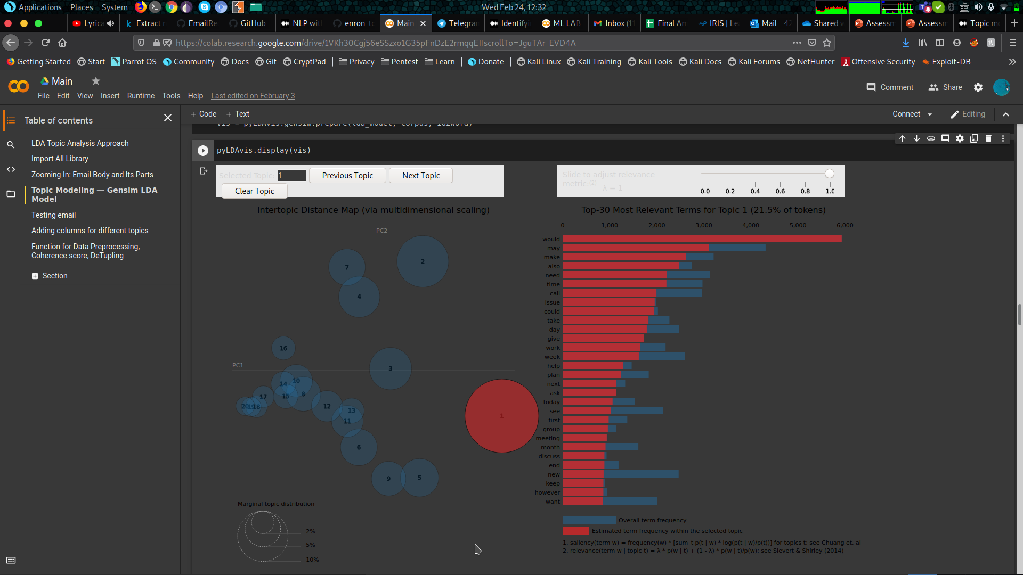
Representation of different topics obtained from LDA model in graphical format.

Slide 13
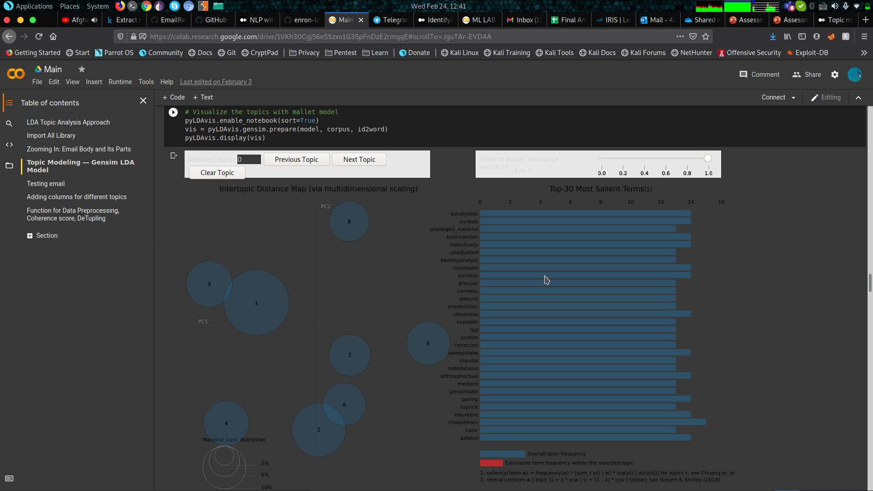

Slide 14
Final Demo
A short video about working of the project

Slide 15
Real-time implementation challenges
Separating Promotional, Primary and Social mails
Adding “star-mark and “important-tag” to the mail for increasing the score
Very large model training time
Adaptive thresholding complexity is higher

Slide 16
References
[1] Yingjie Zhou, Mark Goldberg “Strategies for Cleaning Organizational Emails with an Application to Enron Email Dataset “. (“Strategies for Cleaning Organizational Emails with an ...”) 5th Conf. of North American Association for Computational Social and Organizational Science (NAACSOS 07), Emory - Atlanta, Georgia, June 7-9, 2007
Available : http://www.cs.rpi.edu/~goldberg/publications/cleaning.pdf
[2] Bryan Klimt and Yiming Yang “The Enron Corpus: A New Dataset for Email Classification Research”. Conference: Machine Learning: ECML 2004, 15th European Conference on Machine Learning, Pisa, Italy, September 20-24, 2004 Available : here
[3] Nahdia Majeed, Ghulam Mujtaba and Ram Gopal Raj, “Email Classification Research Trends: Review and Open Issue (“Social network-based filtering of unsolicited messages ...”) s.” IEEE Access Vol 5, 2017, May 2017, pp. 9044-9064
Available : here
[4] Jana Diesner, Kathleen M. Carley “Exploration of Communication Networks from the Enron Email Corpus.”(Carnegie Mellon University) Available : here
[5] Bryan Klimt and Yiming Yang “Email Folder Classification using Threads.” (Carnegie Mellon University)
Available : here
[6] Kuldeep Kaur, Asst. Prof. Anantdeep Kaur “Email Summarization using Latent Dirichlet Allocation (LDA).” (IJARSE, volume no 6, issue no 9, September 2017 Available : here

