Slide 1

PUNE INSTITUTE OF COMPUTER TECHNOLOGY, PUNE
DEPARTMENT OF E&TC
“FALL DETECTION SYSTEM FOR ELDERLY PERSON”
By: 1. Manas Bedekar -- 32309
2. Aditi Deodhar -- 32319
3. Arnav Deshmukh -- 32320
Guided by: Dr. R. Sreemathy

Slide 2


NEED OF THE DEVICE
Falls are the leading cause of injury in elderly and the leading cause of accidental death.
For a human, experiencing a fall unobserved can be doubly dangerous.
Post-fall consequences can be greatly reduced if relief personnel can be alerted in time.
Therefore , a need for an automatic fall detection system in which a person can summon help even if they are unconscious or unable to get up after the fall.

Slide 3
INSPIRATION
To do our bit for the society we live in.
To help prevent the magnitude of the injury caused by the fall.
To help the elderly get the required assistance at the time of need.
Easy access and connectivity with family members.

Slide 4
OBJECTIVES
To study existing work done in this area.
To design an algorithm that reduces false triggering, while improving fall detection accuracy.
To make a system that instantly notifies to a concerned person with SMS when fall occurred.
To include a panic button so that an emergency notification can be sent by pressing it.
To make the device cost-effective and wearable.

Slide 5
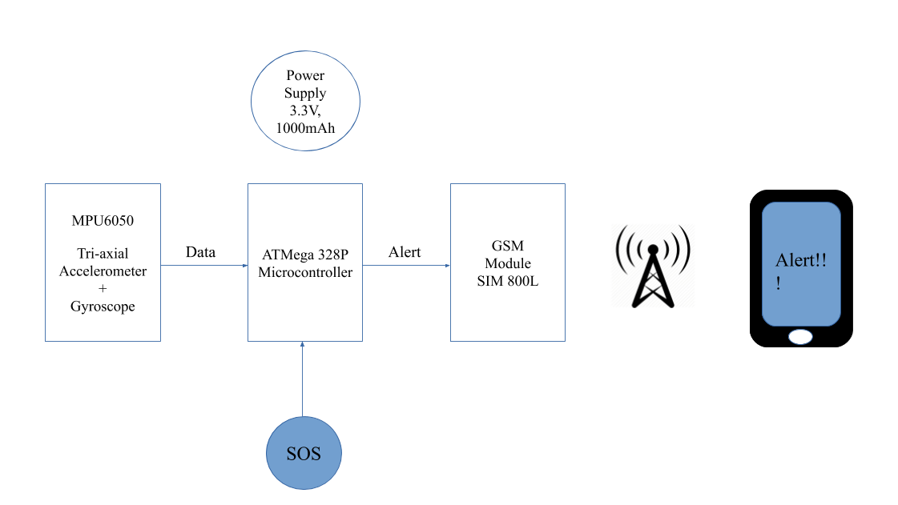
BLOCK DIAGRAM

Slide 6
COMPARATIVE STUDY
ATMega328P | LPC2148
ATMega328P is suitable for mostly sensor communications. | LPC2148 is suitable for many more applications like sensors, electrical control, mobile application and lot more.
ATMega328P works on max 16MHz. | LPC works on 60MHz.
ATMega328P costs 100 Rs. And Arduino board costs 350 Rs. | LPC 2148 costs 500 Rs. And development board costs 1K to 3k Rs.
Library support is biggest advantage. | Don’t have good library support.

Slide 7
COMPARATIVE STUDY
Parameter | MPU6050 | ADXL335
Data output X, Y, Z axis | Digital | Analog
Measurement range | Up to +/- 16g | +/-3g
Analog to Digital Converter (ADC) | 16 bit (internal sensor converter) | 8 – 10 bit (microcontroller converter)
Sensitivity | Up to 16384 LSB/g | 300mV/g

Slide 8
HARDWARE USED
MPU 6050 ( 3 axis accelerometer + gyroscope + temperature sensor )
ATMega328P Microcontroller ( 5V, 16MHz, 14 digital pins )
SIM800L GSM module (Recommended supply voltage: 4V, SIM card socket: microSIM (bottom side), Supported frequencies: Quad Band (850 / 950 / 1800 /1900 MHz)
LiPo battery and charging module( 3.3V, 1000mAH)

Slide 9
SOFTWARE USED
Jupyter Notebook(for data pre-processing)
Arduino IDE(for main programming)
EASY EDA (for PCB designing)

Slide 10
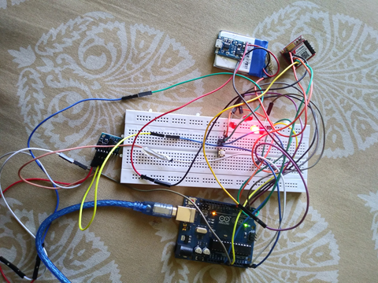

PROJECT SETUP
LiPo Battery
SIM800L GSM Module
MPU6050
ATMega328P

Slide 11
ALGORITHM
Check for panic button status if pressed a=send alert to concerned person else continue.
From MPU 6050 take accelerometer reading.
Using tri axial readings find average acceleration.
Find deviation of average acceleration from ‘g’ value.
Repeat step 1 to 3 for 15 times and accumulate result.
Find average of avg acceleration value.
Determine activity of person.
If avg acceleration is less than 2.5 m/s sq. Then check for fall.

Slide 12
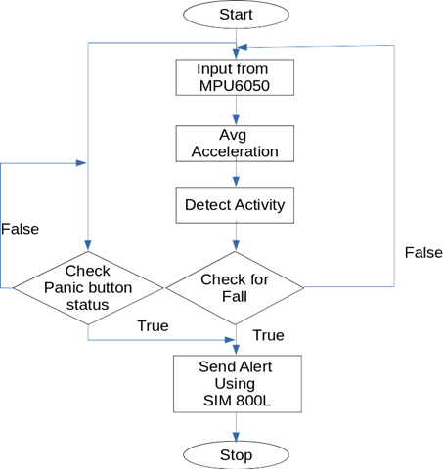
FLOW CHART

Slide 13
ACTIVITY TRACKING
For activity tracking Machine Learning technique is used.
In initial stages large amount data was collected using third party mobile application.
We collected accelerometer readings for daily activities like walking, running, seating on a chair etc.
To classify that data into an activity unsupervised learning was used.
For predicting activity we use 40 samples of acceleration readings.

Slide 14
In unsupervised learning K Means clustering algorithm was used to find cluster thresholds.
K Means algorithm is an iterative algorithm that tries to partition the dataset into 'K' pre-defined distinct non-overlapping subgroups (clusters) where each data point belongs to only one group.
Here we are dividing activity in 3 types.
Steady
Walking
Running
If average deviation from 'g' (9.8 m/s^2) is greater than 4.35 then activity is Running.
If deviation from 'g' (9.8 m/s^2) is between 1.2 and 4.34 then it is Walking else it is Steady activity.

Slide 15
FALL DETECTION
Fall is predicted when specific pattern is observed in the accelerometer readings.
When average acceleration value goes below 2.5 m/s^2 then fall prediction routine is called.
For fall prediction 100 samples are used.
If average acceleration value is nearly zero then sudden rise above 56 m/s^2 then it is definitely fall.

Slide 16
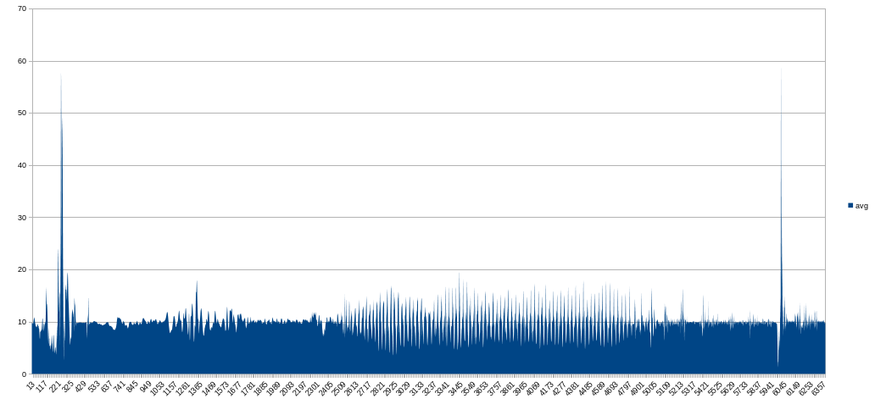
ACTIVITY TRACKING AND FALL DETECTION READINGS
Acceleration in m/s^2
Fall
Walking
Steady
Running
Fall
Samples

Slide 17
CONCLUSION
The proposed fall detection system can be regarded as alternative device to the existing detection approaches, it is less complex as compared to other devices, fast fall response and will be more accurate and economical.
The system can track type of activity from accelerometer signal using threshold algorithm.
After fall is detected, short message is sent to the concerned person. Also, provision is made to alert the concerned person about the fall by using the calling feature of GSM module.
Also, in case of emergencies a panic button is included which can be pressed manually and instantaneously to send alert

Slide 18



FUTURE SCOPE
The direction in which the fall has occurred can be determined by using the gyroscope.
Taking inspiration from the air bags system implemented in the cars, we can develop a system where an air bag like suite pops out when a situation like a true fall occurs which will save the person from fatal injuries.
Complete Health Care Monitoring System, which includes more features such as tracking the body temperature, blood pressure and heart beat rate.

