Slide 1
A Replication Study of the Growth of Eclipse Defects
Deokate Sayali

Slide 2
Motivation
Eclipse is a widely used Java IDE with added plug-ins including other major programming languages such as C, C++, Python, PHP, R, Scala, etc.
The software must work bug-free to satisfy the customer’s need. In order to make the software more efficient and fix the issues by removing the defects, one needs to detect the bugs.
Once a definite growth rate of the quantity of the defects is derived, a proper prediction model can be designed to find the number of defects in future versions of the software.

Slide 3
Introduction
I followed the work of H. Zhang from Tsinghua University, On “An Initial study of the growth of eclipse defects ” .
The reference paper shows data analysis for period June 2004 to November 2006 and its growth pattern. After training the machine with this growth rate data, it compares the 2007 data set he collected from the same website with the 2007 Prediction data set.
Mean Relative Error is calculated using formula
MRE = |N - N^|/N
where N and N^ are the actual and estimated values, respectively.
MRE results are used to define the degree of certainty of the predicted value being correct. For MRE value less than 25% then the prediction results are acceptable.

Slide 4
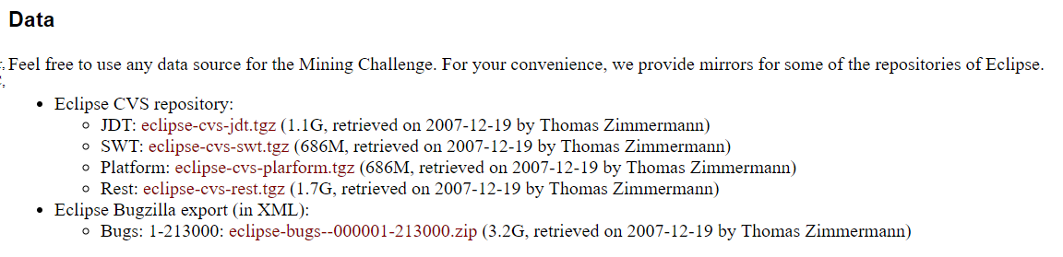
Getting the dataset
The Eclipse bug date set is a public information and is available at the MSR 2008 Challenge website .
This data is provided in the form of XML format. In order to process the data, I used python script for converting the data set in CSV file.
Once the CSV file is available, data fields such as different bug IDs, their Creation time stamps, Product Name and Component Name are used.
Using this information, I have calculated number of bugs observed for combination of different platform and component names.

Slide 5
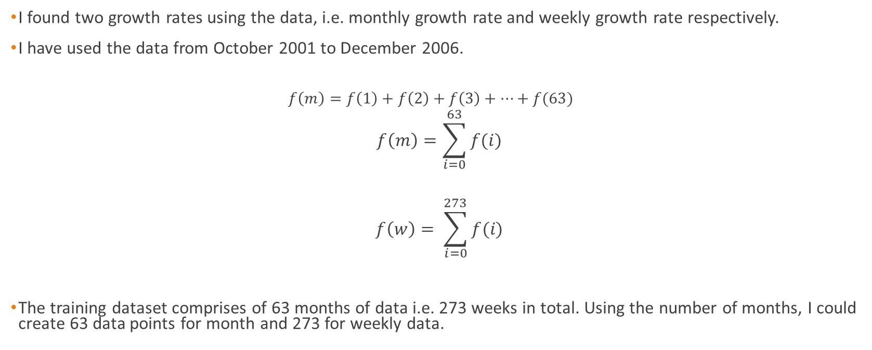
Finding the growth rate
I found two growth rates using the data, i.e. monthly growth rate and weekly growth rate respectively.
I have used the data from October 2001 to December 2006.
$$f\left(m\right)=f\left(1\right)+f\left(2\right)+f\left(3\right)+…+f(63)$$
$$f\left(m\right)=\sum_{i=0}^{63}{f(i)}$$
$$f\left(w\right)= \sum_{i=0}^{273}{f(i)}$$
The training dataset comprises of 63 months of data i.e. 273 weeks in total. Using the number of months, I could create 63 data points for month and 273 for weekly data.

Slide 6
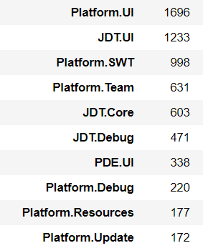
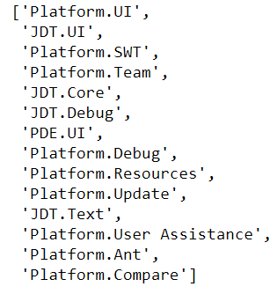
Choosing Eclipse Components
The components are grouped and counted and they are stored in a data frame in descending order. The first picture shows this.
Then from the data frame the names of the first 14 of the components are taken for analysis. Second picture shows it

Slide 7
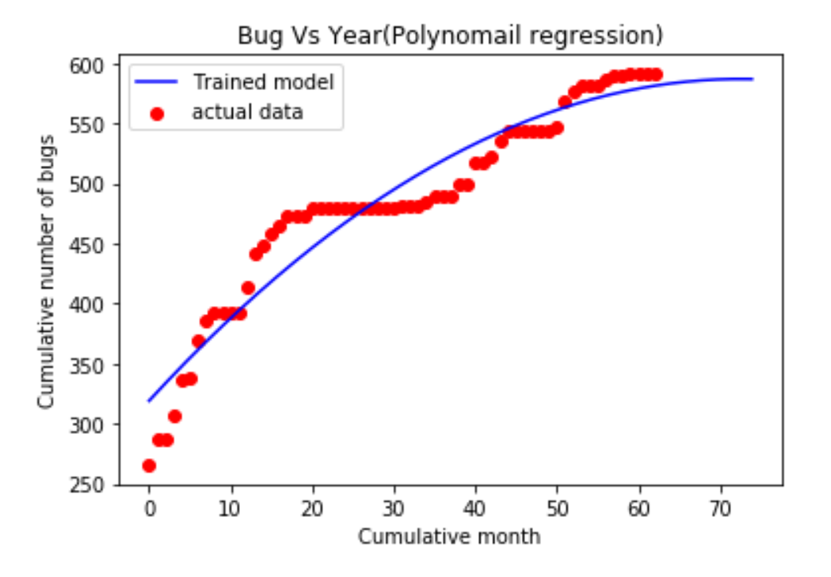
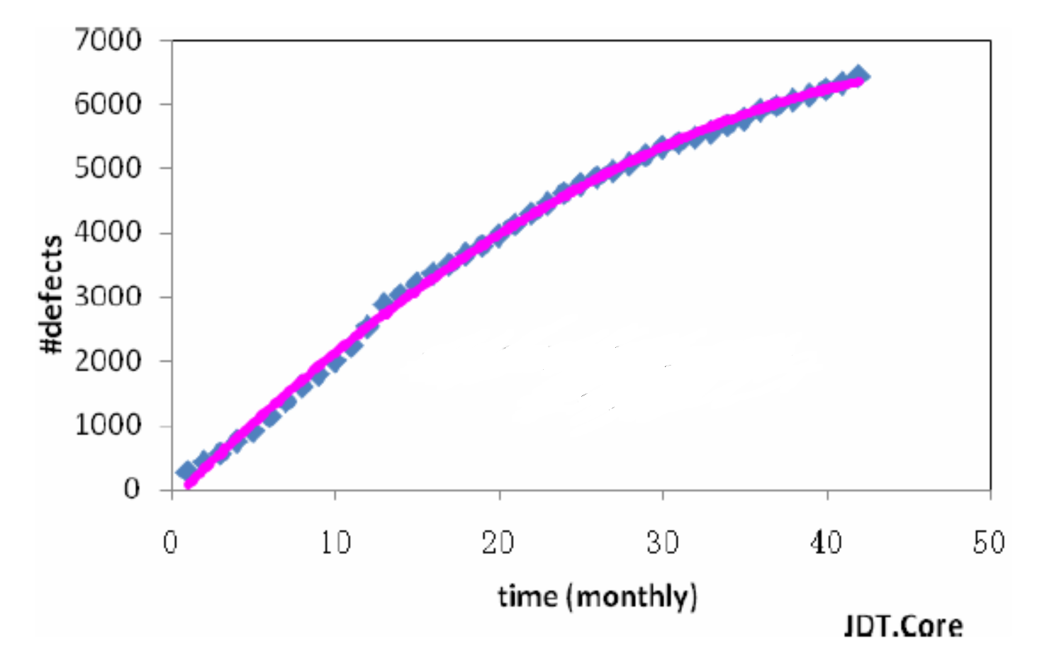
Replication [Data Analysis using Polynomial Regression]
We use the Polynomial Regression technique that was used in the original study to train the machine.
Figure 1 shows original paper result for growth rate for monthly bugs for JDT.Core and figure 2 shows replicated result for growth rate for monthly bugs for JDT.Core .

Slide 8
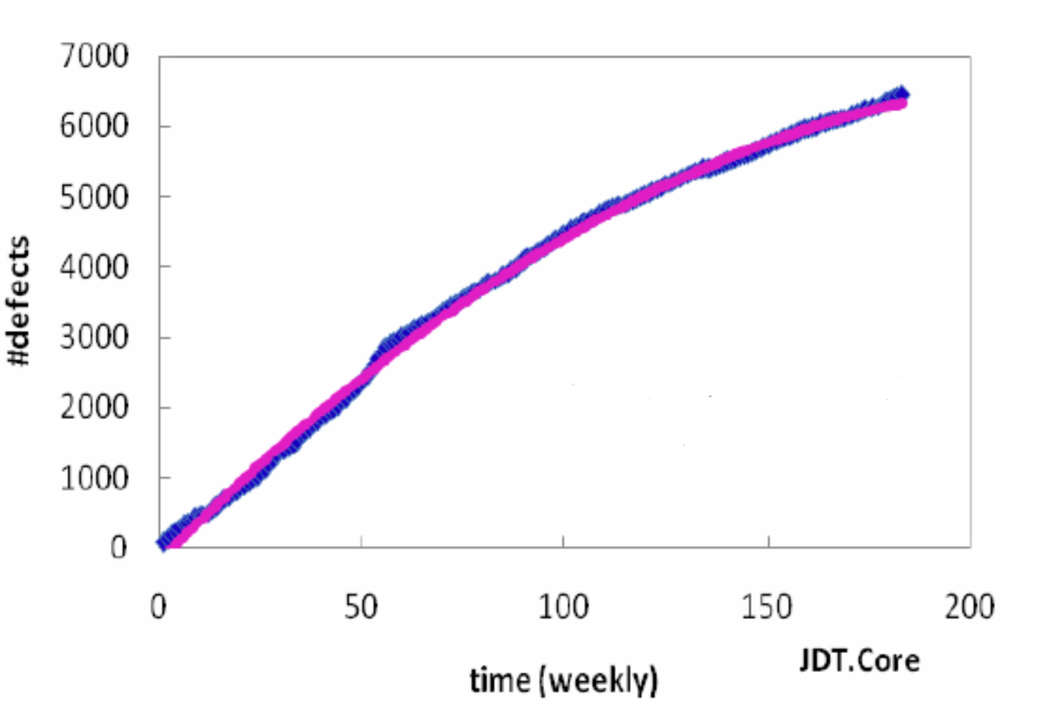
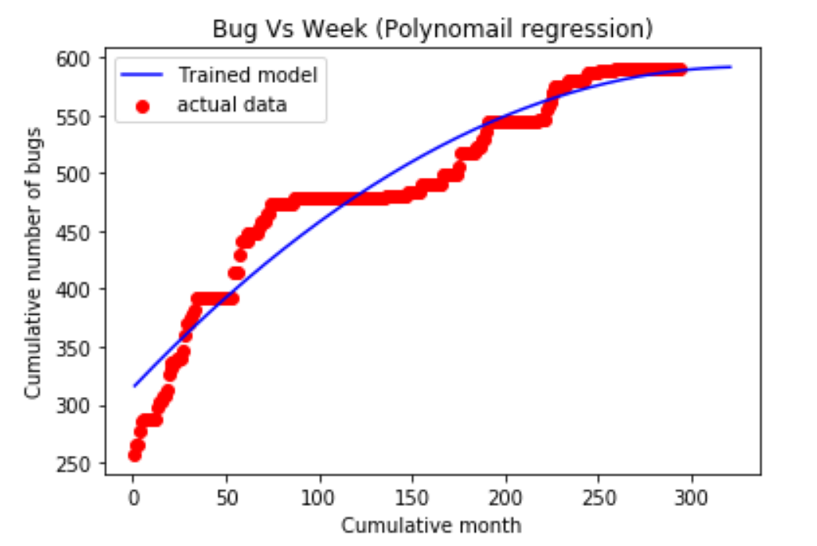
Figure 3 shows original paper result for growth rate for weekly bugs for JDT.Core and figure 4 shows replicated result for growth rate for weekly bugs for JDT.Core The only similarity in original result graphs and replicated result graphs is the nature of the growth of defect number is increasing manner

Slide 9
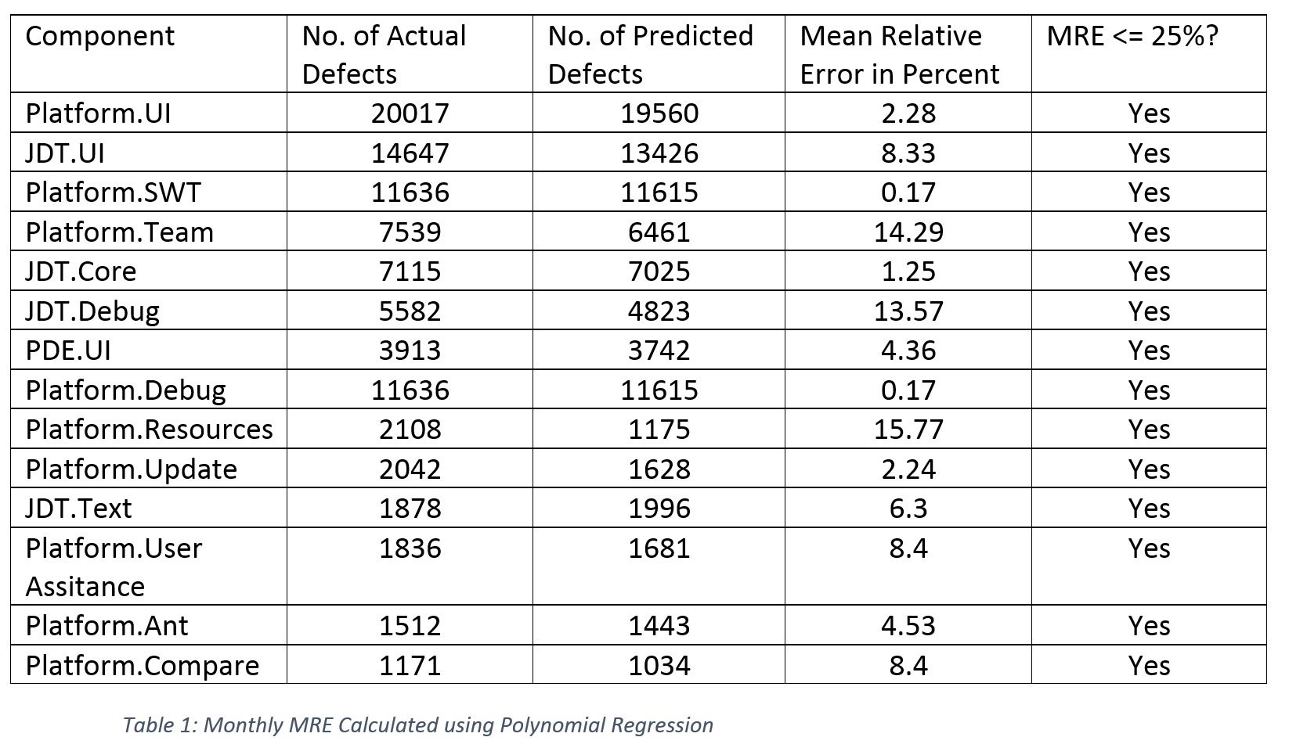
After getting the result we calculate the Mean Relation Error MRE = |N – N^|/N, where N and N^ are the actual and estimated values. Below is the table1 : Monthly MRE Calculated using Polynomial Regression.

Slide 10
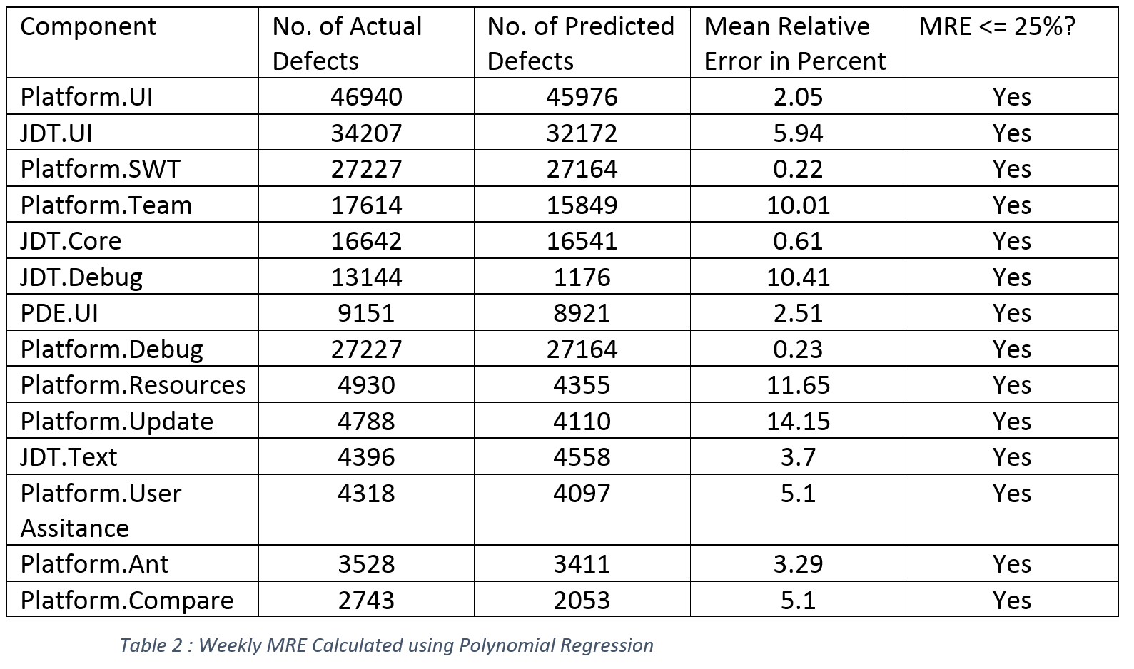
Below is the table 2 : Weekly MRE Calculated using Polynomial Regression.

Slide 11
Extension [Data Analysis using Ensemble Regression]
Ensemble regression algorithm uses a variety of machine learning algorithms to train the machine
The input it requires is much less compared to regular polynomial regression but gives a more accurate result.
In this we use the data from November 2001 to December 2006 we build a random forest classifier for month and week.
Using this classifier we predict the result for all months of 2007 and few week of 2007.

Slide 12
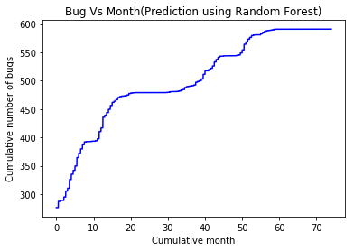
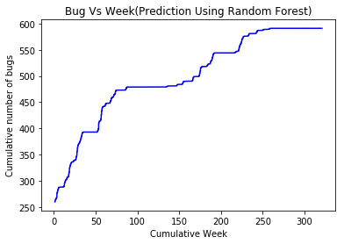
The actual data set curve is like ensemble regression curve.

Slide 13
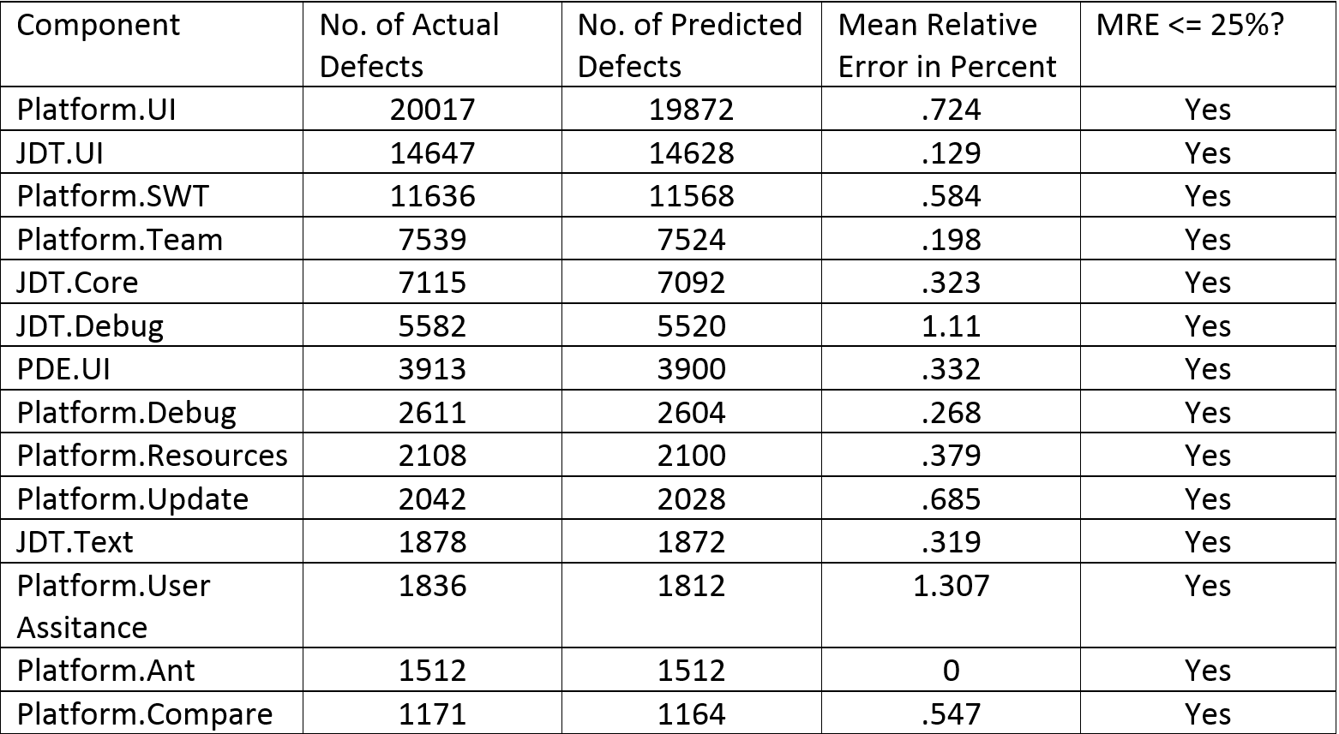
After getting the result we calculate the Mean Relation Error MRE = |N – N^|/N, where N and N^ are the actual and estimated values. Below is the table3 : Monthly MRE Calculated using Random Forest Regression.

Slide 14
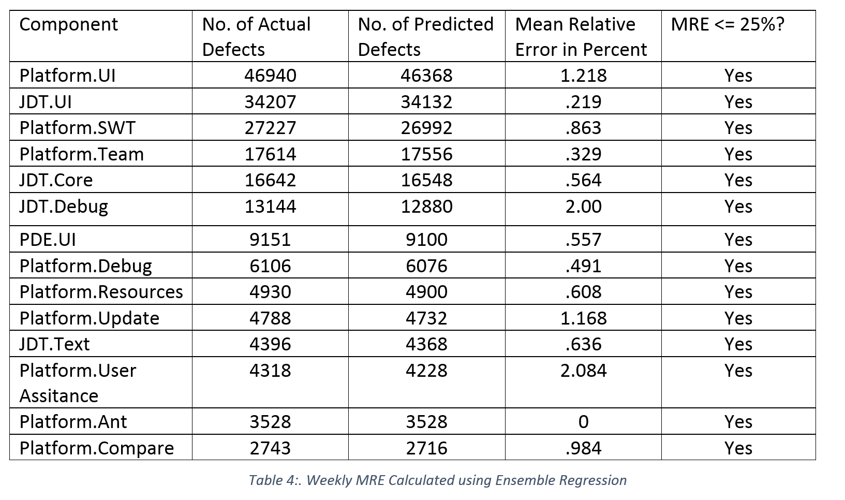
Below is the table 4 : Weekly MRE Calculated using Random forest Regression.

Slide 15
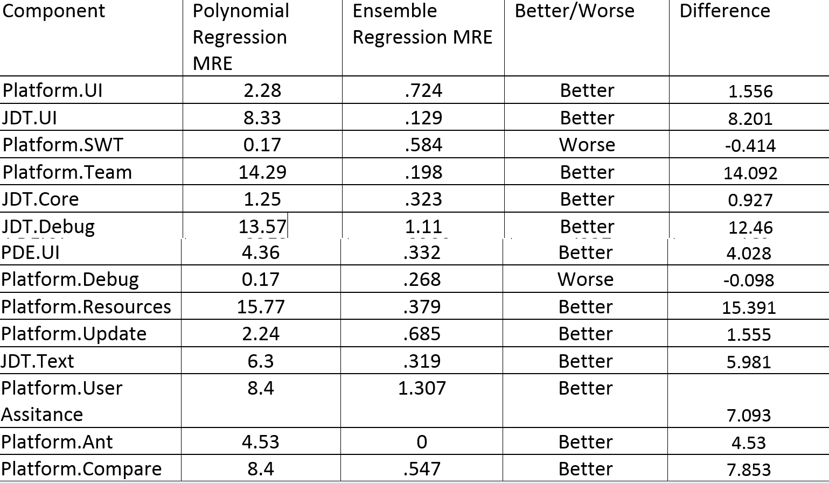
Result In the following table5 we are comparing polynomial regression MRE with Random forest regression MRE(Monthly)

Slide 16
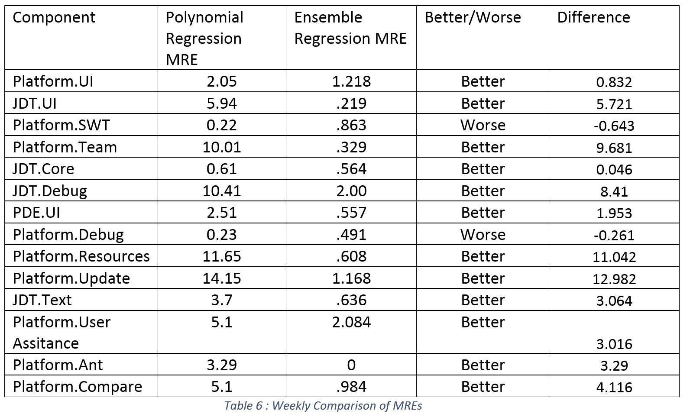
In the following table 6 we are comparing polynomial regression MRE with Random forest regression MRE (weekly)

Slide 17
Conclusion
The ensemble regression method used is one of the most effective algorithms in machine learning to make predictive methods.
This algorithm makes predictions based on the decisions from a series of base models. The algorithm combines these decisions and produces a very accurate predictive analysis.
As we see from Table 5 and table 6, the MRE values produced by the ensemble regression technique is much lower than that produced by the original study, which used polynomial regression model.
The reduced MRE is also evident from the prediction graphs produced on training the data sets with the different algorithms.
This shows the competence and superiority of the random forest regression algorithm over the polynomial regression technique.

Slide 18
Retrospect
Success:
Extraction of data
Replication of Paper
Extension of one topic
Analysis of data
Failure:
R square values

Slide 19
Thank You

