Slide 1
Employee Tracker using MERN stack
CODING BOOT CAMP AT UT AUSTIN
Final Project
Jimmy Hong

Slide 2
GOAL
To build a web application for companies to manage employee information, AND TO LEARN REACT
MAIN FUNCTIONALITIES
MANAGEMENT: add/delete employee data
MANAGEMENT: approve/reject/delete requests
EMPLOYEES: create time-off request

Slide 3
FRONT-END
REACT / SEMANTIC UI
BACK-END
NODE / EXPRESS / MONGODB
NPM
Superagent (API calls)
React-router v4
React-big-calendar
Semantic-ui-react

Slide 4
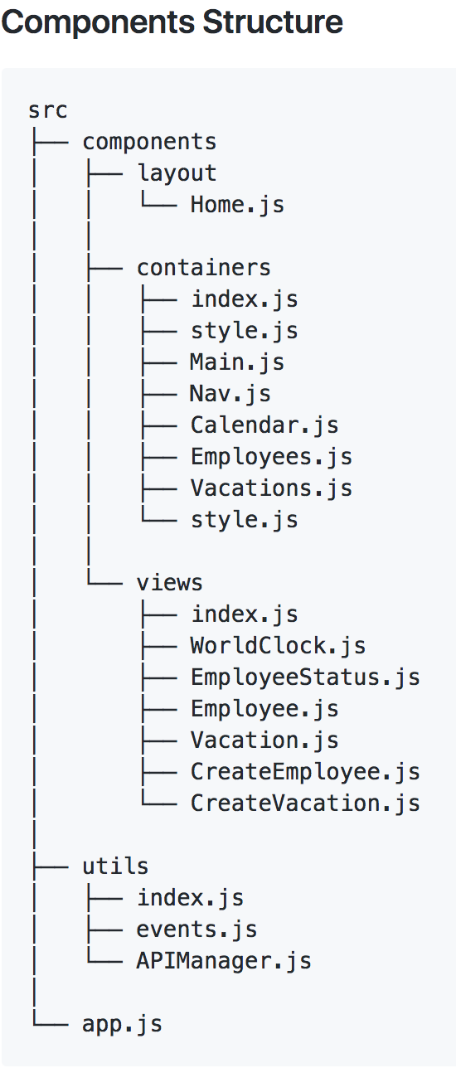
RESEARCH
REACT starter templates
TUTORIALS
DEVELOPMENT PROCESS
EXPRESS server
GET / POST / PUT / DELETE
WEBPACK
COMPONENTS
API calls
TEST

Slide 5
DEMO
https://final-project-deokpyo.herokuapp.com/
GITHUB LINK
https://github.com/deokpyo/final-project

Slide 6
Future
Login system
Manager / Employee views
Slack & Google Calendar API
Redux
Server-Side Rendering
AWS
React native
https://electron.atom.io/
GET A JOB

Slide 7
Questions…?

