Slide 1
2025/11/11 – lab meeting (Capstone Project Progress)
Simulation of 2D Ultrasound Transducer (8×8) Using Verasonics
Deoliana Matilde
Notes:
“Good afternoon everyone. I’m Deoliana Matilde, and today I’ll present my progress on simulating a 2D 8×8 ultrasound transducer using the Verasonics.

Slide 2
01. Objectives
Simulate 2D (8×8) transducer geometry in Verasonics (simulation-only mode).
Study beamforming behavior:
Plane-wave transmissions with multiple steering angles
Single plane wave
Notes:
The main objective is to simulate the 8×8 transducer geometry and study beamforming behavior. I examined two cases — plane-wave transmission with multiple steering angles and a single, unfocused plane wave.

Slide 3
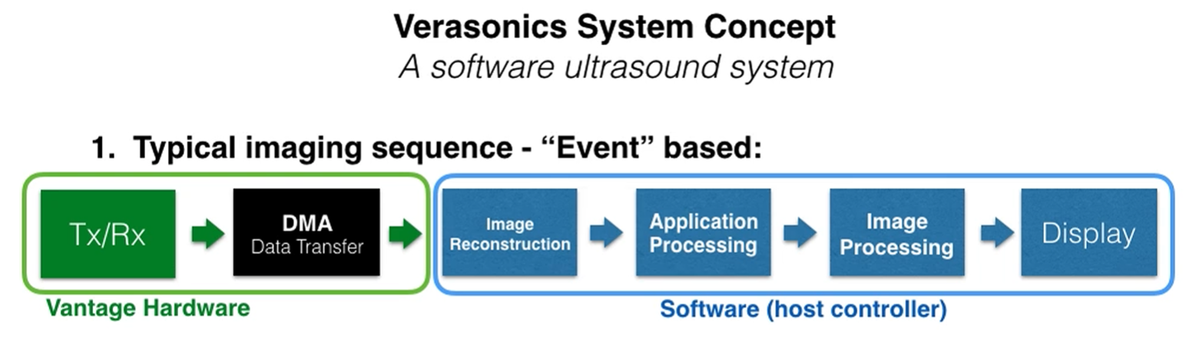
02. Setup
Simulation Flow:
Notes:
“This diagram shows the Verasonics imaging sequence. It begins with transmission and reception, then data is transferred for reconstruction, processing, and finally displayed.

Slide 4
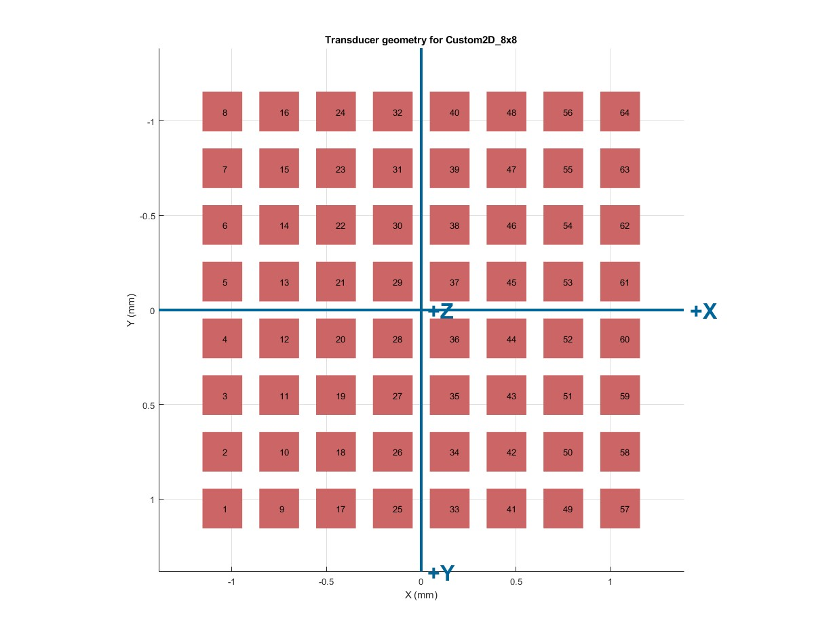
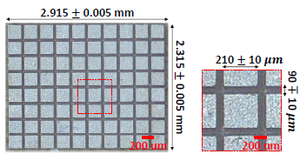
02. Setup
Transducer Geometry and Parameter:
Transducer : 8x8 matrix, (64 total elements)
Center frequency : 11MHz
Pitch : 300 μm
Kerf (gap) : 90 ± 10 μm
Element width/height : 210 ± 10 μm
Speed of sound of soft tissue : 1540m/s
Element Mapping
Notes:
“My custom array consists of 64 elements, with an 11 MHz center frequency and 300 µm pitch. The gap between elements is around 90 µm, and the element size is 210 µm. with the sound speed of 1540 m/s.”

Slide 5
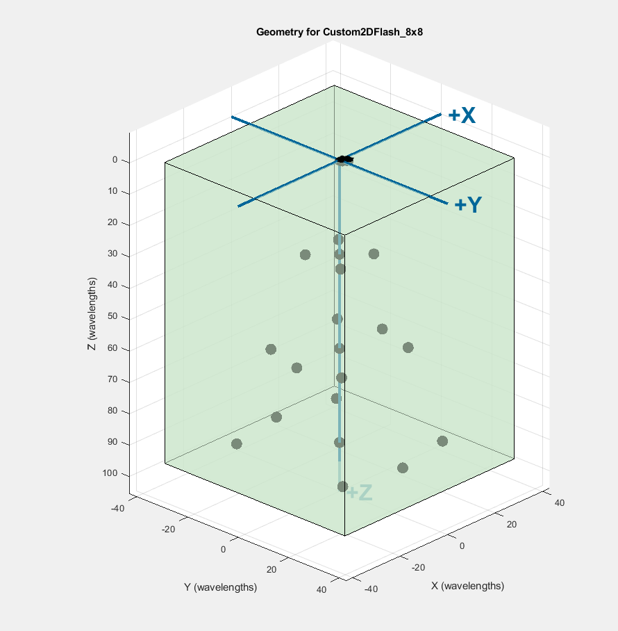
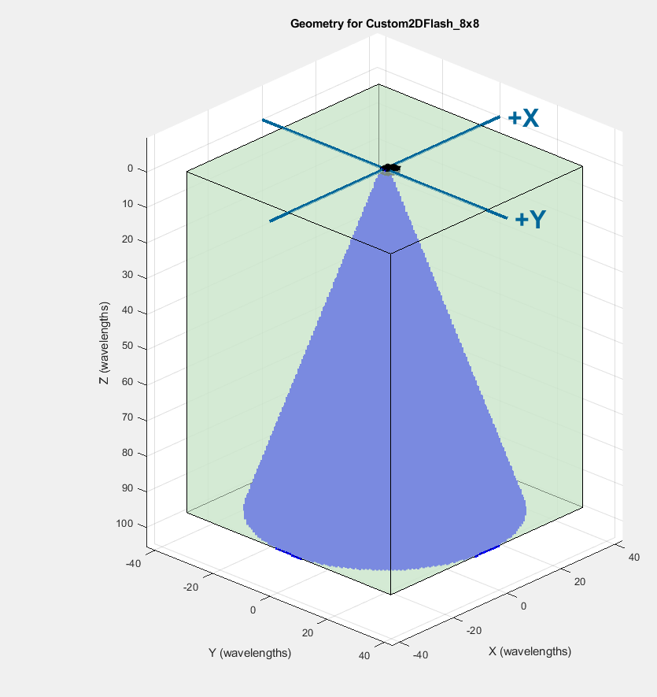
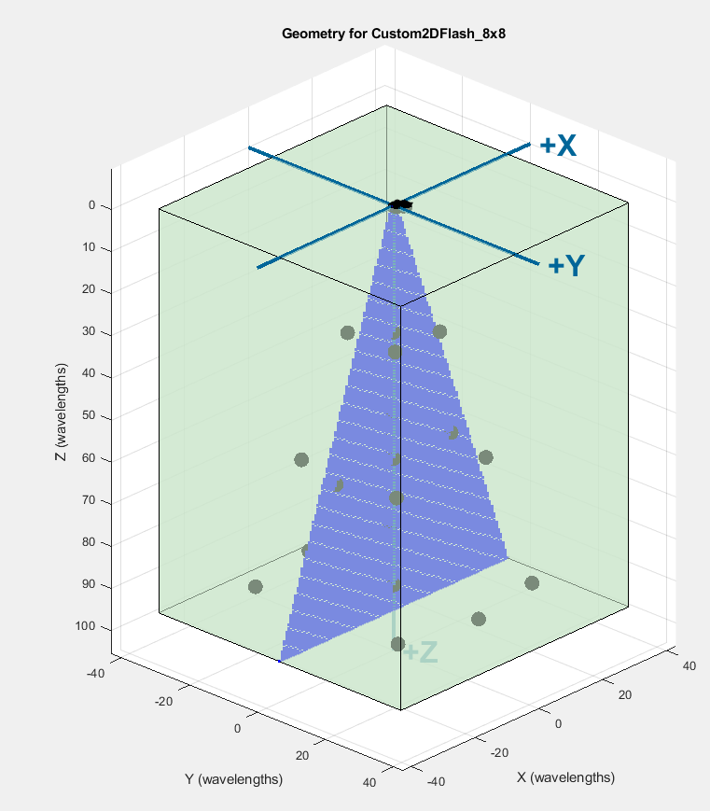
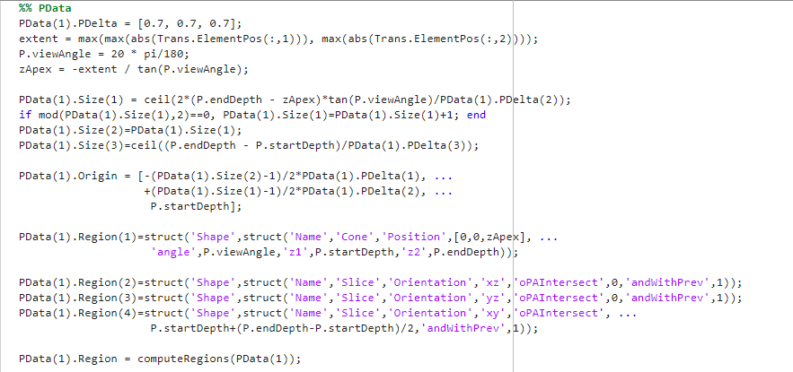
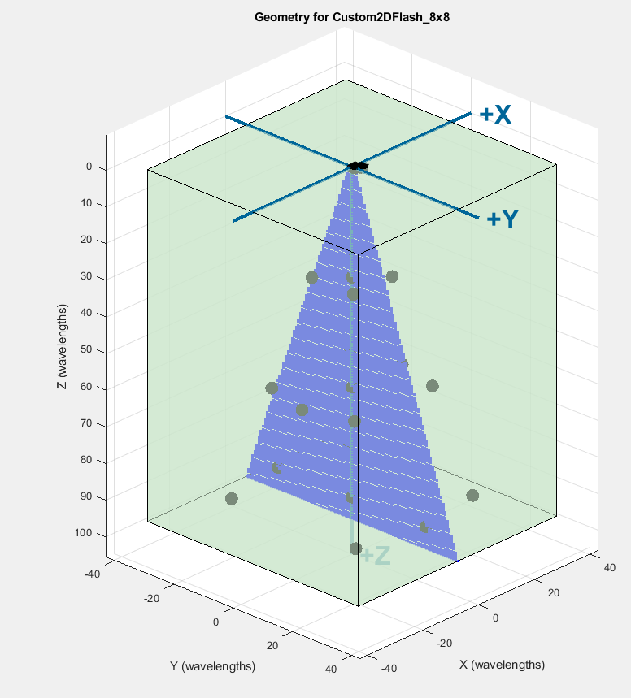
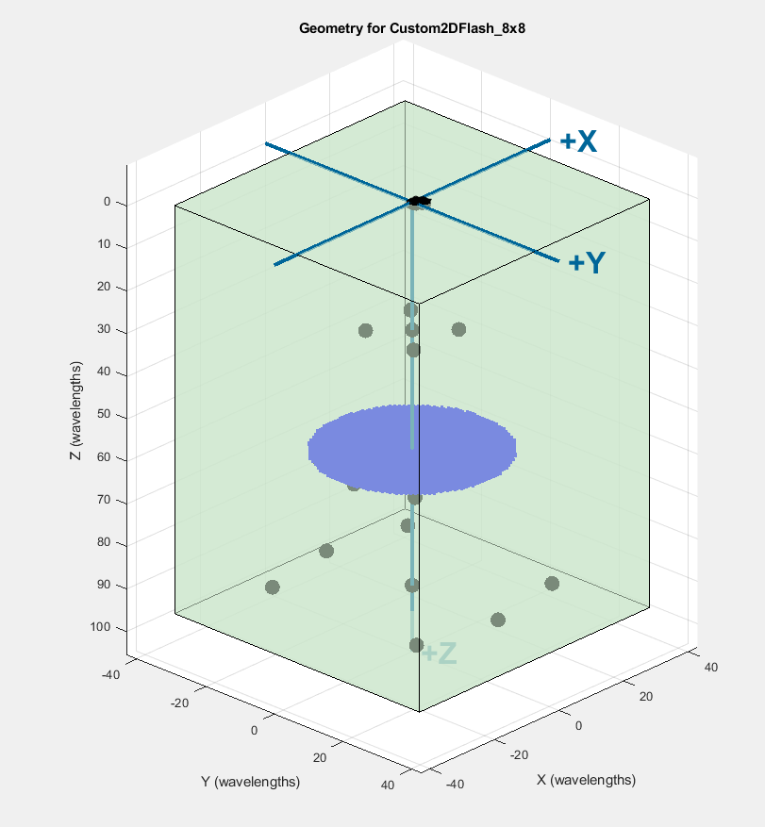
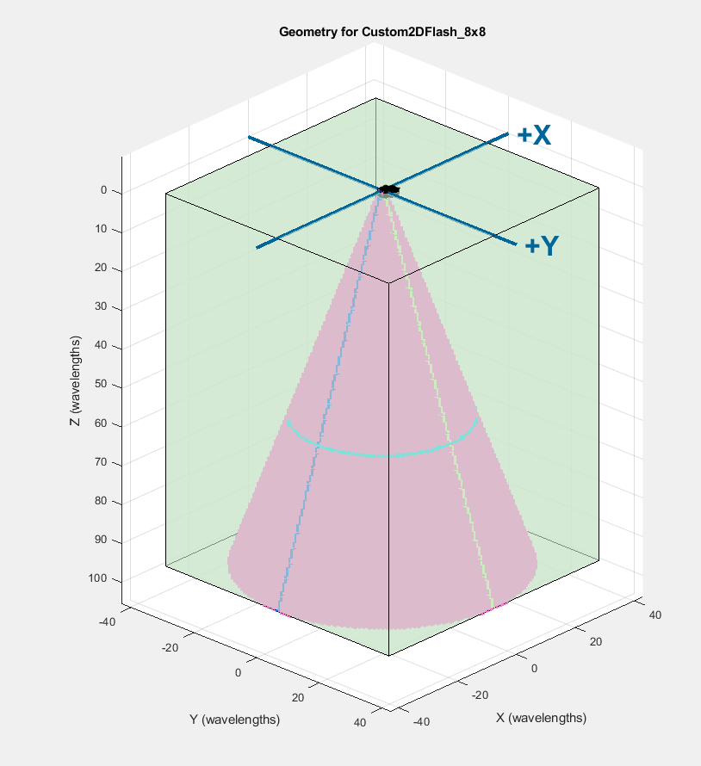
02. Setup
Snippet Code of PData Region
Homogeneous Media
Points Scattered
Pdata – Cone Region
FOV – 20 degree
Slice – XZ plane
Slice – YZ plane
Slice – XY plane
Imaging Dept along Z-direction
Notes:
“This code snippet defines the imaging region in Verasonics, known as PData. Here I set up a cone-shaped field of view with a 20-degree angle and defined slices for XY, YZ, and XZ planes.”

Slide 6
02. Setup – Media & PData Geometry
Homogeneous Media
Points Scattered
Pdata – Cone Region
FOV – 20 degree
Slice – XZ plane
Slice – YZ plane
Slice – XY plane
Imaging Dept along Z-direction
Notes:
“These plots show the simulation geometry. The medium points are randomly scattered, and the PData region represents the cone-shaped imaging zone viewed from different planes.”

Slide 7
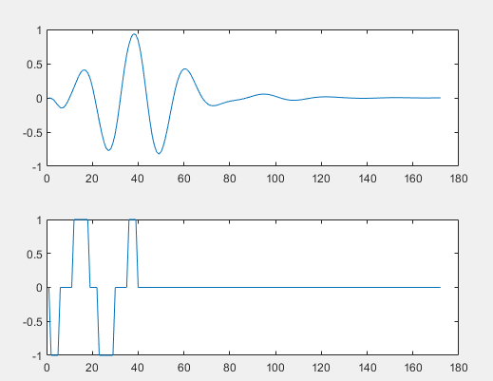
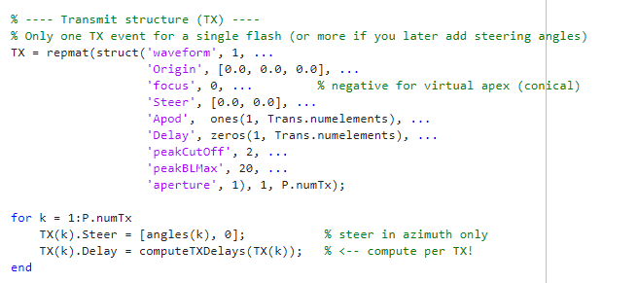
03. Simulation – TX
PW-STEERING ANGLE(-20 <-> +20 DEGREE/1 TX Per Frame)
All 8×8 elements fire simultaneously per transmit event.
The emitted plane wave is tilted by angle θₖ to steer the acoustic beam.
Five angles (−20°, −10°, 0°, +10°, +20°) create five subframes.
TransmitWaveform
Notes:
“For the first experiment, I implemented plane-wave compounding using five steering angles: −20, −10, 0, +10, and +20 degrees. Each transmission fires all 64 elements simultaneously, but with linear time delays computed from the steering angle. These delays tilt the plane wave in the desired direction, giving different angular views of the same scene.”

Slide 8
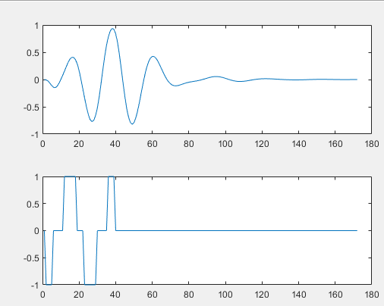
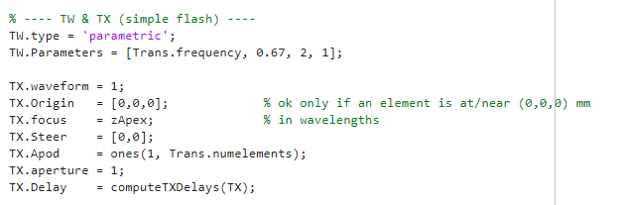
03. Simulation – TX
2. PW-No Steering
All Elements Transmit at the same time
Total 64 elements
Unfocus transmission
TransmitWaveform
Notes:
“In the second setup, I used a single plane-wave transmission with no steering. Here, all elements fire at exactly the same time, producing a flat wavefront that propagates straight along the z-axis.

Slide 9
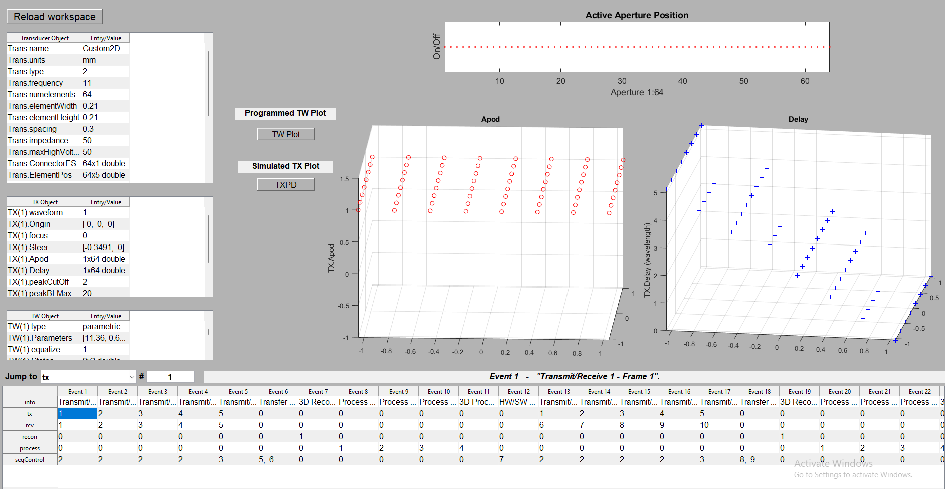
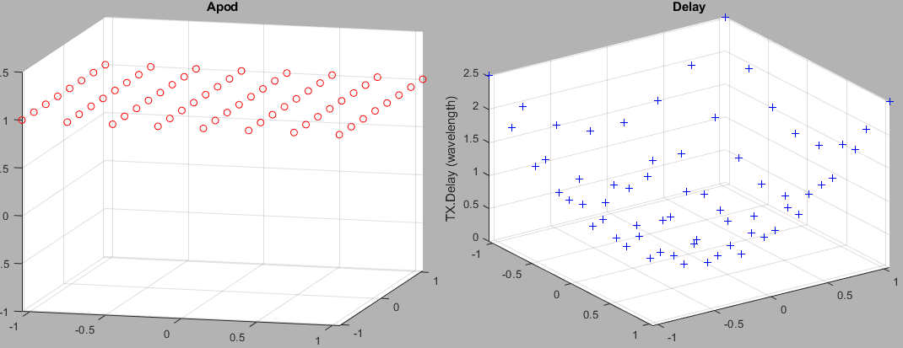
03. Simulation – TX
>> showEventAnalysisTool
Apod active
Tilt angle by−20°
Tilt angle by−10°
Tilt angle by 0°
Single plane-wave – no steering
All elements are active at once
Notes:
“This Event Analysis Tool is used to verify transmit parameters. As shown, the delay patterns vary with steering angle, while for the single flash case, all delays are uniform.”

Slide 10
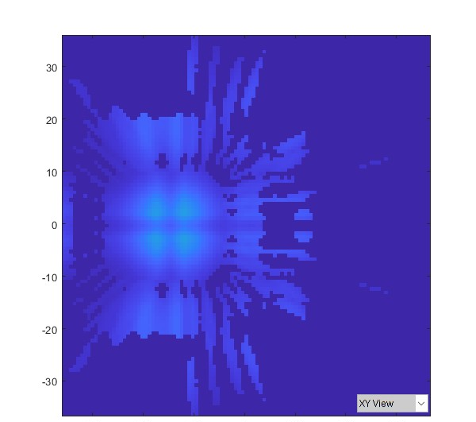
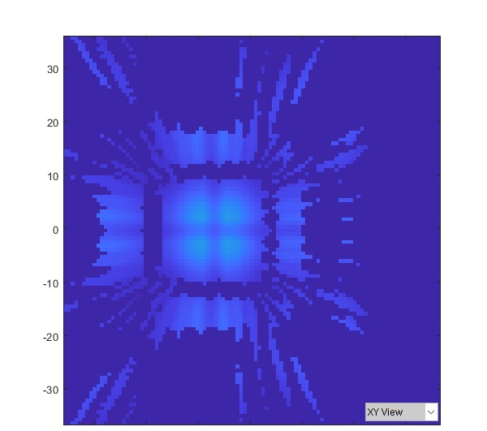
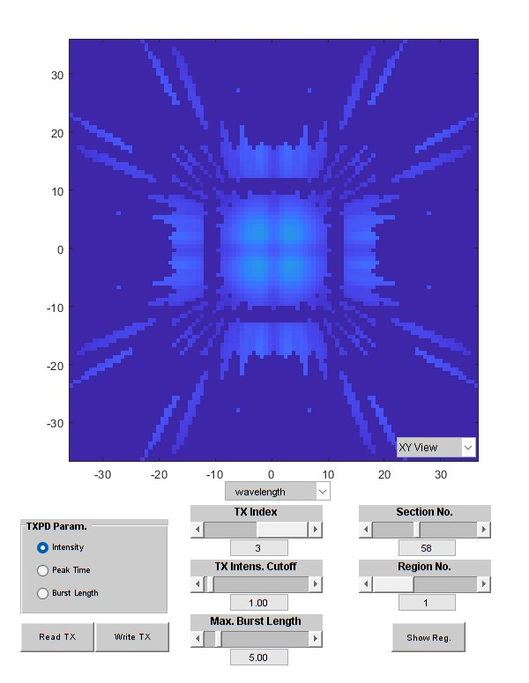
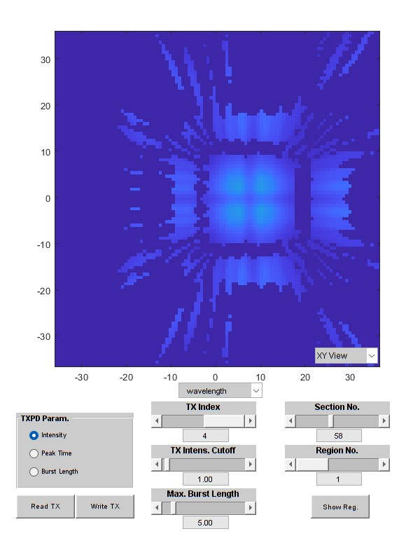
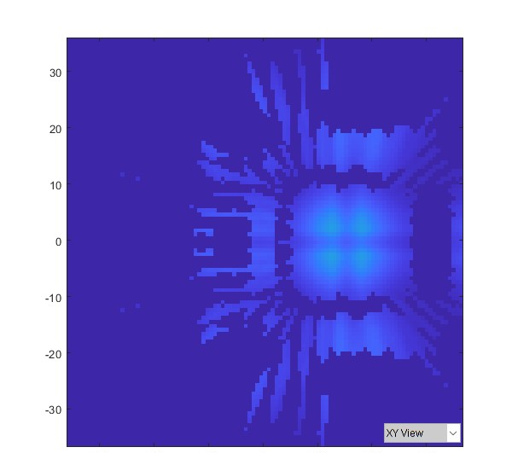
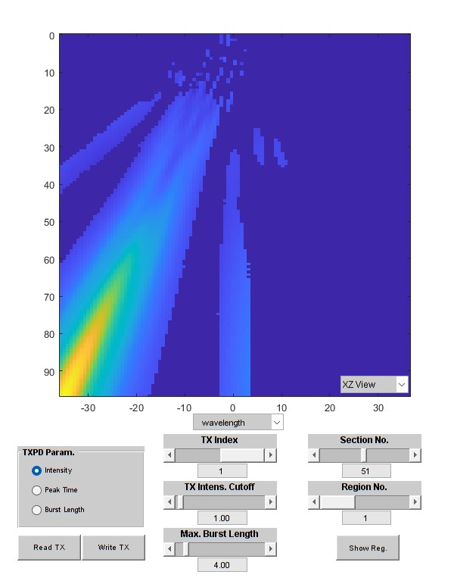
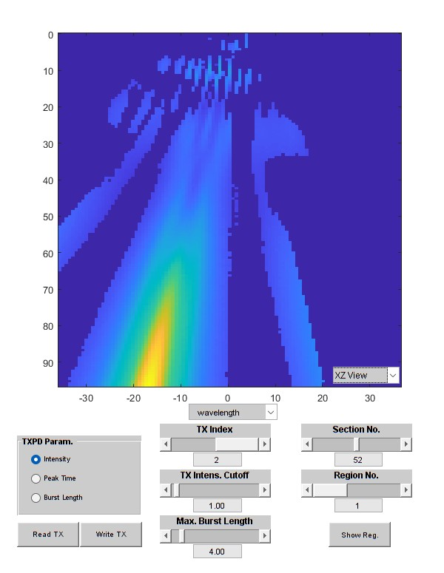
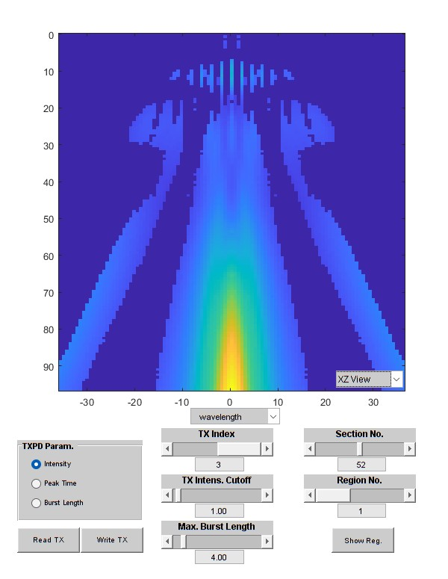
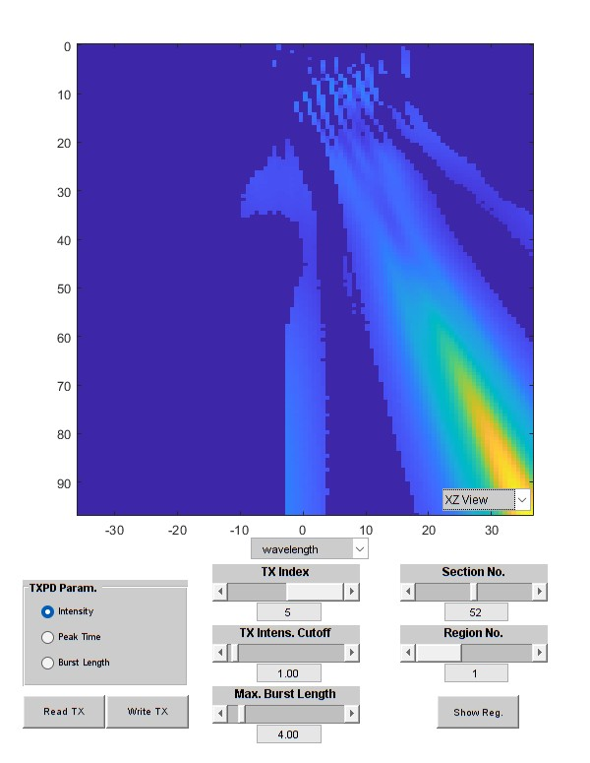
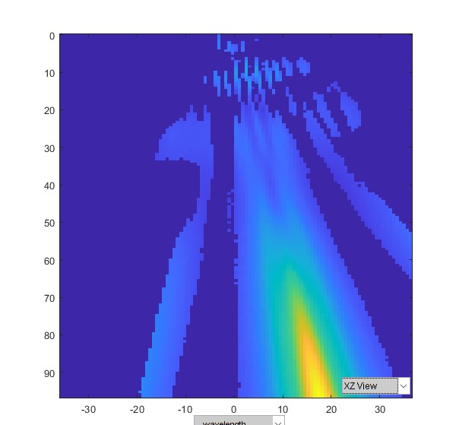
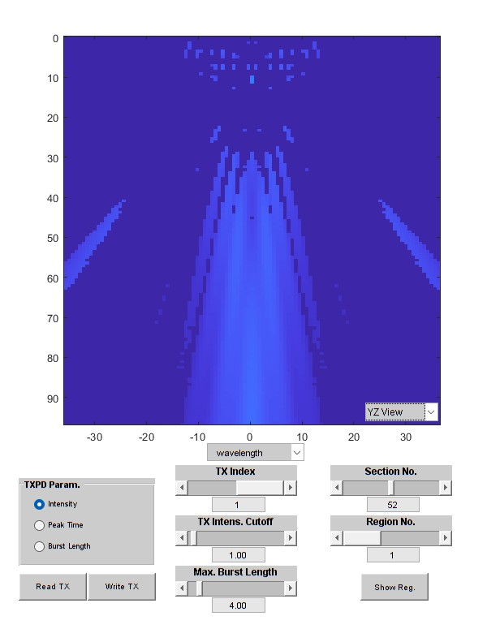
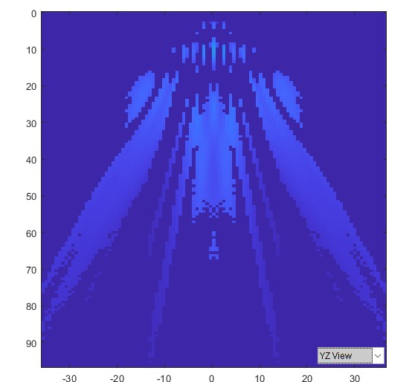



03. Simulation – TX
Vizualizatoin of Transmission of Plane Waves, Steering at Different Angles
XY-plane
at -20°
XY-plane
at - 10°
XY-plane
at 0°
XY-plane
at 10°
XY-plane
at 20°
XZ-plane
at -20°
XZ-plane
at -10°
XZ-plane
at 0°
XZ-plane
at 10°
XZ-plane
at 20°
YZ-plane
at -20°
YZ-plane
at -10°
YZ-plane
at 0°
YZ-plane
at 10°
YZ-plane
at 20°
Notes:
“These plots show simulated wave propagation for the five steering angles. At −20°, the beam tilts to the left; at +20°, it tilts to the right.

Slide 11
03. Simulation – TX
Single flash plane wave
TX.steer = [0.0,0.0]
XY-plane
at -20°
XY-plane
at - 10°
XY-plane
at 0°
XY-plane
at 10°
XY-plane
at 20°
XZ-plane
at -20°
XZ-plane
at -10°
XZ-plane
at 0°
XZ-plane
at 10°
XZ-plane
at 20°
YZ-plane
at -20°
YZ-plane
at -10°
YZ-plane
at 0°
YZ-plane
at 10°
YZ-plane
at 20°
Notes:
“This figure shows the single, non-steered transmission. The wavefront is symmetric and moves straight along the z-axis,

Slide 12
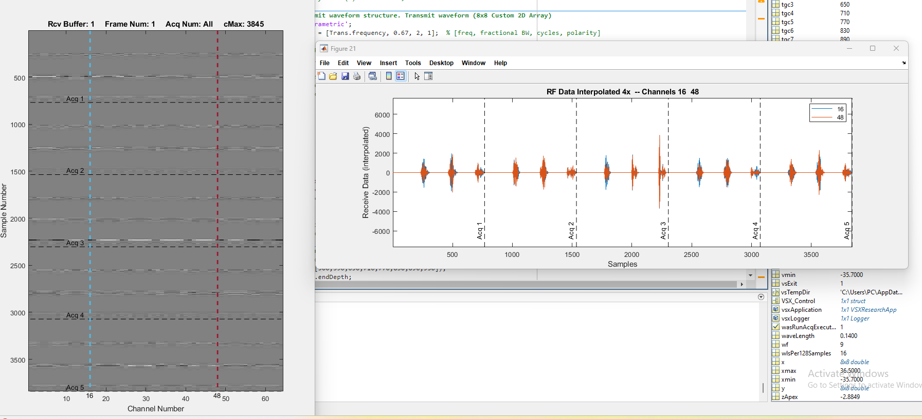
03. Simulation – Rx
To visualize the raw RF signals received by the array for each transmit angle (Acq 1–5)
Notes:
“Here is the raw RF data recorded for each transmit event. There are five acquisitions corresponding to the five steering angles. You can see how the signal arrival times differ slightly due to the tilted propagation path.”

Slide 13
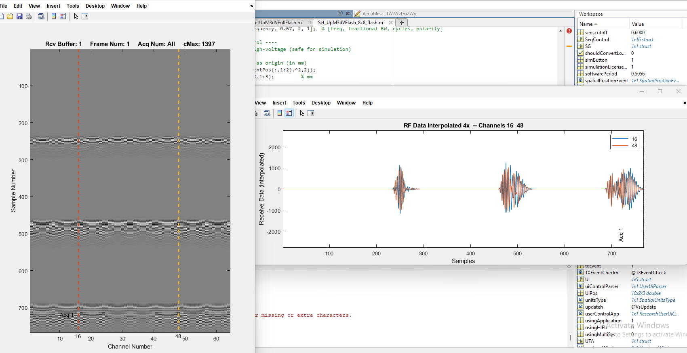
03. Simulation – Rx
RF signal of single flash Transmission
Notes:
This plot shows the RF signal received in the no-steering condition. Channels 16 and 48 are shown here — both symmetric, reflecting the equal propagation distance for all elements.”

Slide 14
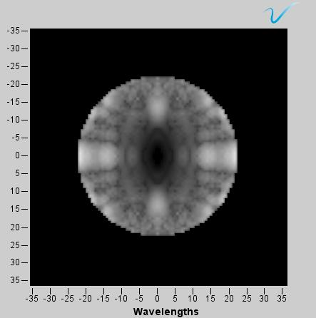
03. Simulation – Image Reconstruction
XY-plane
at -20°
XY-plane
at - 10°
XY-plane
at 0°
XY-plane
at 10°
XY-plane
at 20°
Rcv Buffer
Image Reconstruction at xy-plane
Notes:
“After data acquisition, the individual RF datasets are reconstructed and compounded. The resulting images are shown here for the XY, XZ, and YZ slices.

Slide 15
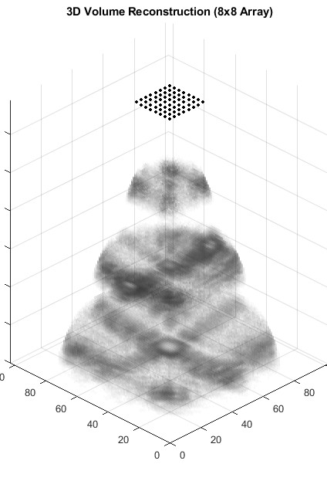
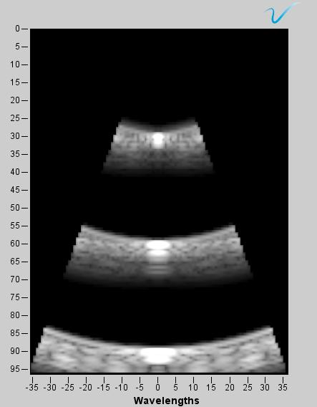
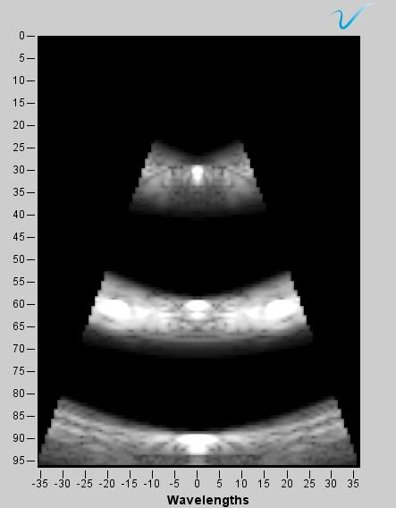
03. Simulation – Image Reconstruction
PWC - image reconstruction
Image Reconstruction at
xy-plane
Image Reconstruction at
xz-plane
Image Reconstruction at
yz-plane
Notes:
“After data acquisition, the individual RF datasets are reconstructed and compounded. The resulting images are shown here for the XY, XZ, and YZ slices. By combining five angular views, speckle noise is reduced and contrast improves significantly.”

Slide 16
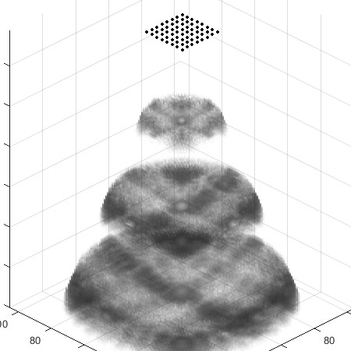
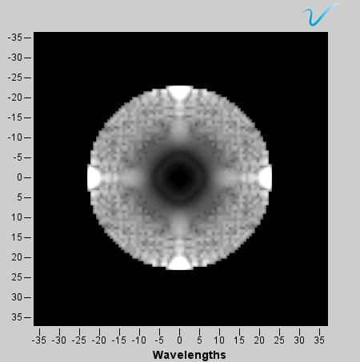
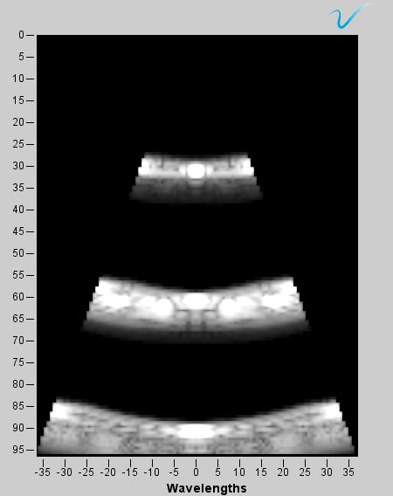
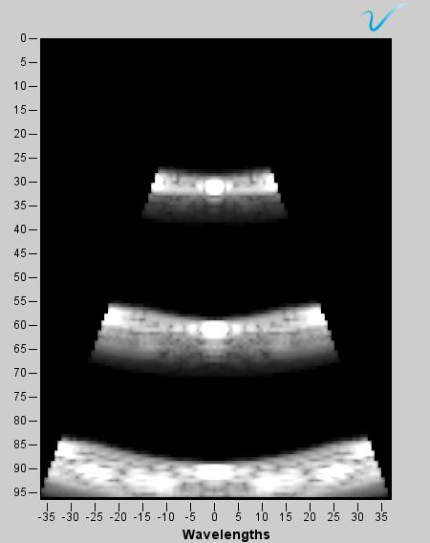
03. Simulation – Image Reconstruction
PW – No-steering
image reconstruction
Image Reconstruction at
xy-plane
Image Reconstruction at
xz-plane
Image Reconstruction at
yz-plane
Notes:
“This shows the reconstructed image from the single plane-wave transmission. It looks more uniform but less detailed compared to the compounded result. The field of view is narrower and lateral resolution is slightly degraded.”

Slide 17
04. Result
CPW steering angles (−20°, −10°, 0°, +10°, +20°)
PW – no steering
xz-plane
xy-plane
xz-plane
yz-plane
xy-plane
yz-plane
Notes:
“Here, we can directly compare the two modes. The compound plane-wave image has higher signal-to-noise ratio and better structure visibility, while the single plane wave provides faster imaging but poorer contrast. In other words, compounding improves image quality at the cost of frame rate.”
Each steered plane wave provides a slightly different view of the tissue. When we sum them coherently, random noise and side lobes cancel out, while true scatterers reinforce each other. This is why the compounded image appears clearer and sharper.”
“In the single flash case, the transmission is defined as coming from a virtual source at the negative z-axis — above the transducer. This mathematical definition creates a flat wavefront that travels along +z through the cone region. There’s no focusing curvature or tilt — all elements transmit in phase.”

Slide 18
04. Next
Study and simulate DAS Beamforming
ADAPTIVE Beam Forming – extend to Deep learning-adaptive Beamforming
Comparing DAS and Adaptive Beamforming

Slide 19

감사합니다
Thank you

Slide 21
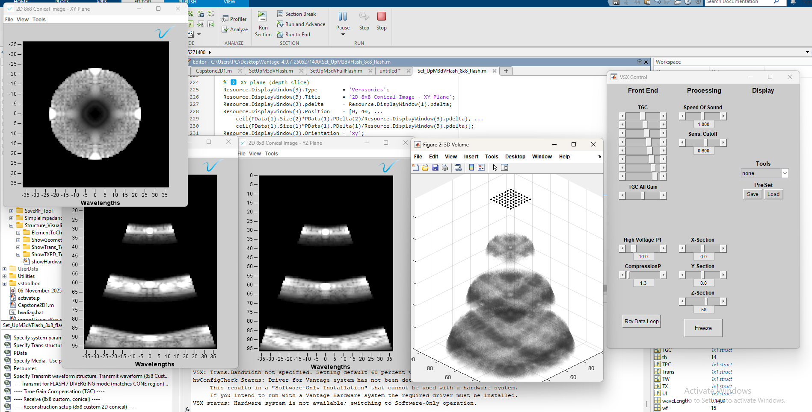

Slide 22
