Slide 1
Lab-Meeting
2025/12/30
Deoliana Matilde

Slide 2
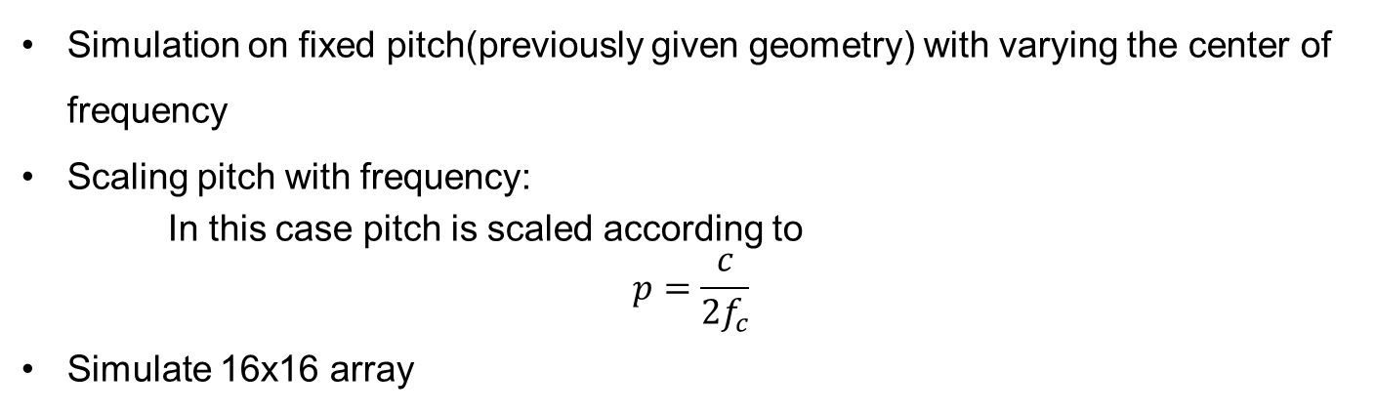
01 Today’s discussion
Simulation on fixed pitch(previously given geometry) with varying the center of frequency
Scaling pitch with frequency:
In this case pitch is scaled according to
$$p=\frac{c}{2f_{c}}$$
Simulate 16x16 array

Slide 3
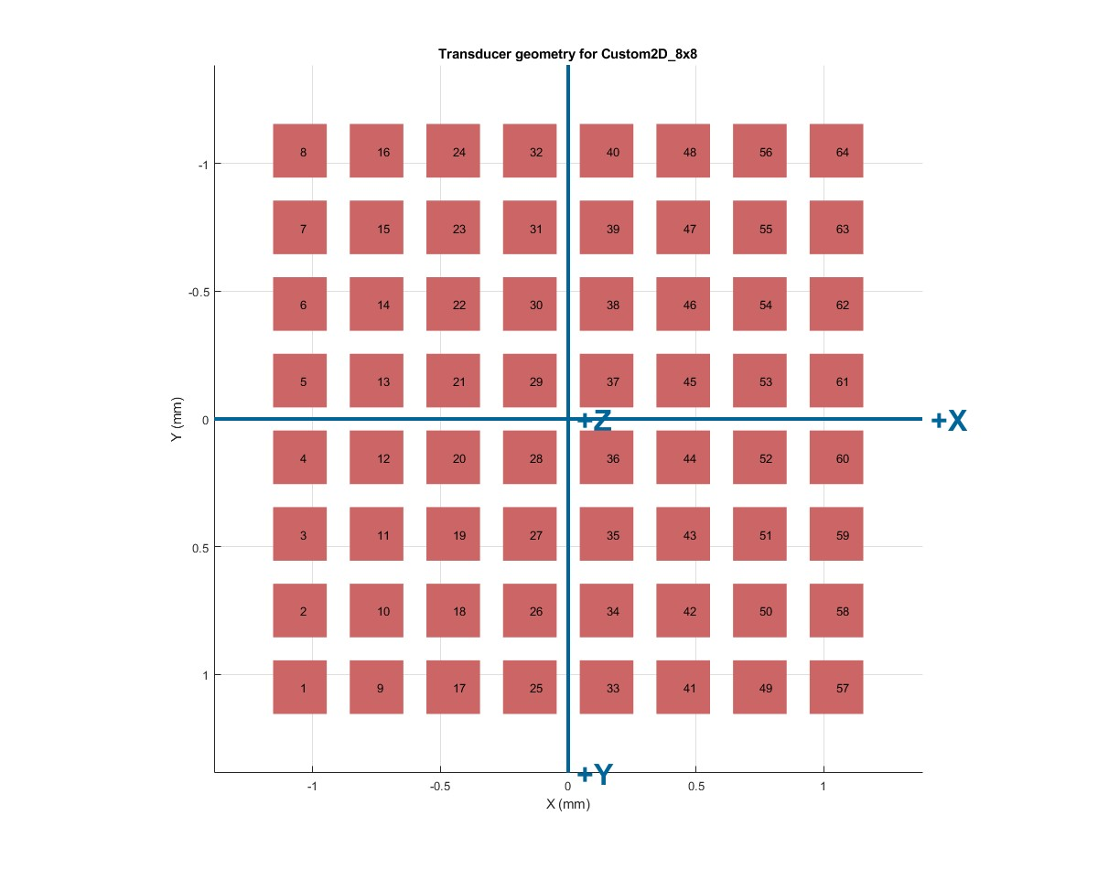
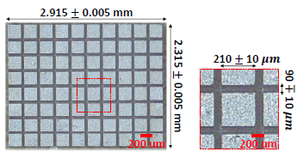
02. Setup
Transducer Geometry and Parameter:
Transducer : 8x8 elements (64total)
Center frequency : 3/7/11MHz
Pitch : 300 μm
Kerf (gap) : 90 ± 10 μm
Element width/height : 210 ± 10 μm
Speed of sound of soft tissue : 1540m/s
Element Mapping
Notes:
“This slide shows the baseline transducer configuration used in the simulations.”
We start with an 8×8 matrix array, giving 64 total elements.
The center frequencies evaluated are 3, 7, and 11 MHz.
The element pitch is fixed at 300 micrometers, with a kerf of approximately 90 micrometers and an element width of about 210 micrometers.
The speed of sound is set to 1540 m/s, assuming soft tissue. On the right, the element mapping shows the spatial layout of the array in the x–y plane.

Slide 4
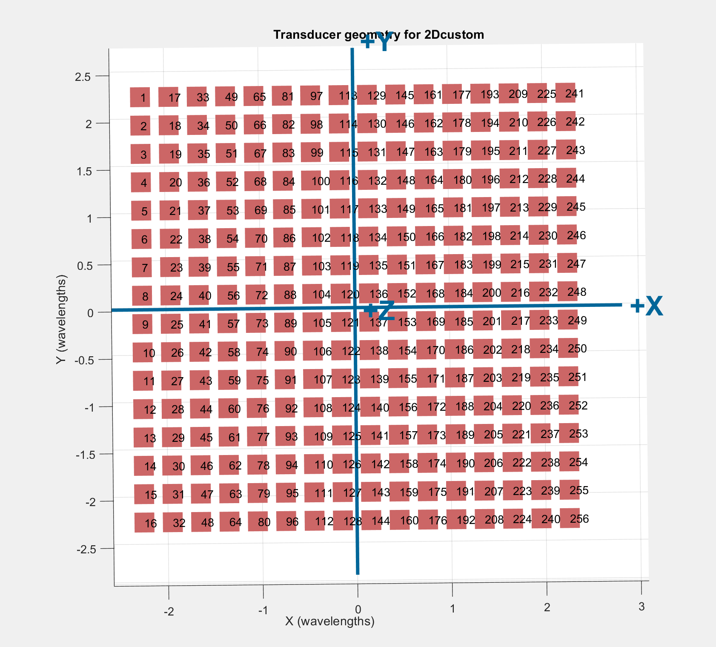
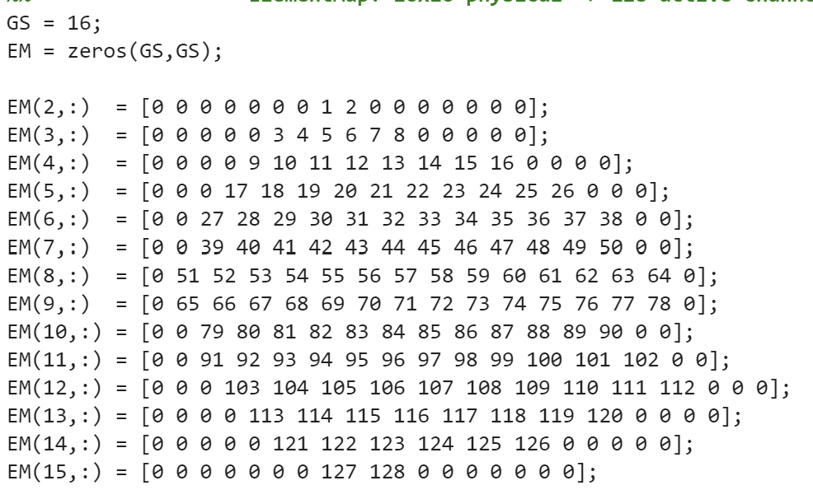
02. Setup
Transducer Geometry and Parameter:
Element Mapping
Transducer : 16x16 elements (256)
Center frequency : 3/7/11MHz
Pitch : 300 μm
Kerf (gap) : 90 ± 10 μm
Element width/height : 210 ± 10 μm
Speed of sound of soft tissue : 1540m/s
Notes:
“To study the effect of aperture size, we also simulate a larger 16×16 array.”
Here, the array size is increased to 16×16 elements, totaling 256 elements, while keeping the pitch fixed at 300 micrometers.
Due to system limitations, only 128 elements are actively used, and the remaining elements are set to zero or ground.
Even with partial activation, the effective physical aperture is larger than the 8×8 case.
This allows us to isolate the effect of aperture size independently from pitch.

Slide 5
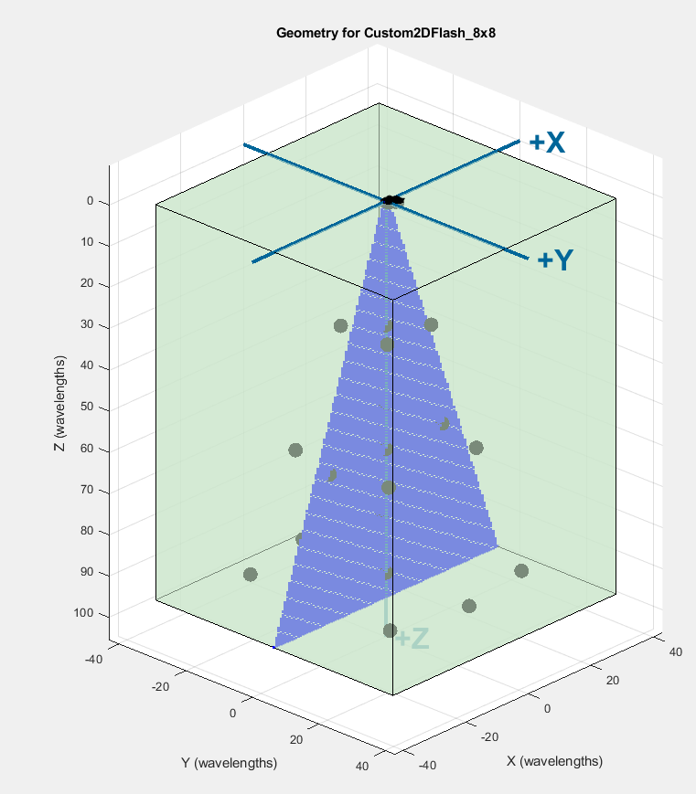
02. Setup
Imaging Parameter:
Depth = 96 wavelength
Num steering angles = 74 stepsize steering angles
FOV = -20, +20 degree
Imaging pixel region = cone
Medium: static scattered point along z-axis
Notes:
These are the imaging parameters used consistently across all simulations.”
The imaging depth is 96 wavelengths, and a plane-wave compounding scheme is used.
We use 74 steering angles, covering a field of view from −20 to +20 degrees.
The imaging region is a conical volume, and the medium contains static point scatterers along the z-axis.
These settings allow us to directly compare lateral resolution and point separability across different array designs.

Slide 6

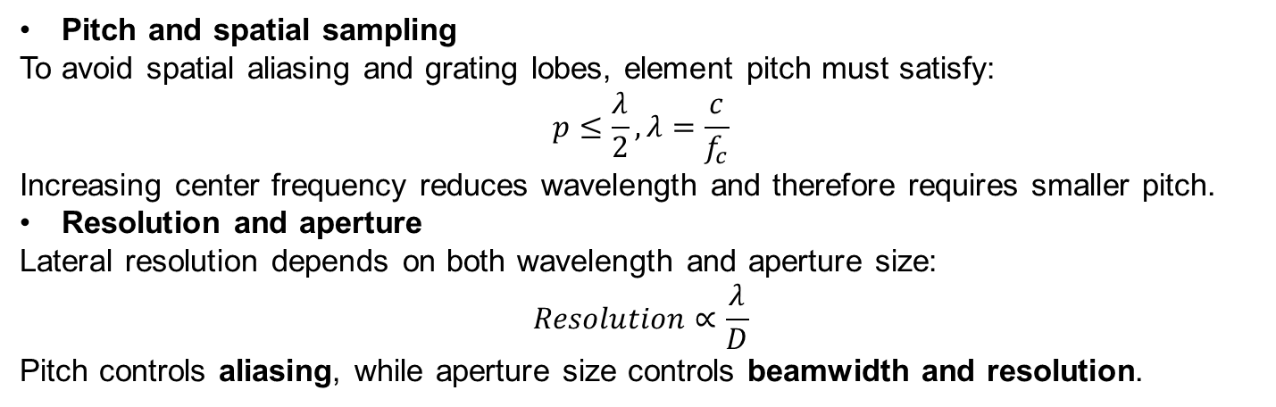
03. Background Theory
Szabo, T. L. (2014). Transducers. In Diagnostic Ultrasound Imaging: Inside Out (2nd ed., pp. 121–165). Academic Press. https://doi.org/10.1016/B978-0-12-396487-8.00005-7
Pitch and spatial sampling
To avoid spatial aliasing and grating lobes, element pitch must satisfy:
$$p≤\frac{λ}{2},λ=\frac{c}{f_{c}}$$
Increasing center frequency reduces wavelength and therefore requires smaller pitch.
Resolution and aperture
Lateral resolution depends on both wavelength and aperture size:
$$Resolution∝\frac{λ}{D}$$
Pitch controls aliasing, while aperture size controls beamwidth and resolution.
Notes:
Now I will briefly review the theory needed to interpret the results.”
To avoid spatial aliasing and grating lobes, the element pitch must satisfy the spatial Nyquist criterion:
$$p≤\frac{λ}{2}, λ=\frac{c}{f_{c}}$$
As the center frequency increases, the wavelength decreases, which requires a smaller pitch to avoid aliasing.
However, pitch and aperture play different roles:
Pitch controls spatial sampling and aliasing
Aperture size controls beamwidth and lateral resolution
Lateral resolution scales as:
$$\text{Resolution}∝\frac{λ}{D}$$
where D is the physical aperture size.
This distinction is critical for understanding the simulation results.

Slide 7
03. Background Theory
Observed behavior
Reducing pitch to satisfy the Nyquist criterion did not improve image quality.
Instead, point targets appeared merged and images became a blurrier.
Physical explanation
For a fixed number of elements:
Smaller pitch → smaller physical aperture
Smaller aperture increases beamwidth
D=N×p
Notes:
“Here is the key observation from the simulations.”
When the pitch is reduced to satisfy the Nyquist condition, image quality does not necessarily improve.
Instead, point targets appear merged, and the image becomes blurrier.
Why does this happen?
For a fixed number of elements:
Smaller pitch → smaller physical aperture
Smaller aperture → larger beamwidth
Larger beamwidth → poorer lateral resolution
Although increasing frequency reduces wavelength, this is not enough to compensate for the loss in aperture size in a small array.
This is why the points appear merged in the scaled-pitch case.

Slide 8
Simulation Design Cases
Case 1: Fixed pitch, varying center frequency
→ Large aperture preserved → resolution improves
Case 2: Scaled pitch with center frequency
→ Aperture shrinks → beam broadening and point merging
Case 3 : Scaled array size
→ Aperture increases → narrower beam / better lateral resolution (but grating lobes may still exist at high fc if pitch > λ/2)
Notes:
“Based on this, we define three simulation cases.”
Case 1: Fixed pitch, varying center frequency
Aperture is preserved
Wavelength decreases with frequency
Lateral resolution improves
Case 2: Pitch scaled with center frequency
Nyquist condition is satisfied
Physical aperture shrinks
Beam broadens and point targets merge
Case 3: Scaled array size
Aperture increases
Beam narrows and lateral resolution improves
Grating lobes may still exist if pitch > λ/2 at high frequency
This framework explains all observed results consistently.

Slide 9
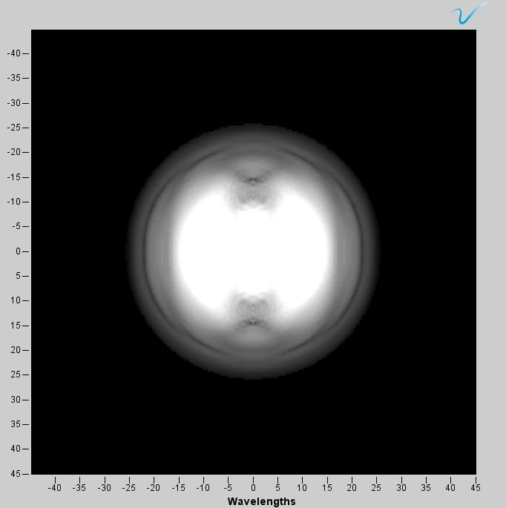
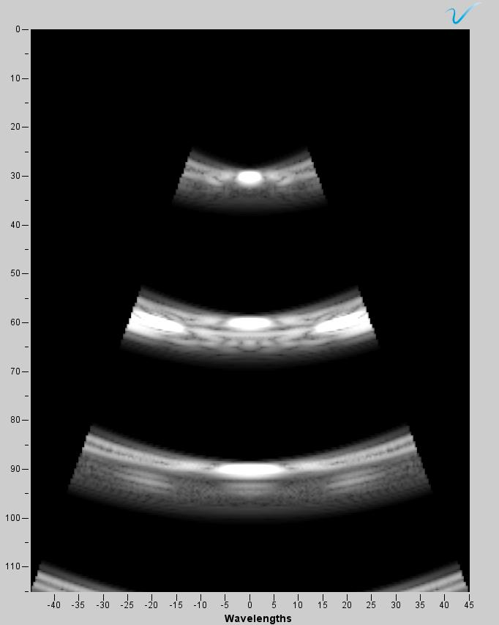
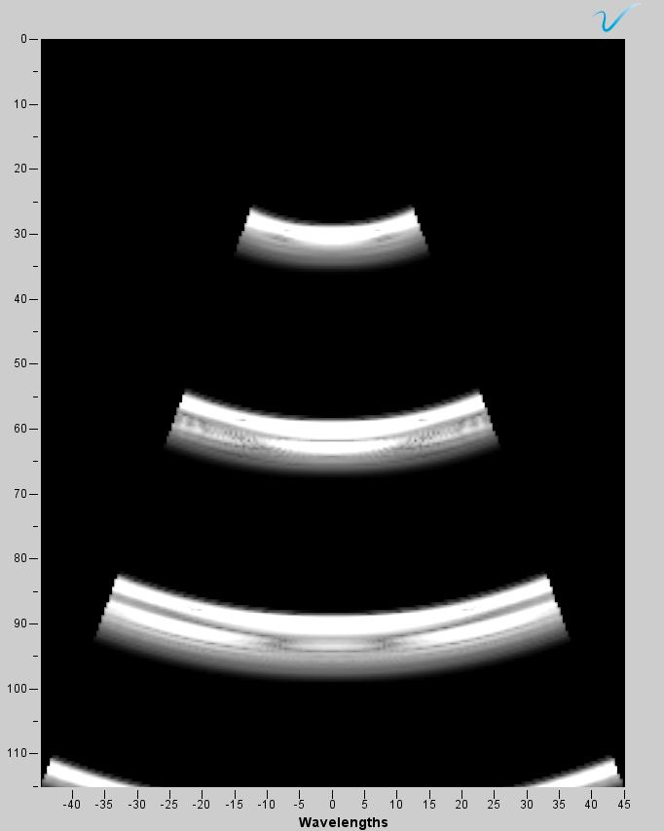
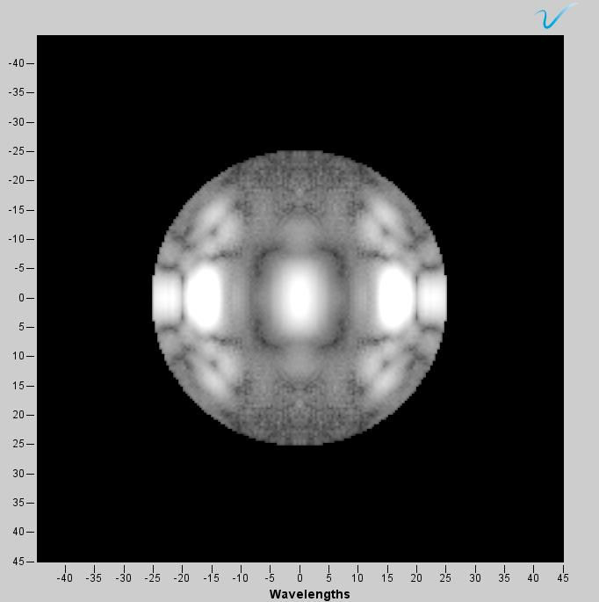
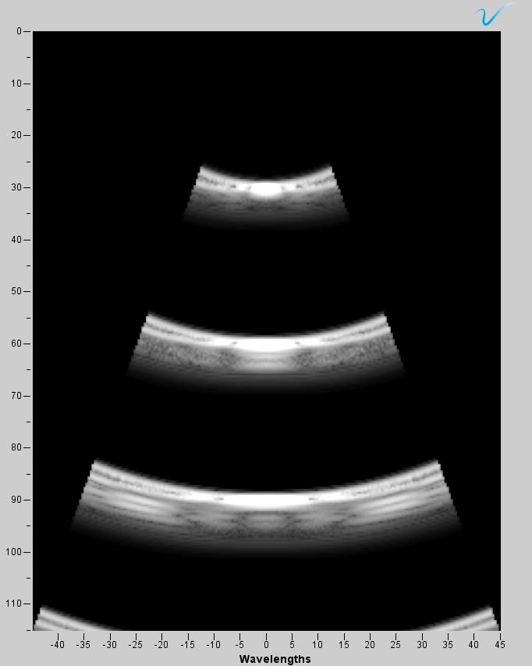
03. Simulation – Result
Case 1 = fixed pitch: 0.30mm
xy-plane
xz-plane
yz-plane
Center frequency = 3MHz
xy-plane
xz-plane
yz-plane
Center frequency = 7MHz
Notes:
“Now I will connect the theory to the results.”
Here I show the simulation results for Case 1, where the element pitch is fixed at 0.30 mm and only the center frequency changes.
At 3 MHz, the wavelength is relatively long. As a result, the beam is wide and poorly focused. This can be clearly seen in all three planes, where the structures appear blurred and point targets are not well separated.
When the frequency increases to 7 MHz, the wavelength becomes shorter while the physical aperture remains unchanged. This leads to a narrower beam, improved focusing, and better point visibility.
This behavior directly follows the resolution relationship
$\text{Resolution}∝λ/D$, where decreasing wavelength improves resolution if the aperture is preserved.

Slide 10
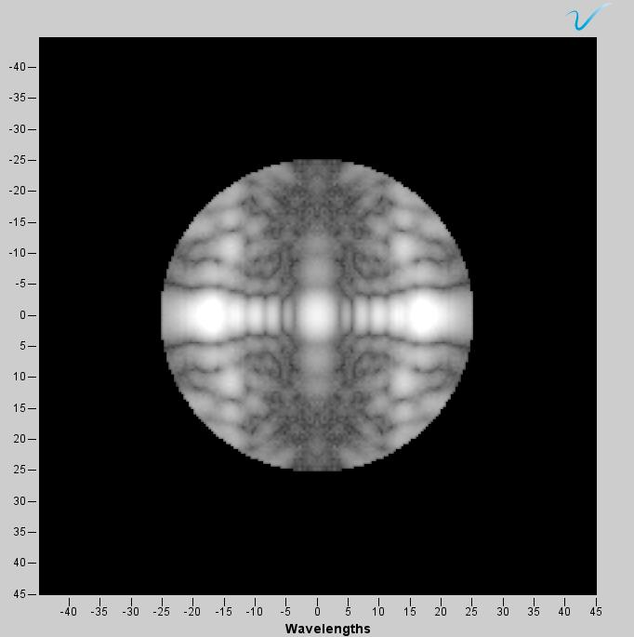
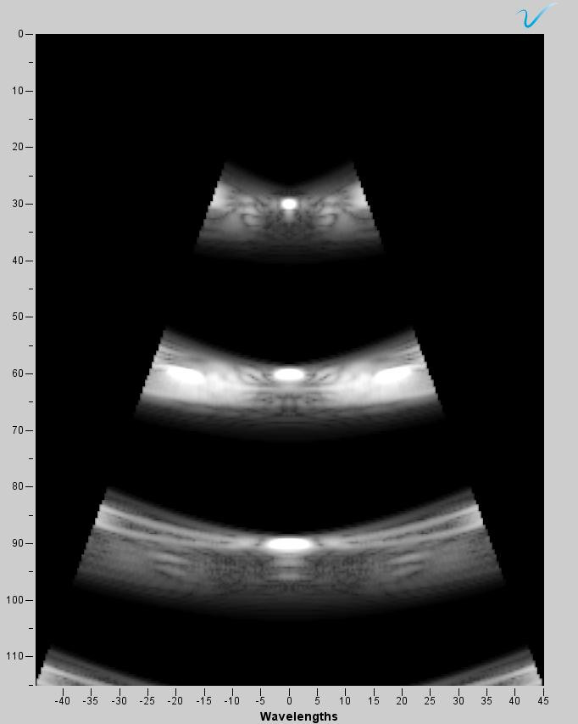
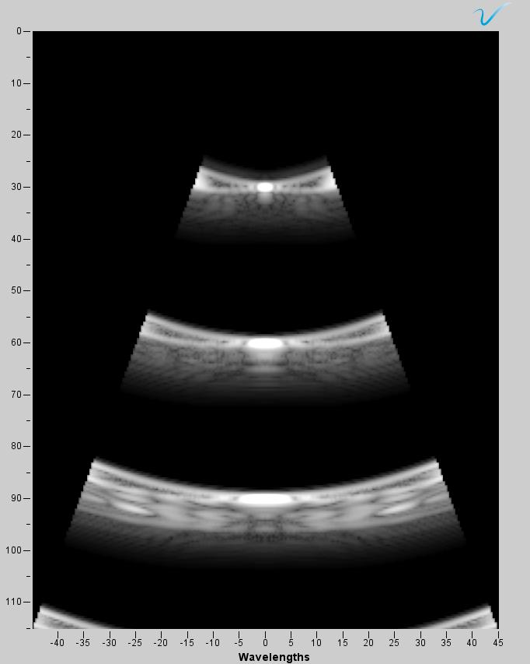
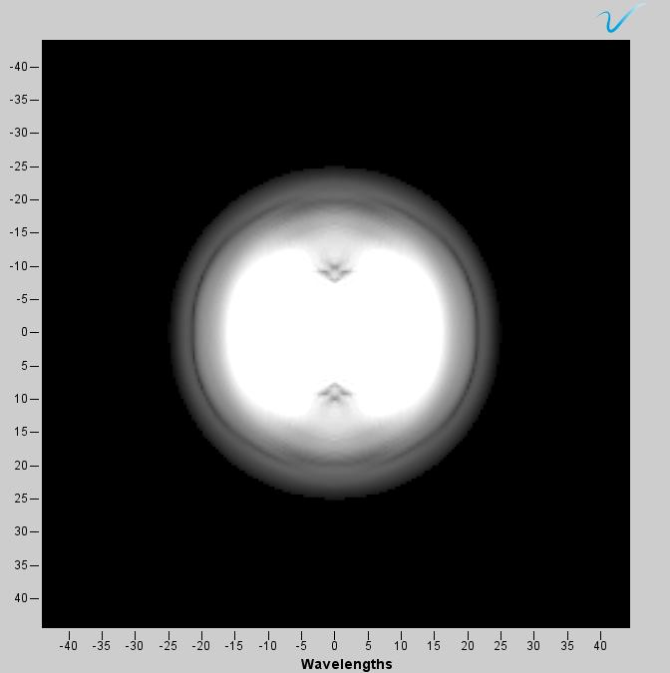
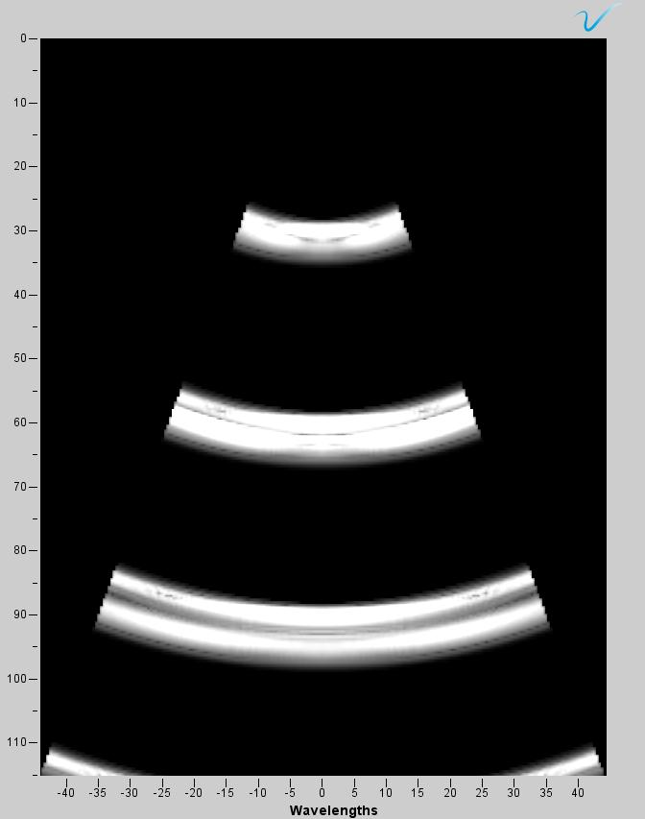
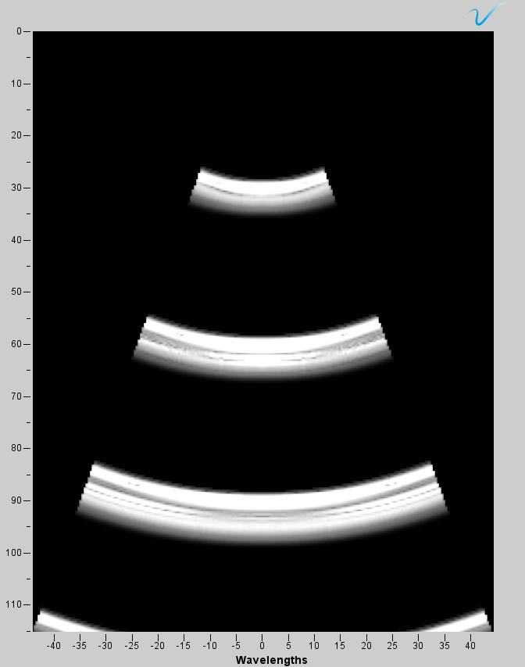
03. Simulation – Result
Case 1 = fixed pitch: 0.30mm
xy-plane
xz-plane
yz-plane
Center frequency = 11MHz
Case 2 = scaling the pitch size: 0.07mm at 11MHz
Center frequency = 11MHz
Notes:
In this slide, the same fixed pitch of 0.30 mm is used, but the frequency is further increased to 11 MHz.
Because the aperture size is still large and the wavelength is now much shorter, the beam becomes even more tightly focused.
As a result, point targets are clearly resolved, and the main lobe is visibly narrower in the xz- and yz-planes.
This case demonstrates that high frequency combined with a large aperture produces the best lateral resolution, even though the pitch does not strictly satisfy the Nyquist criterion.
Case 2, where the pitch is scaled according to the Nyquist criterion and reduced to 0.07 mm at 11 MHz, while keeping the array size fixed at 8×8.
Although this configuration satisfies spatial sampling requirements and suppresses grating lobes, it causes the physical aperture to shrink significantly.
Because beamwidth depends on the ratio $λ/D$, the reduction in aperture dominates over the wavelength advantage.
As a result, the beam becomes wider and point targets appear merged and blurred, despite using a higher frequency.
This confirms that Nyquist-compliant pitch alone does not guarantee improved resolution if the aperture becomes too small.

Slide 11
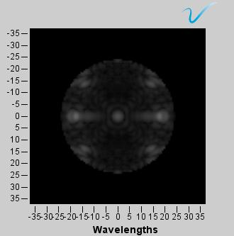
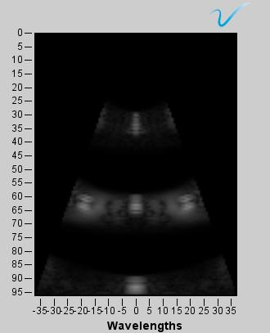
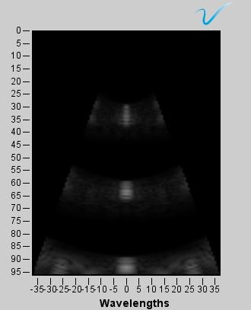
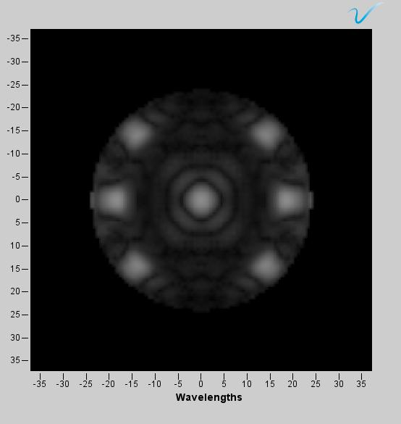
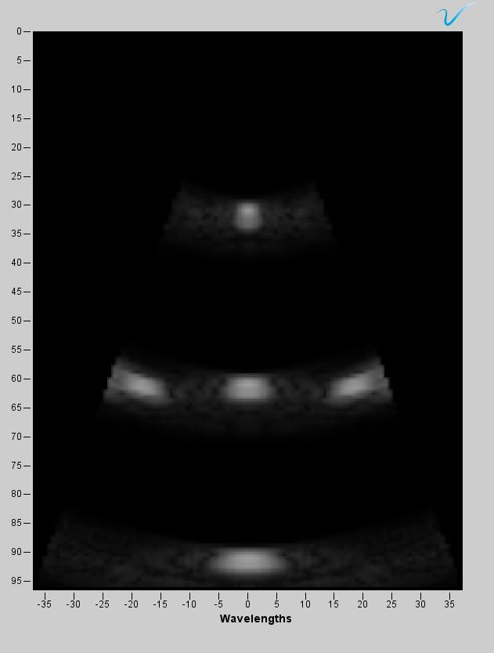
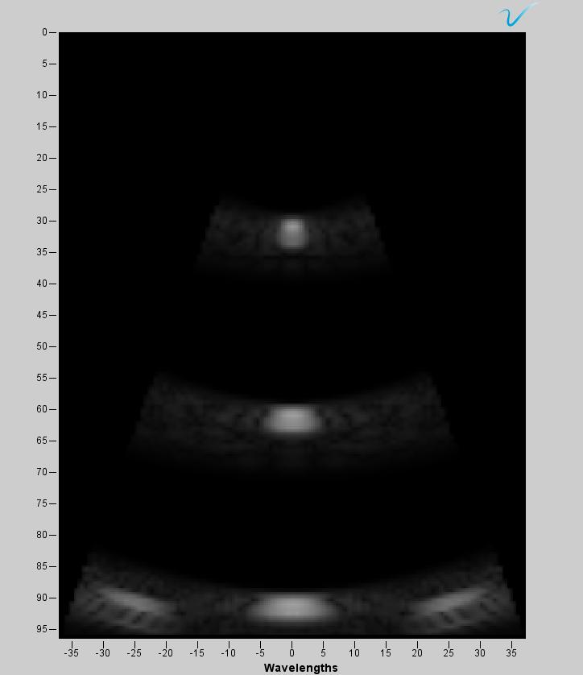
03. Simulation – Result
Case 3 = scaling the array size to 16x16 – fixed pitch: 0.30mm
Center frequency = 11MHz, pitch size = 0.30 mm
Center frequency = 7MHz, pitch size = 0.30 mm
Notes:
In Case 3, the array size is increased from 8×8 to 16×16, while keeping the pitch fixed at 0.30 mm.
This change increases the physical aperture, allowing the array to collect and focus energy over a larger area.
The images show noticeably improved beam focusing and better point separation compared to the 8×8 array.
This confirms that increasing the number of elements is an effective way to improve lateral resolution, even without changing the pitch.

Slide 12
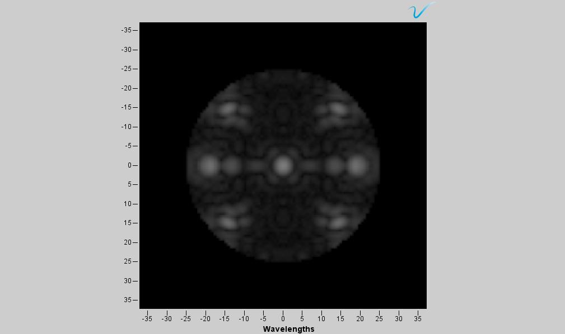
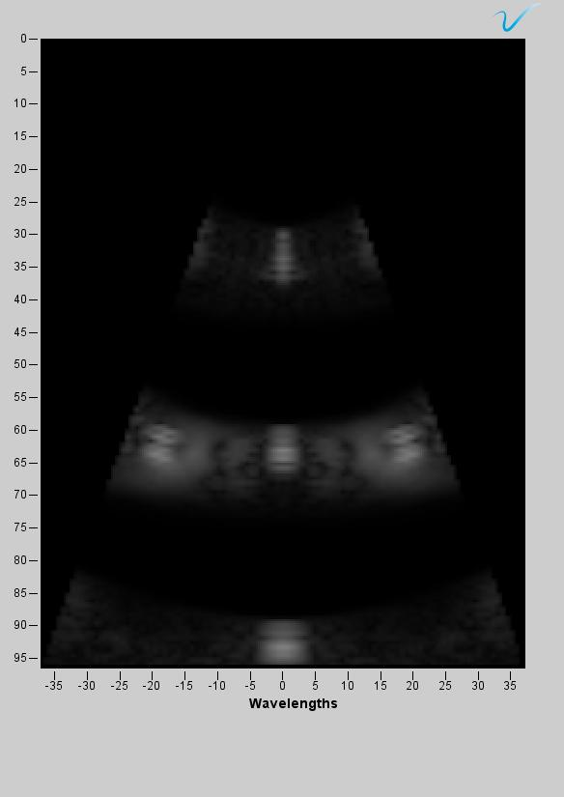
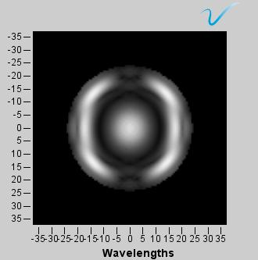
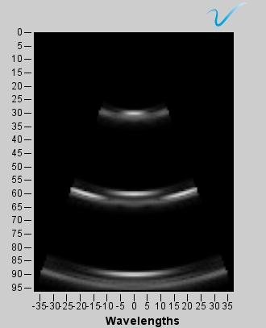
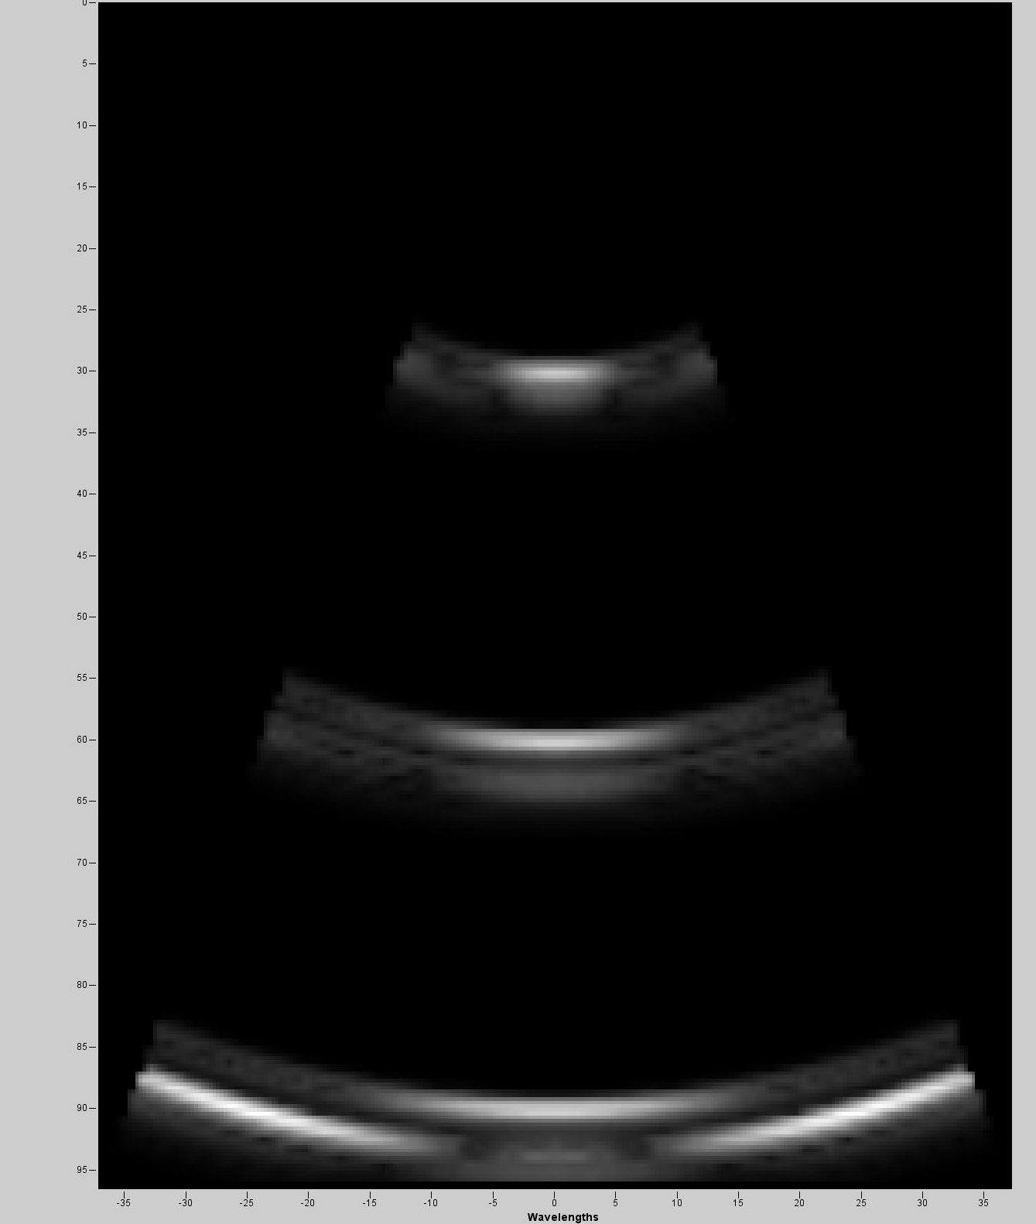
03. Simulation – Result
Case 3 = scaling the array size to 16x16 and pitch size
Center frequency = 11MHz, pitch size = 0.07mm
Center frequency = 11MHz, pitch size = 0.11mm
Notes:
Finally, this slide shows the combined effect of increasing the array size to 16×16 while also reducing the pitch.
In this case, both Nyquist sampling and large aperture conditions are better satisfied.
The result is improved point separation, reduced grating lobes, and more balanced beam profiles across all planes.
This configuration best reflects the ideal design principle for 2-D arrays, where spatial sampling and aperture size are optimized simultaneously.

Slide 13
04. Next plan
Finishing DL-model beamforming
Simulate 8x8, 16x16 and 32x32 with fixed geometry → for comparison

Slide 14

감사합니다
Thank you

