Slide 1
Lab-Meeting
2025/12/30
Deoliana Matilde

Slide 2
01 Today’s discussion
Simulation on fixed pitch(previous given geometry) but varying the center frequency
Scaling pitch with frequency
Simulate 16x16 array

Slide 3
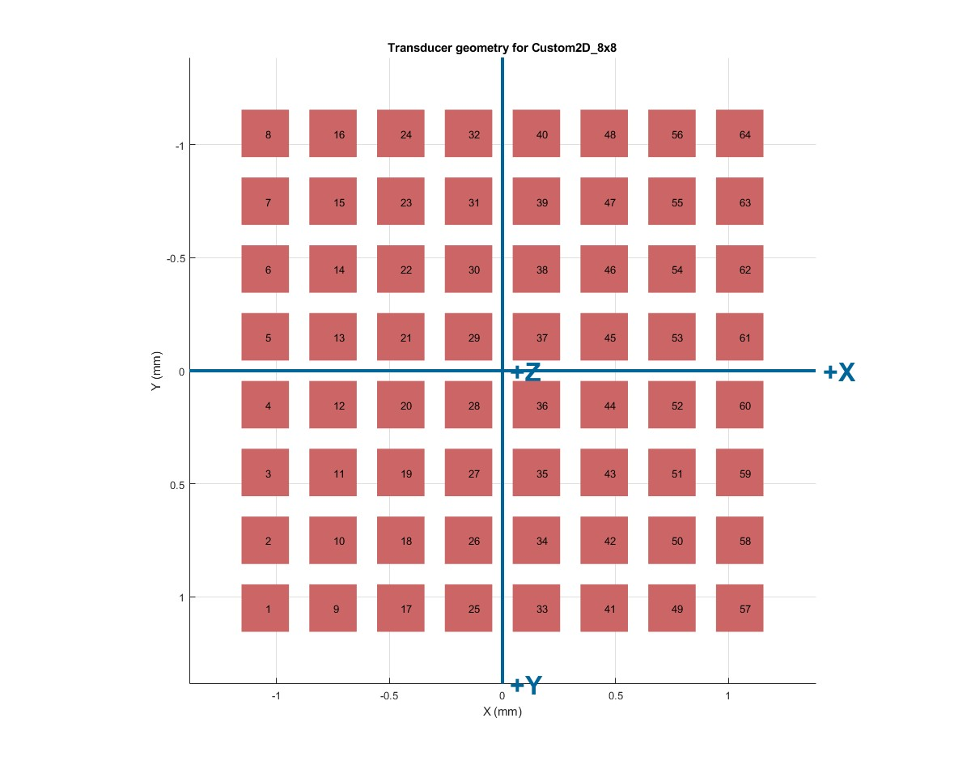
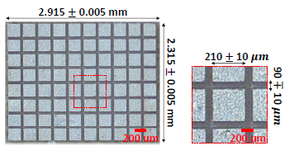
02. Setup
Transducer Geometry and Parameter:
Transducer : 8x8 elements (64total)
Center frequency : 3/7/11MHz
Pitch : 300 μm
Kerf (gap) : 90 ± 10 μm
Element width/height : 210 ± 10 μm
Speed of sound of soft tissue : 1540m/s
Element Mapping

Slide 4
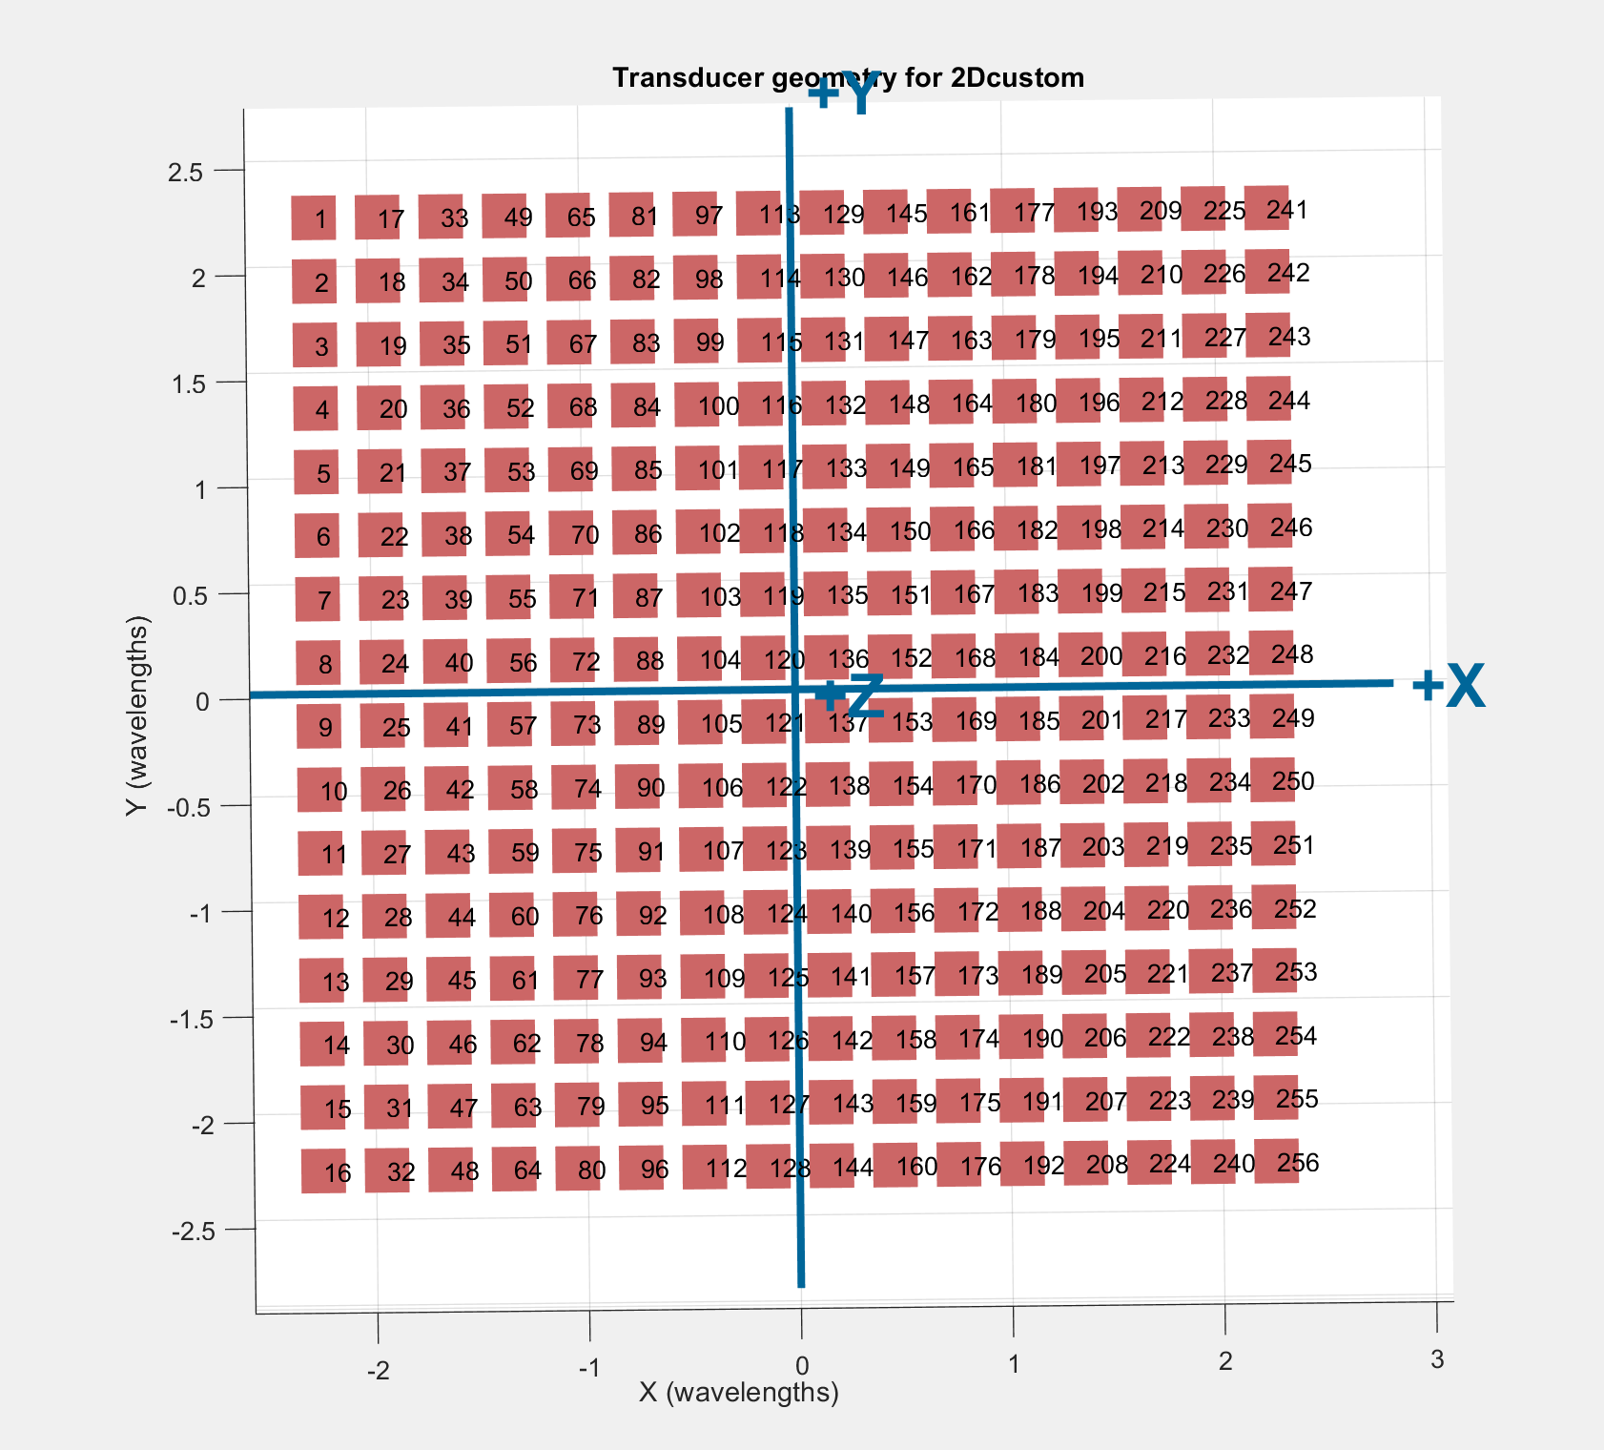
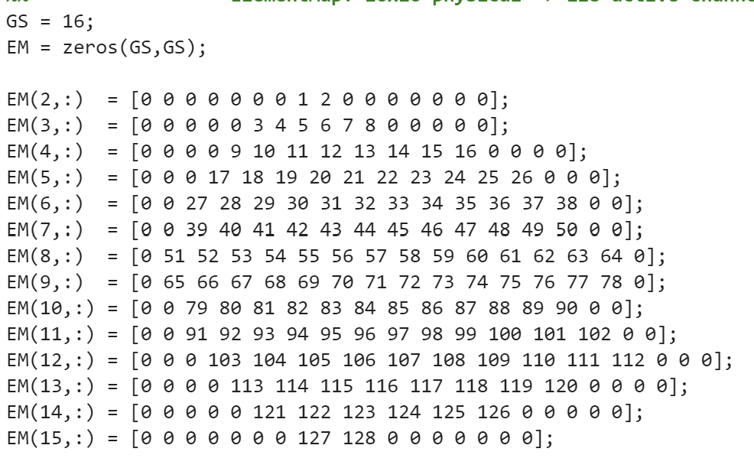
02. Setup
Transducer Geometry and Parameter:
Element Mapping
Transducer : 16x16 elements (256)
Center frequency : 3/7/11MHz
Pitch : 300 μm
Kerf (gap) : 90 ± 10 μm
Element width/height : 210 ± 10 μm
Speed of sound of soft tissue : 1540m/s

Slide 5
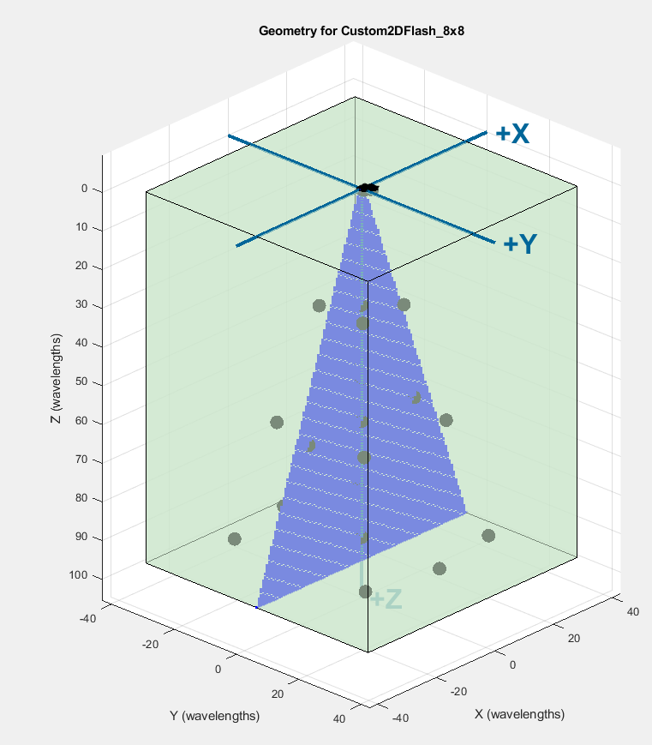
02. Setup
Imaging Parameter:
Depth = 96 wavelength
Num steering angles = 74 stepsize steering angles
FOV = -20, +20 degree
Imaging pixel region = cone
Medium: static scattered point along z-axis

Slide 6
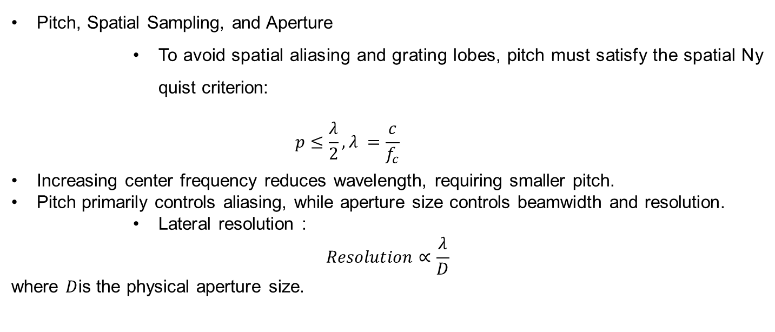
03. Background Theory
Pitch, Spatial Sampling, and Aperture
To avoid spatial aliasing and grating lobes, pitch must satisfy the spatial Nyquist criterion:
$$p≤\frac{λ}{2},λ =\frac{c}{f_{c}}$$
Increasing center frequency reduces wavelength, requiring smaller pitch.
Pitch primarily controls aliasing, while aperture size controls beamwidth and resolution.
Lateral resolution :
$$Resolution∝\frac{λ}{D}$$
where $D$is the physical aperture size.

Slide 7
03. Background Theory
Problems
Reducing pitch to satisfy Nyquist did not improve image quality; images appeared coarser. For a fixed array size (e.g., 8×8):
Smaller pitch → smaller aperture
Smaller aperture → wider main lobe
Wider beam → reduced lateral resolution
Simulation Design Cases
Case 1: Fixed pitch, varying center frequency
Case 2: Scaled pitch with center frequency

Slide 8
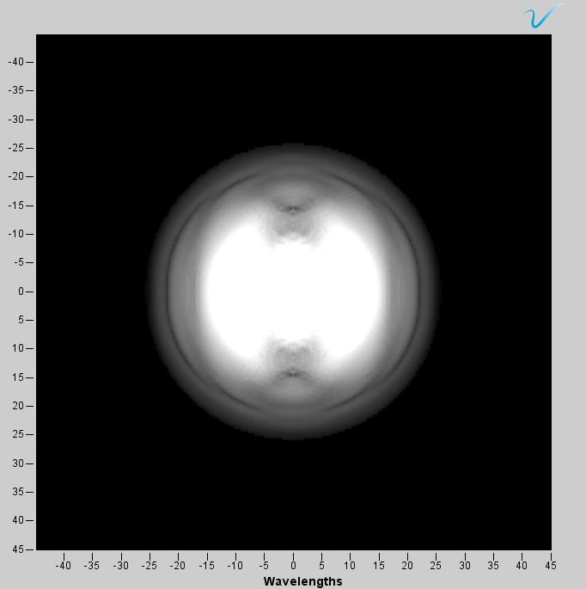
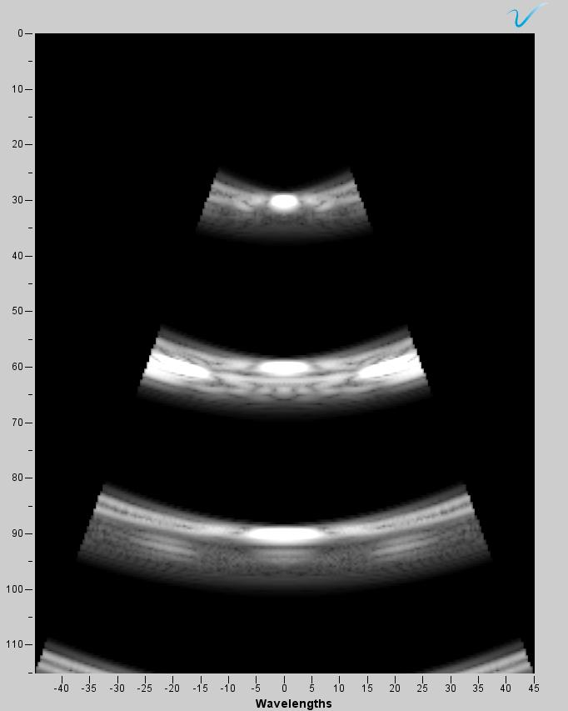
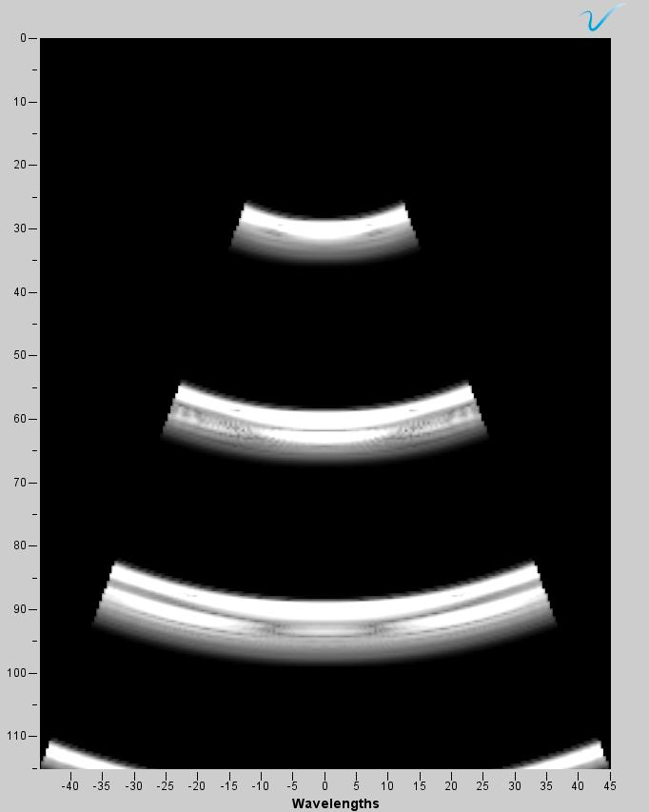
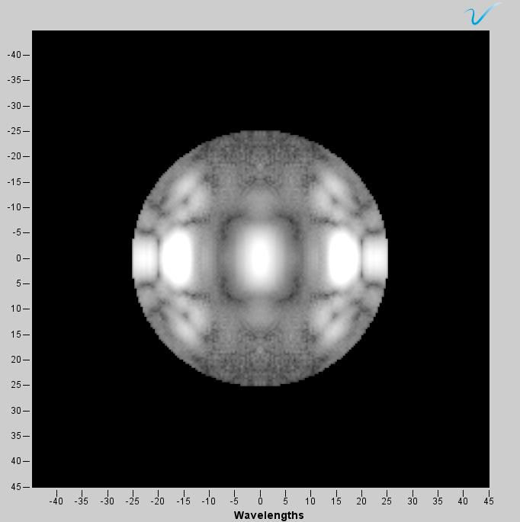
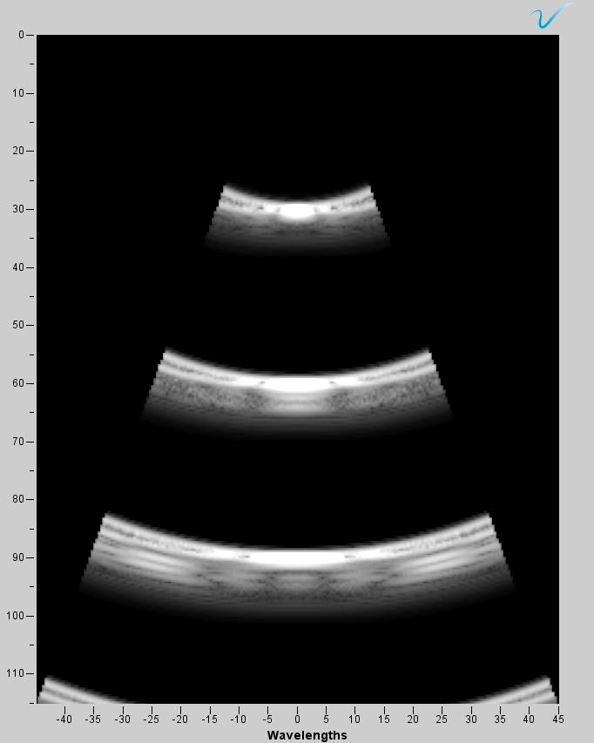
03. Simulation – Result
Case 1 = fixed pitch: 0.30mm
xy-plane
xz-plane
yz-plane
Center frequency = 3MHz
xy-plane
xz-plane
yz-plane
Center frequency = 7MHz

Slide 9
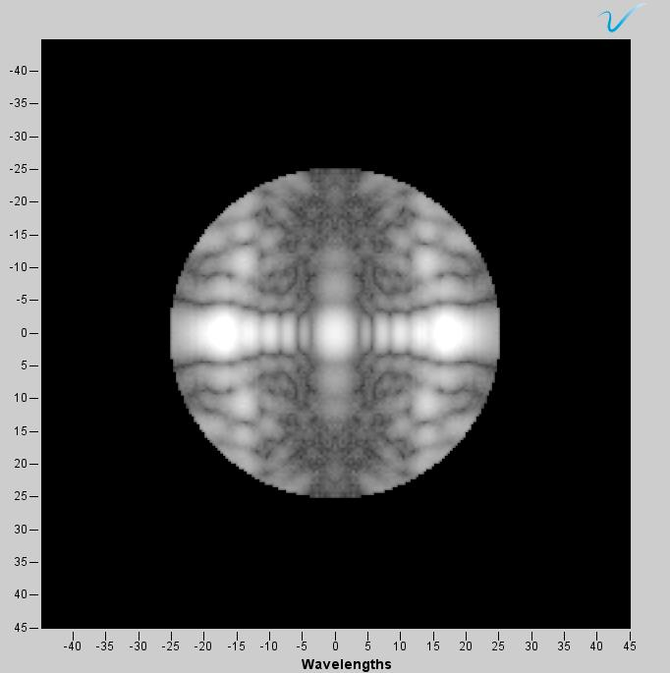
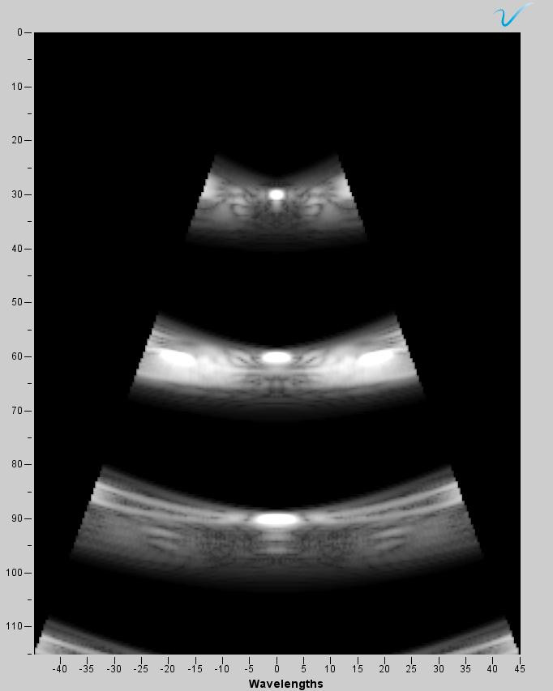
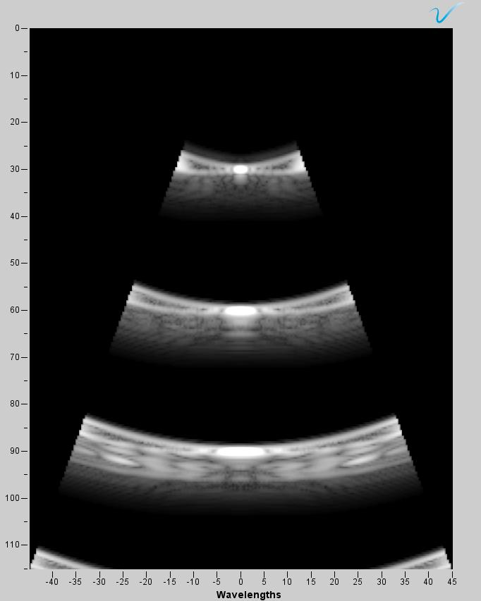
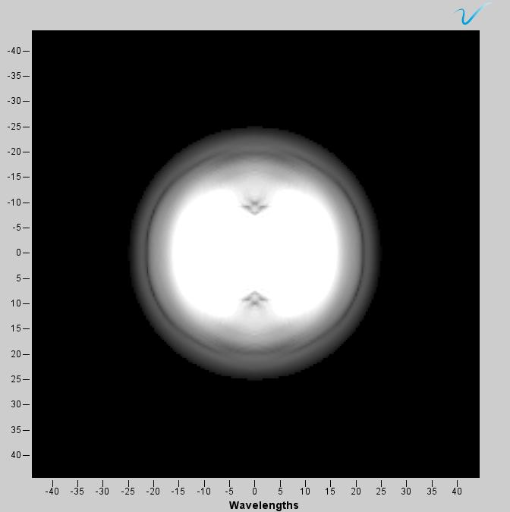
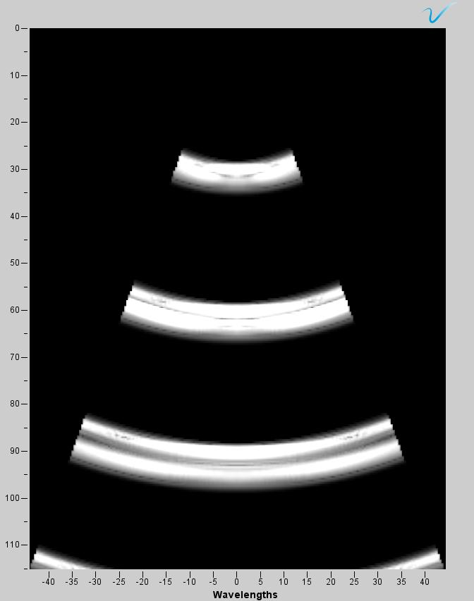
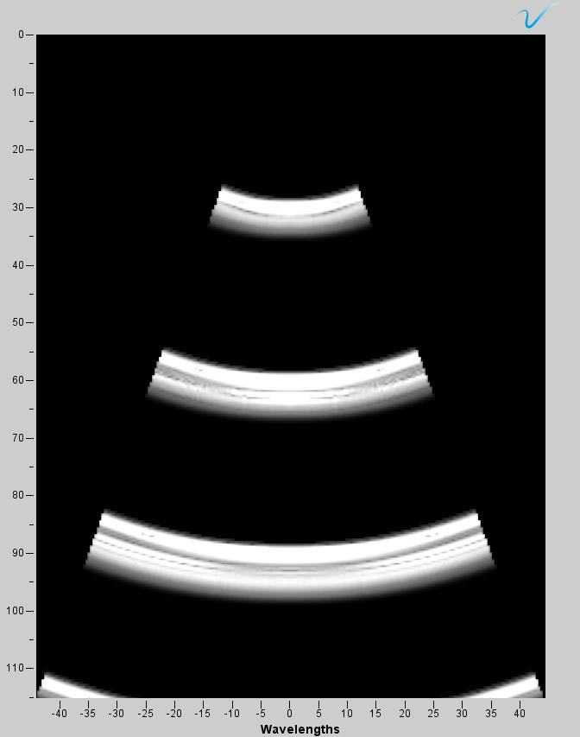
03. Simulation – Result
Case 1 = fixed pitch: 0.30mm
xy-plane
xz-plane
yz-plane
Center frequency = 11MHz
Case 2 = scaling the pitch size: 0.07mm at 11MHz
Center frequency = 11MHz

Slide 10
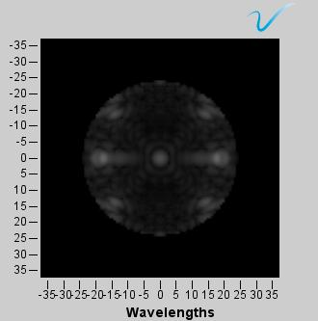
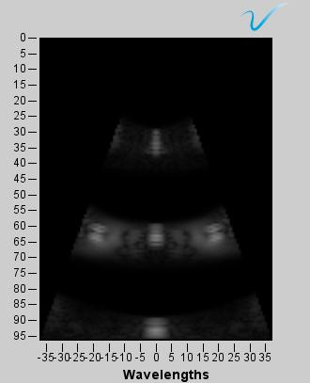
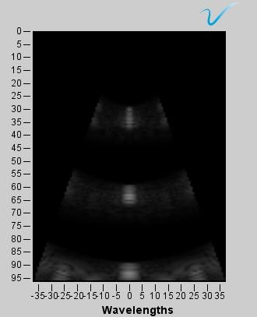
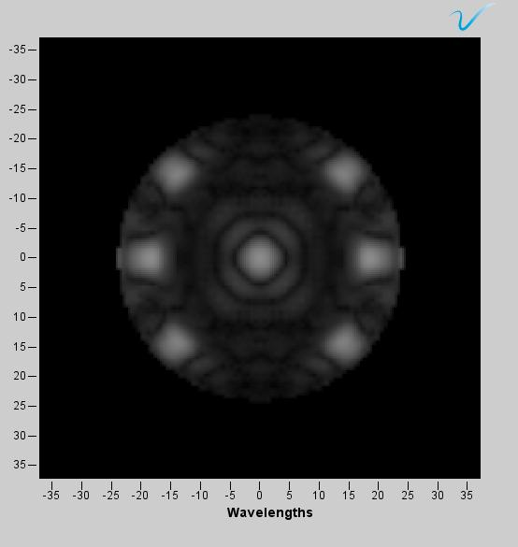
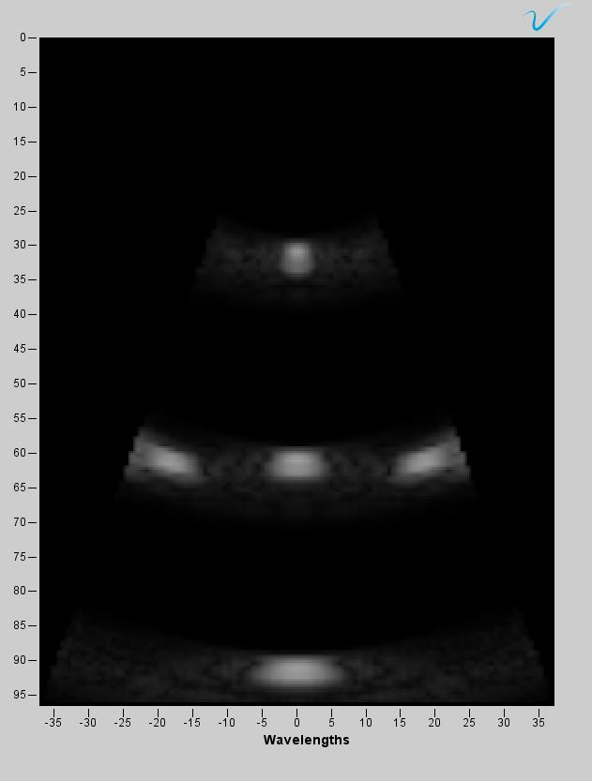
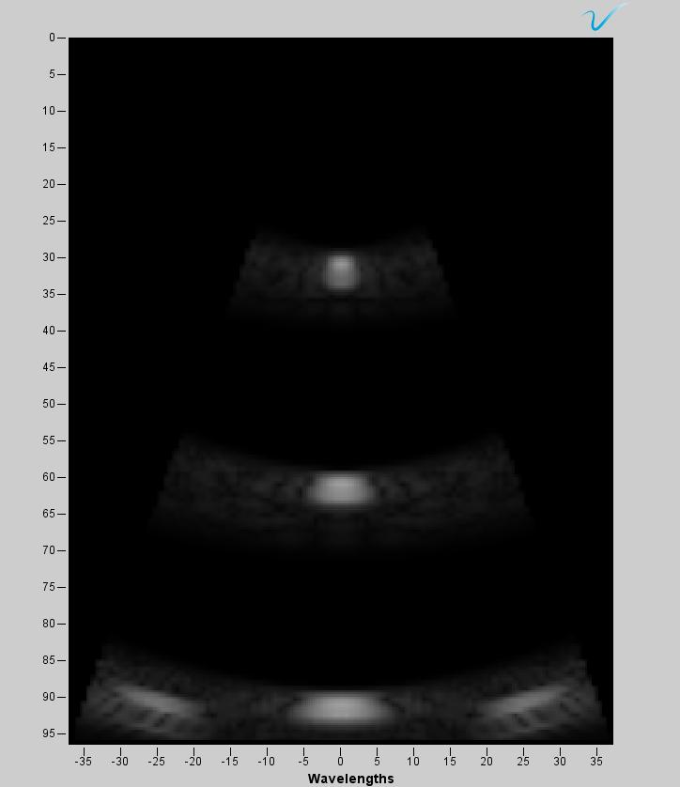
03. Simulation – Result
Case 1 = scaling the array size to 16x16 – fixed pitch
Center frequency = 11MHz, pitch size = 0.30 mm
Center frequency = 7MHz, pitch size = 0.30 mm

Slide 11
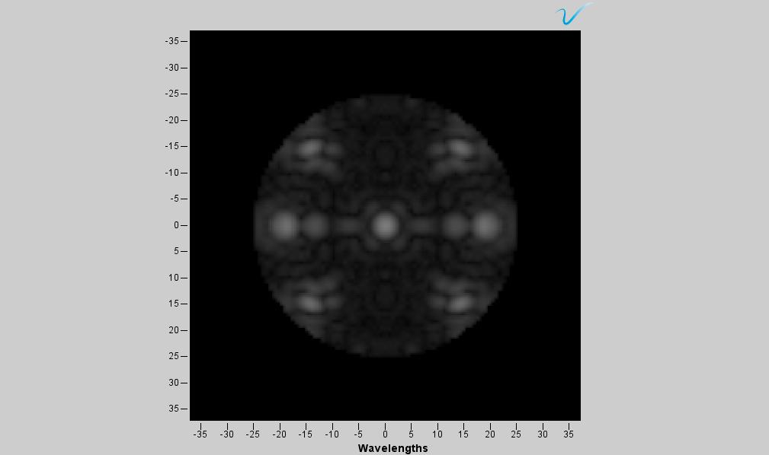
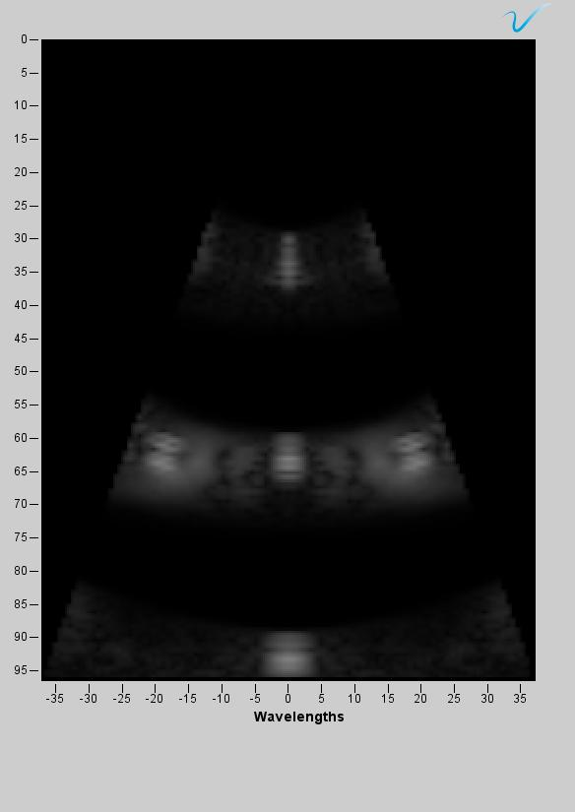
03. Simulation – Result
Case 2 = scaling the array size to 16x16 and pitch size
Center frequency = 11MHz, pitch size = 0.07mm

Slide 12
04. Next plan
Finishing DL-model beamforming
Simulate 8x8, 16x16 and 32x32 with fixed geometry → for comparison

Slide 13

감사합니다
Thank you

