Slide 1
Energy Management for Parallel Mild Hybrid Electric Vehicle
Seminar Electromobility SS 2019
Electromobility Research Group
Manal Sheth (411833)
Shweta Kulkarni (411840)
Pankaj Deoli (410704)
University of Kaiserslautern

Slide 2
Index
Definitions
Model Vehicle
Driving Cycles
Control Parameters
Operation Modes
Control Strategies
Control Algorithm
Results and Discussion

Slide 3
Definitions
Hybrid Vehicle: Hybrid Vehicle (HV) means a vehicle with atleast two different energy converters and two different energy storage systems (on vehicle) for the purpose of vehicle propulsion.
Hybrid Electric Vehicle: A vehicle that, for the purpose of mechanical propulsion draws energy from both of the following on-vehicle sources of stored energy/power
A Combustion fuel
Electrical energy/power storage device

Slide 4
Hybrid Architectures: Hybrid electric vehicle can be classified in three types on the basis of architecture of propulsion drive,
Series-hybrid electric vehicle
Parallel-hybrid electric vehicle
Combined-hybrid electric vehicle
Degree of Hybridization: Degree of hybridization can be understood as the ratio between the power rating of the motor and the power rating of the IC-engine.
Micro-Hybrid
Mild-Hybrid
Full-Hybrid

Slide 5
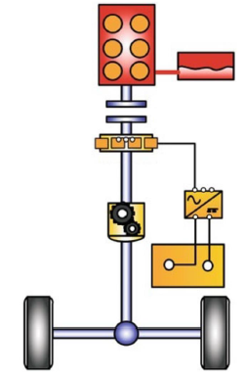
Model Vehicle
Parallel Mild Hybrid Configuration:
Mercedes-Benz A 170 CDI.
Quasi-static modelling approach for simulation.
Software used: MATLAB/Simulink.
Electric Motor is coupled with Gear-box.
Friction clutch is linked between motor and engine.
Vehicle | Mercedes-Benz A 170 CDI (W168, 1115 kg)
Engine | Diesel Engine (OM 622, 60 kW, 187 Nm, 4200 rpm, 1698 cm³)
Motor | Permanent magnet synchronous motor (12 kW, 60 Nm, 7639 rpm, rescaled)
Battery | Lithium-ion battery (16.38 kW, 0.468 kWh, 46.8 V, 13 mΩ)
Gear-box | Manual (5-speed)

Slide 6
MATLAB/Simulink Model

Slide 7
Driving Cycles
NEDC
New European Driving Cycle (NEDC)
Length (km) | 11 km
Duration (s) | 1180 s
Maximum Speed (km/h) | 120 km/hr
Average Speed (km/h) | 33.6 km/hr

Slide 8
Driving Cycles
FTP-75
Federal Test Procedure (FTP-75)
Length (km) | 17.77 km
Duration (s) | 1874 s
Maximum Speed (km/h) | 91.2 km/hr
Average Speed (km/h) | 34.1 km/hr

Slide 9
Control Parameters
Torque-split ratio: Torque split ratio, u = T_{EM} / T_{MGB}, which signifies the ratio, torque delivered by the motor (T_{EM}) to the overall torque requirement (T_{MGB}), where torque coupler constraint (T_{EM} + T_{CE} = T_{MGB}) must be regarded.
Where,
CE Combustion Engine
BT Battery
EM Electric Motor
TC Torque Coupler
MGB Mechanical Gear-box
V Vehicle
T_CE Torque of Combustion Engine
T_EM Torque of Electric Motor
T_MGB Overall torque requirement
T_CE
T_EM
CE
T_MGB
BT
EM
TC
MGB
V

Slide 10
Control Parameters
State_CE: It signifies the state of combustion engine. Vehicle configuration allows us with the provision to shut-off combustion engine, whenever required. This can be integrated in different operation modes.

Slide 11
Operation Modes
Regeneration of kinetic energy : A certain fraction of kinetic energy can be restored using electric motor, while applying brakes.
This can be helpful, as in conventional braking system (i.e. friction braking) kinetic energy is dissipated in form of heat.
Where,
CE Combustion Engine
BT Battery
EM Electric Motor
TC Torque Coupler
MGB Mechanical Gear-box
V Vehicle
T_CE Torque of Combustion Engine
T_EM Torque of Electric Motor
T_MGB Overall torque requirement
T_CE
T_EM
CE
T_MGB
BT
EM
TC
MGB
V

Slide 12
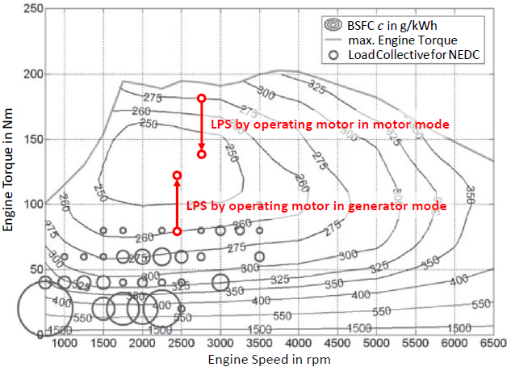
Operation Modes
Load point shifting: The efficiency of the IC-engine can be realized using two factors i.e. angular velocity and the torque of the engine.
The load of engine can be shifted by operating the electric component in either motor mode (load point decrease) or in generator mode (load point increase) to optimize the efficiency of the engine.
T_CE
T_EM
CE
T_MGB
BT
EM
TC
MGB
V

Slide 13
Operation Modes
Electric Driving: When the electric storage unit (usually electric batteries) consists of sufficient charge, then the vehicle can be driven in pure electric mode.
Where,
CE Combustion Engine
BT Battery
EM Electric Motor
TC Torque Coupler
MGB Mechanical Gear-box
V Vehicle
T_CE Torque of Combustion Engine
T_EM Torque of Electric Motor
T_MGB Overall torque requirement
T_CE
T_EM
CE
T_MGB
BT
EM
TC
MGB
V

Slide 14
Operation Modes
Operating Modes | Torque requirement | Power-split ratio, u | state of the engine, State_CE
Regeneration | < 0 | 0 <= u < 1 | off
Electric Driving | > 0 | 1 | off
Load point shifting (Motor mode) | > 0 | 0 <= u < 1 | on
Load point shifting (Generator mode) | > 0 | u < 0 | on
Combustion Driving | > 0 | 0 | on

Slide 15
Control Strategies
Predictive
Adaptive
Conventional
State Machine theory
Fuzzy Logic
Deterministic Approach
Rule-Based
Optimization-Based
Real-Time Optimization
Global Optimization
Linear Programming
Dynamic Programming
Stochastic D.P.
ECMS
Robust Control
Model Predictive Control

Slide 16
Control Strategies
Rule-Based Strategy:
The Rule Based approach is set up based on the following heuristics,
Below a certain minimum vehicle speed, only the electric motor is used.
If the demanded power is greater than maximum engine power at its operating speed, the motor is used to produce excess power.
The motor charges the battery by regenerative braking.
The engine shut off when the power demanded falls below a limit at the operating speed to prevent inefficient operation of the engine.
If the battery SOC is lower than its minimum allowable value, the engine should provide additional power to replenish the battery via the electric motor or generator.

Slide 17
Control Algorithm

Slide 18
Control Algorithm
Control algorithm for the supervisory control has been developed by exploring different execution combinations of these operation modes.
Based on the efficiency map of the combustion engine.
T_{MGB} vs ω_{MGB} (i.e. Torque of the mechanical gear box and angular velocity of the mechanical gear box).
Graph can be divided into multiple sections to optimise the efficiency of the vehicle propulsion system.

Slide 19
Results & Discussion
Complete Charge Sustainment:
Vehicle Type | Driving Cycle | Equivalent Fuel Consumption (litres/100 kms) | Charge at the end of driving cycle (*10^4) | Average fuel consumption
Conventional Vehicle | NEDC | 4.897 | - | 4.786
 | FTP-75 | 4.675 | -
Parallel Hybrid Mild Electric Vehicle | NEDC | 3.542 | 1.788 | 3.4065
 | FTP-75 | 3.271 | 1.786

Slide 20
Results & Discussion
Lowest Fuel Efficiency:
Vehicle Type | Driving Cycle | Equivalent Fuel Consumption (litres/100 kms) | Charge at the end of driving cycle (*10^4) | Average fuel consumption
Conventional Vehicle | NEDC | 4.897 | - | 4.786
 | FTP-75 | 4.675 | -
Parallel Hybrid Mild Electric Vehicle | NEDC | 3.542 | 1.788 | 3.4
 | FTP-75 | 3.258 | 1.091

Slide 21
Results & Discussion
NEDC

Slide 22
Results & Discussion
FTP-75

Slide 23
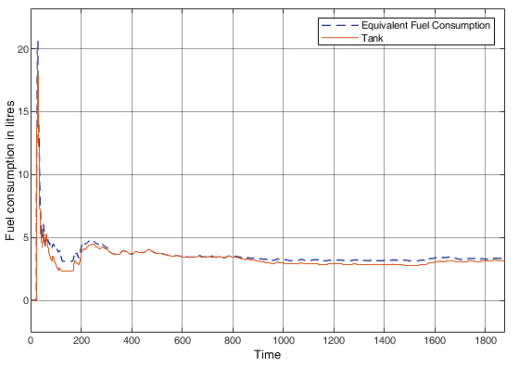
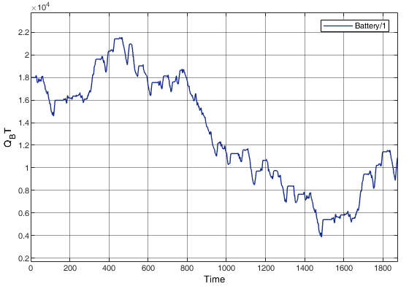
Results & Discussion
FTP-75

Slide 24
Results & Discussion
Efficiency improvement in Percentage:

Slide 25
Results & Discussion
Efficiency improvement in Percentage:

Slide 26
Thank You!!!

