Slide 1

Statistics Final Project
By: Mercedes Baveghems, Oliver Chalcraft, Ronald Dupuis, Christianna Hawkins, Oleksandra Holubenko, Deondra Johnson, Ethan Khan, Juliana Martinez Calvillo, Alexa Rump

Slide 2
Abstract
Purpose: The purpose of our study at VCentials was to act as a continuation of Professor Chriswell’s Spring ‘25 class’s data and study. We still had the same goal of understanding why people left VCentials empty handed, but we wanted to specifically see if the improvements that were suggested in the conclusion of the original study were put into effect and how that impacted the amount of people leaving without anything.
Method: Replication of Spring ‘25 process by collecting data through an observational study and having a questionnaire available for those who left VCentials without anything.
Conclusion: Increase in amount of people leaving VCentials without any items.
*However the enrollment size of spring is significantly less than that of the fall semester.

Slide 3
Introduction
Background: VCentials provides free food and hygiene products to students and staff/faculty. A survey over the course of five weeks was done during the 2025 Spring semester to see why people were leaving VCentials without taking anything.
Problem: This is a follow up study to see how changes made at VCentials have impacted the amount of people who leave VCentials without anything.
Research Questions: Why do people leave VCentials without anything and how does the data collected from the 2025 fall semester compare to data collected from the 2025 spring semester?

Slide 4
Methodology
Our survey was conducted over a five-week period. Each team member was assigned a one-hour slot during VCentials’ operating hours to administer the survey to students and faculty who had not previously checked out an item.
The survey consisted of a few open response questions accessed by scanning a QR code on your phone. This survey was optional and people could always opt out of it.
After this 5 week period we compiled all of the results and were then pasted into Excel Sheets to compare the outcomes from the past Spring Semester to the current Fall Semester.

Slide 5
Ratio Comparison
Amount of people who entered VCentials week-by-week
Spring ‘25
Fall ‘25
1 | 882
2 | 904
3 | 852
4 | 742
5 | 698
1 | 1043
2 | 1000
3 | 1055
4 | 1046
5 | 845

Slide 6
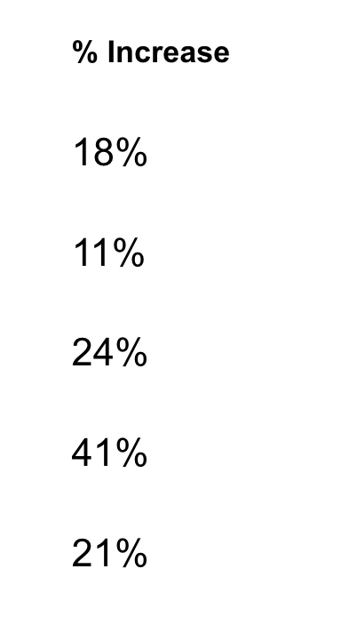
Ratio Comparison Analysis
Fall 2025 vs. Spring 2025 Ratio Comparison
The ratio comparison between Spring 2025 and Fall 2025 shows a consistent increase in the total number of people served across all five weeks. Fall numbers were higher each week, ranging from an 11% increase in Week 2 to a 41% increase in Week 4, which showed the largest jump. Overall, the data clearly indicates that VCentials served significantly more individuals during the Fall semester compared to the Spring semester.
Week | Amount of People Who were served Overall (Spring 2025) | Amount of People Who were served Overall (Fall 2025)
Week 1 | 882 | 1043
Week 2 | 904 | 1000
Week 3 | 852 | 1055
Week 4 | 742 | 1046
Week 5 | 698 | 845

Slide 7
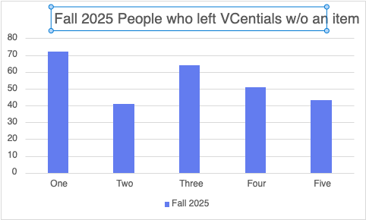
Fall 2025 Data

Slide 8
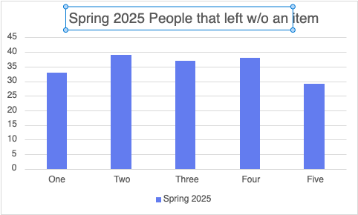
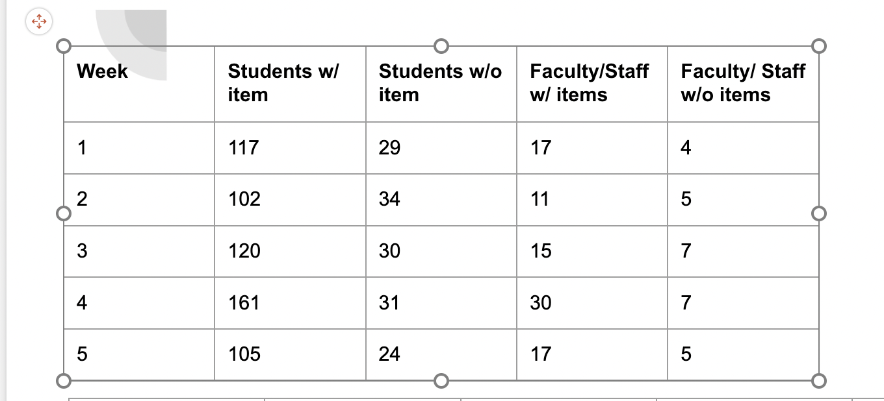
Spring 2025 Data

Slide 9
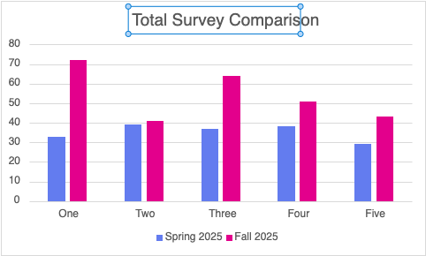
Comparison Raw Data between Spring 2025 and Fall 2025

Slide 10
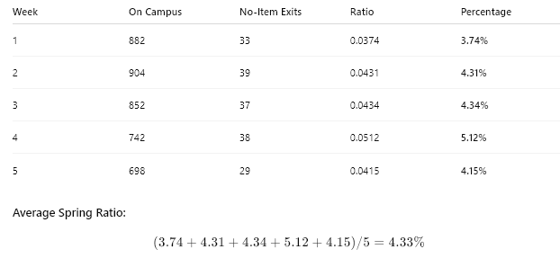
Ratio of people leaving w/o an item in Spring 2025

Slide 11
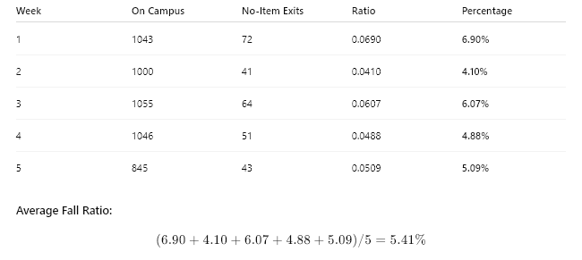
Ratio of people leaving w/o an item in Fall 2025

Slide 12
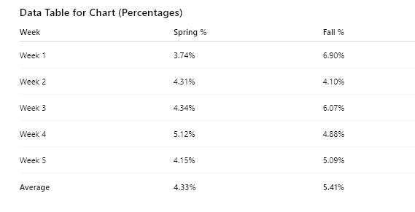
Weekly Comparisons for Spring and Fall

Slide 13
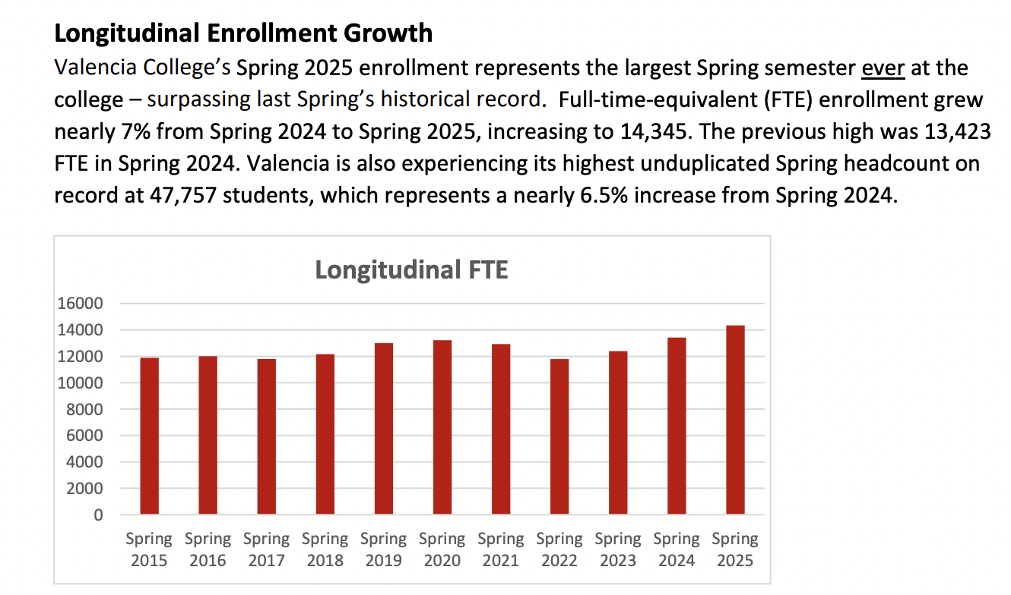
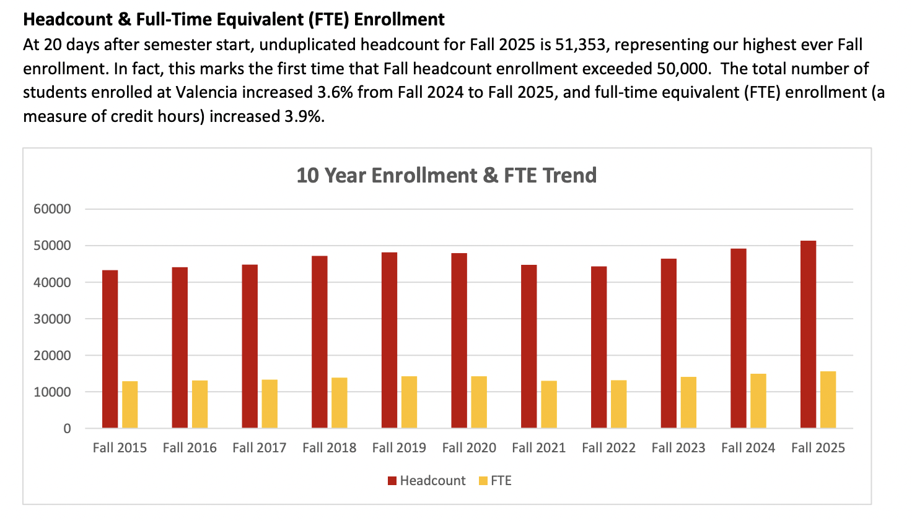
Student Enrollment based on semester
Based on the enrollment of Spring 2025 and Fall 2025, Fall had significantly more people enrolled than Spring.

Slide 14
Limitations
The Survey was done in the second half of the semester: This means that we missed any data that could have been collected in the beginning of the semester.
High Volume on people: On Busier days with people constantly exiting and entering the building, losing count would be common and the results might be off slightly.
Barriers: Some customer had a language barrier that don’t allow us to convey the survey.
Groups: Some customers would come in groups and one person bought an item for everyone in the group, so multiple leave without an item but couldn’t fill out the survey.
Misinterpretation: Some customers got confused filling out the survey because the question was worded wrong. It asked if you bought anything but the products in VCentials are free.
Supply Chain Issues: On some days the inventory is low and more people are more likely to not pick something up on certain days.
Unaware: Because this is the Fall Semester, a lot of people will be entering their first semester here. This could mean that the new students are unaware on how VCentials.

Slide 15
Discussion
After analyzing the data it is clear to see that the percent of people who left VCentials without collecting an item increased from the spring semester to the fall semester. However between the spring and fall semesters the amount of people that left without an item increased by only 1.08% overall. These patterns suggest that something during the Fall semester contributed to the higher rate of people leaving without items and the changes VCentials has made has impacted whether or not people leave with an item.

Slide 16
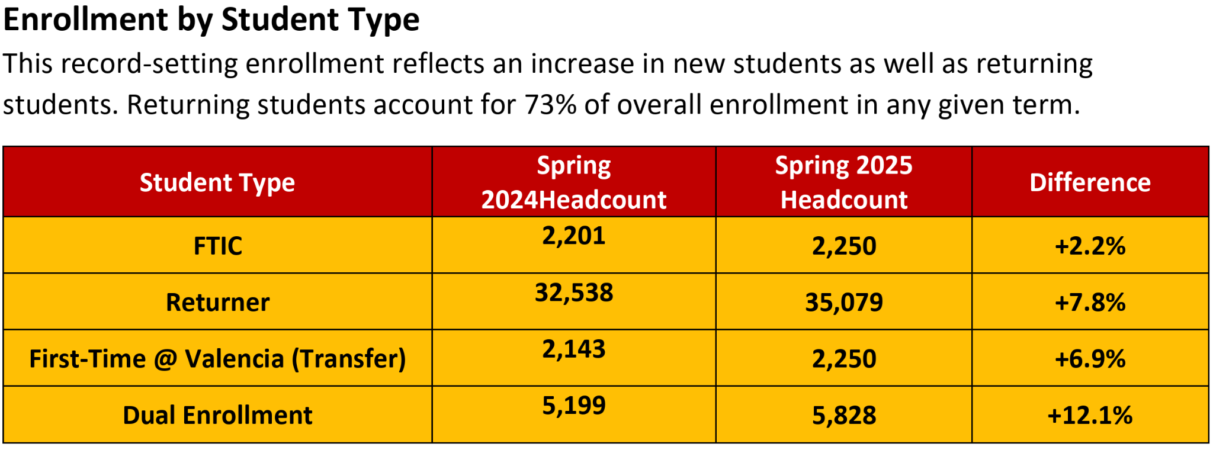
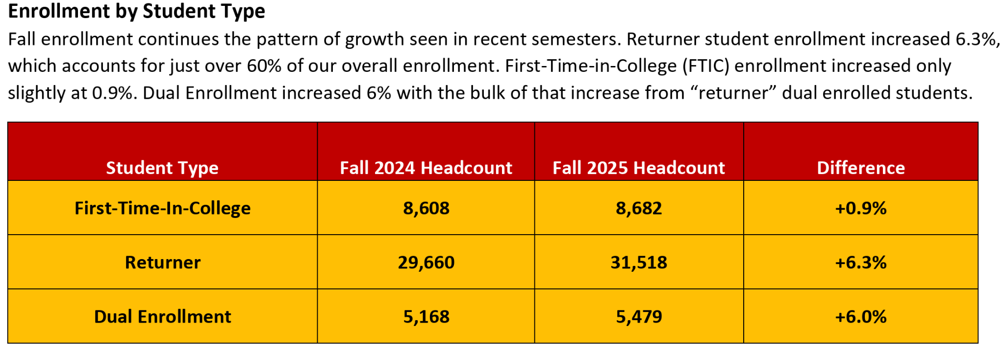
Discussion
A variable that may influence this increase is that, according to data from Valencia’s Spring 2025 Enrollment report and Fall 2025 Enrollment Report, there were 6432 more First-Time-In-College students in the 2025 Fall semester than in the 2025 Spring semester. These students likely do not know anything about VCentials and because of that might not take anything. Comparing data collected from VCentials in Spring 2025 to Spring 2026 may give a better understanding as to how these changes have affected whether or not people leave without an item, since the amount of FTIC students tend to be similar based on the season of the semester.

Slide 17
Updates Implemented Since Spring 2025
Since the Spring 2025 report, VCentials has implemented several improvements to increase accessibility, variety, and overall student satisfaction. These changes directly address the concerns raised last semester and reflect our commitment to providing reliable, high-quality resources for the Valencia community.
Shelves are now fully stocked throughout the week. Supply shortages from last semester have been resolved.
Expanded variety of items, including multiple cereal choices, five ready-to-eat meals, and additional lunch/dinner options.
Fresh fruit is available primarily Monday–Wednesday, aligning with peak traffic days. New guidelines for frozen protein items and increased student access to weekly servings. Continued availability of Starbucks and bakery items, which has increased student engagement.
Added more brand-name snacks (granola, peanuts, sunflower seeds, and others) to broaden selection.

Slide 18


VCentials Feedback Analysis
Survey Insights & Trends

Slide 19
Most Common Reasons & Items
Bread Items: By far the most frequently cited missing item was bread. Users reported this being an item that was infrequently restocked.
Protein & Meat: Respondee’s often commented on a lack of diversity in protein items. Some also they perceived the meat to be “old”.
Dietary Restrictions: Food intolerances and dietary needs were commonly stated. The lack of vegetarian options was mentioned a few times.
Fresh Produce: Lack of fruit and fresh produce was also cited.
Access Barriers: Technical friction is a key reason for non-use. Several students cited broken IDs, login failures, or lack of time to complete forms.

Slide 20
Conclusion
To condense all the data and findings into key takeaways, several new implementations were introduced after the Spring 2025 VCentials research project. However, when comparing the Spring 2025 and Fall 2025 data, it becomes clear that these updates did not produce the improvements that were expected. Even though VCentials expanded its variety of available items, the percentage of students leaving without receiving an item still increased. While the percentage of students leaving without items did increase the number of students enrolled on this campus also tripled.
Based on the ratio analysis, the average Spring 2025 no-item exit rate was 4.33 percent, while the average Fall 2025 rate increased to 5.41 percent. This higher ratio indicates that the proportion of students leaving VCentials without collecting an item grew in the Fall semester. Because the ratio reflects how many students were served overall, this rise shows that the increased number of students visiting in the Fall directly contributed to more students exiting without an item compared to the Spring semester.
One contributing factor to this puzzling outcome is the increase in student enrollment during the Fall semester. With more students entering the store, items were likely being taken more quickly, causing popular selections to run out sooner. As a result, more students may have walked out because the item(s) they hoped to obtain were already unavailable.
Overall, these findings suggest that while improvements were made, VCentials still needs to expand inventory and restocking capacity to keep up with higher demand, ensuring that a growing student population can access the resources they need.

Slide 21
References
Y. Morales-Moreno, personal communication, Dec 2nd 2025
Spring Stats class (2025).VCentials Project 2025 : Analyzing Why People Leave With No Items at VCentials Market​, volume(number),https://mailvalenciacc-my.sharepoint.com/:p:/r/personal/mbavegehims_mail_valenciacollege_edu/_layouts/15/Doc.aspx?sourcedoc=%7B55DE9EA5-E93A-4E08-8B64-5815D132BBF8%7D&file=VCentials%20Presentation%20Spring%202025%20Copy%20(1).pptx&action=edit&mobileredirect=true&DefaultItemOpen=1&wdOrigin=APPHOME-WEB.DIRECT%2CAPPHOME-WEB.FILEBROWSER.RECENT&wdPreviousSession=19dd556e-4444-41fd-8117-86d2439ddf8c&wdPreviousSessionSrc=AppHomeWeb&ct=1764790905648

