Slide 1


18 million children
did not receive a single vaccine in 2021 due to:
service
disruptions
humanitarian
emergencies
resource
diversions
increased
vaccine
hesitancy

Slide 2
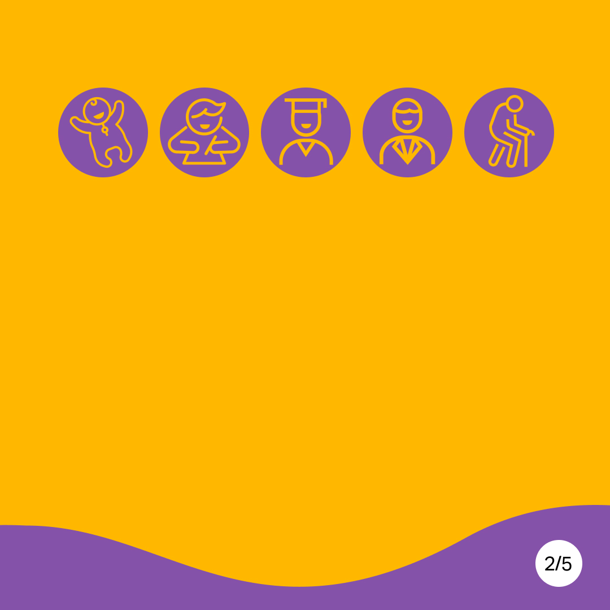
Childhood vaccines protect us from preventable illnesses well into adulthood, and throughout our lifetime.

Slide 3
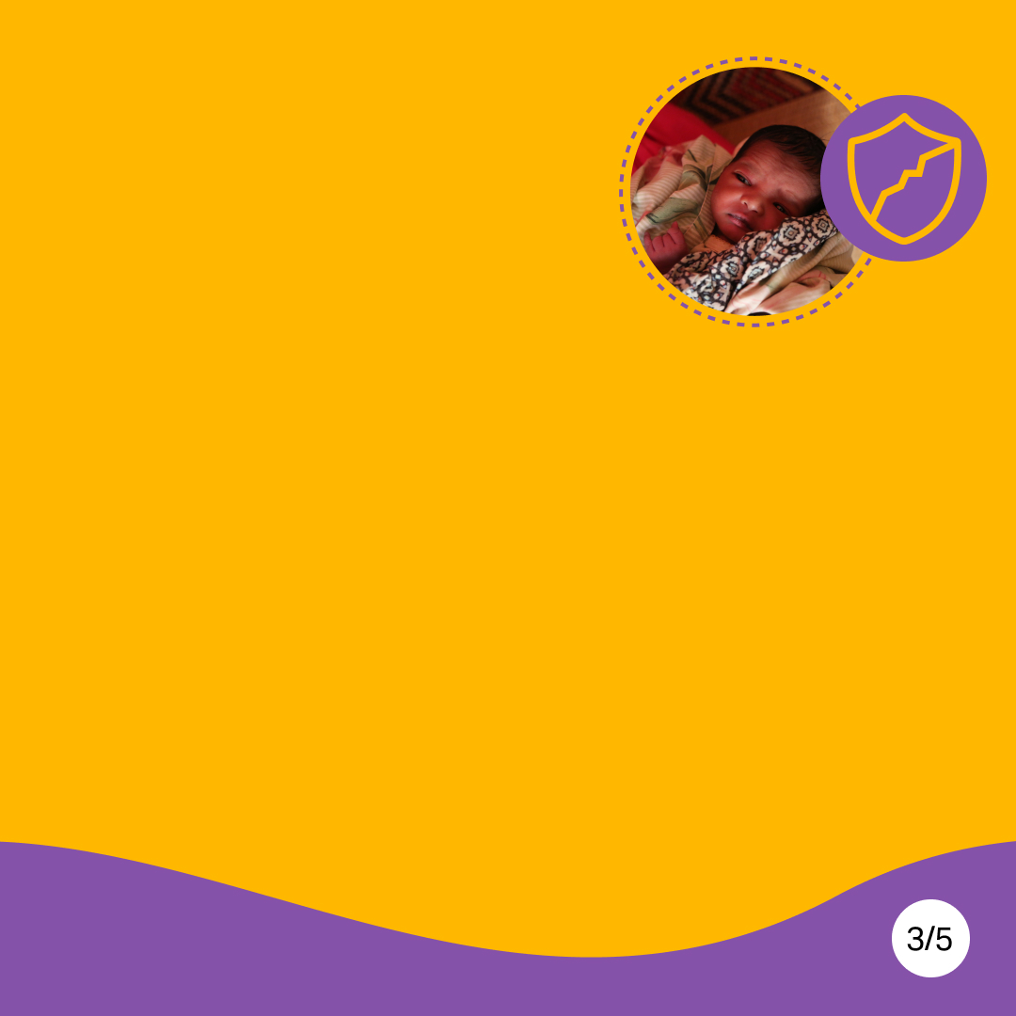
Without sufficient childhood immunization, preventable outbreaks of diseases such as measles and polio are bound to happen, putting millions of children’s lives at risk.

Slide 4

WHO, UNICEF and partners are working to deliver the goals of the global Immunization Agenda 2030:
Reducing zero dose children by 50%
Achieving 90% global coverage for basic vaccines.

Slide 5
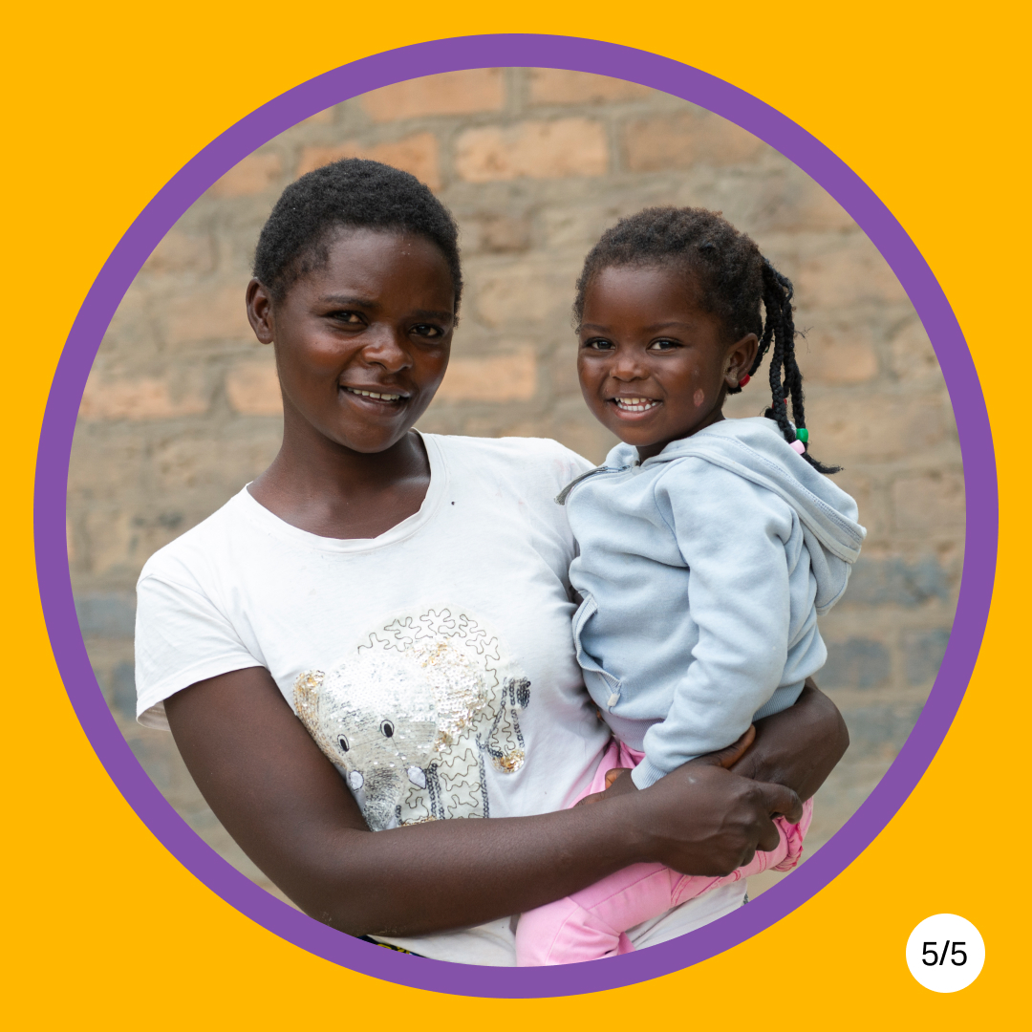
Because every
child has the right to a healthy childhood.

