Slide 1
Project Overview
This system is designed to avoid traffic jams and accidents, while being time efficient.
Based on Finite State Machine, code written in Verilog HDL and Pynq Z2 board is used for implementation.
Designed for 4-way road junction.
System is made smart using inputs from sensors to open next set of roads when currently open road has no cars.

Slide 2
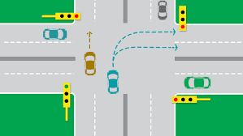
Design Overview
At once any 2 roads can be open.
One road can have the traffic moving straight and sideways while the other one has traffic moving only sideways.
4 states of the FSM (where each road opens after the same time interval to avoid bias)

Slide 3
All 4 entry roads equipped with sensors; which give output low when there is traffic on the road and output high when there is no traffic on the corresponding road
The output from the sensors is used to control the states on the FSM.
Each state of the FSM is set for a fixed time interval but can be skipped if there are no cars on the entry roads in the present state.
The skipping of states works only when both the corresponding sensors have high output.
The current state can also be skipped after all the traffic through the open roads has passed through, so that the next road can be opened and make the traffic’s movement time efficient.

Slide 4
FSM- Finite State Machine
It is an abstract machine that can be in exactly one of a finite number of states at any given time.
An FSM is defined by a list of its states, its initial state, and the inputs that trigger each transition.
The FSM can change from one state to another in response to some inputs; the change from one state to another is called a transition.
The FSM in our system has 4 states which describe the operation of the traffic lights.

Slide 5



States for the system

