Slide 1
AI-POWERED FACT CHECKING
VeriLens
Verify Before You Believe.
An AI-powered fake news detector: retrieve real evidence, verify the claim, explain the verdict.
Shree Deore · Krish Dalvi · Vaishnavi Rathi
Built with ❤️ by Algorithm Avengers

Slide 2
WHY THIS MATTERS
02
The Problem
▪ Misinformation spreads faster than verified facts — it reaches more people, sooner.
▪ Readers cannot manually verify every claim they see on social media.
▪ Viral fake news erodes public trust in real journalism and institutions.
▪ Most people lack a fast, trustworthy way to check a claim before sharing it.
“Falsehoods spread significantly faster than the truth online.”
— MIT Media Lab, “The Spread of True and False News Online”
VeriLens · AI-Powered Fake News Detector · Algorithm Avengers

Slide 3
OUR APPROACH
03
The Solution — RAG-Based Fact Checking
▪ VeriLens verifies a claim by retrieving real web evidence — it never invents facts.
▪ A RAG (Retrieval-Augmented Generation) pipeline extracts relevant passages and classifies them as supporting, contradicting or neutral.
▪ A deterministic verifier aggregates the evidence into a clear verdict (Supported / Contradicted / Mixed / Unverified).
▪ An LLM writes a short, evidence-grounded analysis — strictly from the retrieved material.
▪ If evidence is insufficient, VeriLens honestly says UNVERIFIED instead of guessing.
VeriLens · AI-Powered Fake News Detector · Algorithm Avengers

Slide 4
TECH WE USED
04
Technology Stack
Backend / API
REST API with automatic Swagger docs, Pydantic validation, CORS and error handling.
Python 3 · FastAPI · Uvicorn
Retrieval
Real-time evidence from the web with source authority ranking.
Tavily / Serper web search
LLM
Grounded explanations; deterministic rule-based fallback when offline.
OpenAI (GPT-4o-mini) / Groq
Frontend
Fast, dependency-free chat & verification UI with dark mode.
HTML · CSS · Vanilla JS
Testing
Offline, mocked, deterministic — no API keys required.
pytest (158 tests)
Security
Input validation, safe errors, prompt-injection guards, .env secrets.
Pydantic · rate limiting
VeriLens · AI-Powered Fake News Detector · Algorithm Avengers

Slide 5
UNDER THE HOOD
05
How It Works — The Pipeline
1
2
3
4
5
6
7
User Claim
›
Web Retrieval
›
Evidence Extraction
›
Classification
›
Verification
›
LLM Analysis
›
Result
User enters a news claim in VeriLens
Search APIs fetch real articles
Relevant passages are selected
Supporting / contradicting / neutral
Verdict + confidence is computed
Grounded explanation is generated
Verdict, evidence & sources shown
Evidence first. The LLM only sees retrieved evidence — never its own knowledge — and every citation is cross-checked against real sources.
VeriLens · AI-Powered Fake News Detector · Algorithm Avengers

Slide 6
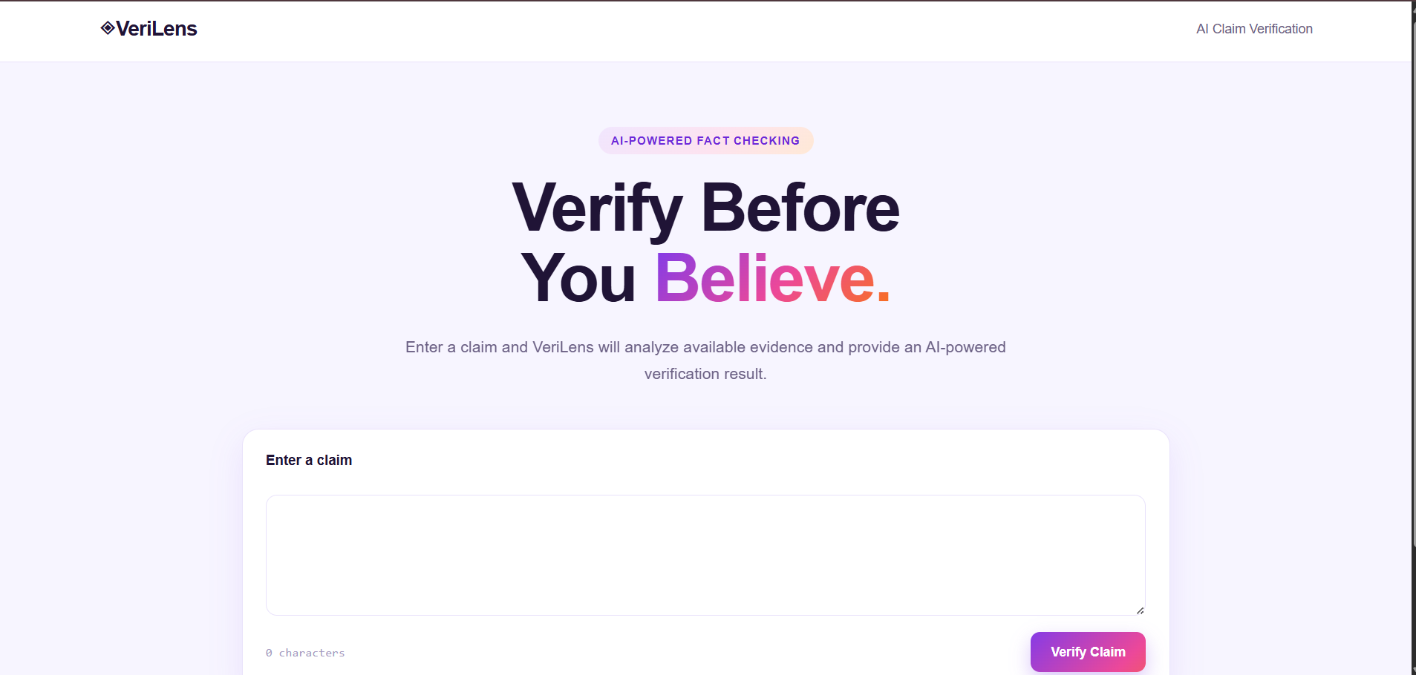
PRODUCT SCREENS
06
Screenshot — Landing Page
Clean hero: “Verify Before You Believe.” with a one-click claim input.
VeriLens · AI-Powered Fake News Detector · Algorithm Avengers

Slide 7
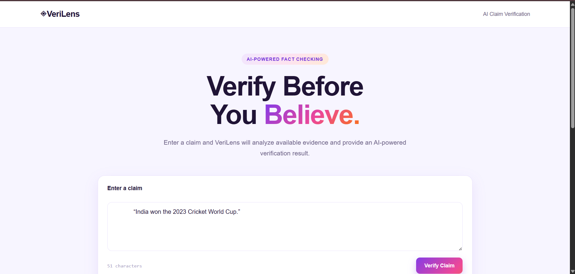
PRODUCT SCREENS
07
Screenshot — Entering a Claim
Typing a claim — live character counter and the Verify Claim action.
VeriLens · AI-Powered Fake News Detector · Algorithm Avengers

Slide 8
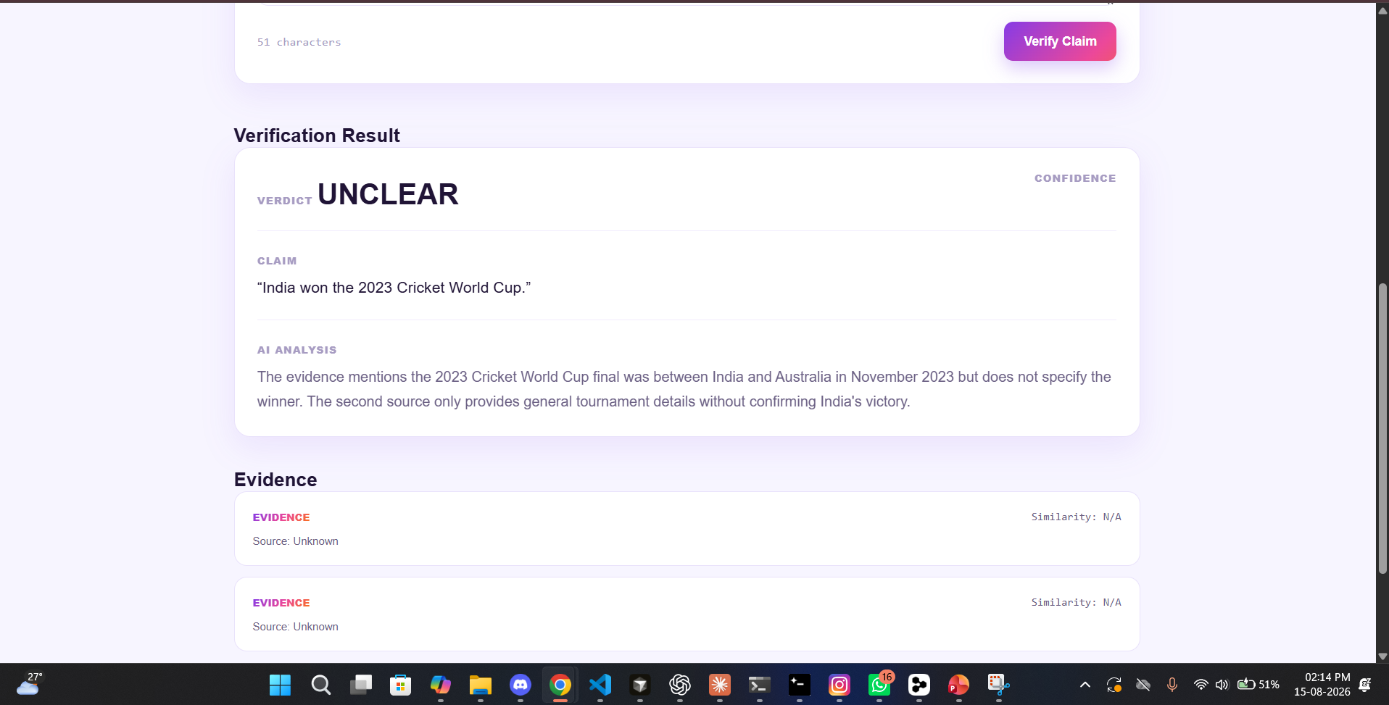
PRODUCT SCREENS
08
Screenshot — Verification Result
Verdict, confidence, claim recap, AI analysis and evidence cards with source + similarity.
VeriLens · AI-Powered Fake News Detector · Algorithm Avengers

Slide 9
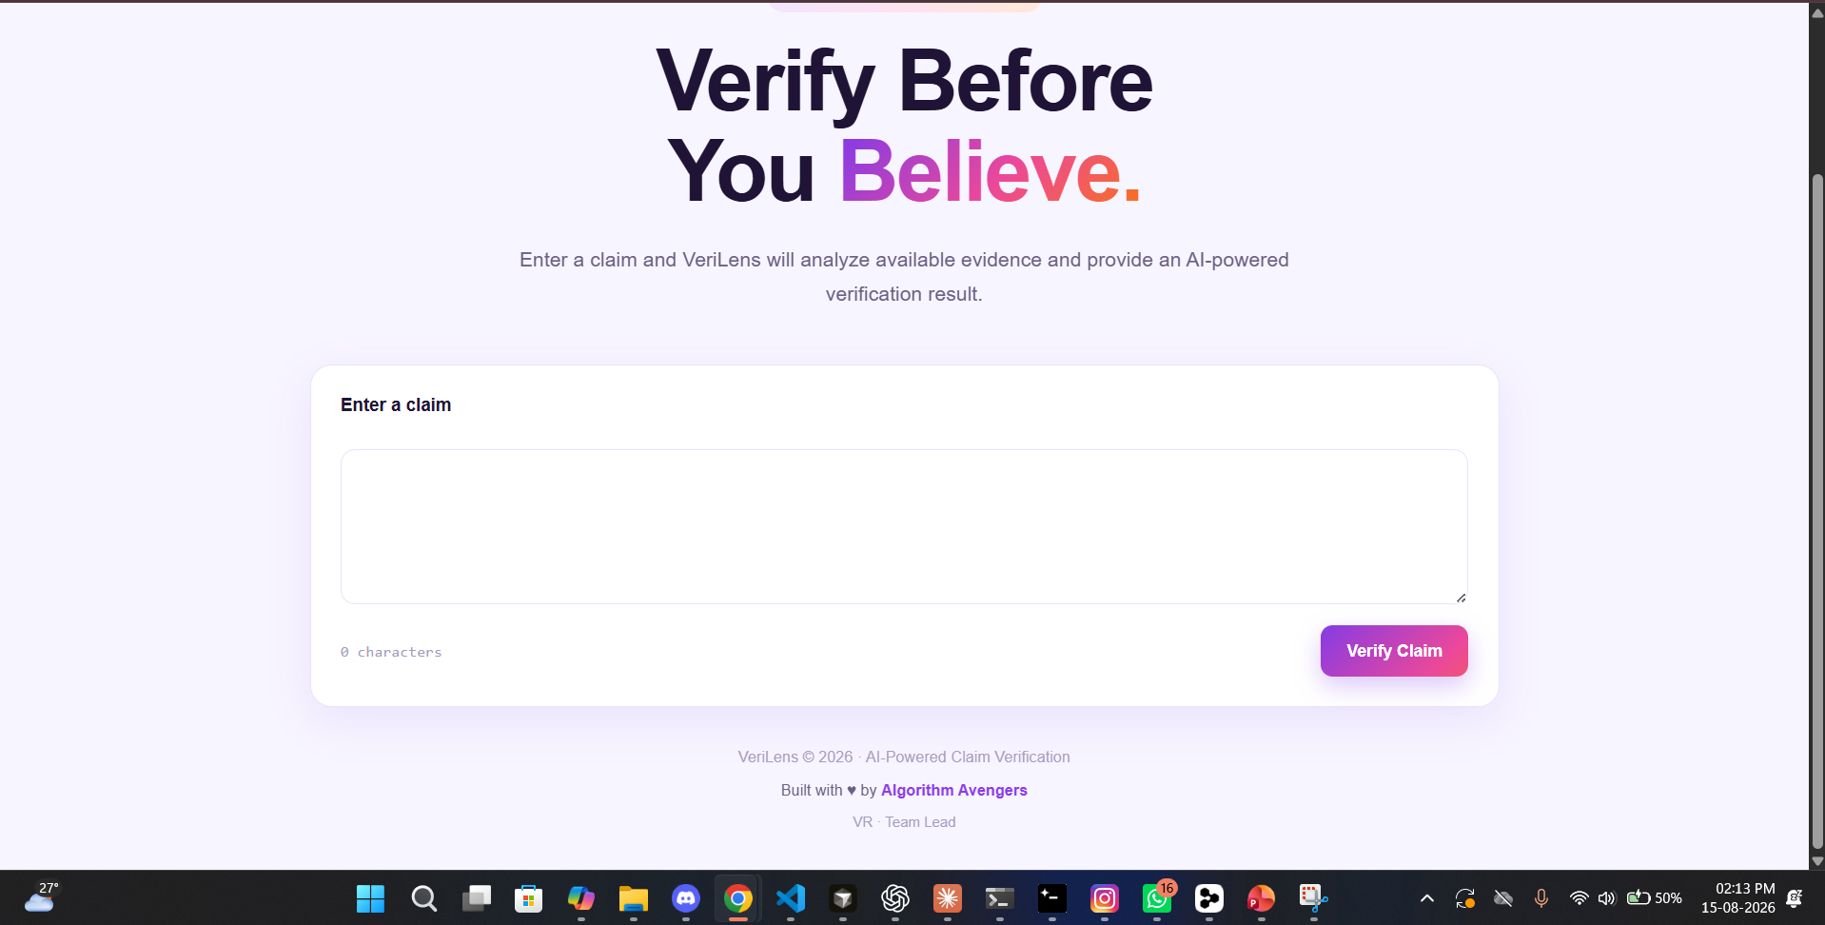
PRODUCT SCREENS
09
Screenshot — Hero & Product Overview
Full landing experience with team footer (“Built with ❤️ by Algorithm Avengers”).
VeriLens · AI-Powered Fake News Detector · Algorithm Avengers

Slide 10
WHAT YOU CAN DO
10
Key Features
Verdict + Confidence
Evidence Cards
Clear verdict badge with a confidence meter
Source and similarity shown for every passage
AI Analysis
Chatbot
Short, evidence-grounded explanation for each claim
Follow-up questions like “Why?” or “Show evidence”
Dark Mode & History
API & Docs
Conversation persists across reloads
Public REST API with Swagger docs (/docs)
VeriLens · AI-Powered Fake News Detector · Algorithm Avengers

Slide 11
BUILT SAFELY
11
Security
▪ Input validation — every claim is length-capped, trimmed and type-checked (HTTP 422 for bad input).
▪ Secrets stay in .env — never committed, never sent to the frontend, never in error messages.
▪ Prompt-injection protection — user claims and retrieved web text are treated as data, not instructions.
▪ Safe errors — internal stack traces and exception details never reach the user.
▪ Rate limiting on public endpoints (HTTP 429) to prevent accidental abuse.
▪ Configurable CORS with credentials disabled.
VeriLens · AI-Powered Fake News Detector · Algorithm Avengers

Slide 12
QUALITY
12
Testing
158
100%
pytest -q
automated tests · 0 failing
offline & mocked — no API keys
one command to verify everything
▪ Retrieval, evidence extraction, classification, explainer and the full RAG pipeline.
▪ API layer: health, valid/invalid requests, safe errors, CORS and rate limiting.
▪ Chatbot, follow-ups, and security (prompt injection, secret exposure, unsafe content).
▪ Deterministic and repeatable — fast enough for every commit.
VeriLens · AI-Powered Fake News Detector · Algorithm Avengers

Slide 13
SEE IT LIVE
13
Demo Flow
1
Open VeriLens and type a claim — e.g. “India won the 2023 Cricket World Cup.”
2
Hit Verify Claim; watch retrieval, evidence extraction and verification run.
3
Read the verdict, confidence and AI analysis.
4
Open the evidence cards and inspect real sources.
5
Ask a follow-up (“Why?”) and get an evidence-based answer.
6
Try an uncertain claim → honest UNVERIFIED. Try malicious input → no secrets leak.
VeriLens · AI-Powered Fake News Detector · Algorithm Avengers

Slide 14
Thank You!
Questions? Let's verify together.
Shree Deore · Krish Dalvi · Vaishnavi Rathi
Built with ❤️ by Algorithm Avengers · VeriLens © 2026

